Slide 1


The Limitations of SMOTE & Class Imbalance in Low-Sample Radiomics
A Cautionary Case Study in Renal Mass Differentiation (RCC vs. AML)
Authors: Kenan Fırat & Albert Güveniş
Domain: Medical Image Computing & Cancer Radiomics
IEEE Citation: 10.1109 / USBEREIT 2026

Slide 2

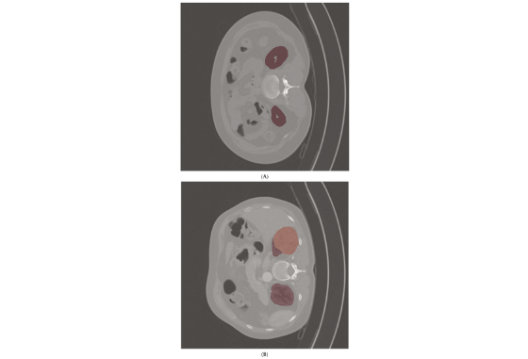
What is Cancer Radiomics?
Beyond standard visual inspection: Radiomics converts non-invasive standard CT scan volumes into minable, high-dimensional quantitative spatial feature spaces ($D > 1000$).
Clinical Context: Differentiating invasive Renal Cell Carcinoma (RCC) from benign Angiomyolipoma (AML) is vital to avoid unnecessary nephrectomies.
The Fat-Poor AML Dilemma: Fat-poor AML variants lack macroscopic fat signatures, appearing visually identical to RCC on standard Hounsfield Unit (HU) CT scans.

Slide 3


Challenges: Small Datasets & Imbalance
Severe Data Scarcity
Skewed Class Distribution
Rare pathologies yield tiny cohorts. Typical clinical datasets contain under 100 total cases, severely restricting statistical power.
Biological rarity induces heavy class imbalance (~84% RCC vs. ~16% AML; 58 malignant vs. 11 benign cases).
Machine learning models naturally collapse toward the majority class without intervention, causing high accuracy illusions.
In high-dimensional spaces ($D = 1182$ PyRadiomics features), vector density is extremely sparse ($N \ll D$).

Slide 4
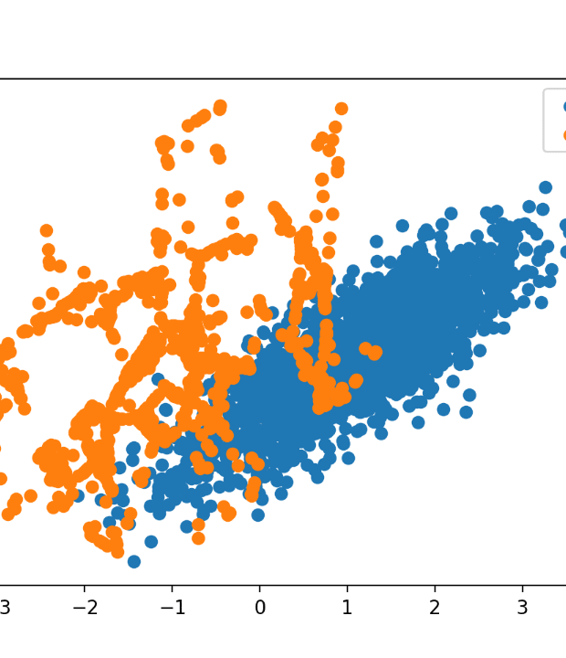
SMOTE: Popularity & Mechanics
Synthetic Minority Over-sampling
What is SMOTE? Tabular algorithm synthesizing synthetic minority instances via linear interpolation between original minority samples and their nearest $k$-neighbors in feature space.
Why so widely used? Simple off-the-shelf implementation, fixes metric skewness instantly, and is heavily endorsed in generic tabular ML benchmark literature.

Slide 5

Objective of This Paper
A critical methodological intervention evaluating whether feature-space oversampling (SMOTE) can anchor a stable decision boundary when pipelines are bound to small, severely imbalanced radiomics cohorts.

Slide 6









Novelty & Methodological Rigor
Dual-State Evaluation
Nested Cross-Validation
Exposing Metric Illusions
Direct head-to-head comparison evaluating pipelines strictly in "With-SMOTE" versus "Without-SMOTE" configurations under identical splits.
Full multi-fold nested CV isolating test folds to eliminate hyperparameter tuning leaks and expose full variance across data partitions.
Foregrounding full multi-fold distributions to prove how single "lucky" train-test splits inflate published radiomics performance literature.

Slide 7

Experimental Methods & Dataset
Pipeline Stage | Technical Specifications & Protocol | Purpose / Optimization
Dataset Cohort | UCSF RMaC CT ($N=69$; 58 RCC vs. 11 AML) | Arterial phase contrast-enhanced CT scans
Preprocessing | $1\text{mm} \times 1\text{mm} \times 1\text{mm}$ isotropic resampling + Z-score HU scale | Device normalization & scanner artifact removal
Feature Space | PyRadiomics ($D = 1182$ volumetric features) | Shape, LoG spatial filters, Wavelet matrices
Feature Selection | ANOVA SelectKBest executed within inner loops | Strict isolation within CV folds to prevent leakage
Classifiers | SVC (Primary Focus), Random Forest, XGBoost, KNN, LogReg | Convex boundary optimization vs tree ensembles

Slide 8

Results: Single-Fold vs Multi-Fold
Classifier Algorithm | Single-Fold Best Peak AUC | Multi-Fold Mean AUC (With SMOTE) | Multi-Fold Mean AUC (No SMOTE) | Computational Strain
Support Vector (SVC) | 0.81 AUC (Fold 2) | 0.49 ± 0.19 | 0.51 ± 0.20 | Low (Deterministic convex)
XGBoost Ensemble | 0.90 AUC | 0.61 ± 0.14 | 0.60 ± 0.20 | Moderate
Random Forest | 0.94 AUC | 0.61 ± 0.21 | 0.57 ± 0.20 | High (Execution timeouts)
K-Nearest Neighbors | 0.81 AUC | 0.49 ± 0.25 | 0.45 ± 0.20 | Low (Instance-based)
Logistic Regression | 0.72 AUC | 0.51 ± 0.15 | 0.62 ± 0.17 | Low (Linear baseline)

Slide 9

Findings: Complete Model Collapse
Deceptive Metric Spikes Exposed
0.49
No Genuine Gains: Adding SMOTE yielded zero performance recovery over the raw unhandled baseline ($AUC = 0.49 \pm 0.19$ vs $0.51 \pm 0.20$).
Single-Fold Volatility: In Fold 2, SVC achieved a deceptive peak AUC of 0.81 (94.1% Accuracy). In single train-test setups, this would be published as a successful model.
SVC MEAN AUC WITH SMOTE
Statistically indistinguishable from random chance (0.50)
Biological Reality: Raw PyRadiomics features lack a separable biological signal for RCC vs fat-poor AML within a single-institution CT scope.

Slide 10
Why SMOTE Fails in Radiomics
High-Dimensional Sparsity
Unphysical Noise Generation
With only 11 AML cases ($N_{\text{minority}} < 15$), training folds hold just 8-9 vectors. Interpolating in $D = 1182$ space creates extreme geometric sparsity.
Tabular SMOTE operates blindly in abstract mathematical spaces, completely uncoupled from 3D anatomical reality and X-ray photon physics.
Linear interpolation creates arbitrary line segments that fail to sample the true biological distribution of tumor phenotypes.
Synthesizing abstract feature vectors produces unphysical noise clusters that shift the decision boundary erratically between folds.

Slide 11
Study Limitations
Small Sample Size Constraints: Cohort ($N=69$) is intentionally small to serve as a case study, though high-dimensional interpolation failure applies universally to scarce datasets.
Single-Institution Scope: Image acquisition was restricted to UCSF RMaC arterial-phase CT scans; multi-center external validation is needed for broader generalization.
Hypothesis Unproven On Image-Level: While shifting from tabular SMOTE to 3D image-level augmentation is theoretically well-grounded, its empirical rescue capacity requires further testing.

Slide 12


Conclusions & Methodological Lessons
"Tabular oversampling is an invalid fix for low-sample radiomics. It creates metric illusions rather than genuine diagnostic signal."
— Fırat & Güveniş, IEEE Case Study 2026

Slide 13
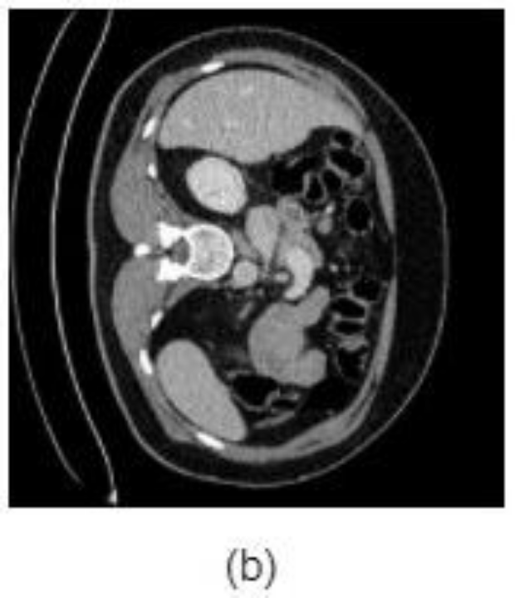
Future Work: Image-Level Shift
Physical 3D Image Augmentation
Image-Domain Transformations: Apply 3D spatial rotations, scaling, and Hounsfield Unit Gaussian noise directly to CT volumes.
Contour Perturbations: Randomize 3D ROI tumor segmentation boundaries to extract features from physically plausible anatomical variations.

Slide 14



Image Sources
https://www.mdpi.com/diagnostics/diagnostics-15-01365/article_deploy/html/images/diagnostics-15-01365-g002a-550.jpg
Source: www.mdpi.com
https://machinelearningmastery.com/wp-content/uploads/2019/10/Scatter-Plot-of-Imbalanced-Dataset-Transformed-by-SMOTE-and-Random-Undersampling.png
Source: machinelearningmastery.com
https://cdn1.imaios.com/i/images/7/7/0/4/464077-1-eng-GB/Rotation.jpg?caption=1&q=75&w=535&s=1610ace054784774c7c3683663cda79e
Source: www.imaios.com

