Slide 1
Authors: Kenan Fırat & Albert Güveniş
Domain: Medical Image Computing & Cancer Radiomics
IEEE Citation: 10.1109/USBEREIT 2026

Slide 2







Historical Imaging Timeline
1971
2015+
2002
CT Scanner Godfrey Hounsfield invents Computed Tomography, introducing 3D density pixel matrices (HU).
Deep Radiomics Integration of Deep Learning & ML classifiers into automated quantitative diagnostic pipelines.
SMOTE Algorithm Chawla et al. publish SMOTE to address class imbalance in machine learning datasets.
1895
1973
2012
X-Ray Discovered Wilhelm Röntgen discovers X-rays, enabling non-invasive qualitative anatomical visualization.
Texture Matrix Haralick proposes GLCM texture features, founding quantitative spatial image analysis.
Radiomics Termed Lambin et al. coin "Radiomics" for high-throughput extraction of tumor phenotypes.

Slide 3
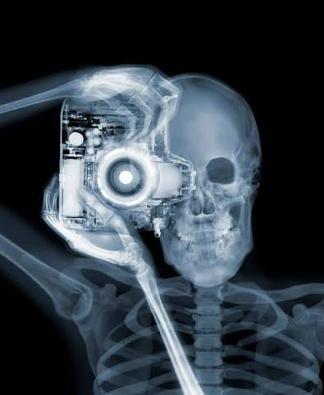
X Ray
X-ray is defined as a form of high energy electromagnetic wave
used in imaging to create pictures of internal bodily structures
able to penetrate the body
&
absorbed by different tissues to produce shadow-like images on a detector.

Slide 4
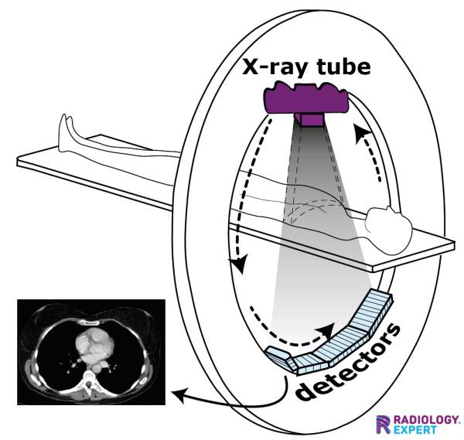
CT Scan : Work on X-Ray photons which allow taking photos of organs and living biostructures
CT is a medical imaging modality that employs x-rays and computer processing to generate detailed internal body images.
(Yousif A. Al-Naser, 2026)
Data mining : Radiomics inspects CT scan pixel values and construct biologically correlated information

Slide 5
Radiomics
Techniques of extracting useful quantitative information from medical images. (Shafiq-ul-Hassan et al 2017)
Extraction clinically relevant information from radiologic images (MR Tomaszewski, RJ Gillies - Radiology, 2021)
Capturing tissue and lesion characteristics such as heterogeneity and shape and may, alone or in combination with demographic, histologic, genomic, or proteomic data, be used for clinical problem solving.
(Marious E Mayerhoufer et al 2020)

Slide 6
Radiomics
Matematically - Construct comlex matrices
Data Science - Data mining from raw data souce(MEdical Images)
Cilinically - Construct quantized structure align with biological structure

