Slide 1
Group 8
Speech-to-text Resume Builder
(https://github.com/eurashin/CS498-Group8.git)

Slide 2
Inspiration for this project
The need of a good resume is unquestionable.
Many individuals have difficulty putting forward their best selves
Therefore, we planned on building a platform for people to format their resume by just talking about themselves.

Slide 3
Brief info about the project
Speech-to-text is the main component.
So, talk about yourself, get better at it; and also build yourself a Resume.
Web application that’s open for all to use.
Get multiple types of Resumes to choose from.
Languages used – JavaScript, HTML & CSS

Slide 4
Key points about the project
It takes away the need for an individual to keep himself/herself aware about the format of a resume.
It can be used for a broad range of applications such as Medical, Computer Science and Business Style Resumes.
The more you talk about yourself and your achievements, in brief; the better you get at pitching yourself to the companies.
If any false inputs are recorded, the first draft of Resume is an editable file. Then once all is saved, it can be saved as a PDF as a final draft.

Slide 5
Brief overview of how it works:
Choose a resume template/theme
Complete an interview
Fill and edit resume as a form
Download resume for printing!

Slide 6
Development with each iteration
Iteration 1 – Get the Speech to Text ready with Google APIs. The bot will ask users questions and record the answers.
Iteration 2 – Create a basic web application that would display interview questions for the user and display user responses in text bubbles.
Iteration 3 – Complete web application with an editable HTML page after user interview, an HTML to PDF convertor, resume templates, and data base for user accounts.

Slide 7
User Stories Implemented
Web App Integration (1)
Accurate Text-To-Speech Bot (2)
Review and Edit Resume (3)
Export Resume as PDF (4)
Displaying Questions for User Input and User Responses (5)
Sections within Resume (6)
Different Resume Templates (7)
Dealing with Background Noise/Microphone Quality (8)

Slide 8
User Stories In Progress
User accounts (9)
Aesthetics (10)
Embed links to Resume PDF (11)

Slide 9
Team Member Contributions

Slide 10
Eura
Worked on front-end and integration
Integrate speech-to-text-API
Created form template (base of CS/Med/Business) for editing by the user
Hosted on web using HTTPS (self-signed certificate)
Contributed to dynamic uploading of questions
Which user stories?
Web App Integration (1)
Review and Edit Resume (3)
Displaying Questions for User Input and User Responses (5)
Sections within Resume (6)
Different Resume Templates (7)xt

Slide 11
Evan
Worked on front end development.
Comment bubbles for interview.js
Landing page for resume review, editing, and pdf export (business.html template).
Exporting the final html resume template to a PDF file using the JS libraries jsPDF and html2canvas.
Which user stories?
Aesthetics.
Resume Templates.
Web App Integration.
Export Resume as PDF.

Slide 12
Tej
Worked on Speech-to-text development in Python during iteration 1.
Worked on Resume templates and gave inputs on editing them as per our need. Also worked to some extent on CSS and HTML files to enable the questions and answers to function properly.
Worked on the tsl test cases.
Which user stories ?
Accurate speech-to-text bot
Unique resume tempelates
Background noise and microphone quality

Slide 13
Kyle
Worked on Junit testing and dealt with microphone quality
Worked on resume templates
Currently implementing User Accounts
Which user stories?
Unique resume templates
Background noise and microphone quality
User Accounts

Slide 14
Demo and Code

Slide 15
To GitHub…

Slide 16
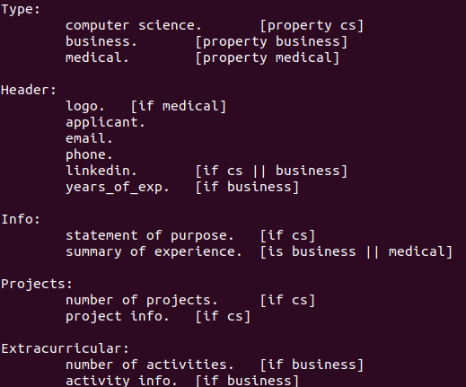
CFG and Tests
TSL tests for the audio component
31 test frames
Diverge with types of questions on the resumes
Unit tests using JUnit

Slide 17
Issues
Resolving Review and Edit feature with the Export to PDF feature.
Getting the test cases set up as the main component was speech to text.
Having unit tests that work with javascript

Slide 18
Future use and development options of this project
Add user accounts to keep track of previous user resumes.
Jsunit tests
Add more resume options to cater to a larger audience.

Slide 19
Thank You!

