Slide 1
Maimonides Medical Center Patient Survey (HCAHPS) Analysis
Presented by Emily Ure

Slide 2
Introduction
Maimonides Medical Center’s (MMC) results from three patient satisfaction survey measures as compared to New York State Average
Data comes from the Patient survey (HCAHPS) – Hospital and includes a list of hospital ratings for the Hospital Consumer Assessment of Healthcare Providers and Systems (HCAHPS)
HCAHPS is a national, standardized survey of hospital patients about their experiences during a recent inpatient hospital stay

Slide 3
Data Description
The Patient survey (HCAHPS) – Hospital survey is available on Data.CMS.gov
Data was published by the Centers for Medicare and Medicaid Services and was last updated on April 5, 2023 and released on April 26, 2023
Survey includes data from hospitals throughout the United States and patient responses to various questions about their experience at the hospital, interactions with hospital staff and the standard of care provided

Slide 4
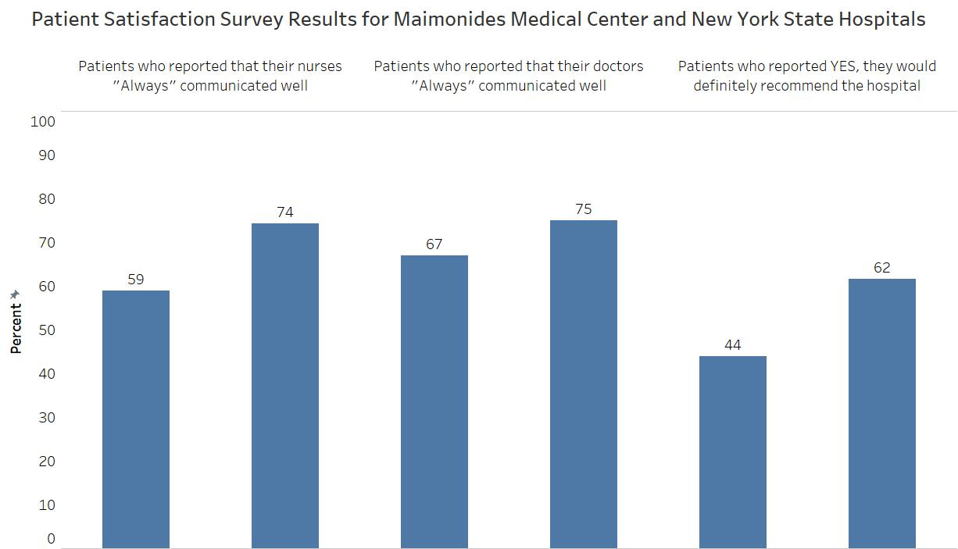
Survey Results
MMC
New York State Avg.
MMC
New York State Avg.
MMC
New York State Avg.

Slide 5
Conclusion
MMC responses to three patient satisfaction survey results analyzed are lower than the New York hospital average
MMC can connect with hospitals that have better patient responses to the same patient satisfaction questions to determine what areas need improvement at MMC
It is important for MMC to maintain satisfactory levels of patient satisfaction scores because Medicare and Medicaid reimbursements are based on the scores provided

