Slide 1



BusinessPerformance
View in Power BI
Last data refresh:
10/09/2026 10:24:28 UTC
Downloaded at:
10/09/2026 10:28:42 UTC

Slide 2
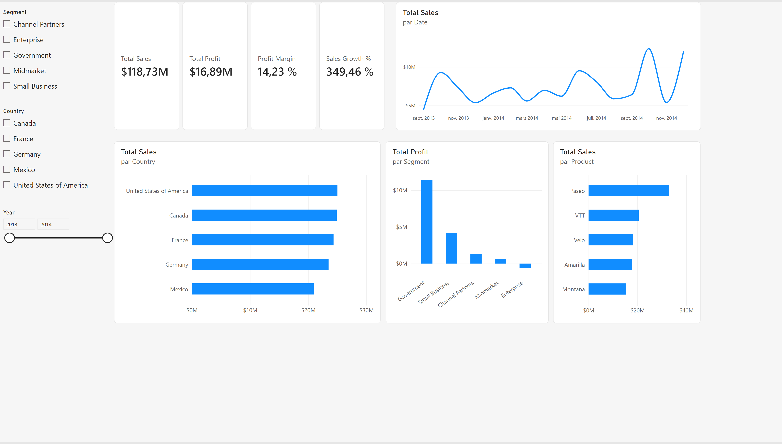
Executive Overview
Notes:
slicer
No alt text provided
lineChart
No alt text provided
cardVisual
No alt text provided
slicer
No alt text provided
slicer
No alt text provided
barChart
No alt text provided
barChart
No alt text provided
columnChart
No alt text provided

Slide 3
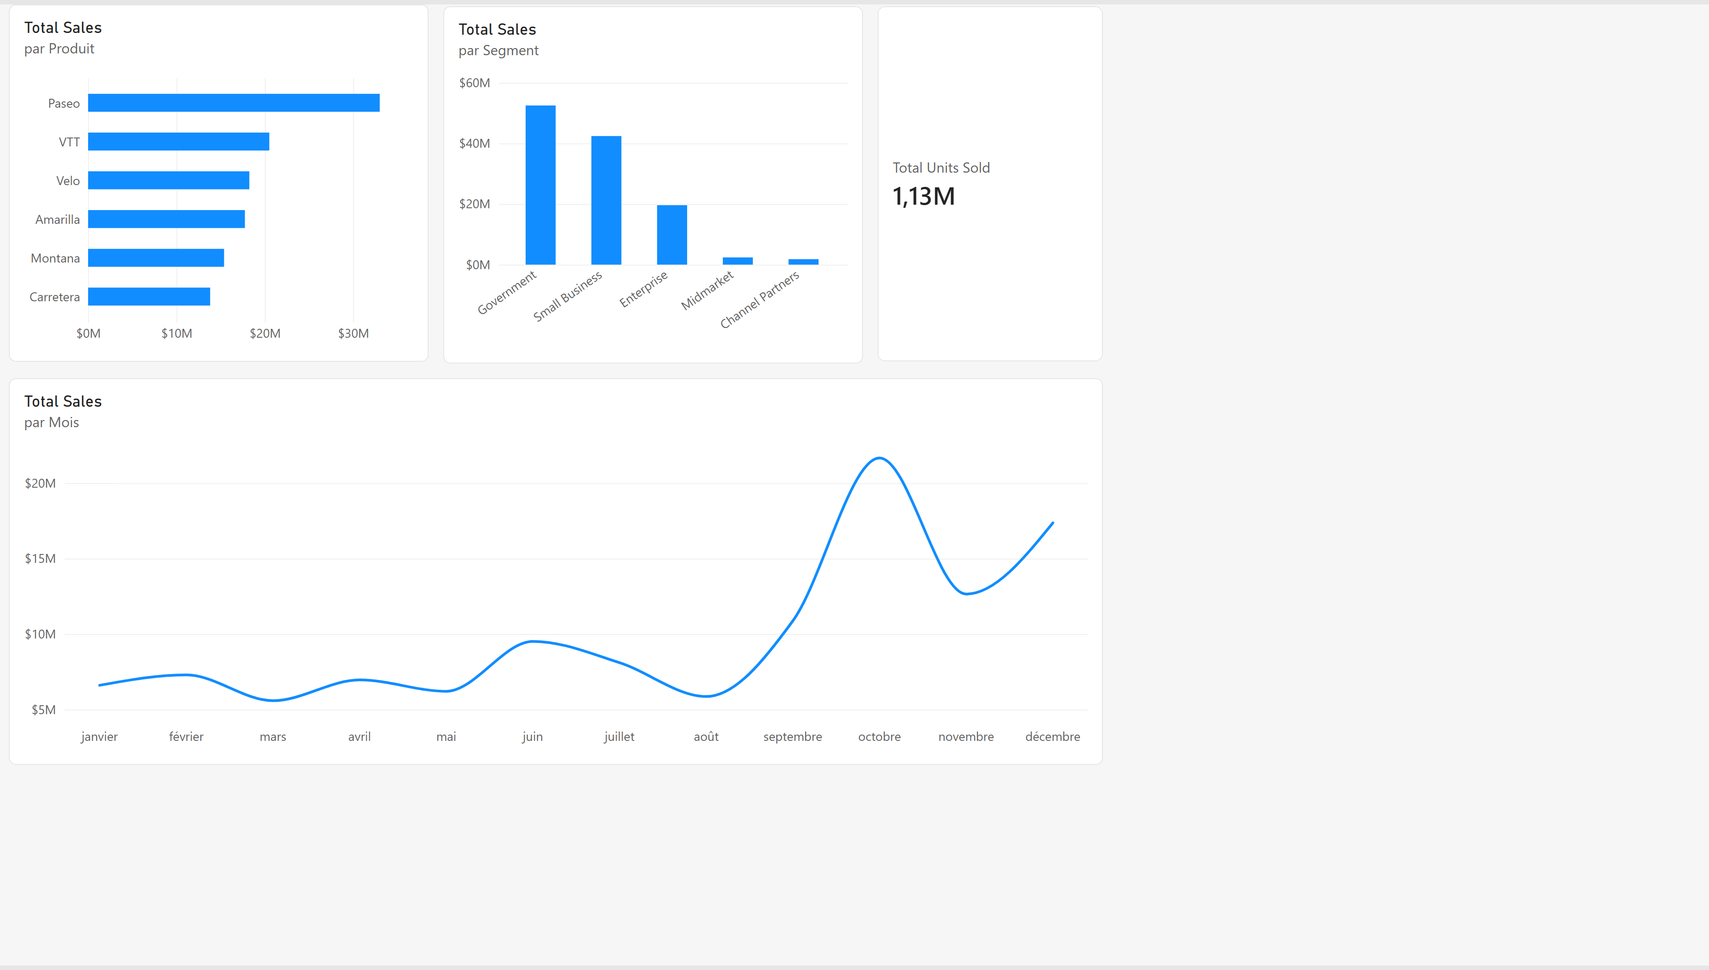
Sales Analysis
Notes:
barChart
No alt text provided
columnChart
No alt text provided
cardVisual
No alt text provided
lineChart
No alt text provided

Slide 4
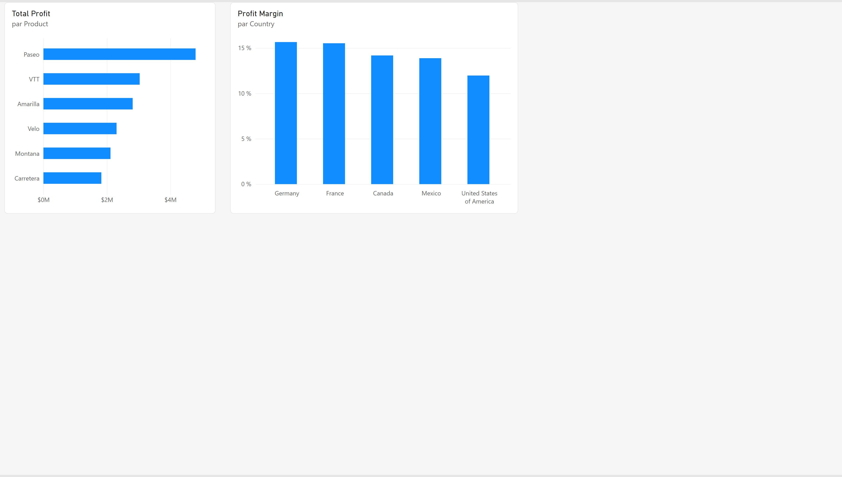
Profitability Analysis
Notes:
barChart
No alt text provided
columnChart
No alt text provided

Slide 5
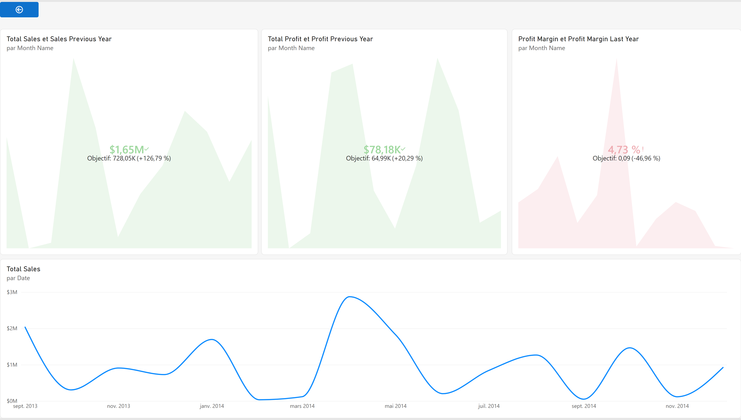
Product Details
Notes:
kpi
No alt text provided
kpi
No alt text provided
actionButton
No alt text provided
lineChart
No alt text provided
kpi
No alt text provided

