Slide 1
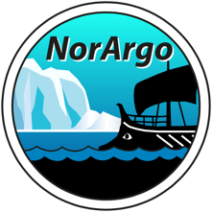
Delayed mode quality control of pressure, temperature, and salinity
Jan Even Øie Nilsen
Institute of Marine Research
NorArgo2 Annual meeting, Bergen
December 2nd 2021

Slide 2
The Matlab toolbox DMQC-fun
Birgit Klein, Ingrid Angel, Kjell Arne Mork, and J. Even Ø. Nilsen
Started in Hamburg 2019
DMQC of core data from Argo floats, incl. salinity calibration
Functions span from download of reference and float data through to a semi automated report and updated D-files
https://github.com/imab4bsh/DMQC-fun.git
New update in progress!

Slide 3

DMQC-fun at a glance
work_log.txt
Explains the whole workflow
A good place to log your overall progress
Coriolis
Coriolis
init_dmqc
init & setup – paths – parameters – list of floats – decisions – all edits in one place – all functions use it
load_referencedata
ingest for DMQC and OWC
quick-check
update list of reference data
download_floats
from the Coriolis server
NetCDF-files
altimetry comparison
current greylist
prepare_floats
general DMQC
builds the mat-files for OWC
run_ow_calibration
OWC
all selected floats
write_D
D-files
operator_CPcor_new
tool for new Cpcor
near-deployment ship CTD
LaTeX report
reads content saved
by toolbox functions
HD

Slide 4
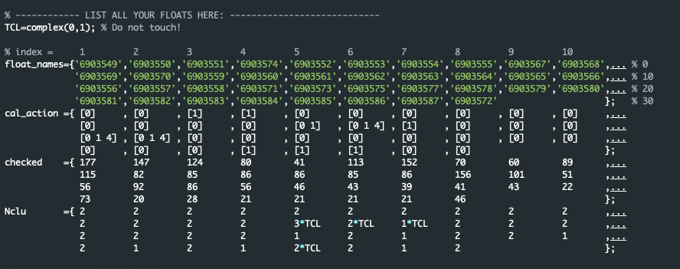
init_dmqc
The ‘mother’ script
Table of floats
Operator data (addr. etc.)
Assorted parameters
Paths to directories:
matlab_ow, float data, reference data, argo toolboxes, my_working_dir
subroutines for initial distribution of necessary files

Slide 5
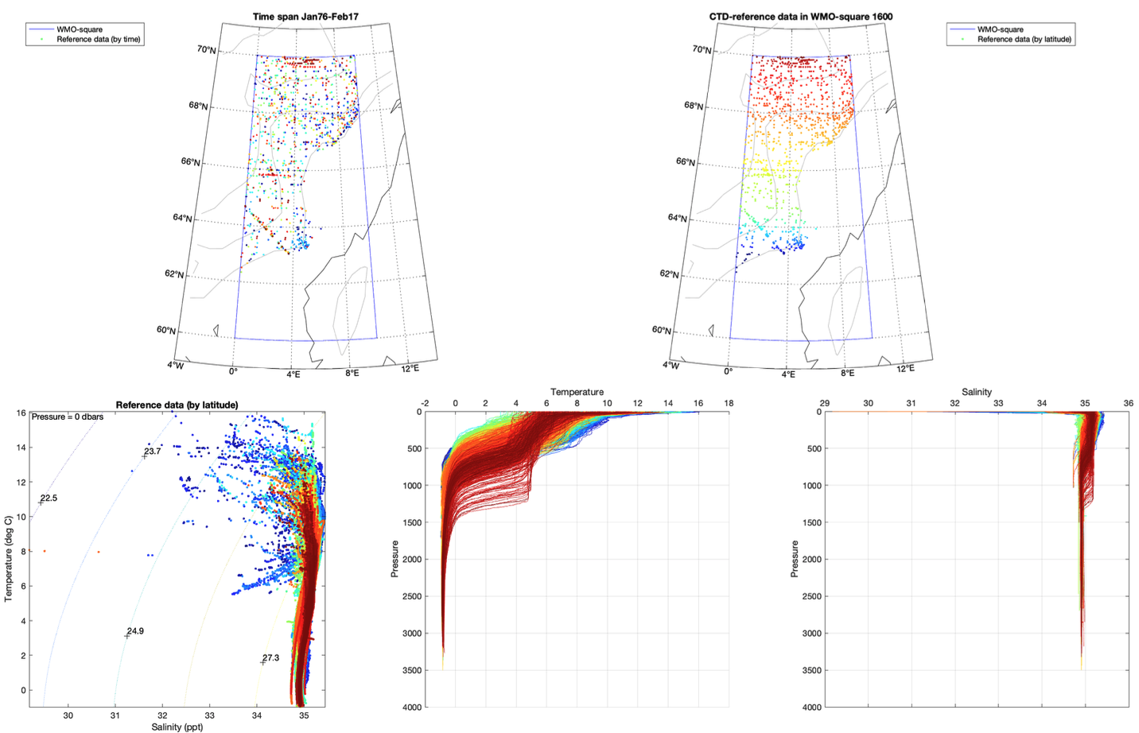
1. load_referencedata
cd ~/Downloads/DMQC
lftp -u <user,password> ftp.ifremer.fr/coriolis/
check for updates
download
run load_referencedata
Ingests into MATLAB_OWC's climatology
Map overview of the chosen WMO squares
Maps and TS, T, and S graphs

Slide 6
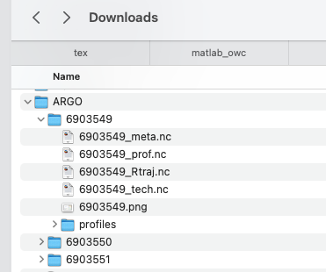
2. download_floats
Automatic
Based on list and paths in init_dmqc.m

Slide 7
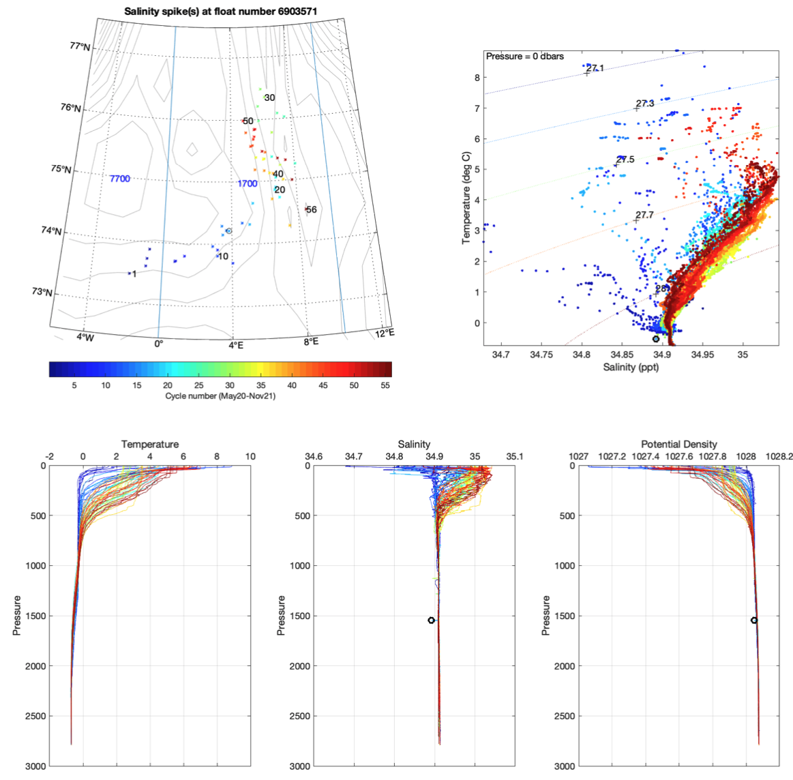
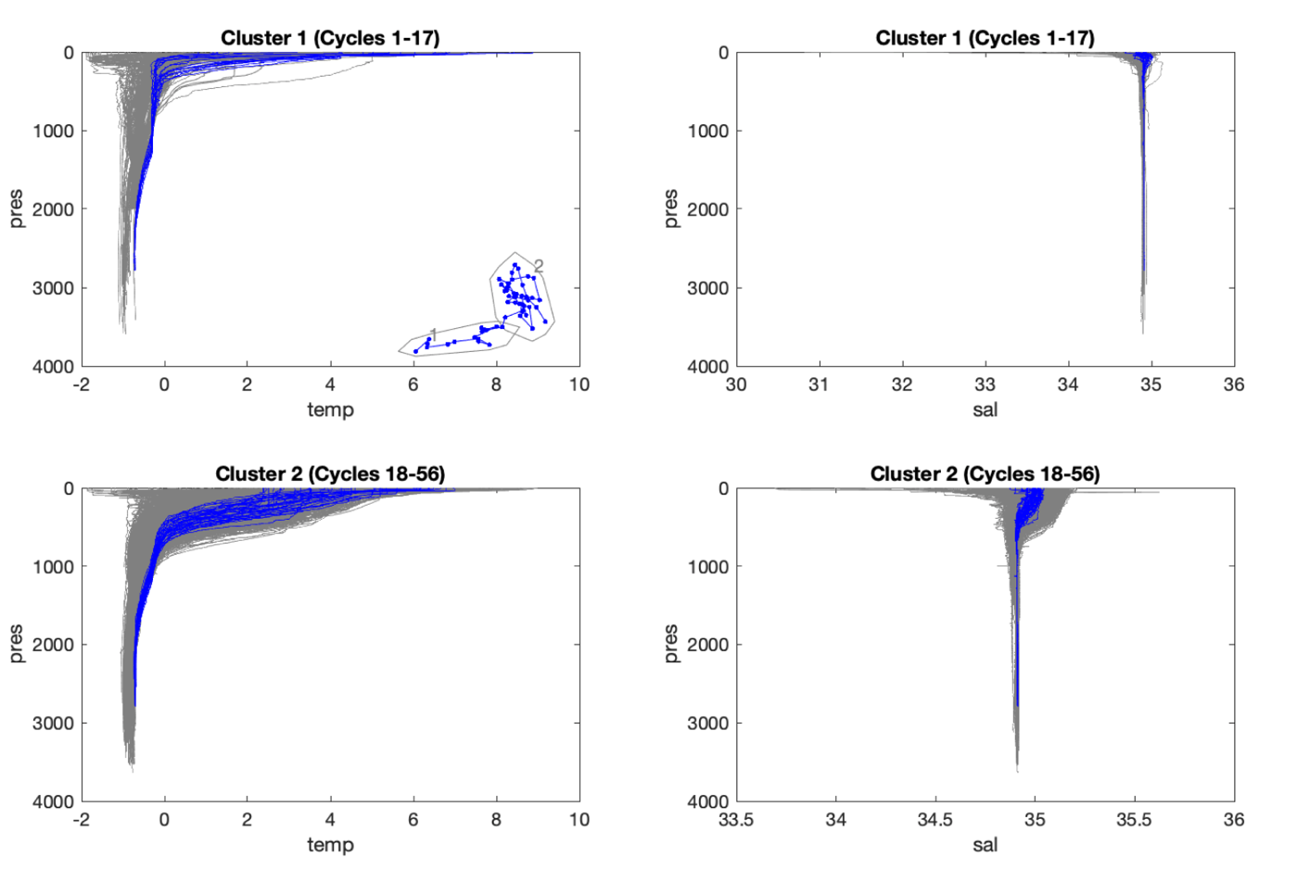
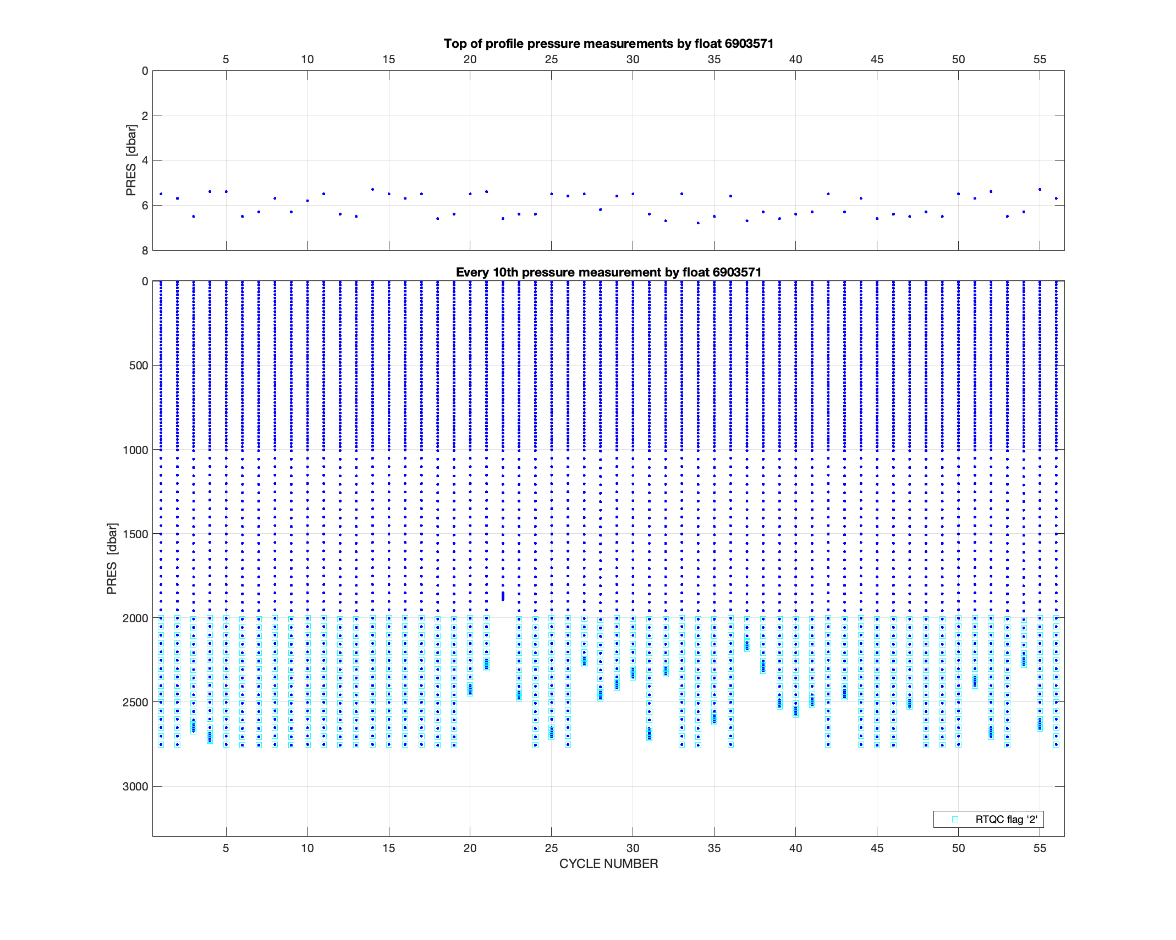
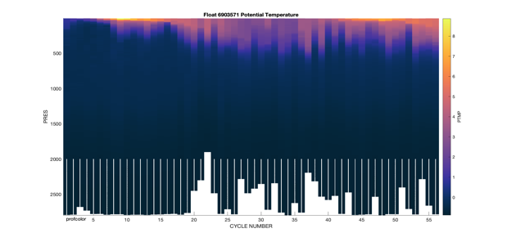
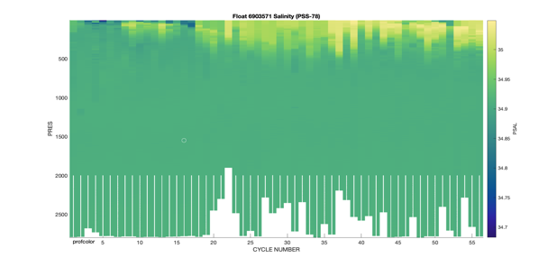
3. prepare_floats
Extracts info
Loads data & flags
DMQC of coordinates
Sea Surface Pressure Adjustment (for APEX floats only)
Visual verification of Real-time mode QC flags
Selected automated tests
Visual DMQC of the variables
Correct deep argo/arvor floats pressure dependent conductivity bias
Organise data for OWC

Slide 8
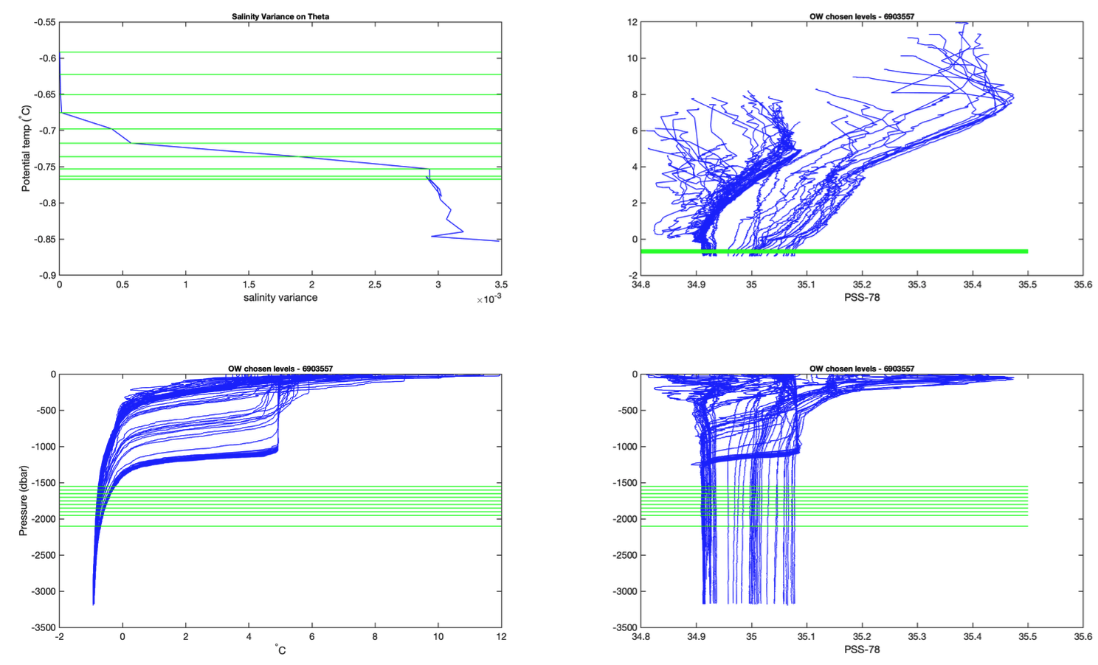
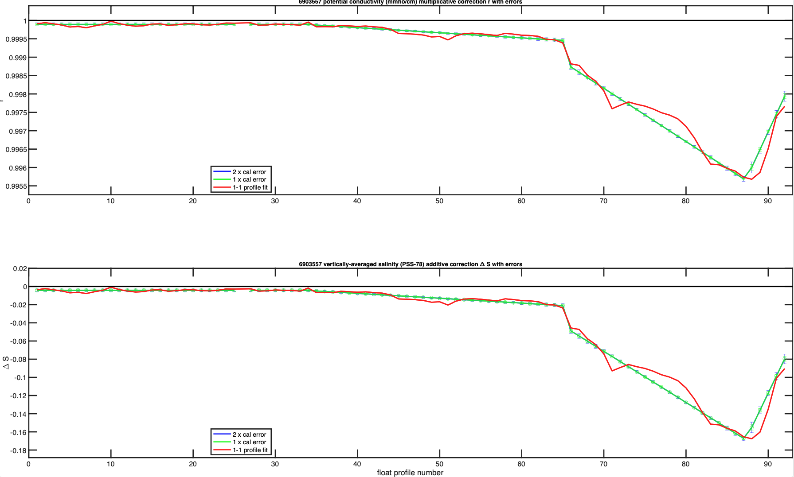
4. run_ow_calibration
ow_config.txt and set_calseries.m copied to local folder
edit and re-run
figures put as normal for OWC
parses results and decisions to write_D

Slide 9
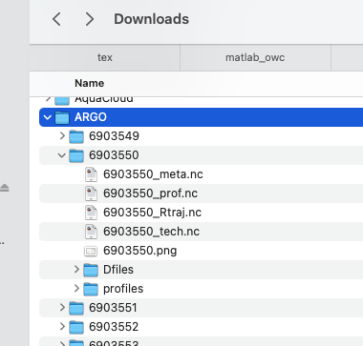
5. write_D
makes D-files
adds all the flags etc.
checks consistency
SCIENTIFIC_CALIBRATION texts

Slide 10
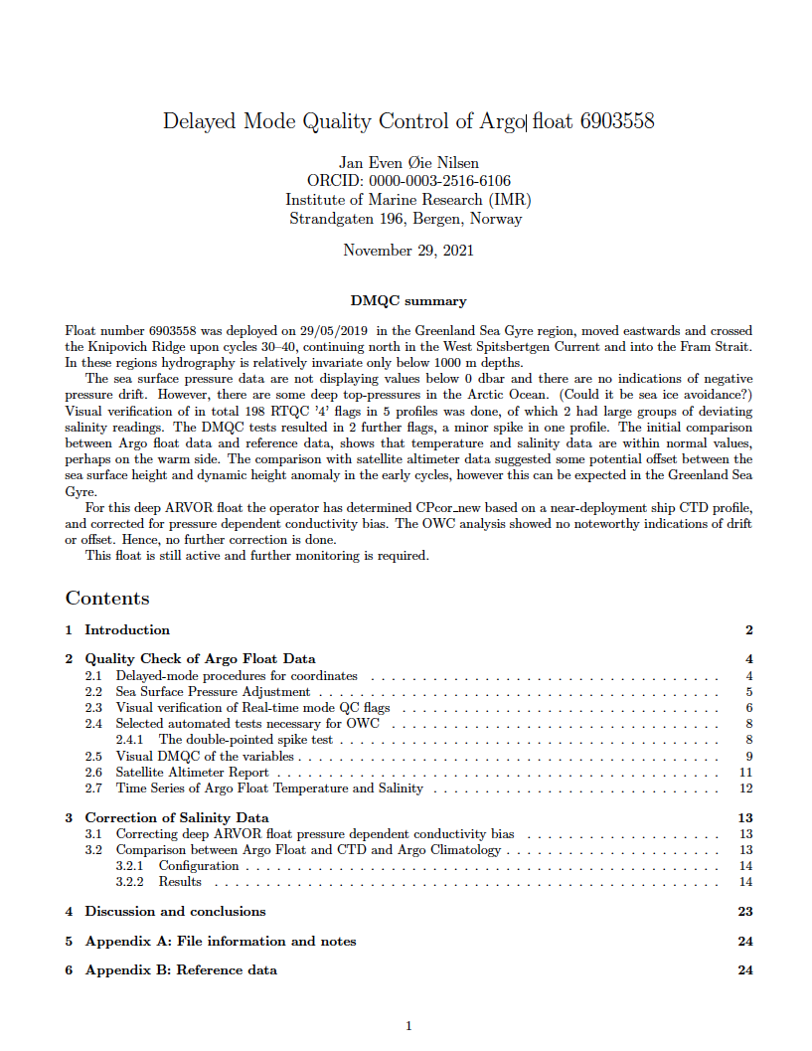
6. Make the report
Follows the flow of the DMQC manual
The master file is fixed
edit notes.tex as you proceed
edit discussion.tex in the end
Input from the matlab functions:
figures
snippets of text
whole tables
whole sections

Slide 11
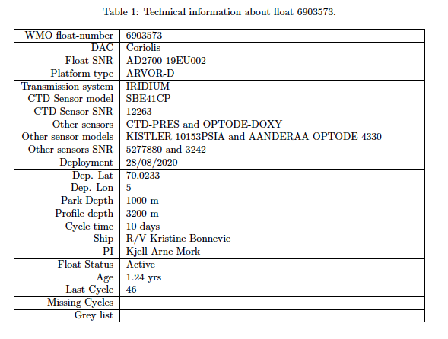
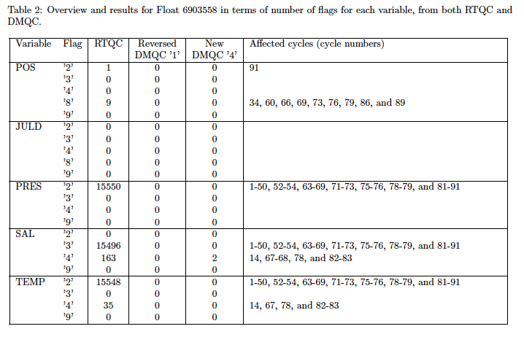
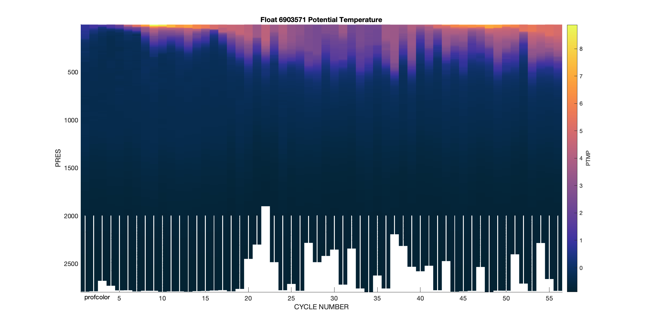
The report
technical info
full overview of flags
plots with flag marks

Slide 12
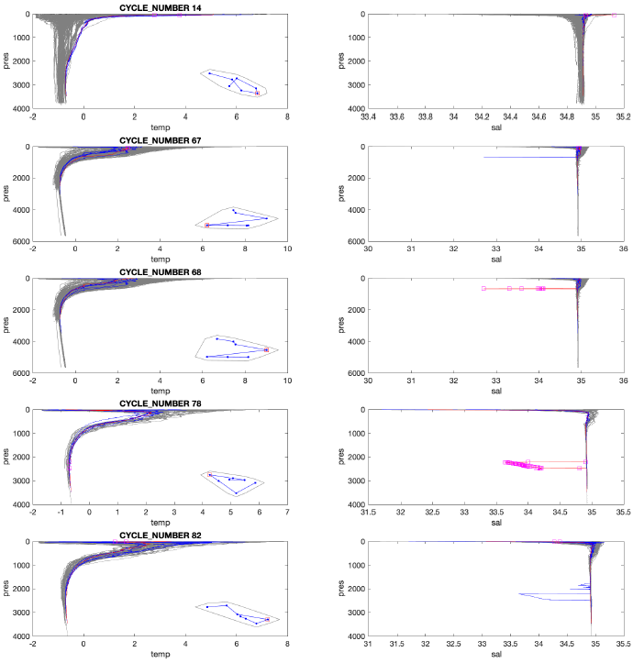
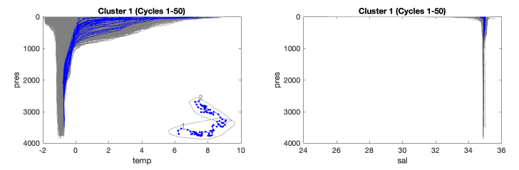
The report
Visualisation of spikes etc.
Simple comparison to reference data

Slide 13
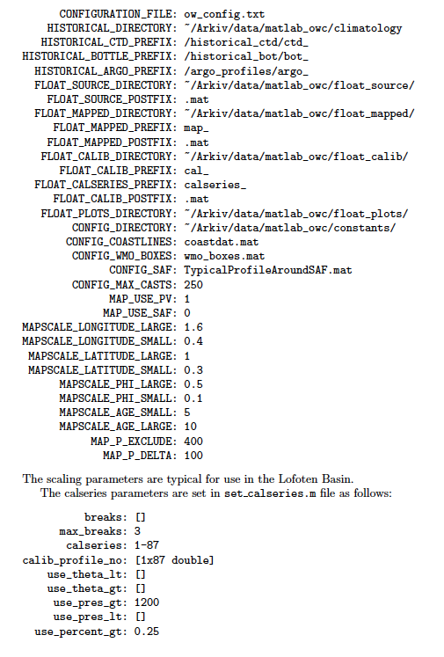
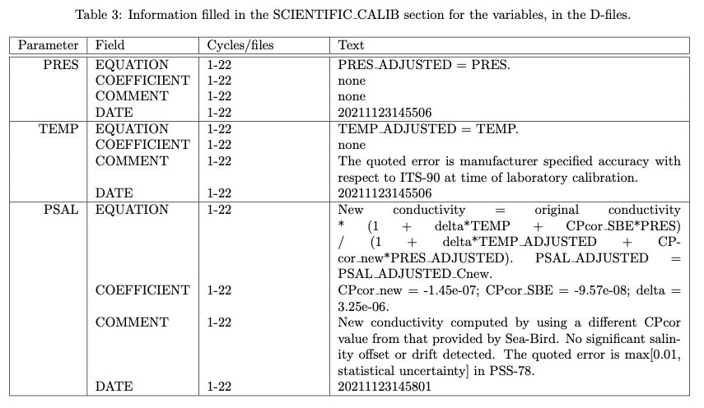
The report
All OWC parameters
All OWC figures
Notes
SCIENTIFIC_CALIB texts
Everything !

Slide 14
DMQC-fun at a glance
work_log.txt
Explains the whole workflow
A good place to log your overall progress
Coriolis
Coriolis
init_dmqc
init & setup – paths – parameters – list of floats – decisions – all edits in one place – all functions use it
load_referencedata
ingest for DMQC and OWC
quick-check
update list of reference data
download_floats
from the Coriolis server
NetCDF-files
altimetry comparison
current greylist
prepare_floats
general DMQC
builds the mat-files for OWC
run_ow_calibration
OWC
all selected floats
write_D
D-files
operator_CPcor_new
tool for new Cpcor
near-deployment ship CTD
LaTeX report
reads content saved
by toolbox functions
HD

