Slide 1
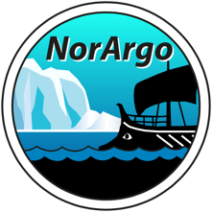
Delayed mode quality control of pressure, temperature, and salinity
Jan Even Øie Nilsen
Institute of Marine Research
NorArgo2 Annual meeting, Bergen
November 21st 2022

Slide 2
Outline
Update on the methodology – DMQC-fun toolbox updates
Status on floats
A brief look at the new floats

Slide 3
The Matlab toolbox DMQC-fun
Birgit Klein, Ingrid Angel, Kjell Arne Mork, and J. Even Ø. Nilsen
Started in Hamburg 2019
DMQC of core data from Argo floats, incl. salinity calibration
Functions span from download of reference and float data through to a semi automated report and updated D-files
https://github.com/imab4bsh/DMQC-fun.git
Being continuously updated.

Slide 4
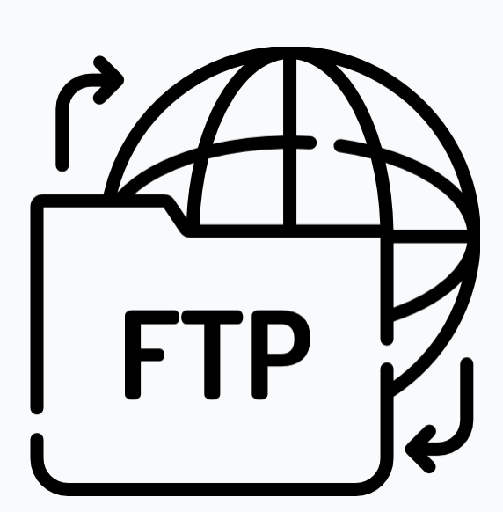
DMQC-fun at a glance
work_log.txt
Explains the whole workflow
A good place to log your overall progress
Coriolis
Coriolis
init_dmqc
init & setup – paths – parameters – list of floats – decisions – all edits in one place – all functions use it
load_referencedata
ingest for DMQC and OWC
quick-check
update list of reference data
download_floats
from the Coriolis server
NetCDF-files
altimetry comparison
current greylist
prepare_floats
General DMQC
Visual control of all profiles
Builds the mat-files for OWC
run_ow_calibration
OWC
all selected floats
Local copies of
ow_config.txt
set_calseries.m
write_D
D-files
operator_CPcor_new
tool for new Cpcor
near-deployment ship CTD
PDF (LaTeX) report
reads content saved
by toolbox functions
HD

Slide 5
Progress 2022
More floats checked
Visual control and manual flagging of all profiles now included
Descending profiles included in our DMQC

Slide 6
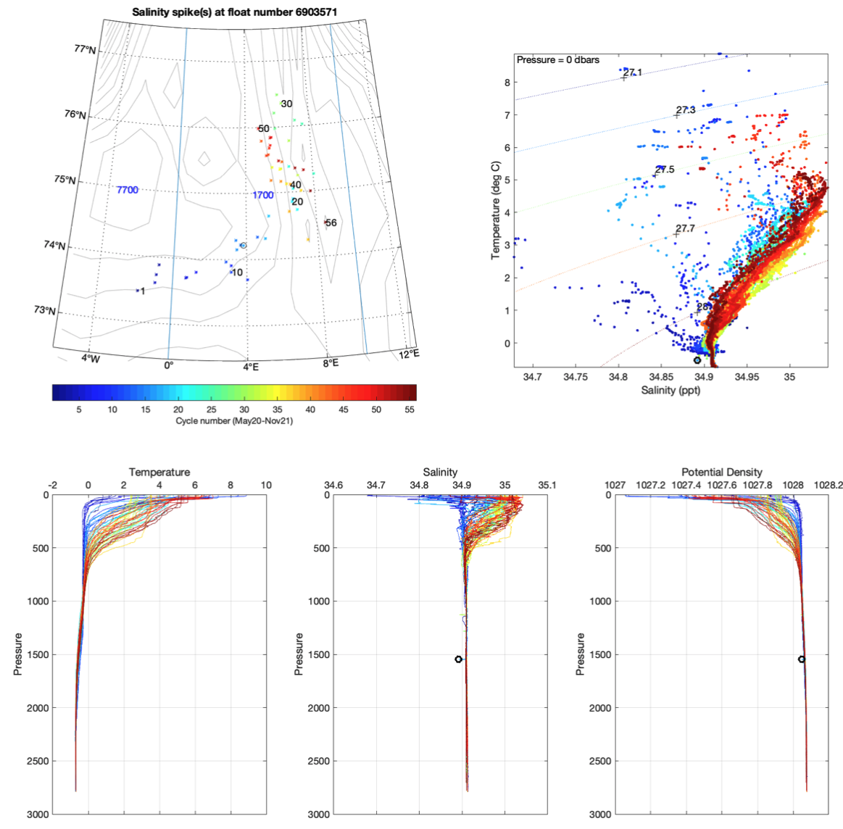
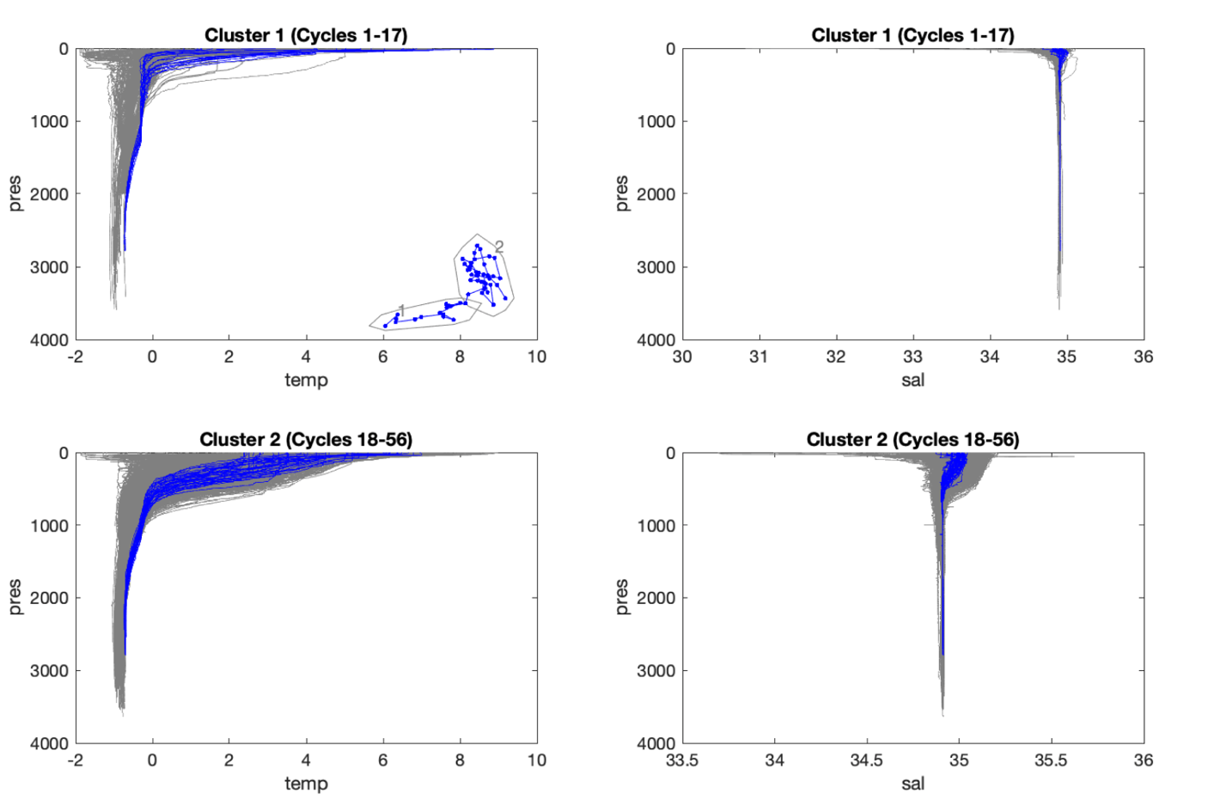
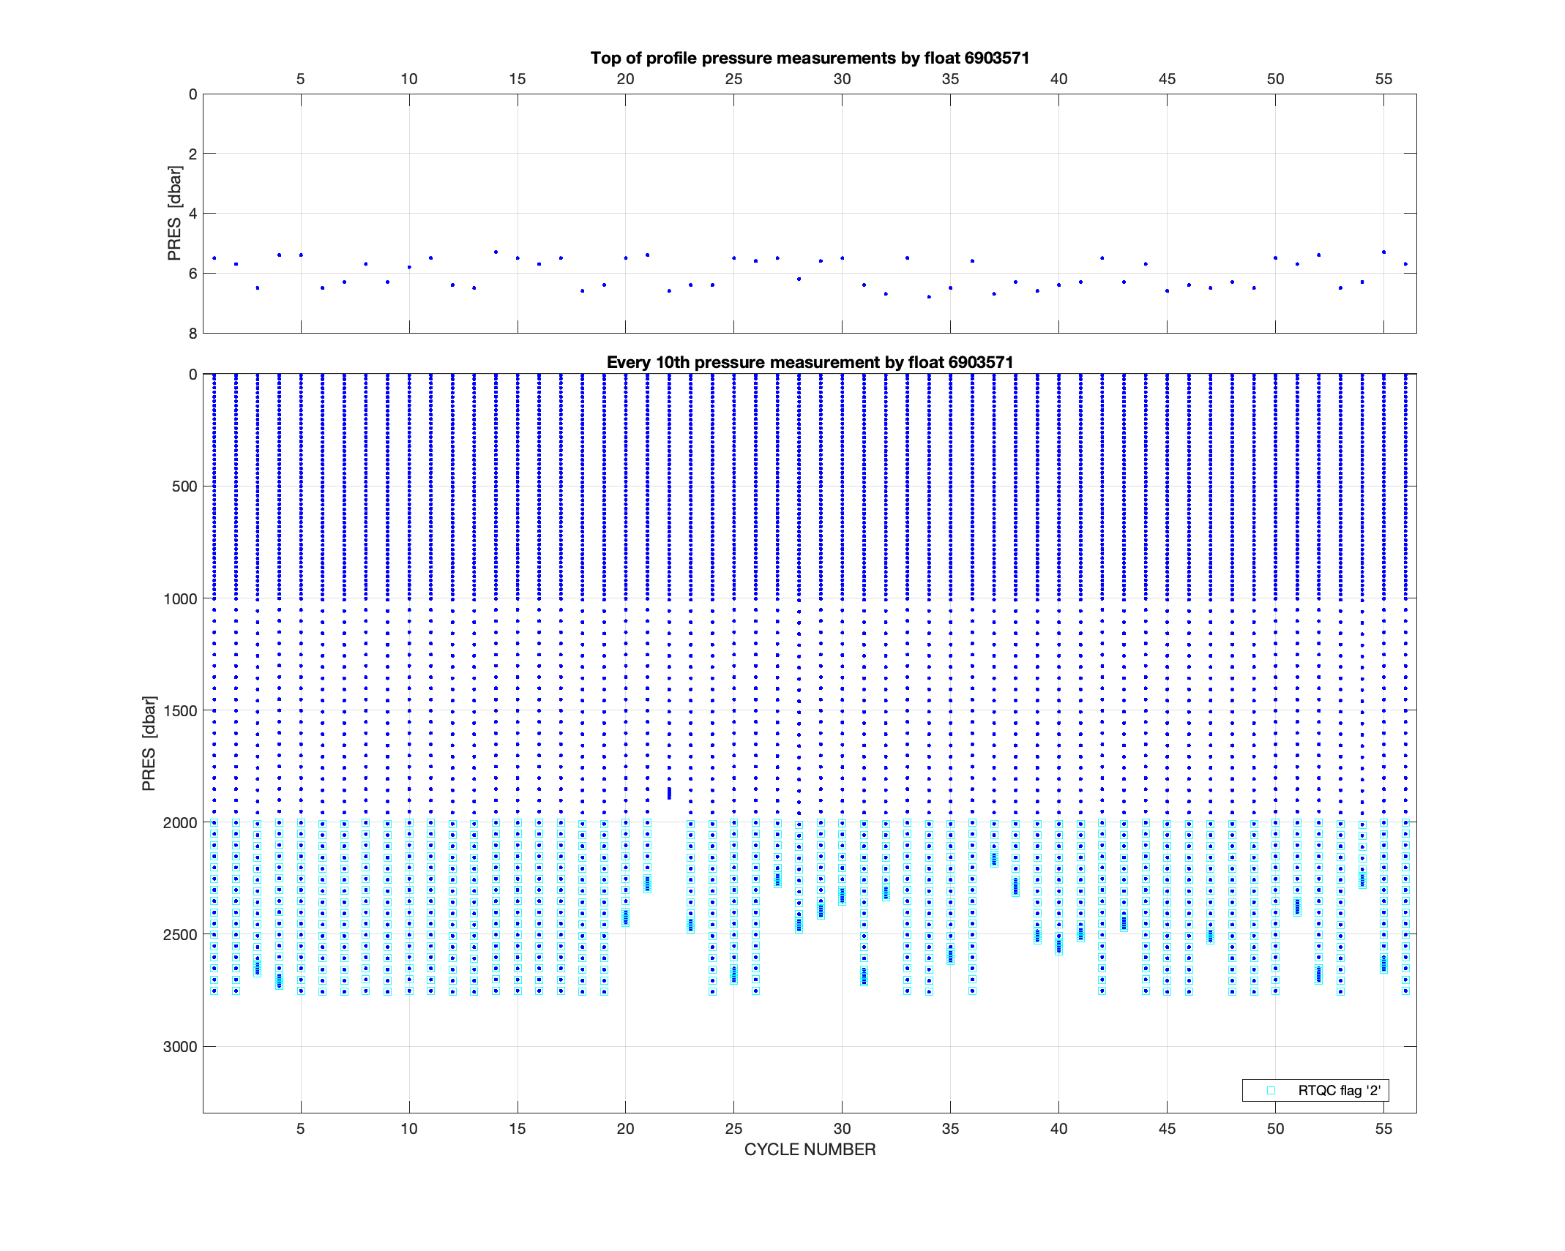
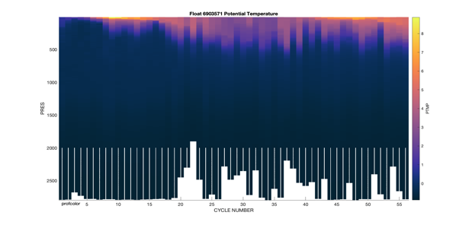
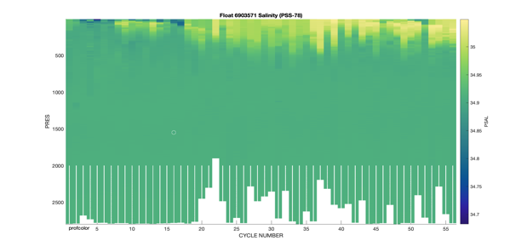
prepare_floats previously
Extracts info
Loads data & flags
DMQC of coordinates
Sea Surface Pressure Adjustment (for APEX floats only)
Visual verification of Real-time mode QC flags
Selected automated tests
Visual DMQC of the variables
Correct deep argo/arvor floats pressure dependent conductivity bias
Organise data for OWC

Slide 7
Now also with visual control of every profile
check_profiles.m and predit.m
Developed as part of evenmat and integrated into DMQC-fun
Takes matrices with data and matrices with flags
Shows p, S and T (and density) profiles with existing flags
Additional profiles as guidance for DMQC
Nearby reference data
Some preceeding and subsequent cycles
Opposite direction profile from same cycle
Keypress markup, zooming, and flagging

Slide 8
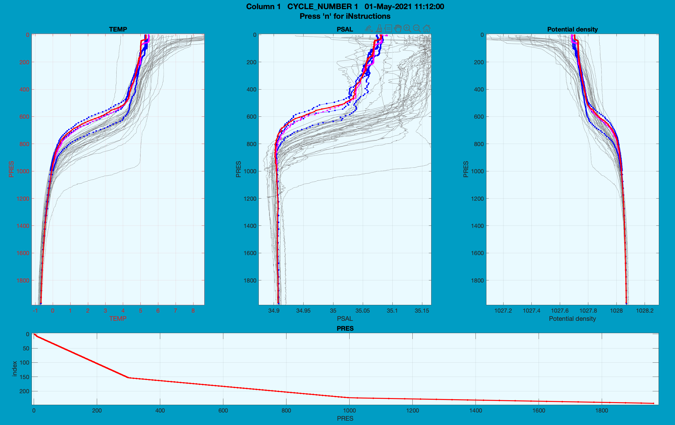
check_profiles example

Slide 9
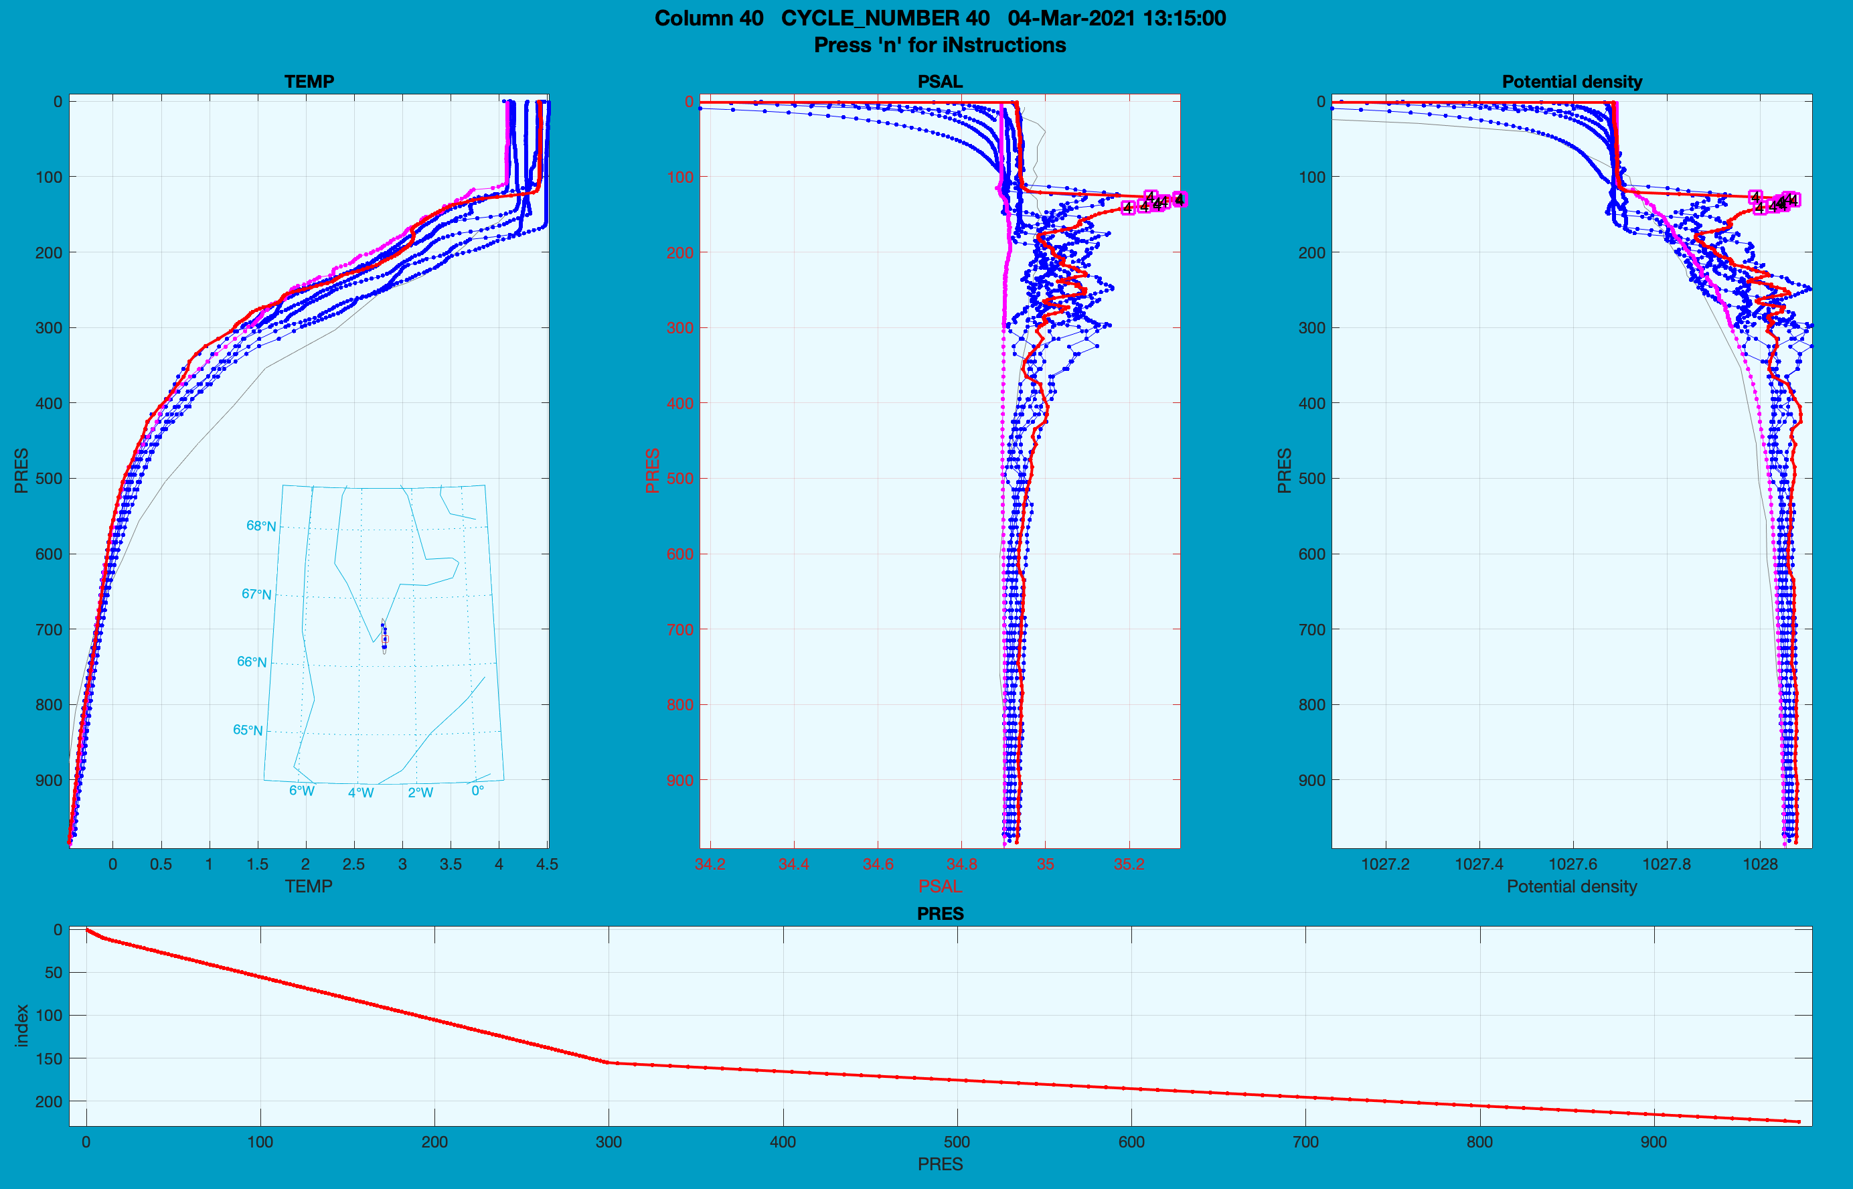
Descending profiles are also checked now
Descending profilees are not used in OWC analysis
But corrected same as ascending profile from same cycle

Slide 10
Status DMQC for p, S & T
53 floats by IMR
12 floats out of service
Deployments
14 (2019) - 8 dead
12 (2020) - 3 dead
14 (2021) - 1 dead
13 (2022) – looks fine
6 are in the Barents Sea where we have no reference data.
All others except 2022 deployments have been DMQC’d summer 2022
All in all 13 floats have been corrected, of which 3 PSAL greylisted

