Slide 1

Serializing and Deserializing
MPI Opaque Objects with MPI Stages
Derek Schafer (UTC), Ignacio Laguna (LLNL),
Kathryn Morhor (LLNL)
Anthony Skjellum—presenter
EuroMPI 2020 [Poster]
September 23, 2020
We Shall Achieve

Slide 2
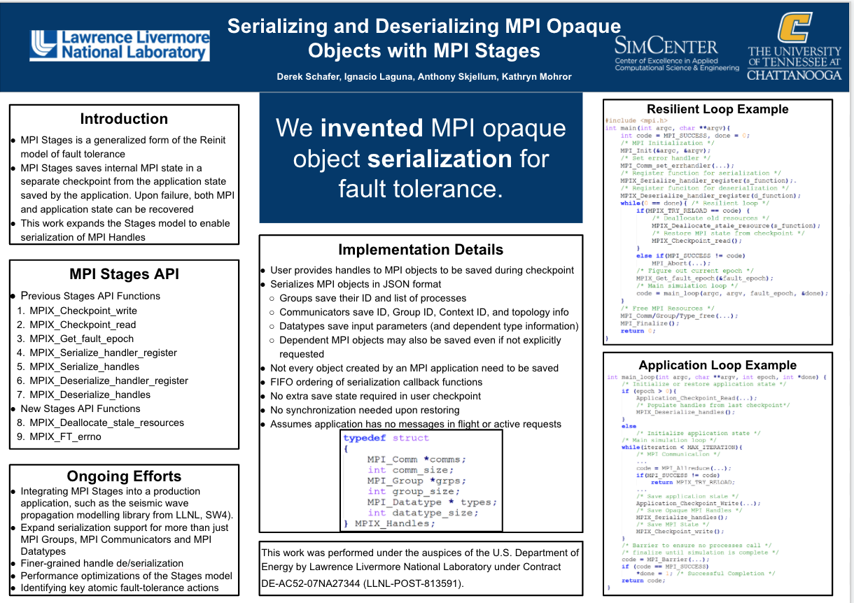

Slide 3
Outline
Background on MPI Stages
Why we need to serialize/deserialize MPI opaque objects + example APIs
What the resilient loop looks like
What the application loop looks like
Summary

Slide 4
Why Serialize/Deserialize
The stages model effects either of these two things to every MPI process after a detected fault
process recovery/restart OR
process “return to consistent state”
Opaque objects held by the user must be reassociated with user code and reconnected with MPI!
Recovery has an aspect of reconnection at deserialization
This is a cooperative model of serialization/deserialization and CPR between the application, MPI+Stages extensions

Slide 5
Background – MPI Stages
Generalized form of the Reinit model of fault tolerant MPI
Key idea: checkpoints MPI and application state at synchronous checkpoints under user control
To support more general MPI programs, we must be able to serialize/deserialize handles
This model is working effectively on more and more complex MPI codes over time
Utilizes our own MPI implementation-ExaMPI- that is designed to support MPI-state
Fault models is currently process faults (like ULFM and others); network and other faults possible also in future.

Slide 6
MPI Stages API
Previous Stages API Functions
MPIX_Checkpoint_write
MPIX_Checkpoint_read
MPIX_Get_fault_epoch
MPIX_Serialize_handler_register
MPIX_Serialize_handles
MPIX_Deserialize_handler_register
MPIX_Deserialize_handles
New Stages API Functions
MPIX_Deallocate_stale_resources
MPIX_FT_errno

Slide 7
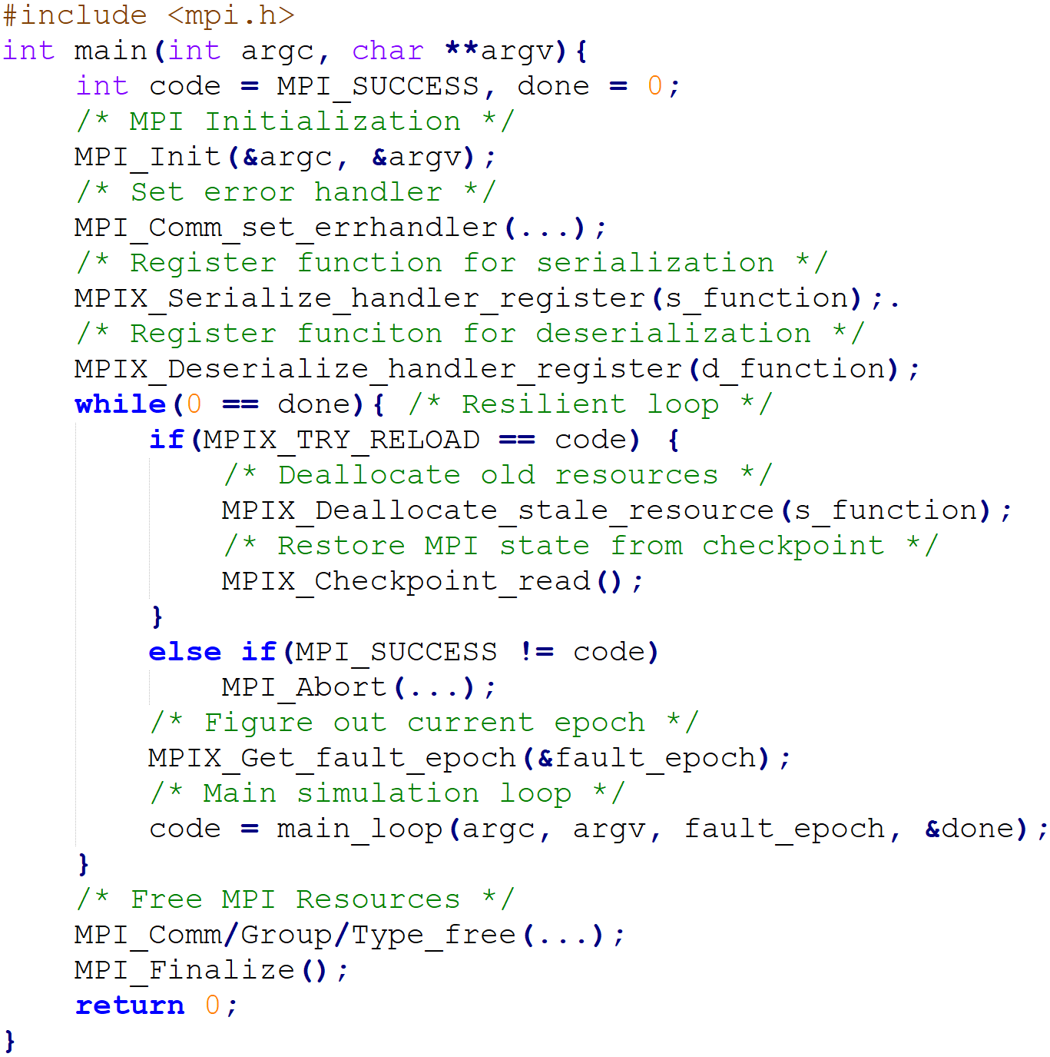
Resilient Loop Example

Slide 8
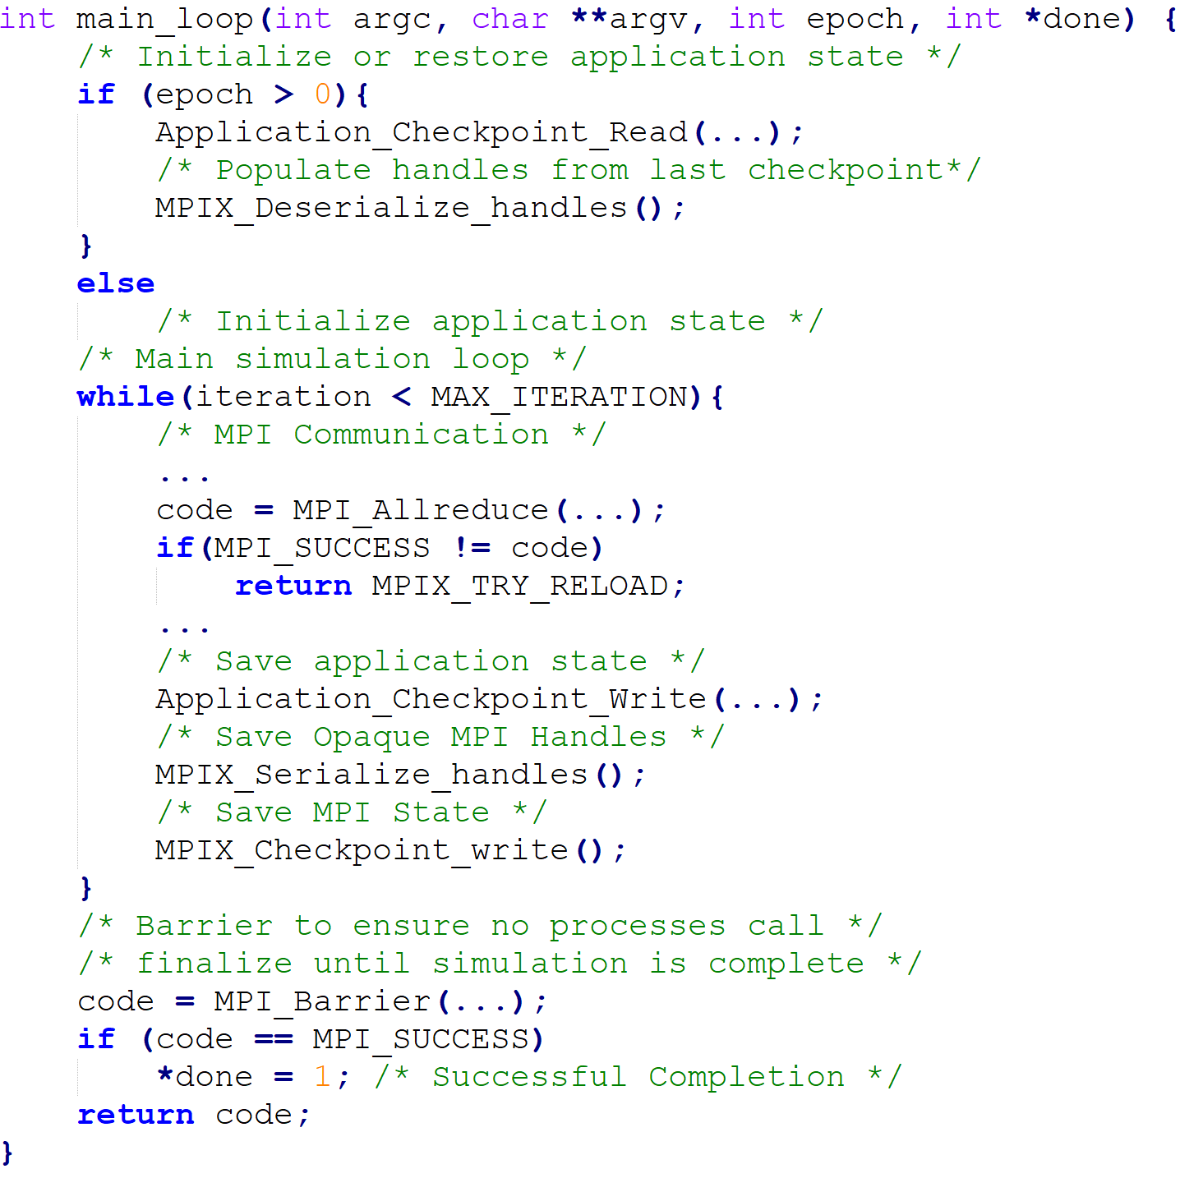
Application Loop Example
Application Loop Example

Slide 9
Summary/Conclusions
MPI Stages is an effective model of MPI Fault Tolerance
The type of serialization and deserialization is useful here and perhaps for other models
The resilient loop model can also, potentially, be useful as common aspect with other MPI F. T. models too
This approach works in practice with acceptable overheads
Future support for I/O, window, and persistent collective handles planned.

Slide 10
Acknowledgements
Ignacio Laguna, Kathryn Morhor, LLNL
Derek Schafer, Anthony Skjellum
Contacts:
lagunaperalt1@llnl.gov
mohror1@llnl.gov
Derek-schafer@utc.edu
Tony-skjellum@utc.edu
This work was performed under the auspices of the U.S. Department of Energy by Lawrence Livermore National Laboratory under Contract
DE-AC52-07NA27344 (LLNL-POST-813591).

