Slide 1

Advanced OpenMP Tutorial
Michael Klemm
Notes:
1

Slide 2
OpenMP Contents
Introduction to OpenMP core concepts
Worksharing
Synchronization
Data scoping
Tasks
Compilers
After the break: GPU programming

Slide 3
Core Concepts

Slide 4

What is OpenMP?
De-facto standard Application Programming Interface (API) to write shared memory parallel applications in C, C++, and Fortran
Consists of compiler directives, runtime routines and environment variables
Version 5.0 was released at SC18
Version 5.2 was released at SC21
Version 6.0 will be released at SC 2024
Parallel Regions
Vector- ization
Work- sharing
Memory Manage- ment
Tasking
Devices

Slide 5
The OpenMP Execution Model
Fork and Join Model
Primary
Thread
#pragma omp parallel
{
....
}
Parallel region
Worker
Threads
Synchronization
#pragma omp parallel
{
....
}
Parallel region
Worker
Threads
Synchronization

Slide 6
Worksharing

Slide 7
The Worksharing Constructs
The work is distributed over the threads
Must be enclosed in a parallel region
Must be encountered by all threads in the team, or none at all
No implied barrier on entry
Implied barrier on exit (unless the nowait clause is specified)
A work-sharing construct does not launch any new threads
#pragma omp for
{
....
}
#pragma omp sections
{
....
}
#pragma omp single
{
....
}

Slide 8
Worksharing illustrated
Pseudo-Code Here: 4 Threads
Memory
A(0)
.
.
.
A(99)
Thread 1
do i = 0, 24
a(i) = b(i) + c(i)
end do
Thread 2
do i = 25, 49
a(i) = b(i) + c(i)
end do
Serial
B(0)
.
.
.
B(99)
do i = 0, 99
a(i) = b(i) + c(i)
end do
do i = 50, 74
a(i) = b(i) + c(i)
end do
Thread 3
C(0)
.
.
.
C(99)
do i = 75, 99
a(i) = b(i) + c(i)
end do
Thread 4

Slide 9
Influencing the For Loop Scheduling / 1
for-construct: OpenMP allows to influence how the iterations are scheduled among the threads of the team, via the schedule clause:
schedule(static [, chunk]): Iteration space divided into blocks of chunk size, blocks are assigned to threads in a round-robin fashion. If chunk is not specified: #threads blocks.
schedule(dynamic [, chunk]): Iteration space divided into blocks of chunk (not specified: 1) size, blocks are scheduled to threads in the order in which threads finish previous blocks.
schedule(guided [, chunk]): Similar to dynamic, but block size starts with implementation-defined value, then is decreased exponentially down to chunk.
Default is schedule(static).

Slide 10
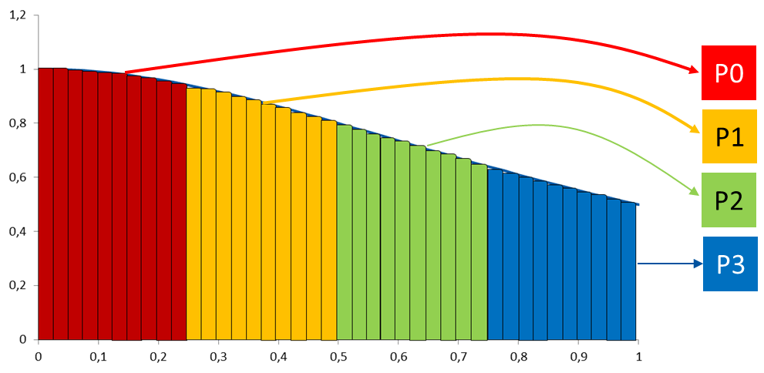
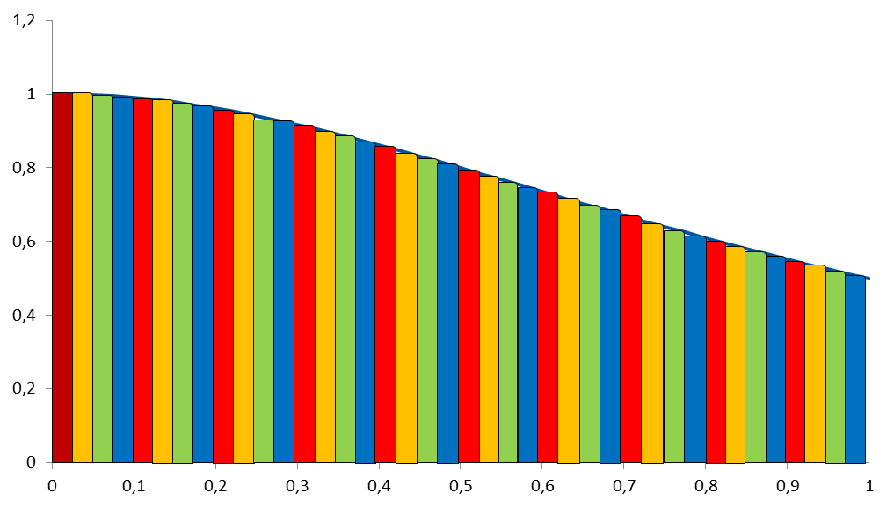
Influencing the For Loop Scheduling / 2
Static Schedule
schedule(static [, chunk])
Decomposition depending on chunksize
Equal parts of size ‘chunksize’ distributed in round-robin fashion
Pros?
No/low runtime overhead
Cons?
No dynamic workload balancing

Slide 11
Influencing the For Loop Scheduling / 3
Dynamic schedule
schedule(dynamic [, chunk])
Iteration space divided into blocks of chunk size
Threads request a new block after finishing the previous one
Default chunk size is 1
Pros ?
Workload distribution
Cons?
Runtime Overhead
Chunk size essential for performance
No NUMA optimizations possible

Slide 12
Single and Master and Masked / 1
Single: only one thread in the team executes the code enclosed
Masked: rule-based selection of threads for region execution
#pragma omp single [private][firstprivate] \
[copyprivate][nowait]
{
<code-block>
}
There is no implied barrier on entry or exit !
#pragma omp masked [filter(integer-expression)]
{<code-block>}

Slide 13
Single and Master and Masked / 2
Single: only one thread in the team executes the code enclosed
Masked: rule-based selection of threads for region execution
Replacement of master construct:
#pragma omp single [private][firstprivate] \
[copyprivate][nowait]
{
<code-block>
}
#pragma omp masked [filter(integer-expression)]
{<code-block>}
#pragma omp masked [filter(0)]
{<code-block>}

Slide 14
Synchronization

Slide 15
The OpenMP Memory Model
private
memory
All threads have access to the same, globally shared memory
Data in private memory is only accessible by the thread owning this memory
No other thread sees the change(s) in private memory
Data transfer is through shared memory and is 100% transparent to the application
private
memory
T
T
Shared
Memory
T
private
memory
private
memory
T
T
private
memory
Private data is undefined on entry and exit
Can use firstprivate and lastprivate to address this

Slide 16
Barrier and Taskwait Constructs
OpenMP barrier (implicit or explicit)
All tasks created by any thread of the current Team are guaranteed to be completed at barrier exit
Task barrier: taskwait
Encountering task is suspended until child tasks are complete
Applies only to direct childs, not descendants!
C/C++
#pragma omp barrier
C/C++
#pragma omp taskwait

Slide 17
The nowait Clause
To minimize synchronization, some directives support the optional nowait clause
If present, threads do not synchronize/wait at the end of that particular construct
In C, it is one of the clauses on the pragma
In Fortran, it is appended at the closing part of the construct
#pragma omp for nowait
{
:
}
!$omp do
:
:
!$omp end do nowait

Slide 18
Scoping Rules

Slide 19
Scoping Rules
Managing the Data Environment is the challenge of OpenMP.
Scoping in OpenMP: Dividing variables in shared and private:
private-list and shared-list on Parallel Region
private-list and shared-list on Worksharing constructs
General default is shared for Parallel Region, firstprivate for Tasks.
Loop control variables on for-constructs are private
Non-static variables local to Parallel Regions are private
private: A new uninitialized instance is created for the task or each thread executing the construct
firstprivate: Initialization with the value before encountering the construct
lastprivate: Value of last loop iteration is written back to Master
Static variables are shared
Tasks are
introduced later

Slide 20
Privatization of Global/Static Variables
Global / static variables can be privatized with the threadprivate directive
One instance is created for each thread
Before the first parallel region is encountered
Instance exists until the program ends
Does not work (well) with nested Parallel Region
Based on thread-local storage (TLS)
TlsAlloc (Win32-Threads), pthread_key_create (Posix-Threads), keyword __thread (GNU extension)
C/C++
static int i; #pragma omp threadprivate(i)
Fortran
SAVE INTEGER :: i !$omp threadprivate(i)

Slide 21
Privatization of Global/Static Variables
Global / static variables can be privatized with the threadprivate directive
One instance is created for each thread
Before the first parallel region is encountered
Instance exists until the program ends
Does not work (well) with nested Parallel Region
Based on thread-local storage (TLS)
TlsAlloc (Win32-Threads), pthread_key_create (Posix-Threads), keyword __thread (GNU extension)
Really: try to avoid the use of threadprivate and static variables!
C/C++
static int i; #pragma omp threadprivate(i)
Fortran
SAVE INTEGER :: i !$omp threadprivate(i)

Slide 22
Irregular Parallelism - Tasks

Slide 23
What is a Task in OpenMP?
Tasks are work units whose execution
may be deferred or…
… can be executed immediately
Tasks are composed of
code to execute, a data environment (initialized at creation time), internal control variables (ICVs)
Tasks are created…
… when reaching a parallel region → implicit tasks are created (per thread)
… when encountering a task construct → explicit task is created
… when encountering a taskloop construct → explicit tasks per chunk are created
… when encountering a target construct → target task is created

Slide 24
Tasking Execution Model
Supports unstructured parallelism
unbounded loops
recursive functions
Several scenarios are possible:
single creator, multiple creators, nested tasks (tasks & WS)
All threads in the team are candidates to execute tasks
Example (unstructured parallelism)
#pragma omp parallel
#pragma omp master
while (elem != NULL) {
#pragma omp task
compute(elem);
elem = elem->next;
}
while ( <expr> ) {
...
}
void myfunc( <args> )
{
...; myfunc( <newargs> ); ...;
}
Parallel Team
Task pool

Slide 25
Fibonacci Numbers (in a Stupid Way ☺)
Only one thread enters fib() from main().
That thread creates the two initial work tasks and starts the parallel recursion.
The taskwait construct is required to wait for the result for x and y before the task can sum up.
1 int main(int argc,
2 char* argv[])
3 {
4 [...]
5 #pragma omp parallel
6 {
7 #pragma omp masked
8 {
9 fib(input);
10 }
11 }
12 [...]
}
14 int fib(int n) {
15 if (n < 2) return n;
16 int x, y;
17 #pragma omp task shared(x)
18 {
19 x = fib(n - 1);
20 }
21 #pragma omp task shared(y)
22 {
23 y = fib(n - 2);
24 }
25 #pragma omp taskwait
26 return x+y;
}

Slide 26
T1 enters fib(4)
T1 creates tasks for fib(3) and fib(2)
fib(4)
T1 and T2 execute tasks from the queue
T1 and T2 create 4 new tasks
fib(3)
fib(2)
T1 - T4 execute tasks
fib(2)
fib(1)
fib(1)
fib(0)
Task Queue
fib(2)
fib(3)
fib(2)
fib(1)
fib(1)
fib(0)

Slide 27
T1 enters fib(4)
T1 creates tasks for fib(3) and fib(2)
fib(4)
T1 and T2 execute tasks from the queue
T1 and T2 create 4 new tasks
fib(3)
fib(2)
T1 - T4 execute tasks
…
fib(2)
fib(1)
fib(1)
fib(0)
fib(1)
fib(0)

Slide 28
Using OpenMP with a Compiler

Slide 29
Production Compilers w/ OpenMP Support
GCC
clang/LLVM
Intel Classic and Next-gen Compilers
AOCC, AOMP, ROCmCC
IBM XL
… and many more
See https://www.openmp.org/resources/openmp-compilers-tools/ for a list

Slide 30
Compiling OpenMP
Enable OpenMP via the compiler’s command-line switches
GCC: -fopenmp
clang: -fopenmp
Intel: -fopenmp or –qopenmp (classic) or –fiopenmp (next-gen)
AOCC, AOCL, ROCmCC: -fopenmp
IBM XL: -qsmp=omp
Switches have to be passed to both compiler and linker:
$ gcc [...] -fopenmp -o matmul.o -c matmul.c
$ gcc [...] -fopenmp -o matmul matmul.o
$./matmul 1024
Sum of matrix (serial): 134217728.000000, wall time 0.413975, speed-up 1.00
Sum of matrix (parallel): 134217728.000000, wall time 0.092162, speed-up 4.49

Slide 31
To be continued…

