Slide 1
Ngao

Slide 2
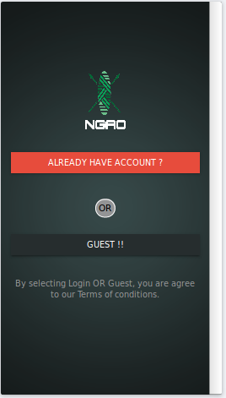
Home
ProjectPageName-Welcome
Functionality-Navigate to Guest Or Login

Slide 3
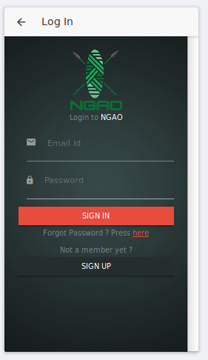
Login
ProjectPageName-Login
Functionality-Allow User to Login

Slide 4
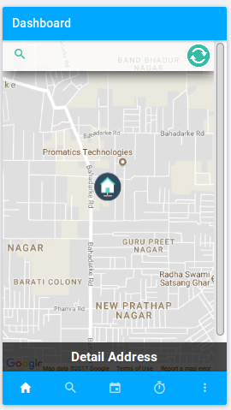
Main
ProjectPageName-Page5
Functionality-Search Location on address and see the address on tapping detail address

Slide 5
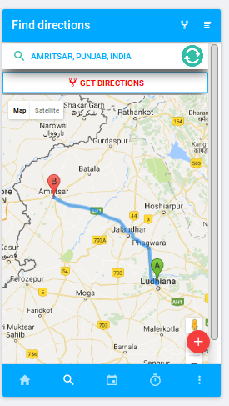
Directions
ProjectPageName-directroute
Functionality-It helps to find source and destination between locations

Slide 6
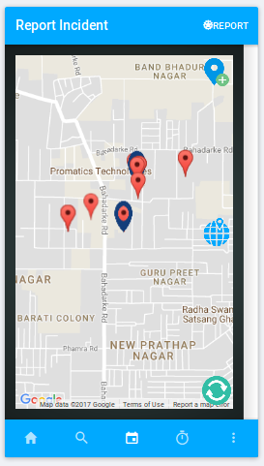
Report Pins
ProjectPageName-directroute(map>reportincident>reportincident)
Functionality-User will be report on map by tapping on report pins

Slide 7
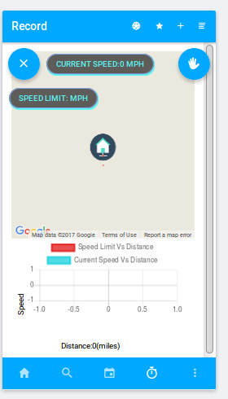
Record Track
ProjectPageName-mind786
Functionality-This will record the user,s current to sourcedestination and will give sound alert if the speed is exceded then speed limit

