Slide 1
EHL PARIS 2026 · INRIA · KAGGLE CHALLENGE
Cross-Modal Retrieval for
3D Medical Images
Matching the same patient across MRI contrasts — no training, no labels, no leak.
0.703
MACRO MRR · from 0.455 baseline
Amine Cheikhrouhou
Notes:
Open: we tackled the Inria cross-modal retrieval challenge. One line: match the same patient across MRI contrasts, no training, no labels. We hit 0.703 macro MRR, up from the 0.455 baseline. Pause on the number.

Slide 2
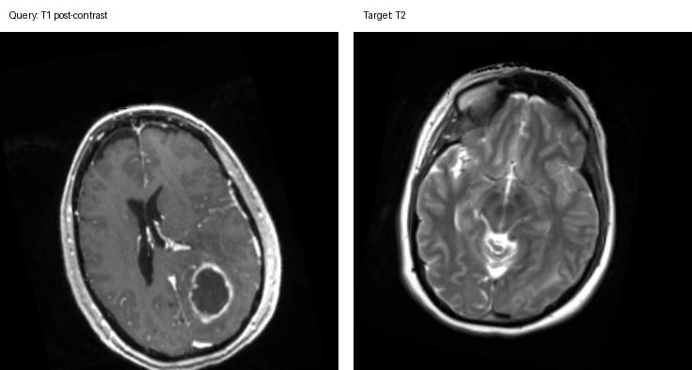
THE TASK
Find the same patient — across imaging modalities
Given a query contrast-T1 (ceT1) brain scan, rank a gallery of T2 scans so the same individual's T2 sits at rank 1.
Query · ceT1
Target · T2
Modality gap — ceT1 and T2 show the same anatomy with inverted, non-linear intensities.
Geometry gap — Volumes are independently positioned, scaled, even deformed.
No identity labels — It is retrieval, not classification — and the patients are unseen.
Same patient, same axial slice.
Metric: mean reciprocal rank, averaged over 3 datasets.
The retrieval engine must see through the contrast.
Notes:
Frame the task precisely — it's retrieval, not tumor classification. Query is a contrast-T1, we rank a gallery of T2s, same patient must be rank 1. Three reasons it's hard: contrast looks totally different (point at image), geometry differs, and the patients are unseen so no learning shortcut. Metric is MRR averaged over 3 datasets.

Slide 3
THE LANDSCAPE
One problem, three difficulty regimes
D1
D2
D3
Aligned
Deformed
Pre → intra-op
Pairs share a common voxel grid (BraTS-format). Solvable by direct image comparison.
D1 + independent rigid & non-linear deformation. Needs geometry-invariant matching.
Structurally different anatomy (resection). The hardest — shape is the signal.
OUR MRR
OUR MRR
OUR MRR
0.72
≈0.60
0.85
Difficulty increases left → right. One generic matcher wouldn't win — so we built one per regime.
Notes:
Three regimes of rising difficulty. D1 aligned — easy, shared grid. D2 same data but deformed — geometry breaks naive matching. D3 pre vs intra-op — anatomy literally changes (resection), shape becomes the signal. Key decision: one matcher per regime, not one generic model.

Slide 4
THE KEY INSIGHT
MIND descriptors make modality irrelevant
MIND (Modality-Independent Neighbourhood Descriptor) encodes each voxel by the local self-similarity of its surroundings — the texture pattern, not the intensity.
WHY IT WORKS
ceT1 voxel
intensity ≠ T2 intensity
MIND(ceT1)
≈ MIND(T2)
Intensities differ between ceT1 and T2 — but the structure around each voxel doesn't.
So the same anatomy yields the same descriptor field across both contrasts.
Correlate the two descriptor fields → a same-patient similarity score that ignores contrast.
Zero training, zero labels — it bridges the modality gap by construction.
Notes:
The conceptual core. MIND describes each voxel by the self-similarity of its neighbourhood — texture, not intensity. Intensities differ between ceT1 and T2; local structure doesn't. So MIND(ceT1) ≈ MIND(T2) for the same anatomy. We correlate the descriptor fields. No training at all — this is what makes cross-modal work.

Slide 5
OUR APPROACH
A specialised matcher for each regime
D1 · Aligned
Correlate MIND fields voxel-by-voxel on the shared grid.
Dense MIND
D2 · Deformed
Align each volume to a canonical pose (GPU, MIND-driven), then match.
Register → Dense MIND
D3 · Pre→intra-op
Match on original-array shape, tie-break with global MIND.
Shape prior + MIND
All on GPU, all classical — no learned weights to train, deploy, or overfit. Fully reproducible from one script.
Notes:
How MIND plugs into each regime. D1: dense voxel-wise MIND correlation on the shared grid. D2: register to canonical pose first, then D1 matcher. D3: original-array shape prior with a global-MIND tie-break. Everything classical and GPU — nothing to train or overfit, reproducible from one script.

Slide 6
THE BREAKTHROUGH
Unlocking D2 by undoing the deformation
D2 is just D1 with each volume independently moved and warped. So we register every volume back to a canonical pose — a rigid + scale transform optimised on the GPU using the modality-invariant MIND similarity itself — then run the D1 matcher.
4.7×
improvement on the D2 proxy
~70 Adam iterations per volume. No labels, no template learning — a clean sample of D1 galleries is the reference.
And the macro score moved with it:
0.61 → 0.703
BEFORE
AFTER (proxy D2)
0.15
0.72
D2 was the bottleneck. This was the single biggest lever.
Notes:
The breakthrough slide — spend time here. D2 is just D1 moved and warped, so we undo it: optimise a rigid+scale transform on GPU using MIND similarity itself as the objective, ~70 Adam iters, then match. Proxy D2 went 0.15 to 0.72 — 4.7x. That dragged the macro from 0.61 to 0.703. D2 was the bottleneck; this was the single biggest lever.

Slide 7
RESULTS
0.455 → 0.703 macro MRR
+55%
relative gain over the baseline
0.455 → 0.703
THE JOURNEY
0.455
Provided baseline
0.61
Per-dataset classical blend + shape prior
0.703
+ D2 canonical-pose registration
Notes:
Results. Per-dataset: D1 0.72, D2 ~0.60, D3 0.85, macro 0.703. The journey: baseline 0.455, classical blend got us to 0.61, the D2 registration pushed to 0.703 — 55% relative gain. Be honest that D2 still has the most headroom.

Slide 8
SCIENTIFIC RIGOR
We chased the leaks — and ruled them out
✕
Identity leak via BraTS
TESTED, REJECTED
D1/D2 are BraTS-format, so we downloaded BraTS-2021 (1,251 patients) and matched. Best similarity ~0.45 vs ~0.95 for a true match — the patients simply aren't there. Leak is dead.
✕
Learned contrastive 3D CNN
TESTED, REJECTED
A CLIP-style embedder on MIND inputs scored 0.17 macro on the proxy — worse than classical everywhere. 350 labelled pairs is far too few for a global 3D network.
Negative results are results. Documenting the dead ends is why the surviving pipeline is trustworthy — and honest about its ceiling.
Notes:
Rigor and honesty. We aggressively chased leaks. Downloaded the full BraTS-2021 set to test an identity leak — the patients aren't in it, dead. Tried a learned contrastive CNN — 0.17, worse than classical, too few labels. Showing what failed is why the pipeline that survived is trustworthy.

Slide 9
TAKEAWAY
Classical descriptors, used well,
beat learning here
MIND bridges the modality gap with no training and no labels.
A matcher per regime + GPU registration took macro MRR from 0.455 to 0.703.
Reproducible in one command make_submission_best.py — fully transparent.
Live demo + code: ceT1 query → ranked T2 gallery, top-1 retrieved.
Thank you — questions welcome.
Notes:
Close. The lesson: classical descriptors used well beat learning in this low-data, cross-modal regime. MIND + per-regime matching + GPU registration = 0.455 to 0.703, reproducible in one command. Offer the live demo: pick a ceT1 query, show the ranked T2 gallery and the correct top-1. Thank you.

