Slide 1
Siemens-Nixdorf Case, Universität Augsburg,1989
Tiziano Di Gregorio Botek (Snr: 2089304) Alexander Maier (Snr: 2095044)
Paul Toussing (Snr: 2105332) Oskar Weber (Snr: 2100180)

Slide 2
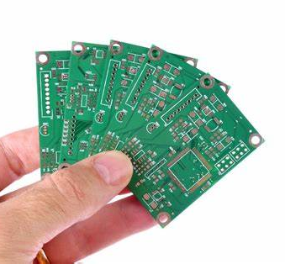
Content
Introduction
Siemens Solution
Our approach
Preliminary results

Slide 3
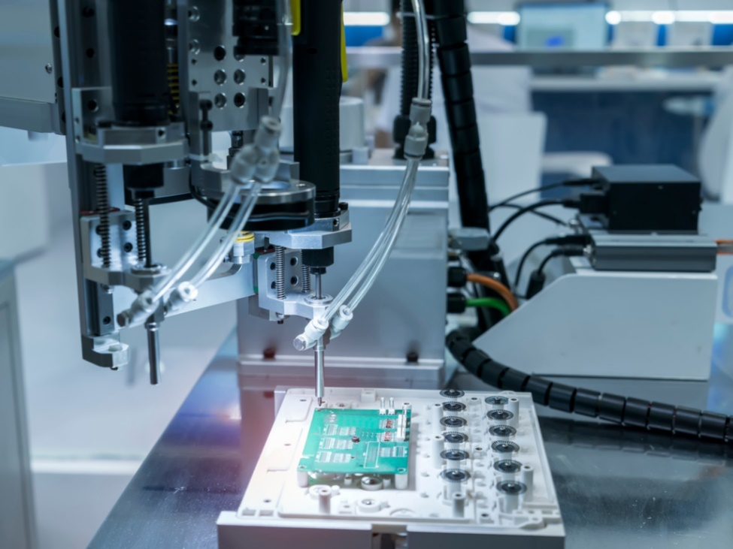
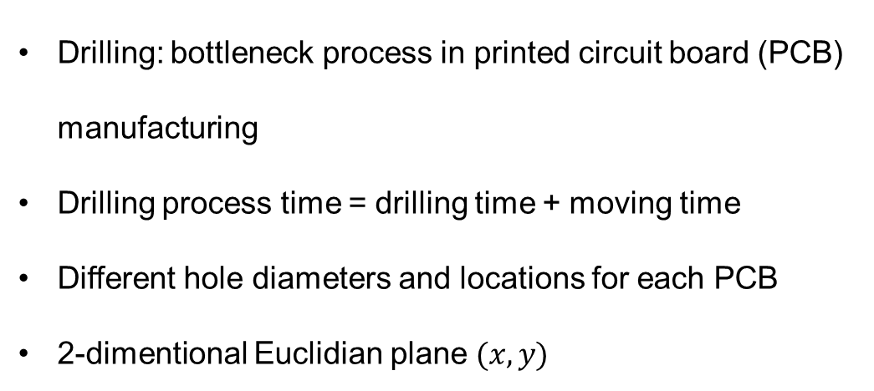
Introduction
Our approach
Siemens Solution
Preliminary Results
Introduction
Drilling: bottleneck process in printed circuit board (PCB) manufacturing
Drilling process time = drilling time + moving time
Different hole diameters and locations for each PCB
2-dimentional Euclidian plane $(x,y)$
Notes:
3

Slide 4
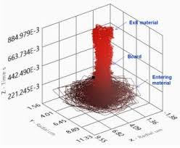
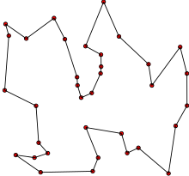
Introduction
Our approach
Siemens Solution
Preliminary Results
Problem definition
Optimization of the production capacity of printed circuit boards (PCBs).
Drilling time: Machine cannot be changed
Moving time: Drilling path can be changed
Provide a solution in less than 5 minutes for any dataset
Notes:
4

Slide 5
Introduction
Our approach
Siemens Solution
Preliminary Results
Problem definition
The x-axis moves 10% slower than the y-axis
Toolbox located at a fixed place
Variable: movement of the drill head
Notes:
5

Slide 6
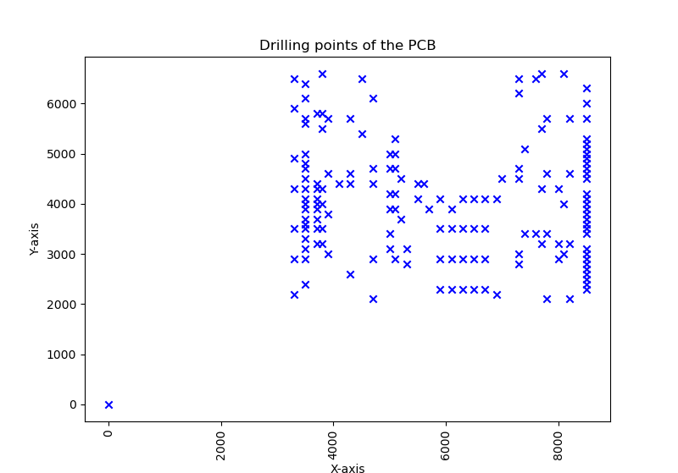
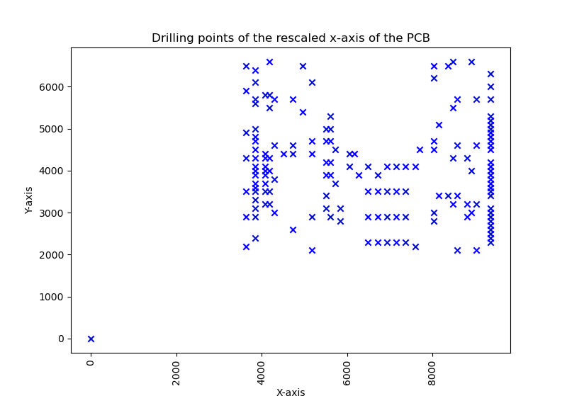
Introduction
Our approach
Siemens Solution
Preliminary Results
Problem Transformation
Optimization of the distance travelled by the drill:
Rescaling of the plane
Total distance define by the sum of Euclidian distance of the going from one point to another
Notes:
6

Slide 7

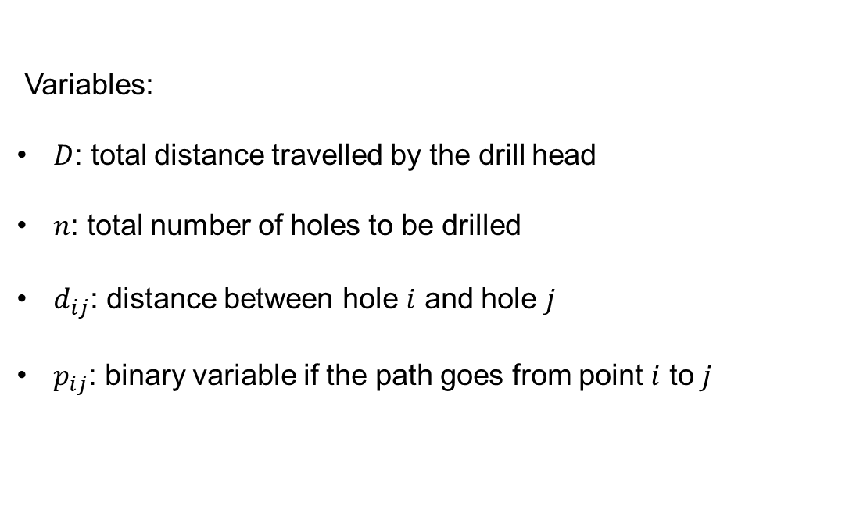
Introduction
Our approach
Siemens Solution
Preliminary Results
Model formulation: Travelling salesman problem (1): Objective function
Variables:
$D$: total distance travelled by the drill head
$n$: total number of holes to be drilled
$d_{ij}$: distance between hole $i$ and hole $j$
$p_{ij}$: binary variable if the path goes from point $i$ to $j$
Notes:
7

Slide 8

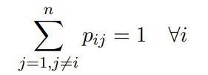
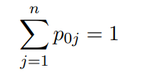

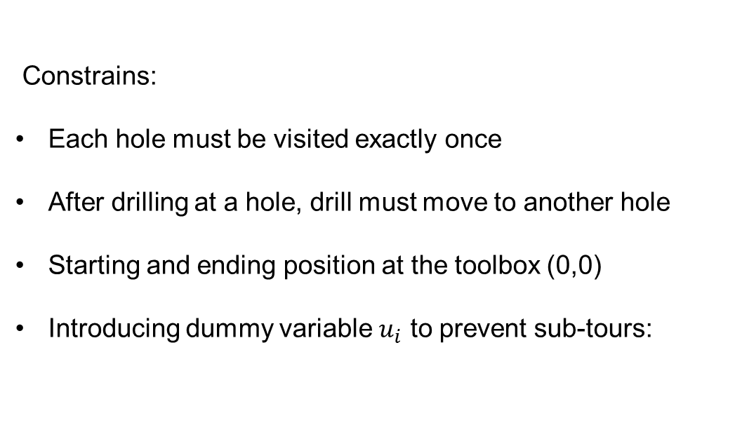
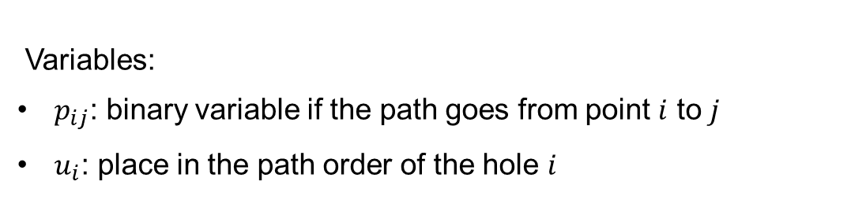
Introduction
Our approach
Siemens Solution
Preliminary Results
Model formulation: Travelling salesman problem (2): Constraint
Variables:
$p_{ij}$: binary variable if the path goes from point $i$ to $j$
$u_{i}$: place in the path order of the hole $i$
Constrains:
Each hole must be visited exactly once
After drilling at a hole, drill must move to another hole
Starting and ending position at the toolbox (0,0)
Introducing dummy variable $u_{i}$ to prevent sub-tours:
Notes:
8

Slide 9
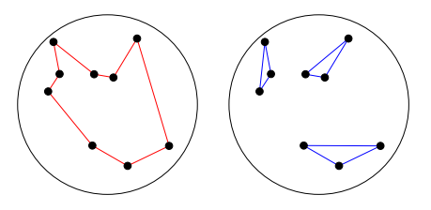
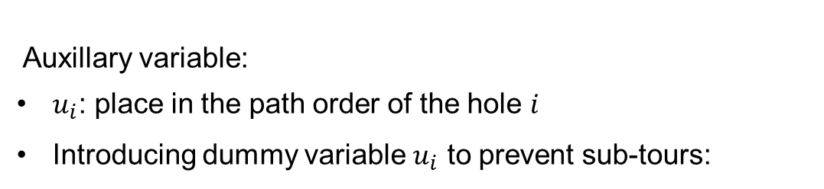
Introduction
Our approach
Siemens Solution
Preliminary Results
Model formulation: Travelling salesman problem (1): Subtours
Auxillary variable:
$u_{i}$: place in the path order of the hole $i$
Introducing dummy variable $u_{i}$ to prevent sub-tours:
Notes:
9

Slide 10
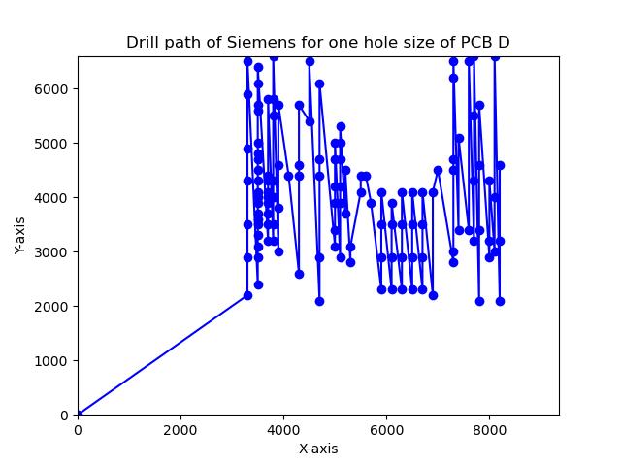
Introduction
Our approach
Siemens solution
Preliminary Results
Example for one hole size of PCB D
Holes drilled in lexicographical order
Total Euclidian Distance:
On re-scaled plane: 142825.1 machine units
Notes:
10

Slide 11
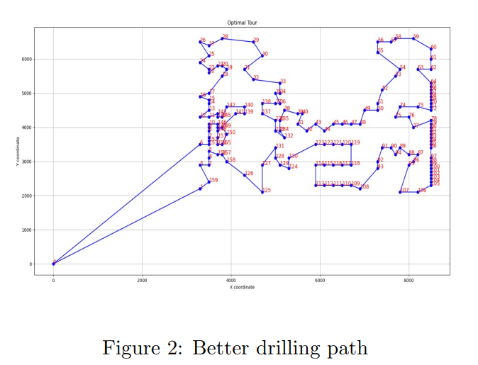
Introduction
Siemens Solution
Our approach
Preliminary Results
Linear optimization solution: an example of a better solution
Total Euclidian Distance:
On re-scaled plane: 53344.687 machine units
Highly optimal solution
Within 4.1619% of true optimum
Costly: power and time
Inefficiency
Notes:
11

Slide 12
Introduction
Siemens Solution
Our approach
Preliminary Results
Solution: investigating heuristics solutions
Trade-off between optimality and time/computation costs
Cost and time efficiency particularly for many holes
Approximation algorithms:
Nearest Neighbour algorithm, Greedy algorithm, etc.
Comparison with the lower bound (optimal solution)
Notes:
12

Slide 13
Questions

