Slide 1
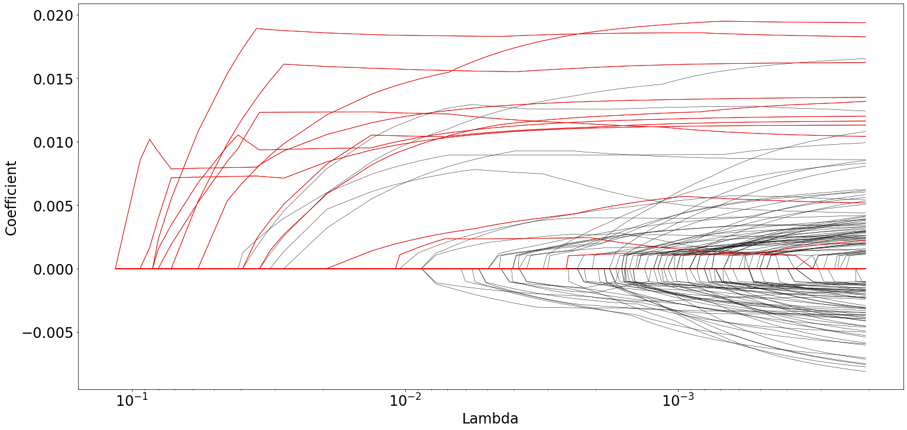
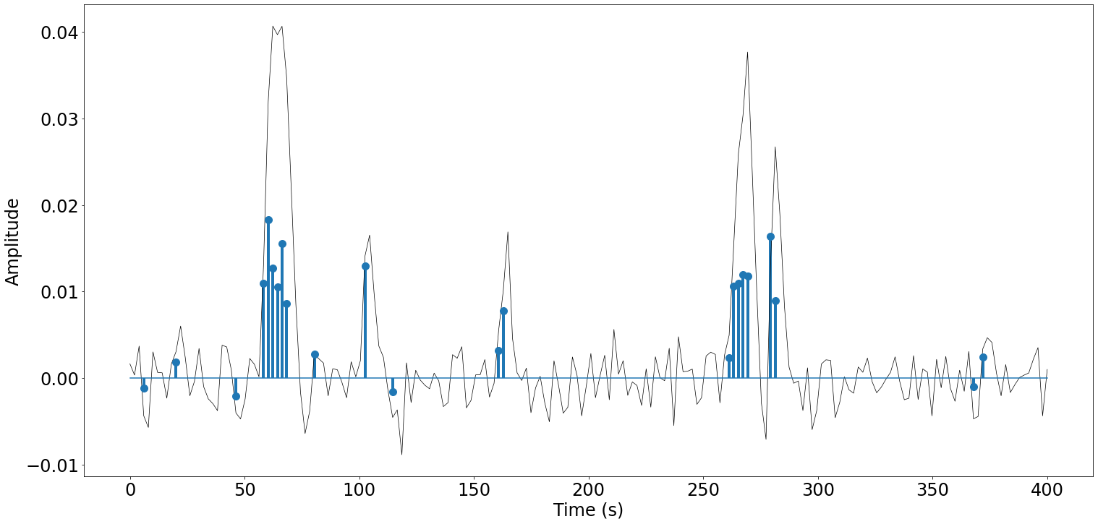
































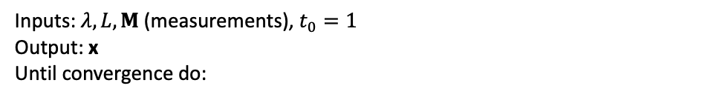


Time
noise
Time
Time
Time
Innovation
Signal
X
Activity-inducing
Signal
X
Expected BOLD Signal
+
Measured fMRI Signal
Estimated Activity Inducing Signal
X
Estimated Innovation
Signal
DECONVOLUTION
$$∆u\left(t\right)$$
$$L$$
$$∆s\left(t\right)$$
$$h\left(t\right)$$
$$x\left(t\right)=h\left(t\right)∗∆s\left(t\right)$$
$$n\left(t\right)$$
$$y\left(t\right)=x\left(t\right)+n\left(t\right)$$
$$∆u\left(n\right)$$
$$L$$
$$∆s\left[n\right]$$
$$h\left[n\right]$$
$$x\left[n\right]=h\left[n\right]∗∆s\left[n\right]$$
$$n\left[n\right]$$
$$y\left[n\right]=x\left[n\right]+n\left[n\right]$$
$$∆\hat{s}\left[n\right]$$
$$D$$
$$∆\hat{u}\left[n\right]$$
PFM
$$∆u=\left[{∆u}_{1},⋯,{∆u}_{N}\right]$$
s=$Lu$
$$∆s=\left[{∆s}_{1},⋯,{∆s}_{N}\right]$$
$$h=\left[h_{1},⋯,h_{L}\right]$$
$$x=H∆s$$
$$n$$
$y=H∆s$ + $n$
$$∆s=\left[{∆s}_{1},⋯,{∆s}_{N}\right]$$
u=D$s$
$$∆u=\left[{∆u}_{1},⋯,{∆u}_{N}\right]$$
TA
$$∆u=\left[{∆u}_{1},⋯,{∆u}_{N}\right]$$
s=$Lu$
$$∆s=DHx$$
$$DH$$
$$x=H∆s$$
$$n$$
$y=x$ + $n$
$$∆s=\left[{∆s}_{1},⋯,{∆s}_{N}\right]$$
u=D$s$
$$∆u=\left[{∆u}_{1},⋯,{∆u}_{N}\right]$$
Least Angle Regression (LARS)
Fast Iterative Shrinkage-Thresholding Algorithm (FISTA)
Start with all coefficients $s$ equal to zero.
Find the predictor $x$ most correlated with $y$.
Increase the coefficient $sj$ in the direction of the sign of its correlation with $y$. Take residuals $r=y−\hat{y}$ along the way. Stop when some other predictor $xk$ has as much correlation with $r$ as $xj$ has.
Increase $(sj , sk)$ in their joint least-squares direction, until some other predictor $xm$ has as much correlation with the residual $r$.
Increase $(sj, sk, sm)$ in their joint least-squares direction, until some other predictor $xn$ has as much correlation with the residual $r$.
Continue until all predictors are in the model.
Inputs: $λ, L, M$ (measurements), $t_{0}=1$
Output: x
Until convergence do:
1
$$x_{k−1}=x_{k}$$
DECONVOLUTION
2
$$z_{k}=f\left(y_{k}, M\right)$$
3
$$x_{k}={prox}_{L,λ,Ω}(z_{k})$$
$$t_{k+1}=\frac{1+\sqrt{1+4t_{k}^{2}}}{2}$$
4
5
$$y_{k+1}=x_{k}+\left(\frac{t_{k}−1}{t_{k+1}}\right)\left(x_{k}{−x}_{k−1}\right)$$

