Slide 1
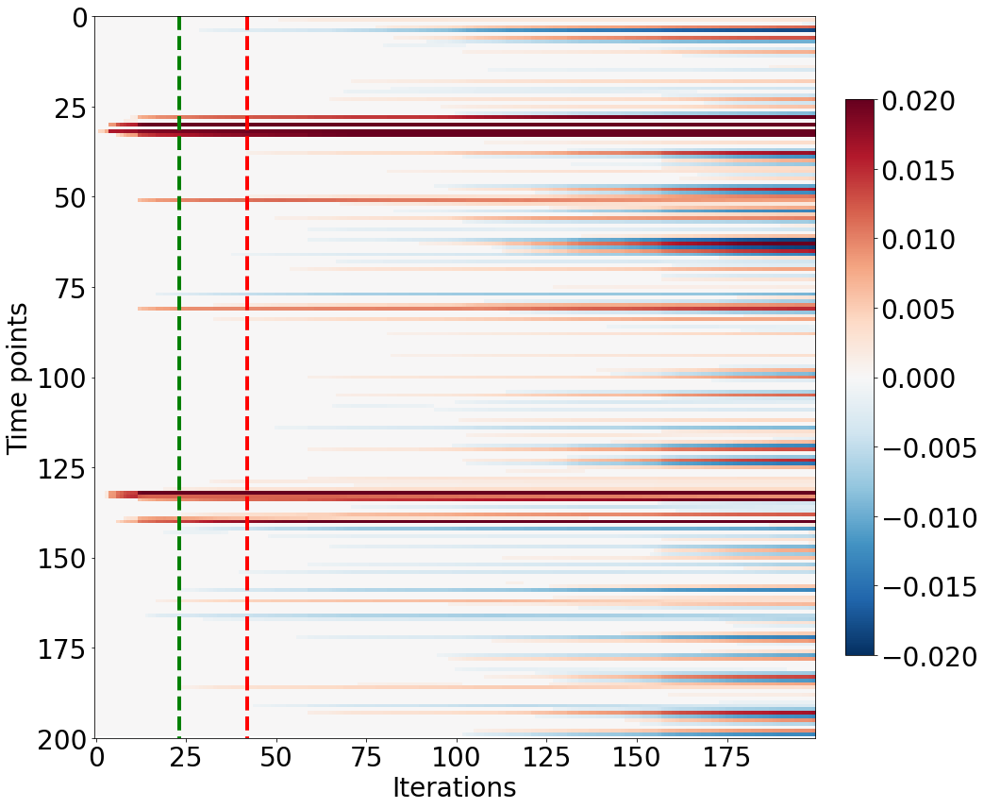
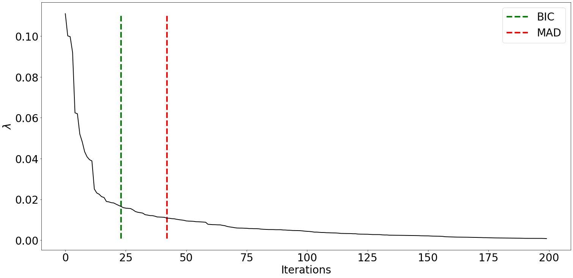
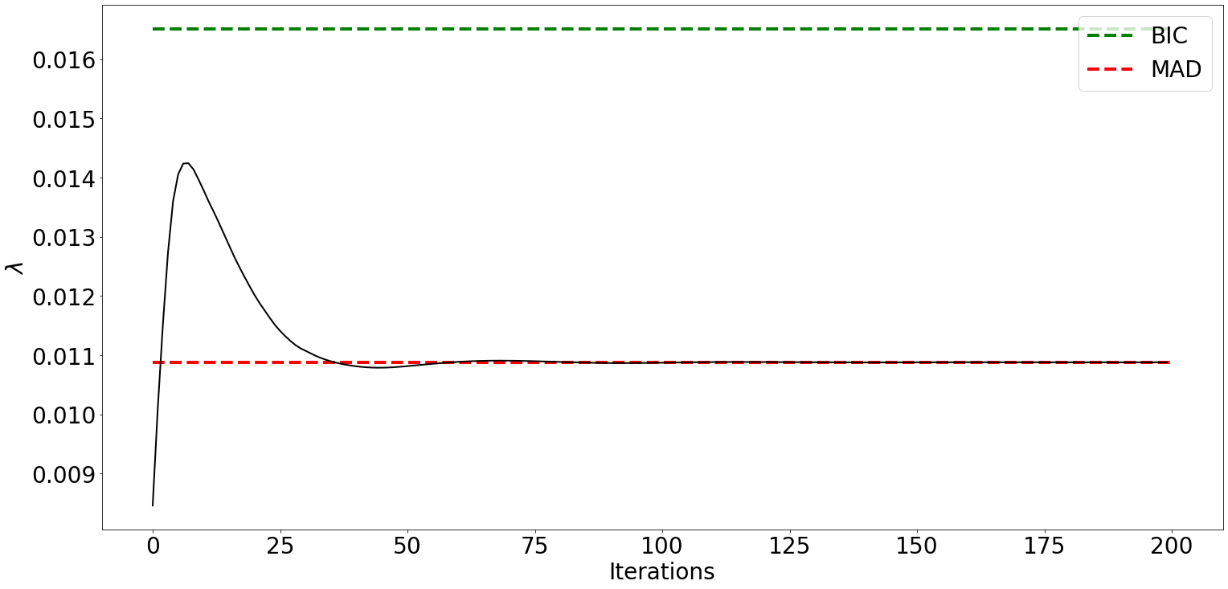




























Time
noise
Time
Time
Time
Innovation
Signal
X
Activity-inducing
Signal
X
Expected BOLD Signal
+
Measured fMRI Signal
DECONVOLUTION: PFM with LARS; TA with FISTA
Estimated Activity Inducing Signal
X
Estimated Innovation
Signal
$$∆u\left(t\right)$$
$$L$$
$$∆s\left(t\right)$$
$$h\left(t\right)$$
$$x\left(t\right)=h\left(t\right)∗∆s\left(t\right)$$
$$n\left(t\right)$$
$$y\left(t\right)=x\left(t\right)+n\left(t\right)$$
$$∆u\left(n\right)$$
$$L$$
$$∆s\left[n\right]$$
$$h\left[n\right]$$
$$x\left[n\right]=h\left[n\right]∗∆s\left[n\right]$$
$$n\left[n\right]$$
$$y\left[n\right]=x\left[n\right]+n\left[n\right]$$
$$∆\hat{s}\left[n\right]$$
$$D$$
$$∆\hat{u}\left[n\right]$$
PFM
$$∆u=\left[{∆u}_{1},⋯,{∆u}_{N}\right]$$
s=$Lu$
$$∆s=\left[{∆s}_{1},⋯,{∆s}_{N}\right]$$
$$h=\left[h_{1},⋯,h_{L}\right]$$
$$x=H∆s$$
$$n$$
$y=H∆s$ + $n$
$$∆s=\left[{∆s}_{1},⋯,{∆s}_{N}\right]$$
u=D$s$
$$∆u=\left[{∆u}_{1},⋯,{∆u}_{N}\right]$$
TA
$$∆u=\left[{∆u}_{1},⋯,{∆u}_{N}\right]$$
s=$Lu$
$$∆s=DHx$$
$$DH$$
$$x=H∆s$$
$$n$$
$y=x$ + $n$
$$∆s=\left[{∆s}_{1},⋯,{∆s}_{N}\right]$$
u=D$s$
$$∆u=\left[{∆u}_{1},⋯,{∆u}_{N}\right]$$
LARS: regularization path
LARS: 𝜆 in each iteration
FISTA: 𝜆 in each iteration
DECONVOLUTION

