Slide 1
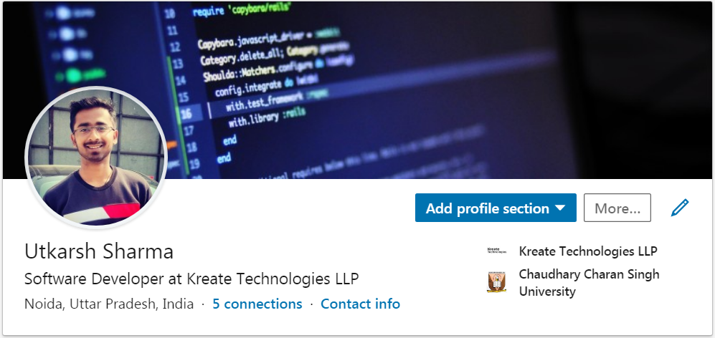



@eshUtkarSHarma Java Class
https://www.linkedin.com/in/eshutkarsharma
https://www.instagram.com/eshutkarsharma
https://www.twitter.com/eshutkarsharma
https://www.facebook.com/eshutkarsharma

Slide 2
Java

Slide 3

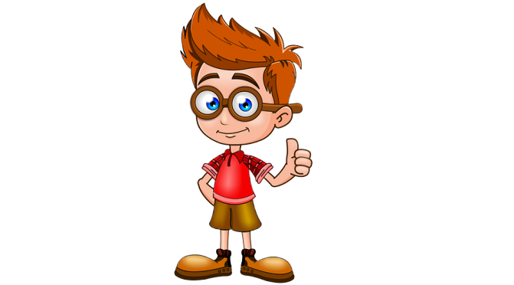

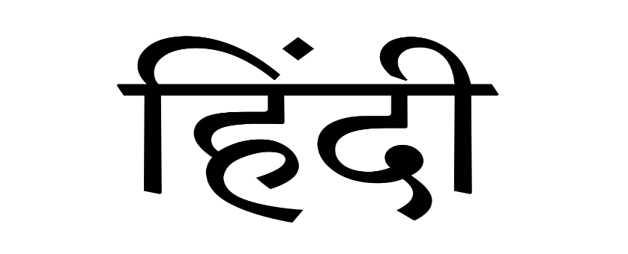
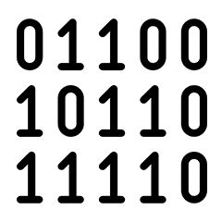

Slide 4

Unary -> 1
Binary -> 2
Ternary -> 3

Slide 5
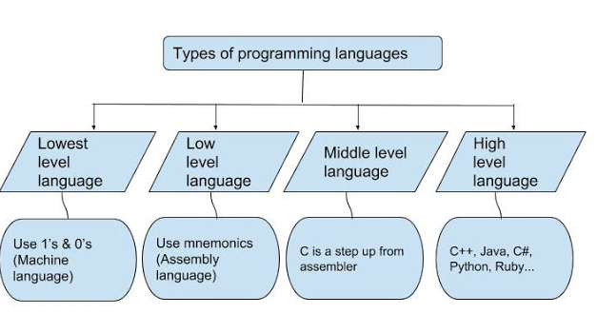

Slide 6
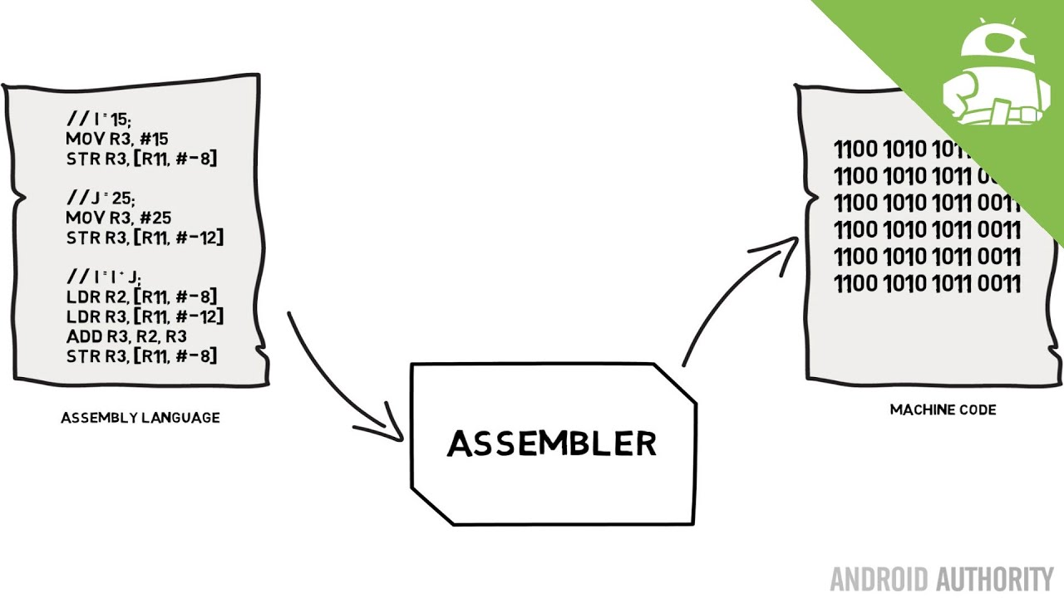

Slide 7
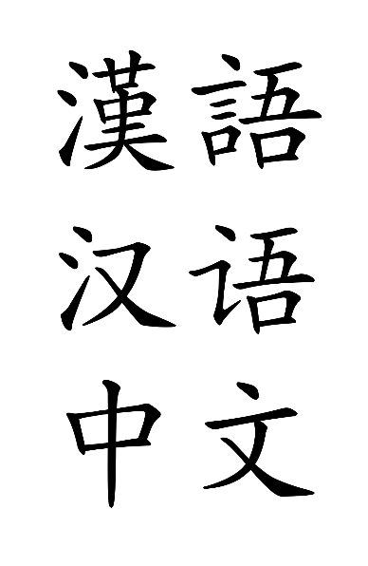

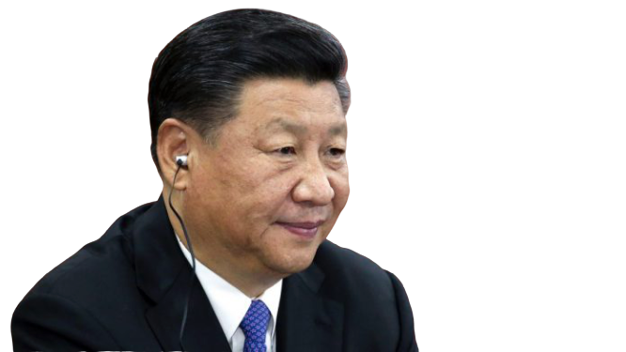
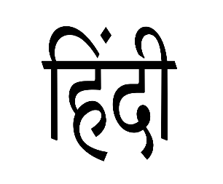
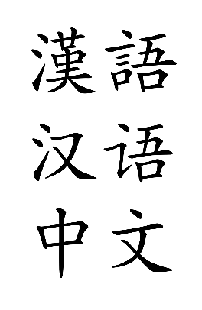
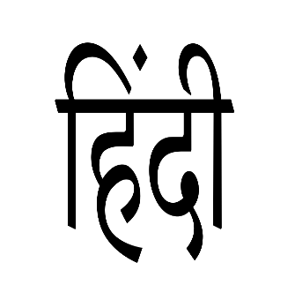
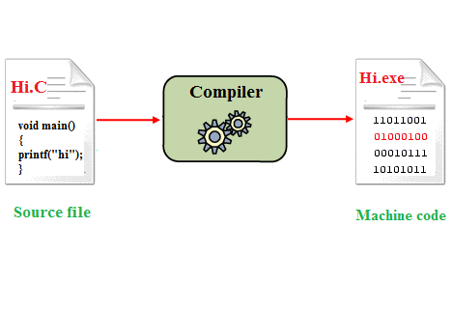

Java

Slide 8
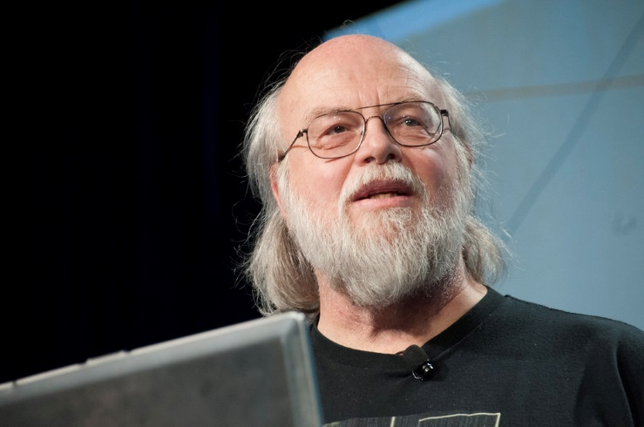
Java History
The principles for creating Java programming were
"Simple, Robust, Portable, Platform-independent, Secured, High Performance, Multithreaded, Object-Oriented, Interpreted and Dynamic“
The history of java starts with Green Team. Java team members (also known as Green Team)
James Gosling, Mike Sheridan, and Patrick Naughton initiated the Java language project in June 1991. The small team of sun engineers called Green Team.
James Gosling
Firstly, it called "Greentalk" by James Gosling, extension was .gt
After that, it was called Oak and was developed as a part of the Green project.
In 1995, Oak was renamed as "Java" because it was already a trademark by Oak Technologies.

Slide 9
Thank You !

