Slide 1
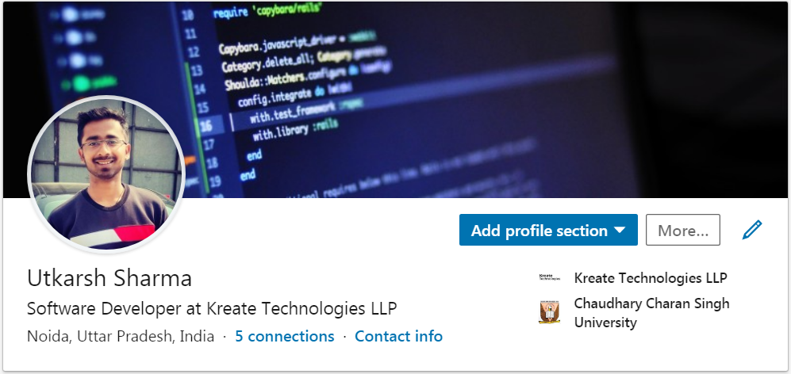



@eshUtkarSHarma Java Class
https://www.linkedin.com/in/eshutkarsharma
https://www.instagram.com/eshutkarsharma
https://www.twitter.com/eshutkarsharma
https://www.facebook.com/eshutkarsharma

Slide 2
Java

Slide 3

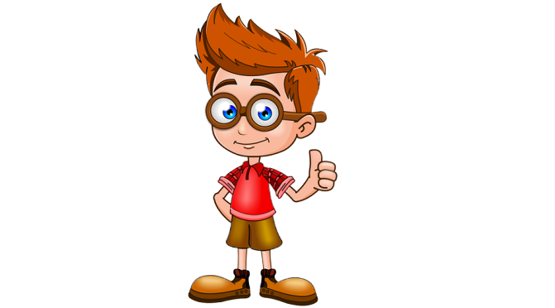

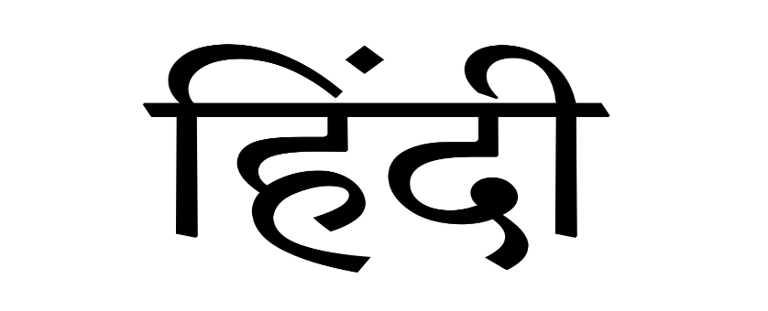
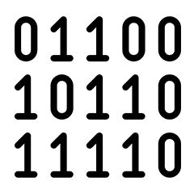

Slide 4
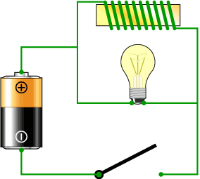
Unary -> 1
Binary -> 2
Ternary -> 3

Slide 5
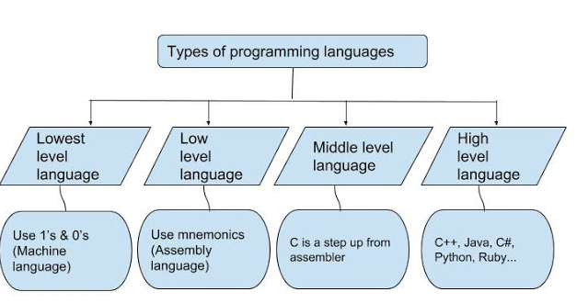

Slide 6
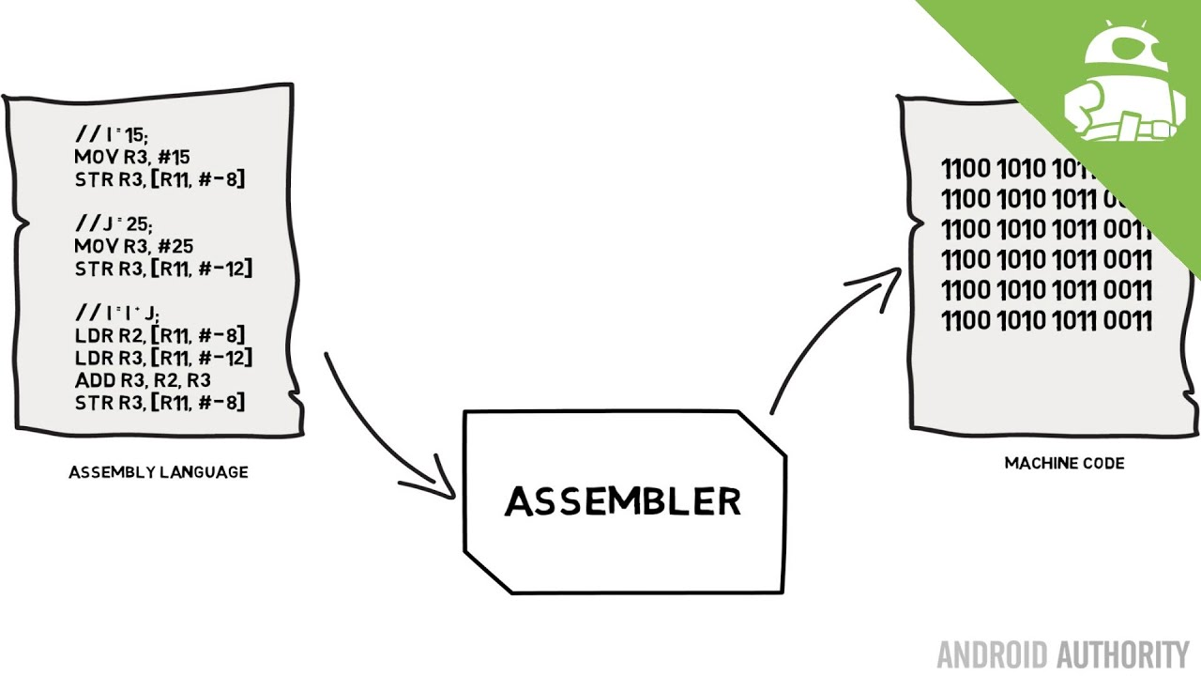

Slide 7
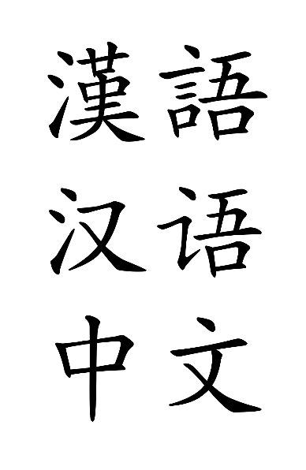
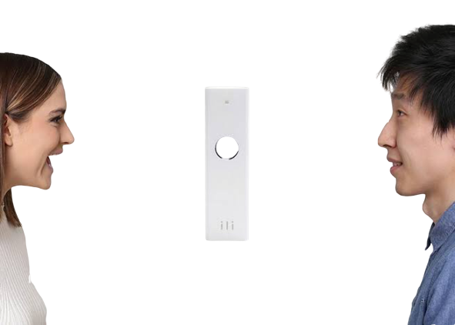
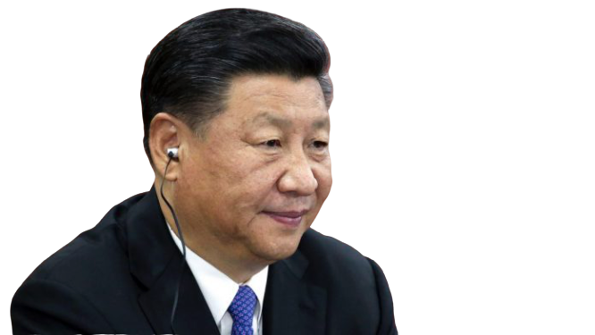
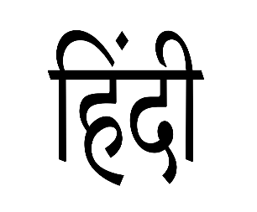
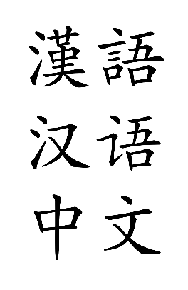
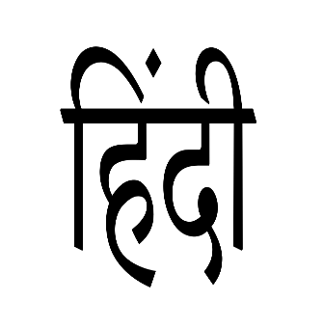
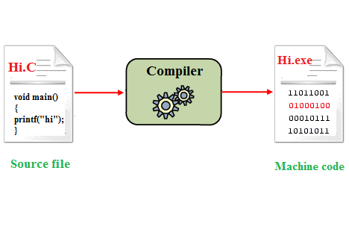

Java

Slide 8
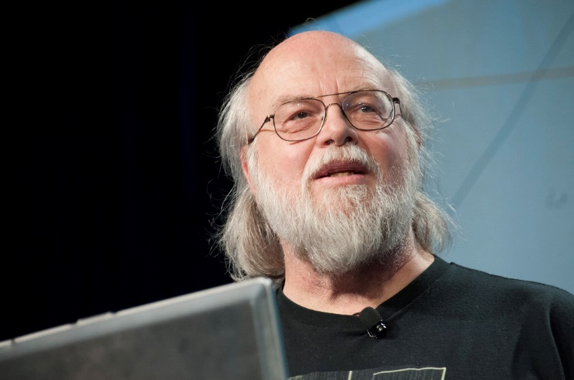
Java History
The principles for creating Java programming were
"Simple, Robust, Portable, Platform-independent, Secured, High Performance, Multithreaded, Object-Oriented, Interpreted and Dynamic“
The history of java starts with Green Team. Java team members (also known as Green Team)
James Gosling, Mike Sheridan, and Patrick Naughton initiated the Java language project in June 1991. The small team of sun engineers called Green Team.
James Gosling
Firstly, it called "Greentalk" by James Gosling, extension was .gt
After that, it was called Oak and was developed as a part of the Green project.
In 1995, Oak was renamed as "Java" because it was already a trademark by Oak Technologies.

Slide 9


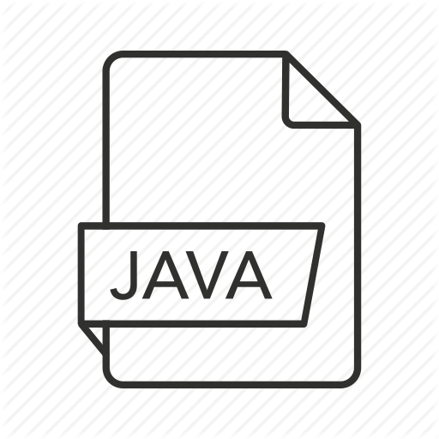
Data.pdf
Data.mkv
filename.java

Slide 10

Execution Process of Java
Java Source Code
Compiler
Java Byte Code
Java
Virtual
Machine
Source file .java extension
Byte Code .class extension
Editor
Java Compiler (javac)
Java Virtual Machine (java)
JDK

Slide 11
Hello Java
Source file Code.java
public class Code{
public static void main(String [ ]args){
System.out.print(“Hello Java”);
}
}
Source Code
Compiler
Java Byte Code
Java
Virtual
Machine
Byte Code.class extension

Slide 12
Why to study Java Token
English:-
Alphabet
Word
Sentence
Paragraph
Alphabet a-z A-Z
My name is Utkarsh.
------------
------------
------------
------------
Java:-
Java Character Set
Token
Statement
Program
Alphabet a-z A-Z
Digit 0-9
Special Symbol
System.out.print(“Hello”);

Slide 13
Java Token
A token is the smallest element of a program that is meaningful to the compiler.
Tokens supported in Java include keywords, Identifiers, constants, special symbols, operator
public class Code {
public static void main(String [ ]args) {
System.out.print(“Hello Java”);
}
}

Slide 14
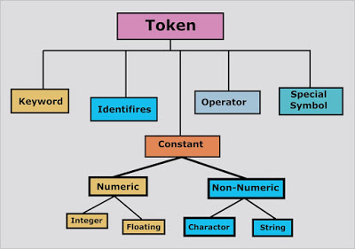

Slide 15
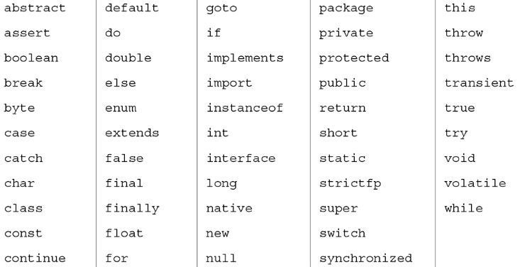
My name is Utkarsh
Keywords
54 keywords
Pre Known To Compiler
Reserve Words

Slide 16
All identifier names must begin with a letter of the alphabet, an underscore, or ( _ )?
After the first initial letter,
identifier names may also contain letters and the digits 0 to 9 or underscore.
No spaces or special characters are allowed.
You cannot use a java keyword (reserved word) for a identifier name

Slide 17
Java Naming Conventions
Variable
Method
Object
Class
Constructor
Interface
Constant
Package
xyz

Slide 18
student data
Class
Object / Variable (Noun)
xyz
studentData
Xyz
StudentData
Method
Constructor
xyz()
studentData()
Xyz()
StudentData()
Constant
Interface (adjective)
XYZ
STUDENT_DATA
Xyzable
Runnable, Remote, ActionListener
Package
xyz
studentdata

Slide 19
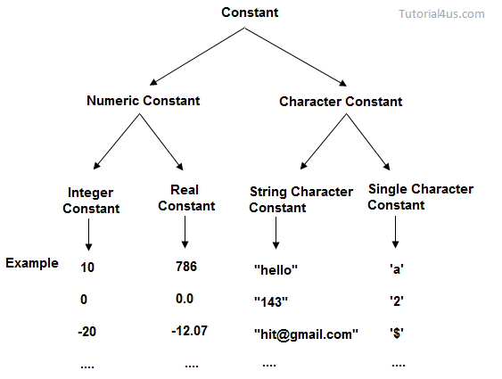

Slide 20
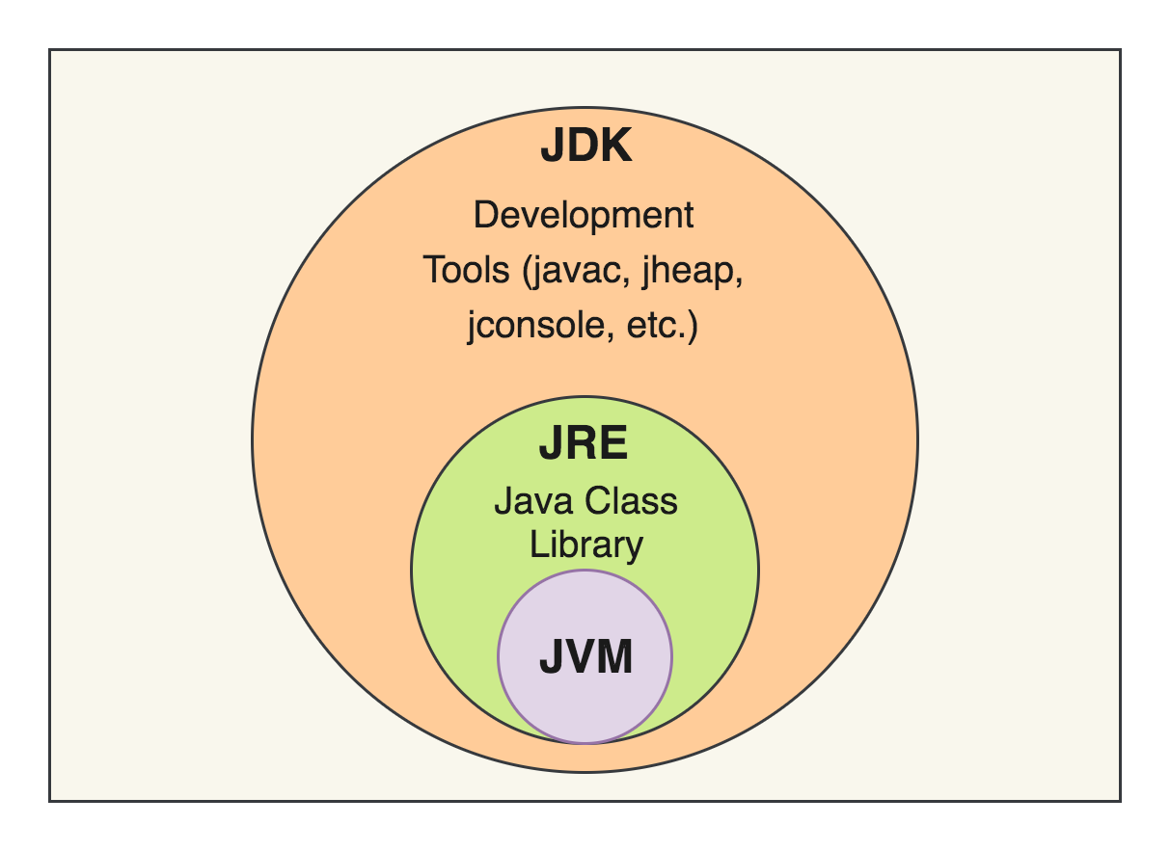
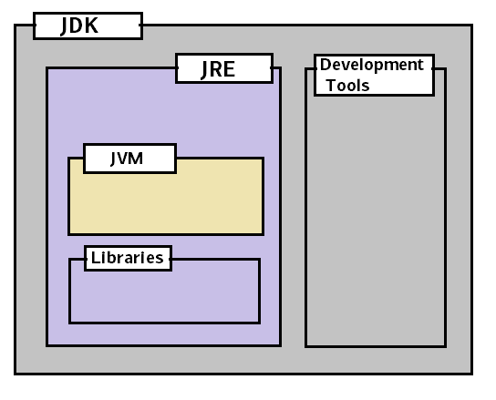

Slide 21
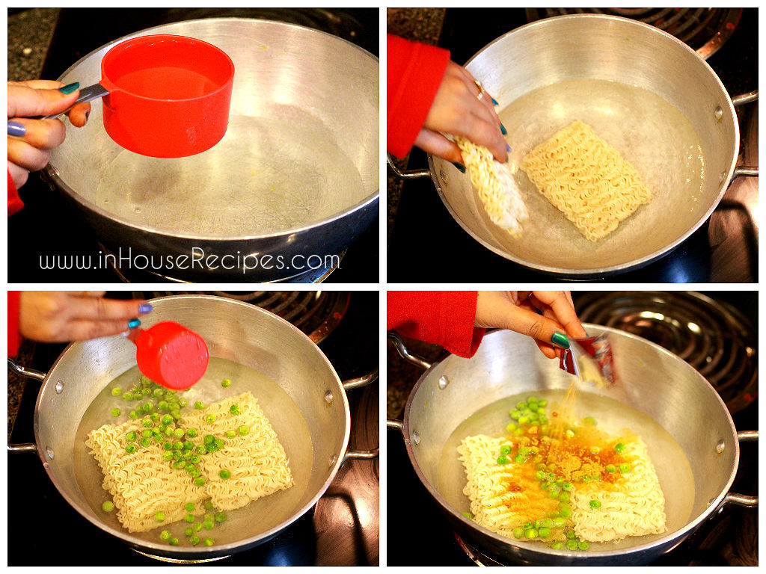
--------------------------------;
--------------;
---------------------------;
-------------------------;
-----------------------------;
--------------------------------;
-----------------------------;
--------------------------------;

Slide 22
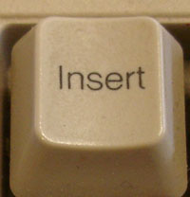
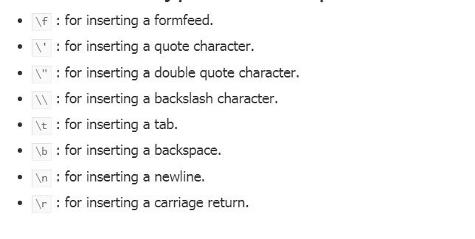
Escape characters

Slide 23
Hello
How
are
You
Hello\\\n\n\a
\n\thi
\n
\t \t\\b”hello”

Slide 24
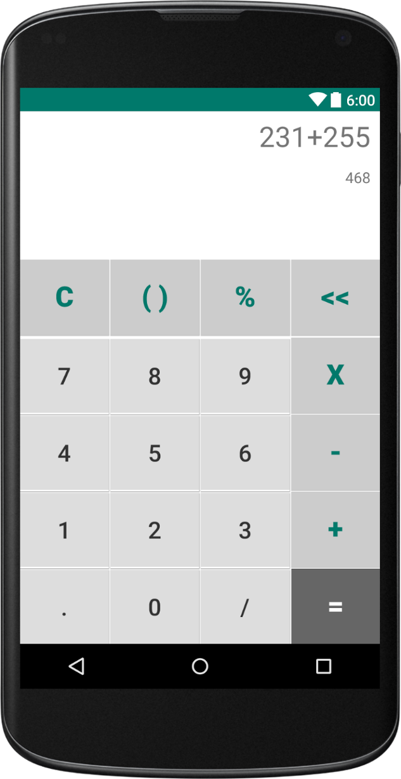
56-6
50
Hello-hi
Input
Output
Data
Processed Data
Process

Slide 25
Data Type
1. Primitive data types
Data Type Default Value Default size
void ---- ----
boolean false 1 bit
char '\u0000' 2 byte
byte 0 1 byte
short 0 2 byte
int 0 4 byte
long 0L 8 byte
float 0.0f 4 byte
double 0.0d 8 byte
integer
floating point
2. Non-primitive data types
non-primitive data types include Classes, Interfaces, and Arrays

Slide 26
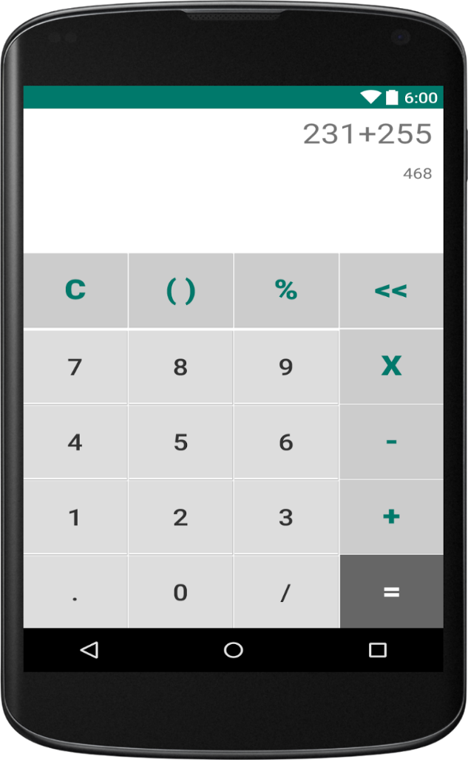
Input
Output
Data
Processed Data
Memory / Storage device

Slide 27
x
Memory / Storage device
4 bytes
int
x
int x;
x = 20;
Variable is a name given to memory allocation in which we can store the data.
And value of the variable can be changed during the program execution.

Slide 28
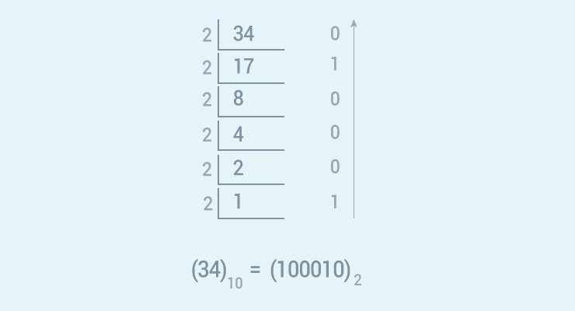

Slide 29
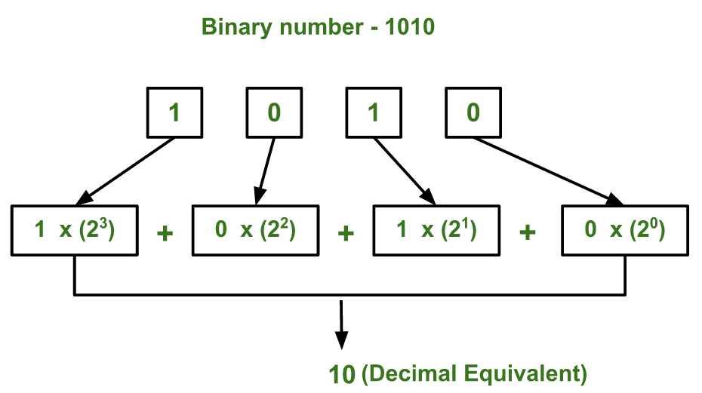

Slide 30
Memory
bit

Slide 31
byte
byte xyz;
xyz
-(2 pow 7) to +(2 pow 7) -1
short
short abc;
abc
-(2 pow 15) to +(2 pow 15) -1
int x;
int
x
-(2 pow 31) to +(2 pow 31) -1
int long;
long
a
-(2 pow 63) to +(2 pow 63) -1

Slide 33
0
0
0
0
1
0
0
0
0
0
0
1
1
0
0
1
0
0
1
0
1
0
1
0
0
0
1
1
1
0
1
1
0
1
0
0
1
1
0
0
0
1
0
1
1
1
0
1
0
1
1
0
1
1
1
0
0
1
1
1
1
1
1
1

Slide 34
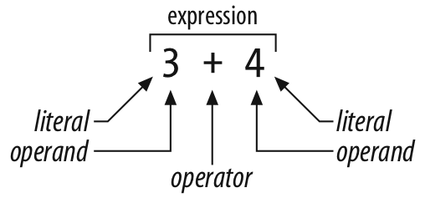
Operators

Slide 35
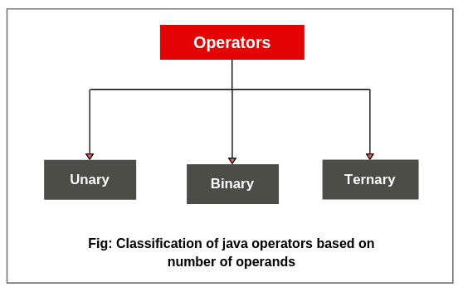
Operators
Arithmetic Operators
Assignment Operator
Relational Operators
Logical Operators
Condition Operator
Bitwise Operators
Miscellaneous operators
Based on Operation

Slide 36
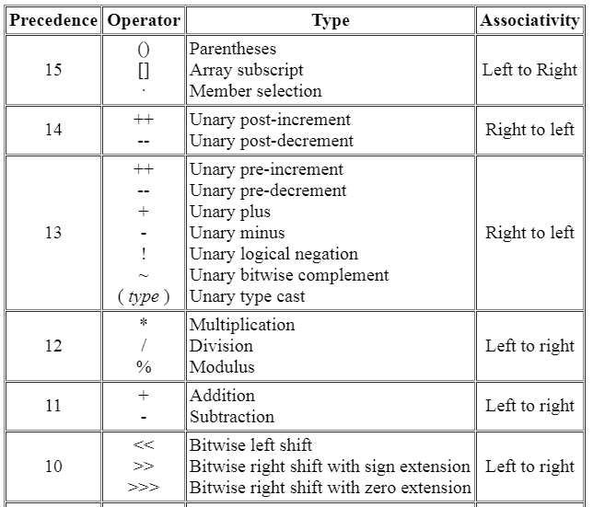
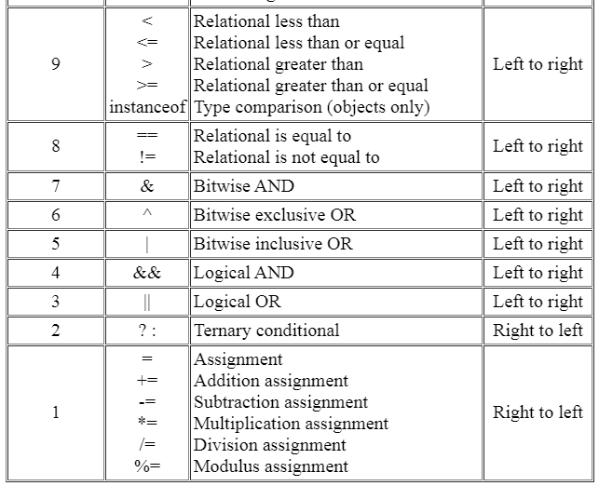

Slide 37
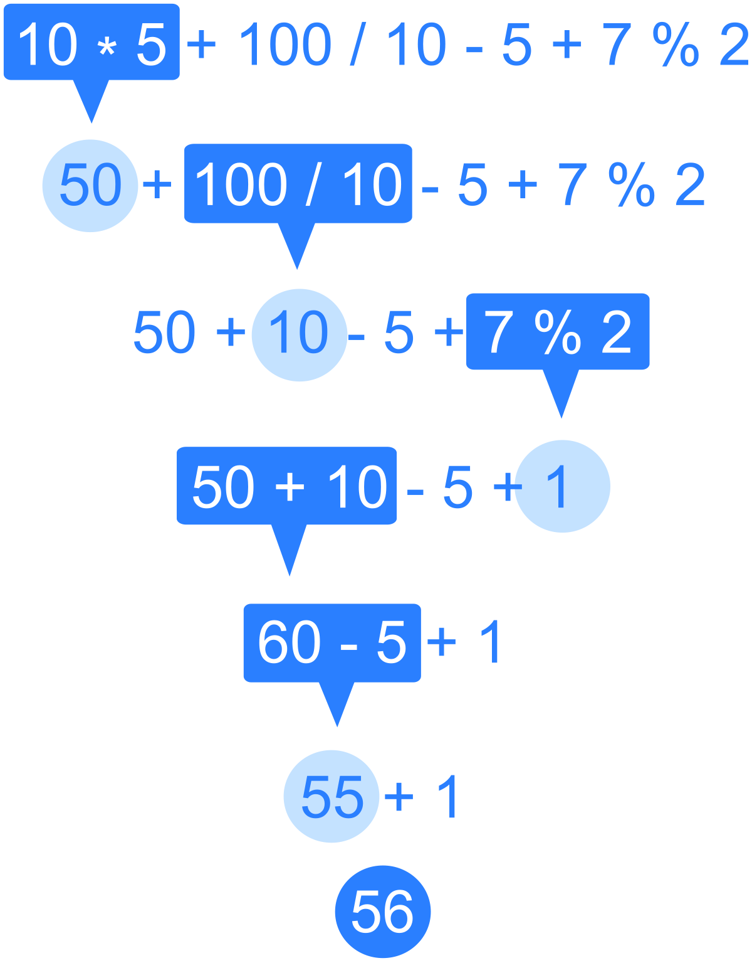

Slide 38
4 / 4 % 2 + 3 – 5 + 7 % 1 % 8 – 0 * 3 % 4
1% 2 + 3 – 5 + 7 % 1 % 8 – 0 * 3 % 4
1 + 3 – 5 + 7 % 1 % 8 – 0 * 3 % 4
1 + 3 – 5 + 0 – 0 * 3 % 4
1 + 3 – 5 + 0 – 0 % 4
1 + 3 – 5 + 0 – 0
4 – 5 + 0 – 0
-1 + 0 – 0
-1-0
-1

Slide 39
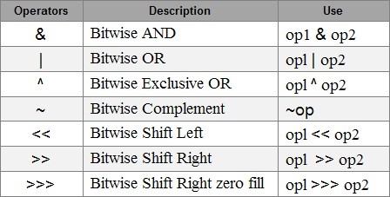

Slide 40
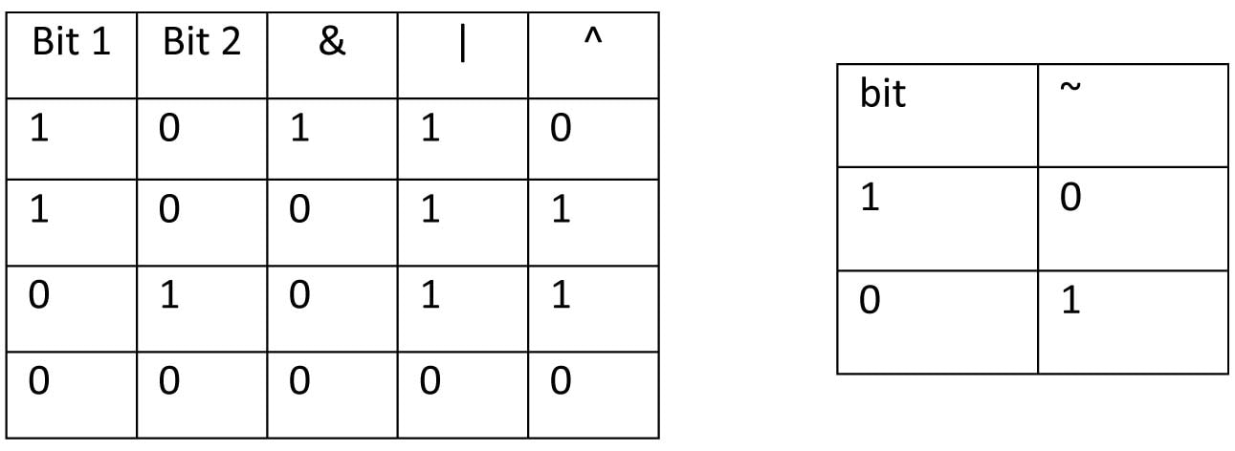

Slide 41
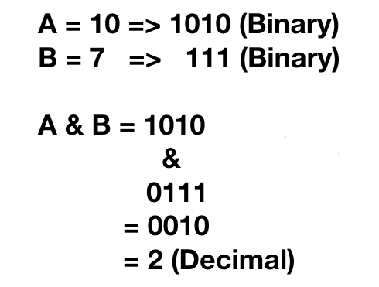

Slide 42
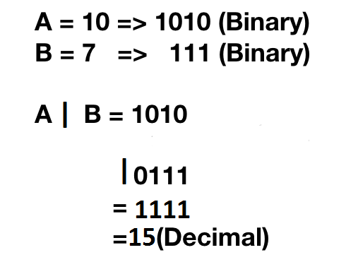

Slide 43
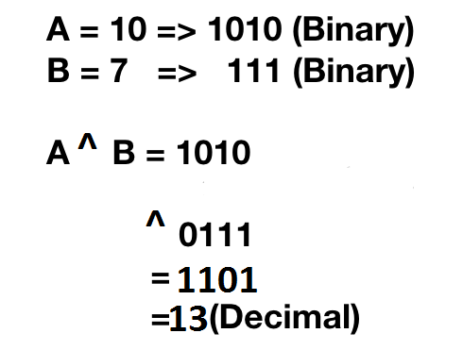

Slide 44
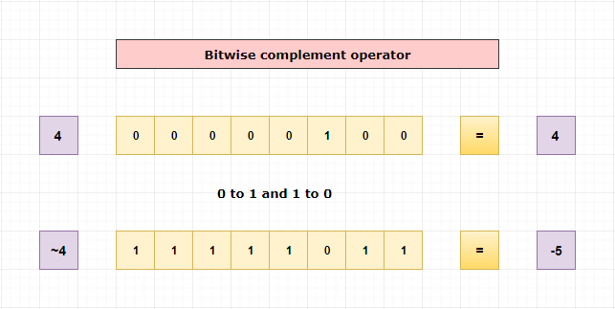

Slide 45
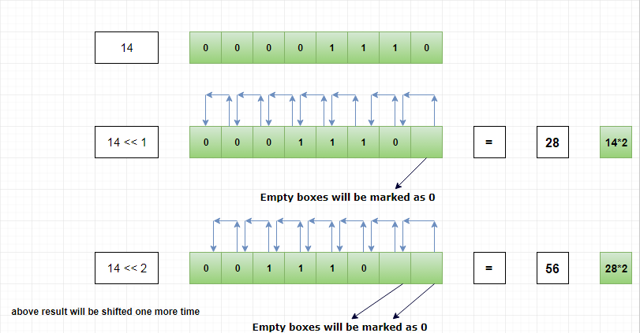

Slide 46
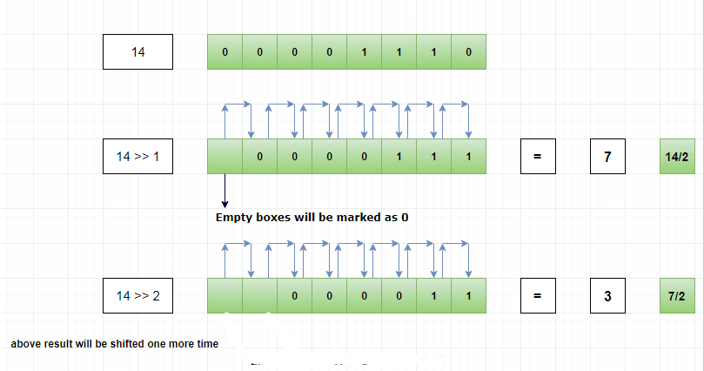

Slide 47
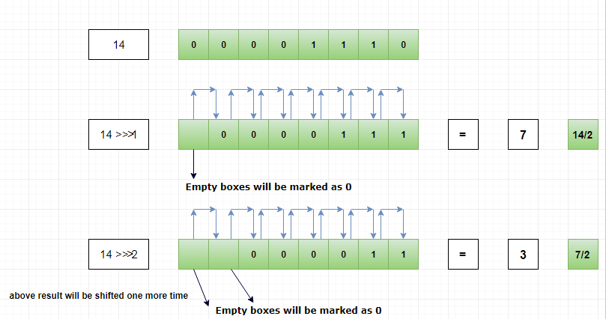

Slide 49
Java support Unicode System -> 0 to 65,536 (unsigned)
The \u0000 is the lowest range of the Unicode system
1100001
0
0
0
0
0
0
0
0
0
1
1
0
0
0
0
1

Slide 50
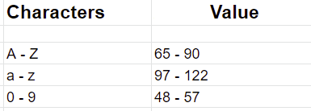

Slide 51
Logical Operator
! -> not
&& -> and
|| -> or
true false
!true -> false
!false -> true
true&&true -> true
true&&false ->false
false&&true -> false
false&&false -> false
true||true -> true
true||false ->true
false||true -> true
false||false -> false

Slide 52
Relation Operator
<
>
<=
>=
==
!=
7<8
true
8<7
false
7<=8
true
8<=7
false
8<=8
true
10==10
true
10==11
false
10!=10
false
10!=11
true

Slide 53
Statement
Simple Compound

Slide 54
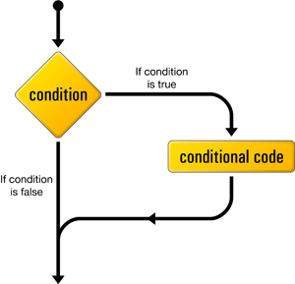

Slide 55
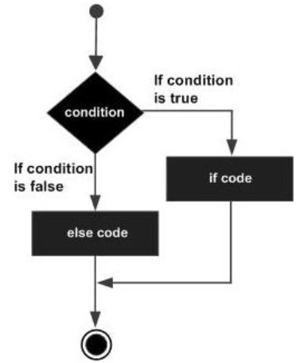

Slide 56
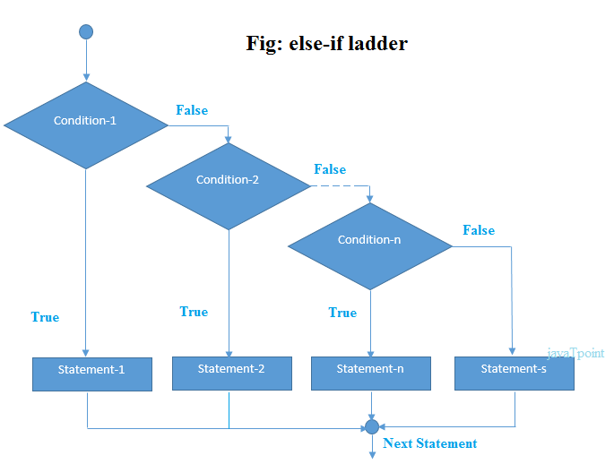

Slide 57
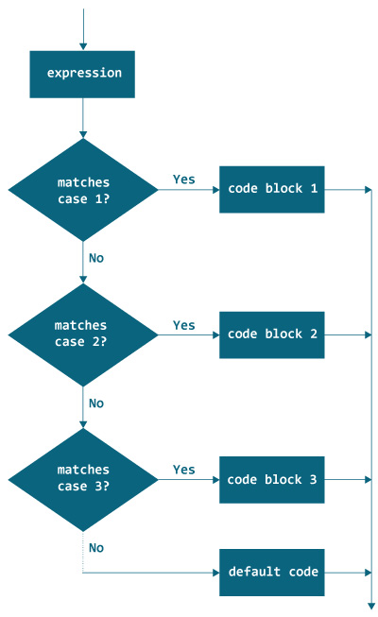

Slide 58
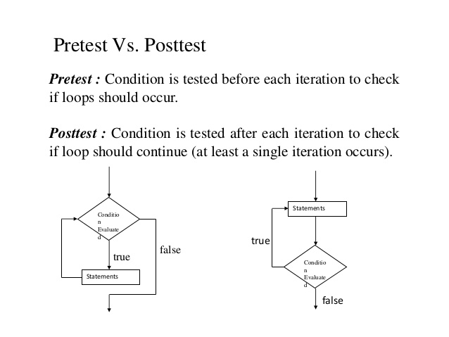

Slide 59
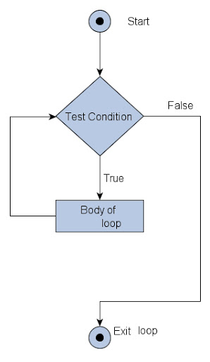

Slide 60
Thank You !

