Slide 1

IS MY AI MODEL A FRAUD OR CAN WE TRULY PREDICT FRAUDULENT TRANSACTIONS?
CIDALIA EUSEBIO
Neural Networks: Assignment 10

Slide 2

AGENDA
Problem vs Solution Get & Explore data Prepare data
AI models: logistic regression & Neural Networks

Slide 3

ORGANIZATIONS EXPERIENCED FRAUD IN THE PAST 24 MONTHS.
47%
" GLOBAL ECONOMIC CRIME AND FRAUD SURVEY 2020" BY PWC

Slide 4

COULD WE PREDICT FRAUD TRANSACTIONS?
TIME TO TAKE ACTION
1.BASIC DESCRIPTIVE STATISTICS
2.LOGISTIC REGRESSION & NEURAL
NETWORKS

Slide 5

EXTRACT & EXPLORE

Slide 6
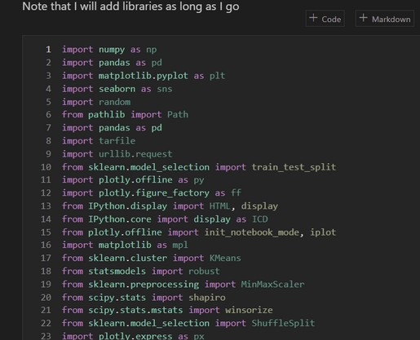
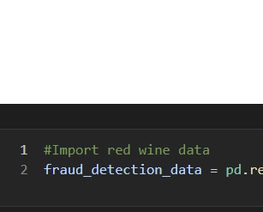
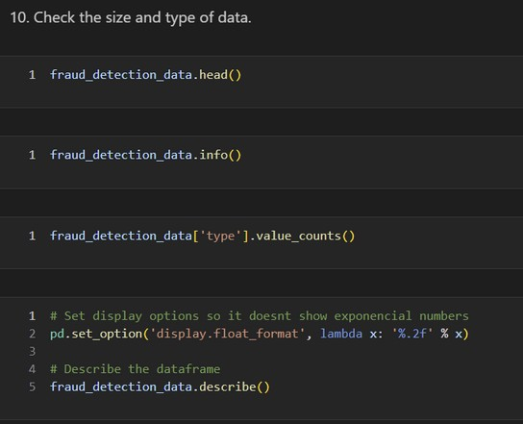
IMPORT LIBRARIES
GET DATA
Extract and explore
CHECK SIZE AND TYPE OF DATA

Slide 7
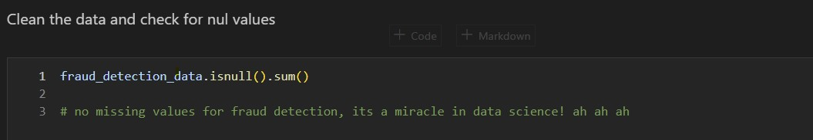
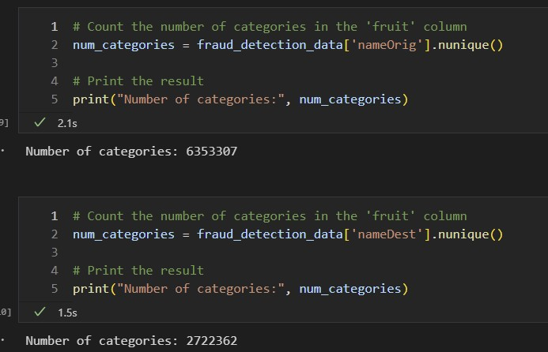
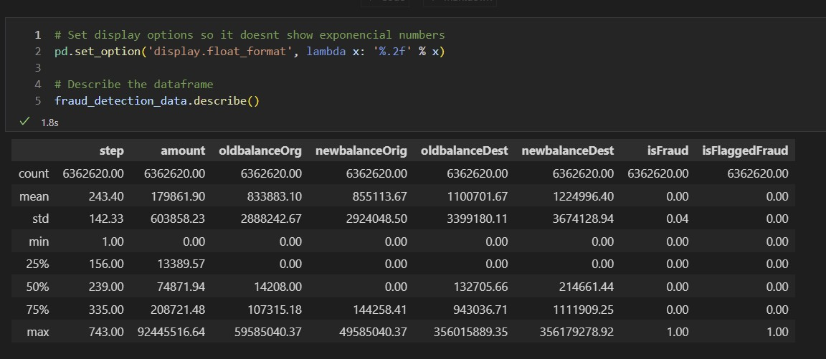
NO NULL VALUES
TOO MANY CATEGORIES!
Extract and explore
DISABLE EXPONENTIAL NUMBERS

Slide 8
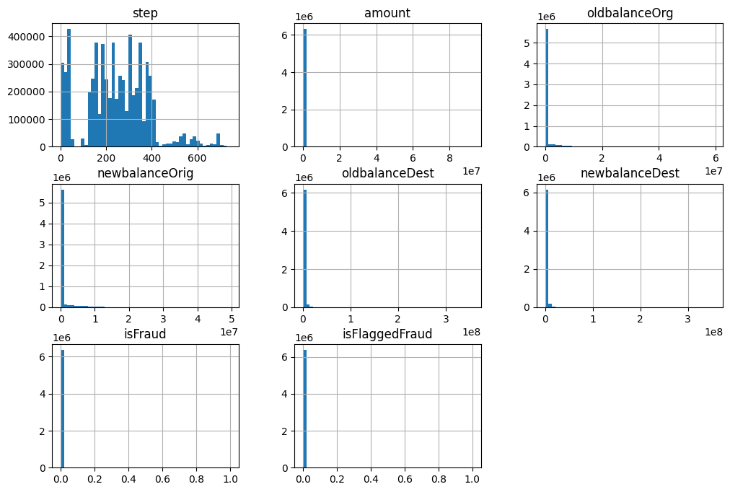
DESCRIPTIVE STATISTICS WAS CHALLENGING
TERRIBLE INSIGHTS!
Tried other types of libraries
without success.

Slide 9
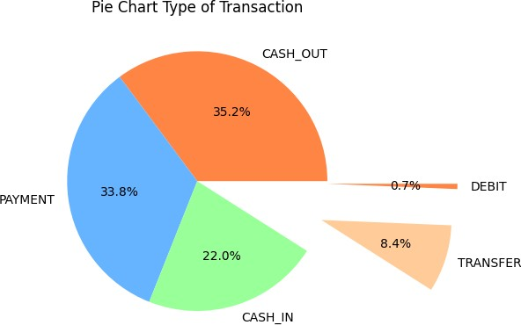
Cash out is the most common transaction

Slide 10
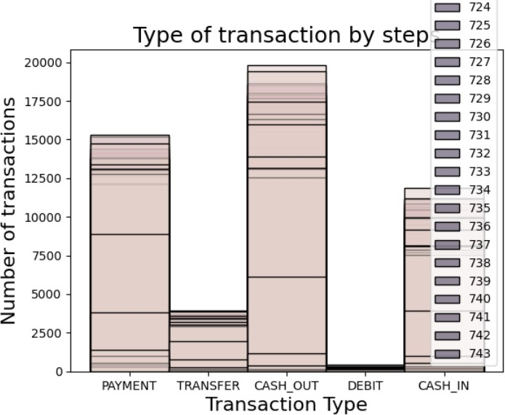
I should have created categories for steps

Slide 11
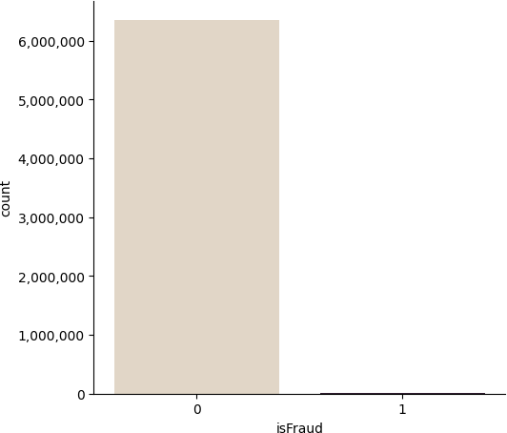
Trouble continues: data is not proportional

Slide 12
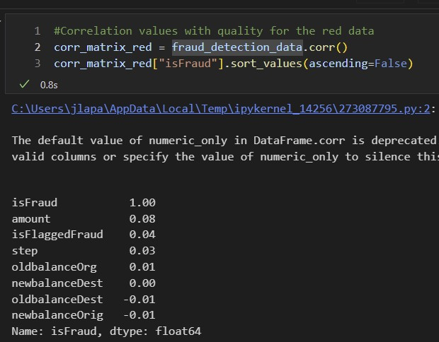
Correlations? Good luck

Slide 13
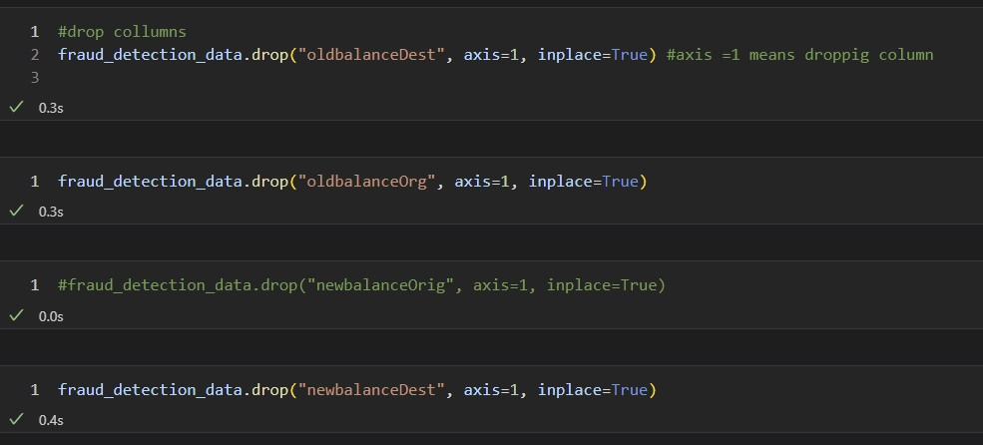
IS THEIR ANY VARIABLE THAT COULD HELP US PREDICT?
newbalanceDest seemed to be always 0
on fraud transactions

Slide 14

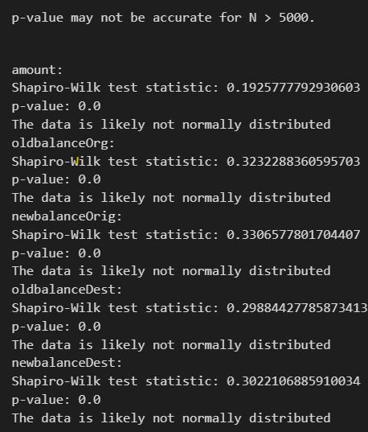
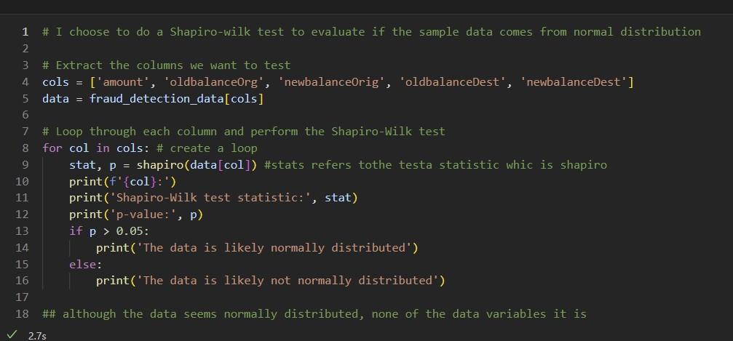
CAN I UNDERSTAND MY DATA?
Item 5 Item 1
20% 20%
Item 4 Item 2
20% 20%
Item 3
20%
Data is not normally distributed

Slide 15
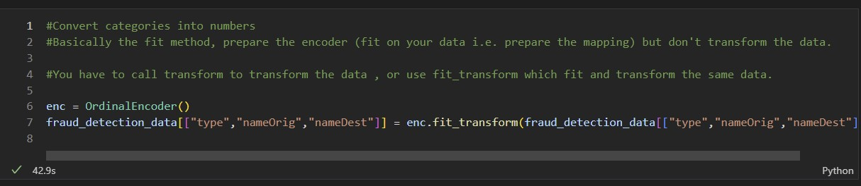
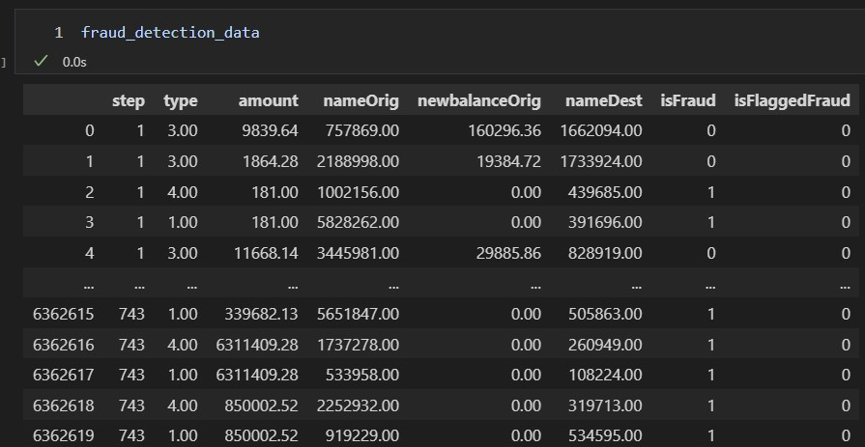
ORDINAL ENCODING FOR CONVERTION OF CATEGORICAL VARIABLES

Slide 16
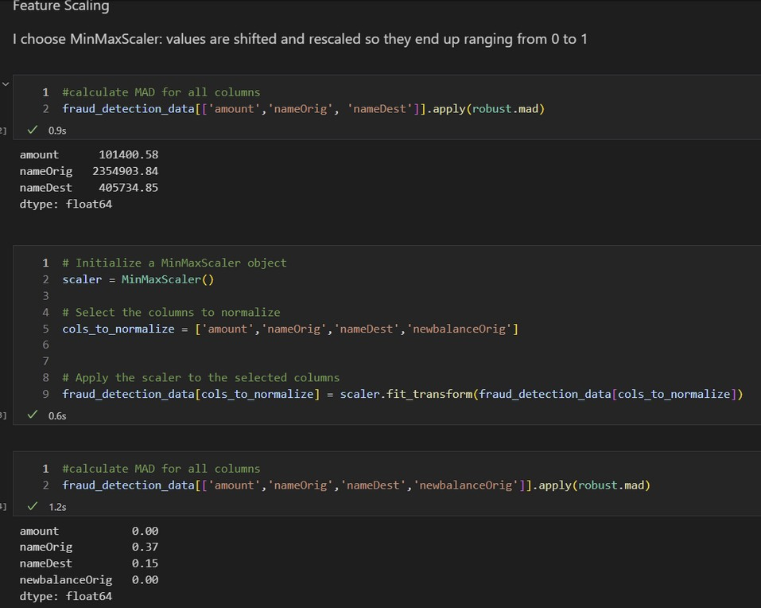
FEATURE SCALING
DO WE NEED TO NORMALIZE DATA WHICH WAS ENCODED BEFORE?

Slide 17
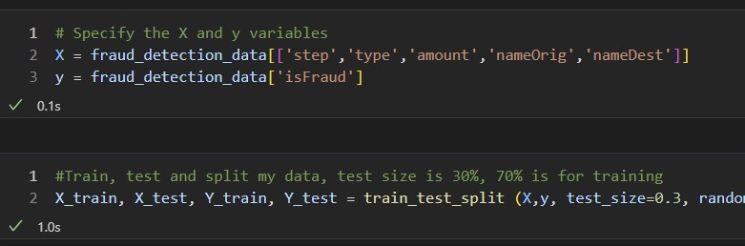
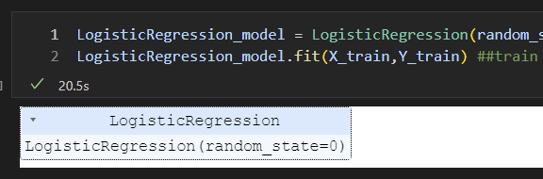
Logistic Regression
_{TERRIB}TR_{L}A_{L}IN AN_{E}D TEST
VARIABLES
FANTASTIC RESULTS!

Slide 18
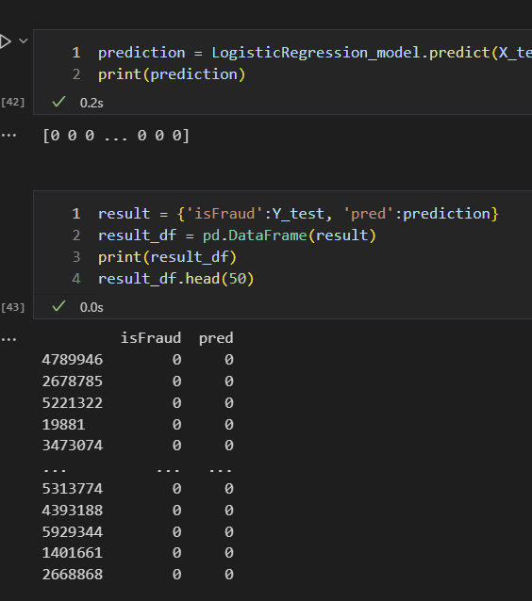
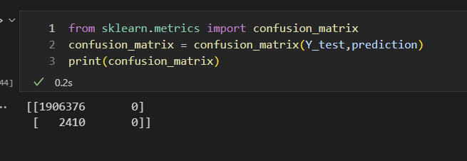
Logistic Regression
_{TERRIB}TR_{L}A_{L}IN AN_{E}D TEST
VARIABLES
Not fantastic… results are.. Well Terrible
FANTASTIC
RESULTS!

Slide 19
NEURAL NETWORKS

Slide 20
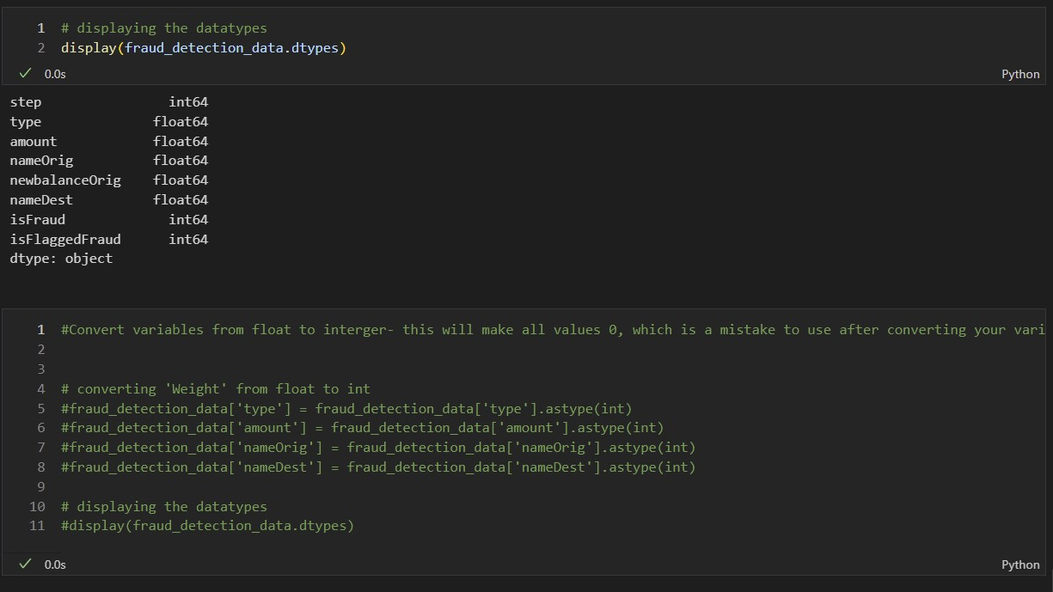
INITIALLY I CONVERTED
HAD TO GO BACK AND UNDO SOME STEPS
AGAIN... DON'T ASK ME WHY

Slide 21
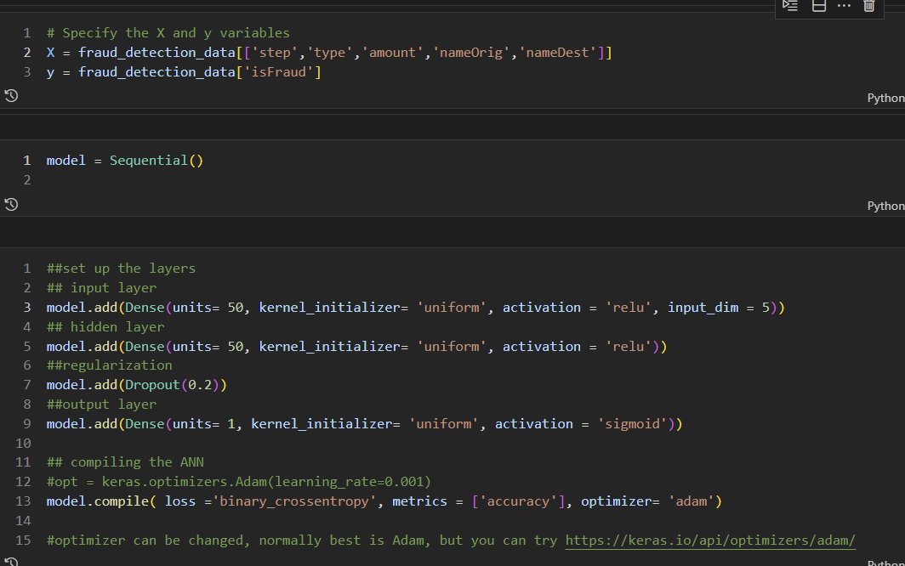
I SPENT 6 HOURS IN HERE...
BECAUSE OF THE OUTPUT LAYER
HAD TO GO BACK AND UNDO SOME STEPS

Slide 22
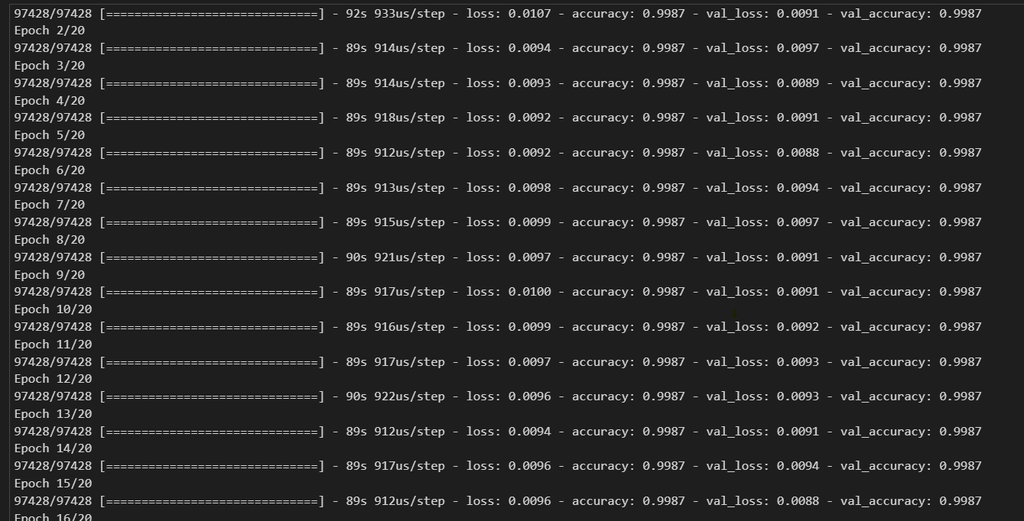
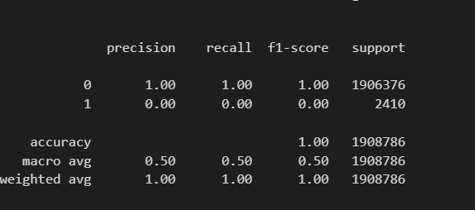
But I had incredible results…

Slide 23
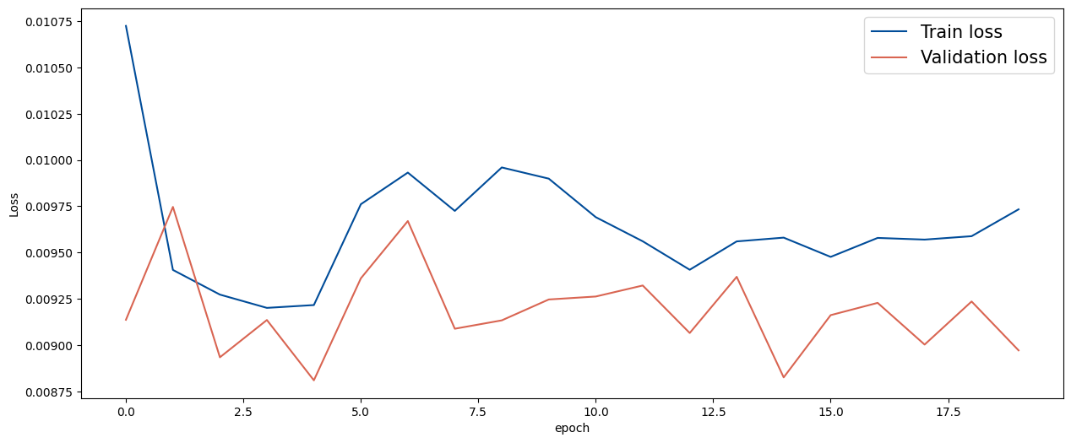
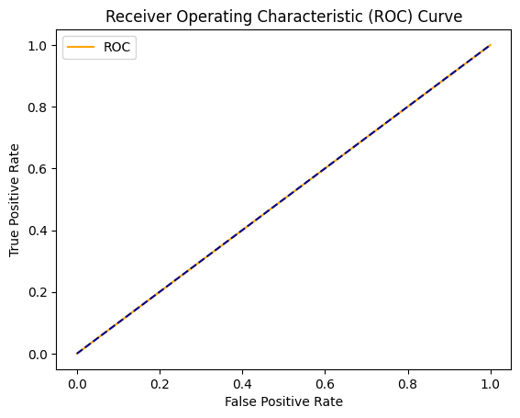
WRONG…

Slide 24
Our fraud model needs some serious help!
Let's give it a makeover so it can spot those fraudulent transactions like a pro.
Notes:
To improve a fraud model that is not helping predict fraud transactions, you can consider the following steps:
Review the data: Check if there is a sufficient amount of data on fraudulent transactions. If the data is imbalanced, where there are very few fraud transactions compared to non-fraud transactions, then the model may not be able to learn patterns that can accurately identify fraud. In this case, you can try to oversample the minority class, or use techniques such as SMOTE (Synthetic Minority Over-sampling Technique) to balance the data.
Feature engineering: Look at the features that are being used for prediction. Are they relevant and informative? Are there additional features that can be created that might better capture the characteristics of fraudulent transactions? Try different feature engineering techniques to create new features that could help the model better differentiate between fraudulent and non-fraudulent transactions.
Model selection: Try different models to see which one works best for the data. You can try different types of classifiers, such as logistic regression, decision trees, random forests, or neural networks. Each model has its strengths and weaknesses, and some models may work better than others for a given dataset.
Hyperparameter tuning: After selecting a model, tune its hyperparameters to optimize its performance. Try different combinations of hyperparameters to see which ones work best for the data. Use cross-validation to avoid overfitting the model to the training data.
Regularization: Implement regularization techniques to reduce overfitting, such as L1 or L2 regularization.
Ensemble methods: Use ensemble methods such as bagging, boosting, or stacking to combine multiple models and improve their performance.
Monitor performance: Keep monitoring the model's performance over time and update the model as new data becomes available. Look for false positives and false negatives and adjust the model accordingly.
Incorporate feedback: Incorporate feedback from domain experts or from customers who report fraudulent transactions. This can help improve the model's accuracy and help it adapt to changing fraud patterns.
Review model assumptions: Check the assumptions that the model makes about the data, such as independence of the features, normality of the residuals, and linearity of the relationships. If these assumptions are not met, then the model may not perform well.
By following these steps, you can improve the fraud model and make it better at predicting fraudulent transactions.

Slide 25
2 PROJECTS WAS TOO MUCH IN A WEEK
SPEND MORE TIME PREPARING DATA
Data pre processing is so important, more is needed to get results.
PANDAS VS NUMPY
Only now, I am starting to understand how different models requires different types of structures
UNDERSAMPLING IN UNBALANCE DATA
If I had more time, we could tried to do this.
Doing two complex projects in 1 week does not allow us to critically reflect on the code and dataset.

Slide 26
Thank you
AI INSPIRATION:
"AI models that fail are not failures of the technology, but rather an opportunity for us to learn and improve upon them. It's through these failures that we can fine-tune and train our AI models to become even better than before.".

