Slide 1
Should I fly from JFK Airport?
Data Science: Modelling Regression
Cidalia Eusebio- Assignment 6

Slide 2
01
02
Problem vs solution
Get & Explore data
03
04
Prepare data
Shorlist Models
Table of Contents
You can describe the topic of the section here
You can describe the topic of the section here
You can describe the topic of the section here
You can describe the topic of the section here

Slide 3
01
Problem & Solutions

Slide 4
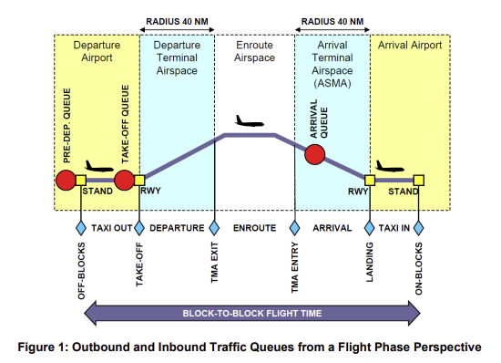
Flight Operations: Taxi Out
Moving on the airport’s taxiways from it’s gate to the runway prior takeoff.
Important as it might:
-Increase fuel consumption
-Affect other flights
-Impacts operation
-Increase costs

Slide 5
Flight Operations: The Problem
Flight data
Basic descriptions of Flight Operations
Can we predict which variables affect taxi-out outcome?

Slide 6
Flight Operations: The solution
Basic Descriptive Statistics
Regression Models:
Linear Regression
Random Forest Regression
Lasso Regression
Ridge Regression
Calculate errors

Slide 7
02
Get Data & Explore it

Slide 8
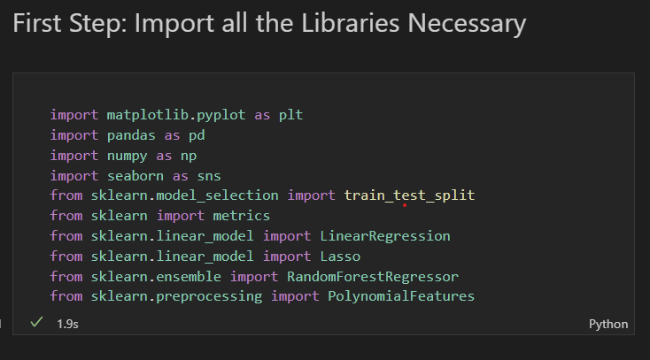
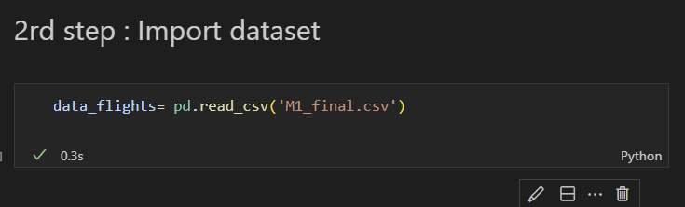
Get and Explore data
Flight Operations: The Problem

Slide 9
Flight Operations: Questions
?
Basic descriptive statistics
What is the average departure delay for flights in the dataset?
Regression Modelling
Tests different models
Choose errors to measure
Which airline has the greatest number of flights in the dataset?
How does the distance traveled by a flight impact its elapsed time?
What is the correlation between the temperature and the number of flight delays?
What is the average taxi-out time for flights in the dataset?
Which day of the week has the highest number of flight delays?
Optimization of models and understand which factors predict Time-out flight

Slide 10
Flight Operations: Data structure
22 variables in the data set
16 Intergern
6 Objects, 1 Float

Slide 11
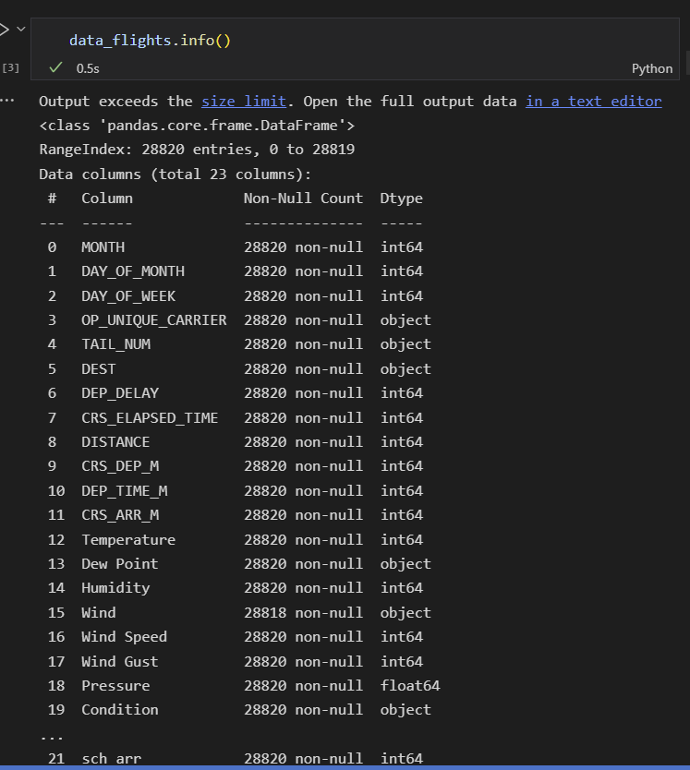
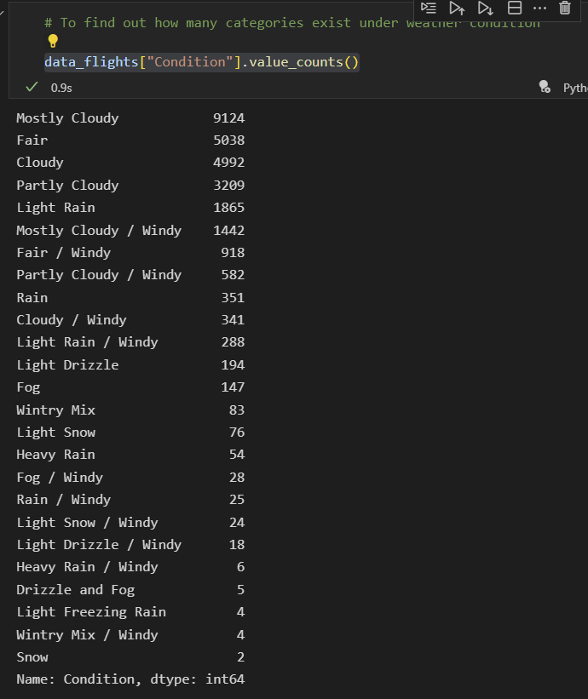
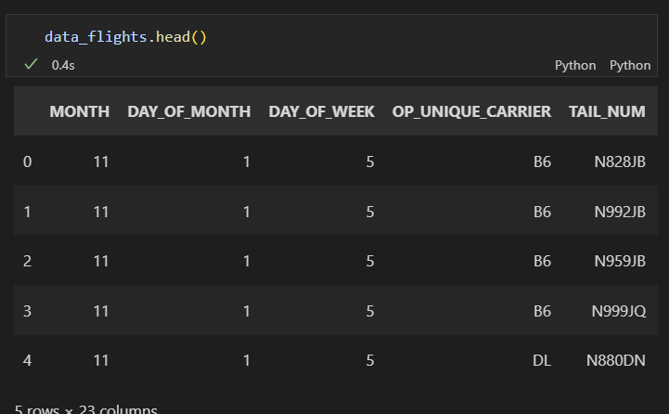
Flight Operations: Data Structure

Slide 12
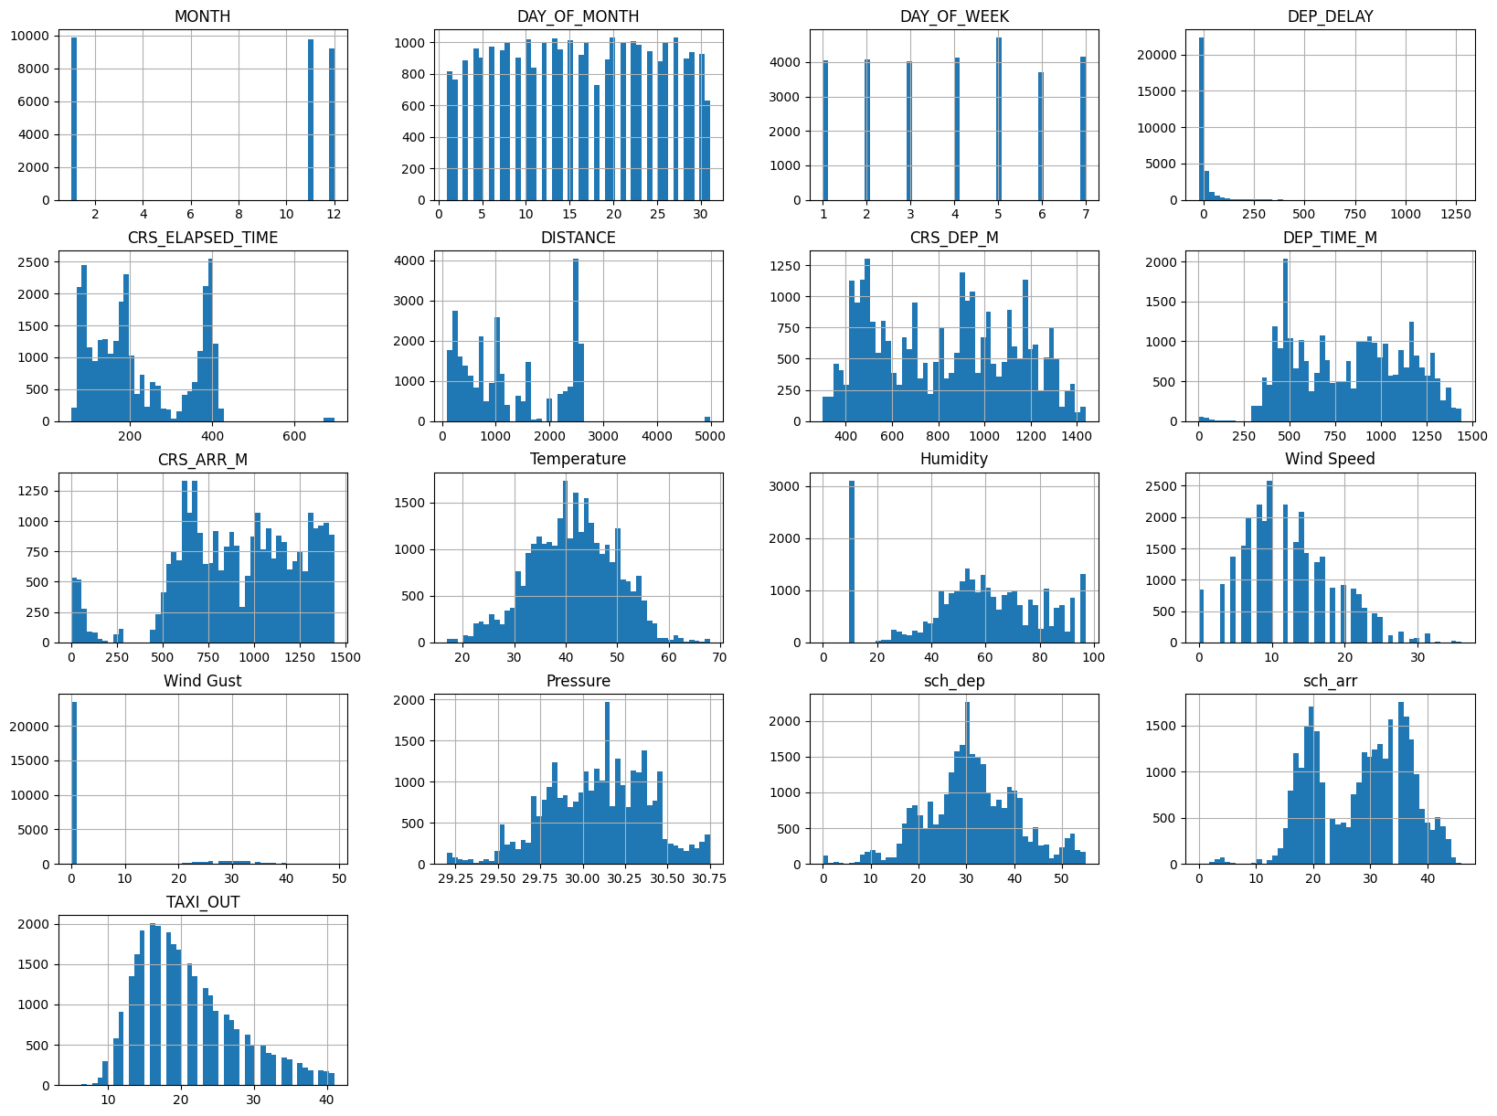
Flight Operations: Describe data
The mean taxi_out is 20(?mts), which can vary between 5-40minutes.
Wind Speed:
Wind speed mean 12.
Dep delay: It seems that the median delay is 4 minutes.
Difference in minutes between scheduled and actual departure time.
Early departures show negative numbers, in minutes
Humidity:
It seems that NEWYork airports has on average, high humidity levels, 74%.
Temperatures:
The average temperature was 5 degrees.

Slide 13
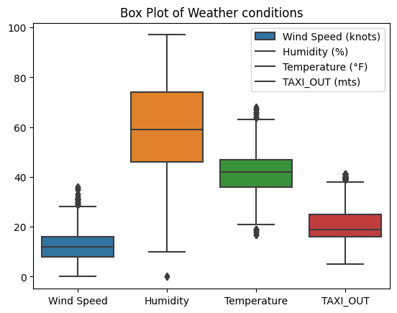
Flight Operations: Describe the data

Slide 14
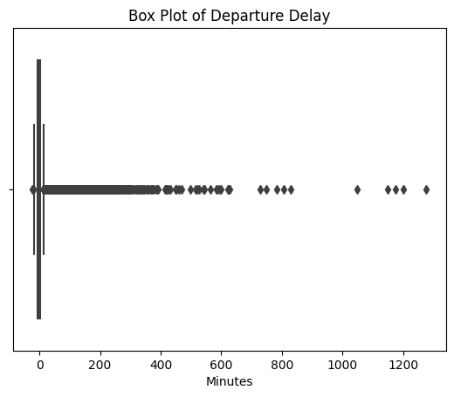
1-What is the average departure delay for flights in the dataset?
We can see that the mean delay is 6 minutes, however, median and mean are quite different.
So the median is more representative, which is -3 minutes.
The minimum -22 and maximum was 1276 minutes. 75% of the flights have a departure delay less than 2 minutes.
min -22.00
25% -6.00
50% -3.00
75% 2.00
max 1276.00

Slide 15
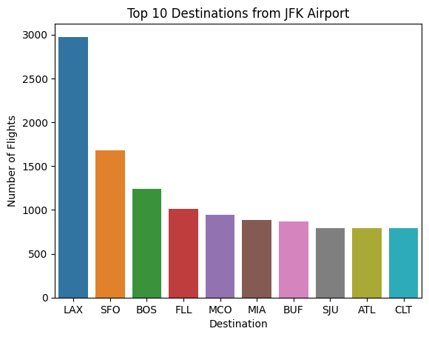
Top 10 destinations?

Slide 16
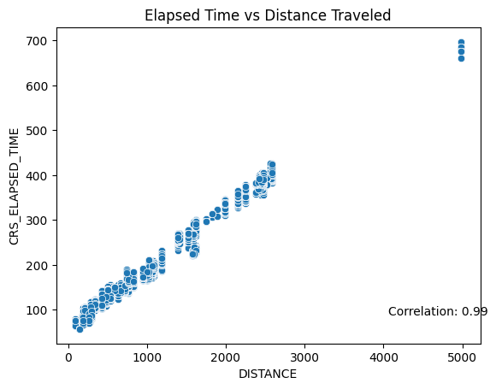
3-How does the distance traveled by a flight impact its elapsed time?
By using the scatter plot, we can see as the distance travel increases, so does the elapsed time
Notes:
Elapsed Flying time: actual time an airplane spends in the air, as opposed to time taxing to and from gate during stop overs

Slide 17
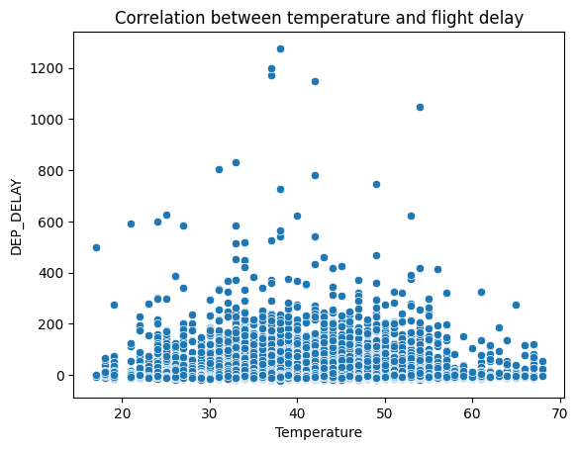
4-What is the correlation between the temperature and the number of flight delays?

Slide 18
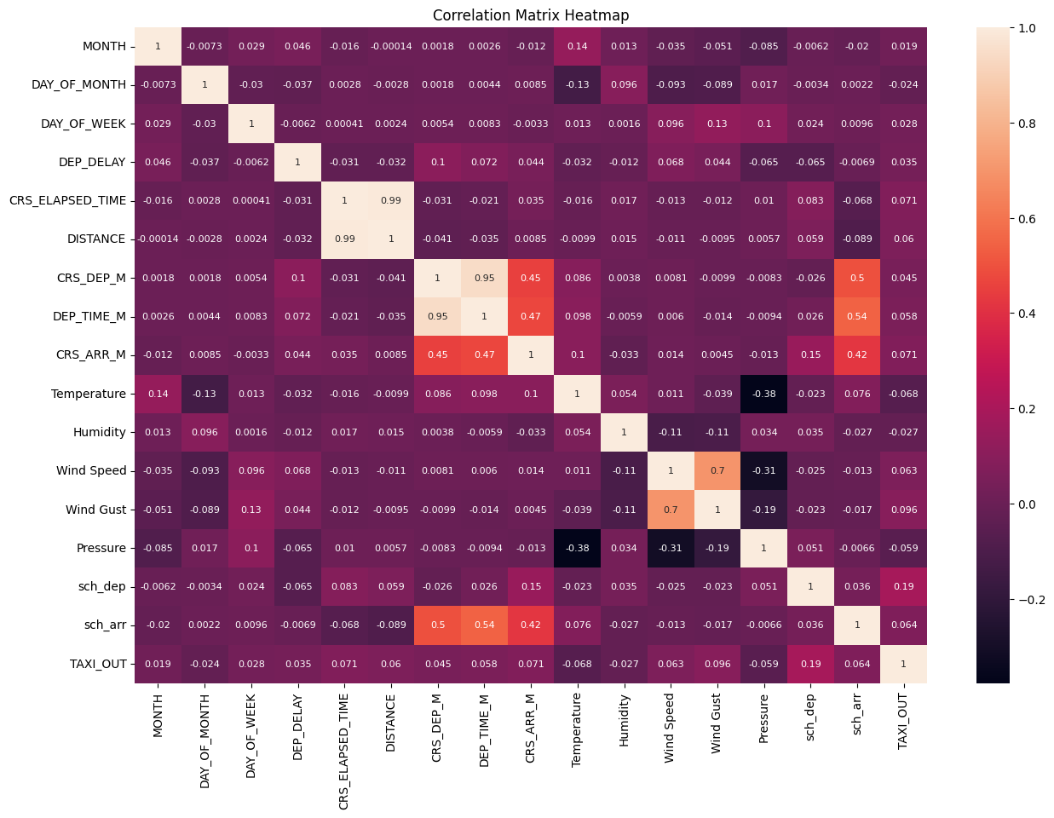
Other Correlations?

Slide 19
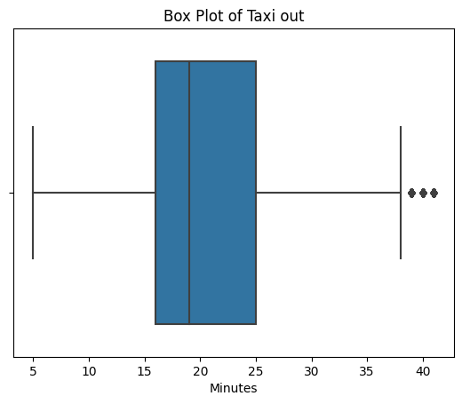
5-What is the average taxi-out time for flights in the dataset?
The average taxi-out time for flights is 20minutes.
75% of the flights have a delay less than 25 minutes.

Slide 20
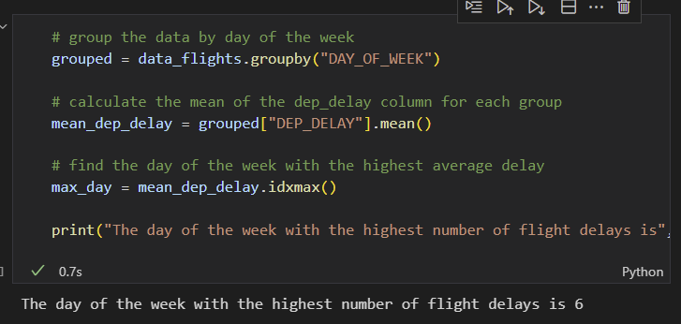
6-Which day of the week has the highest number of flight delays?
Day six, impossible to understand what day one of the week belongs to.

Slide 21
03
Data Preparation

Slide 22
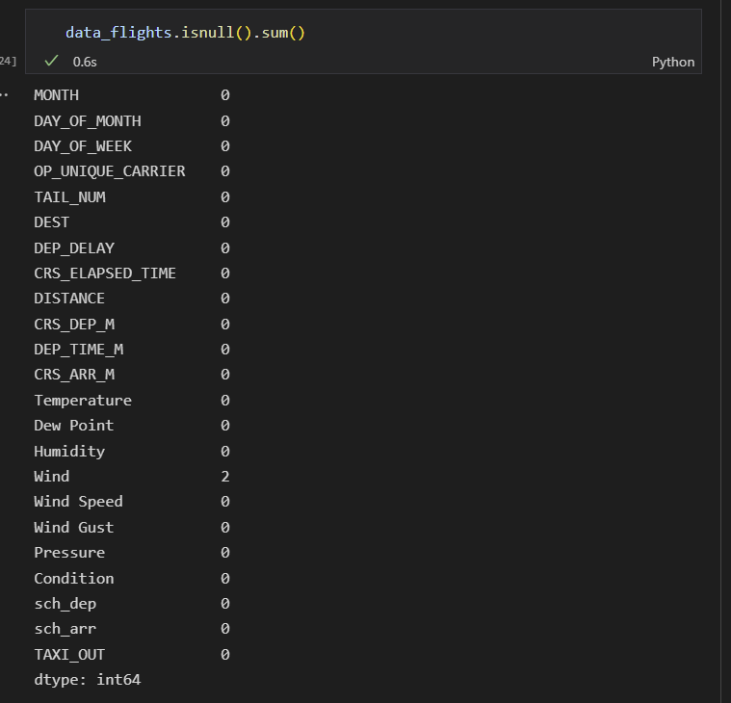
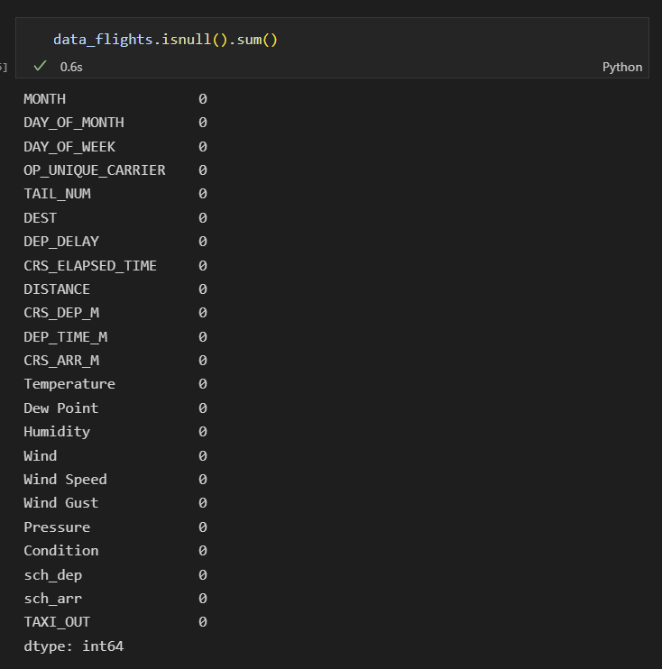
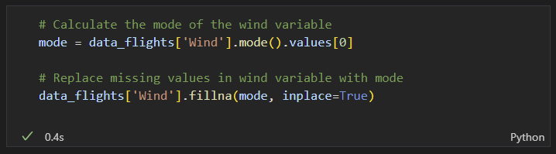
6th Step: Looking if we have any missing data: handling .
I handle missing values, in this case, for a categorical variable wind, by imputing missing values with a mode.

Slide 23
04
Select Performance
Measure

Slide 24
6th Step: Looking if we have any missing data: handling.
Since we are using a linear regression, both RMSE and MAE can be used.
Both are ways to measure the distance between two vectors: the vector of predictions and the vector of target values.
RMSE (Root Mean Square Error), gives an idea of how much error the system typically makes in its predictions, with high weight for larger errors.
If there are many outliers , you can use the mean absolute error (MAE, average absolute deviation)

Slide 25
05
Check Assumptions

Slide 26
The data is only available from the months November 2019 and December 2020, although the data includes months just us January?
Unable to understand some of the codes.
This dates were still affected by Covid-19 restrictions which might impact the insights we might collect.
Only cover winter months of Nov and December, includes Christmas season.

Slide 27
06
Regression Models

Slide 28
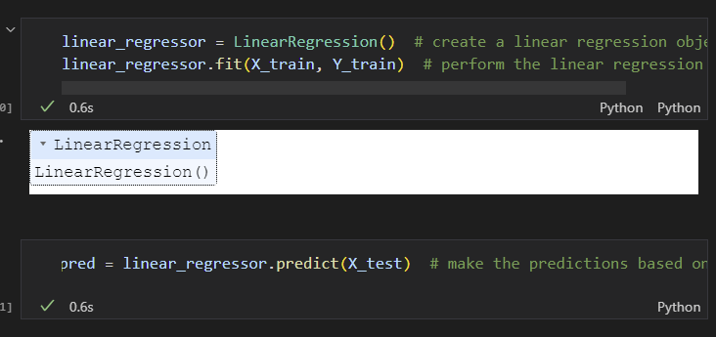
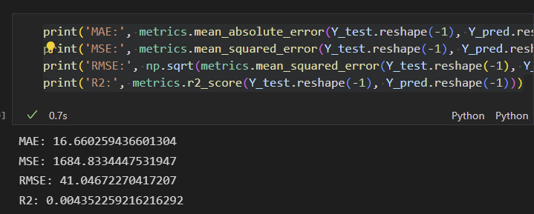
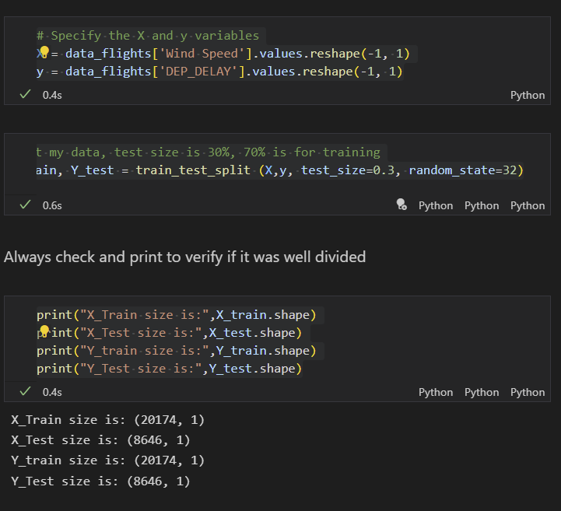
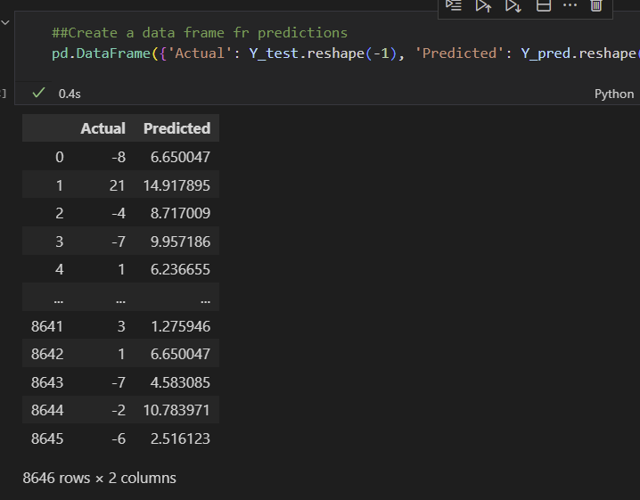
Linea Regression: Does deep delay is affected by Wind speed?

Slide 29
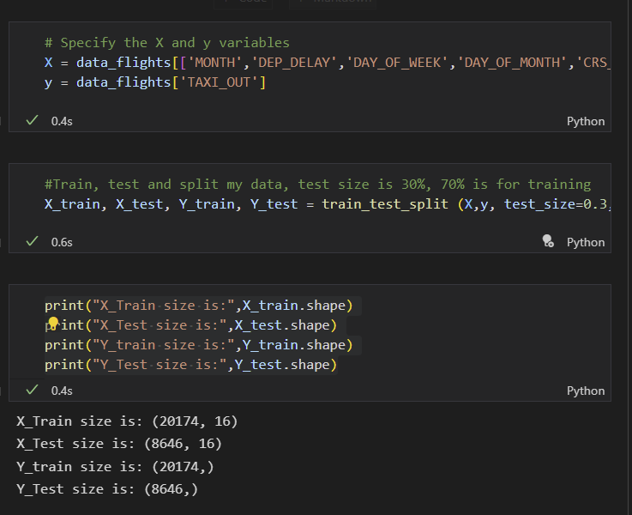
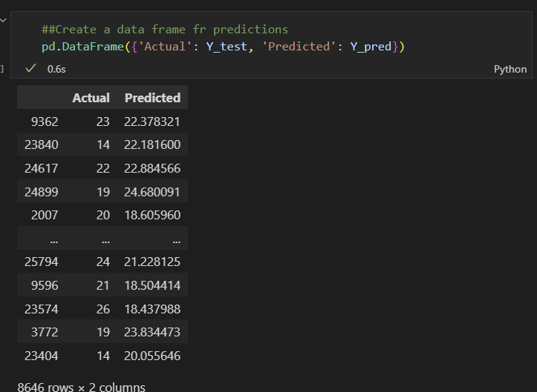
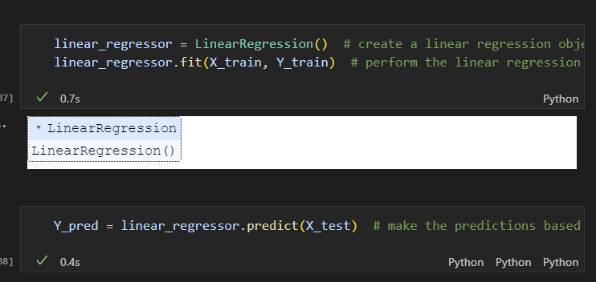
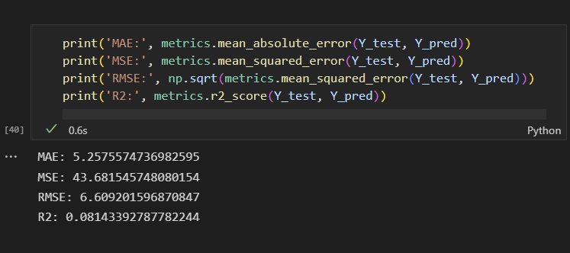
Linea Regression: Can the variables help us predict TAXI_OUT?

Slide 30
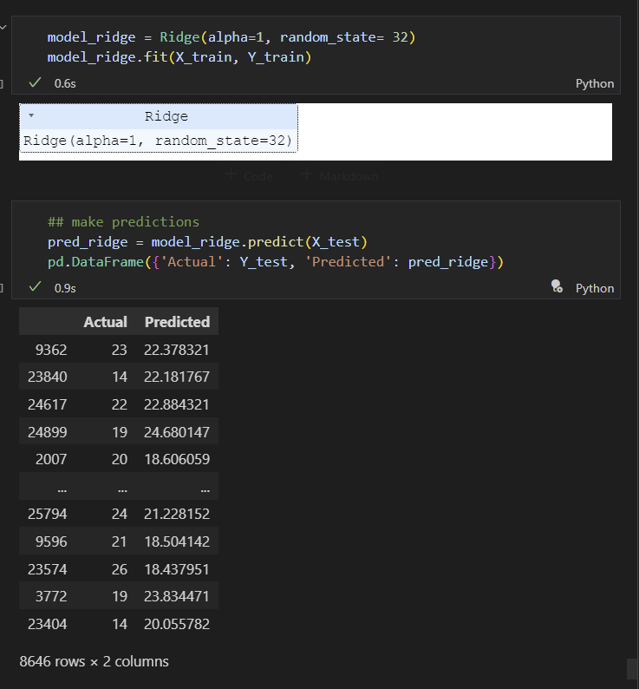
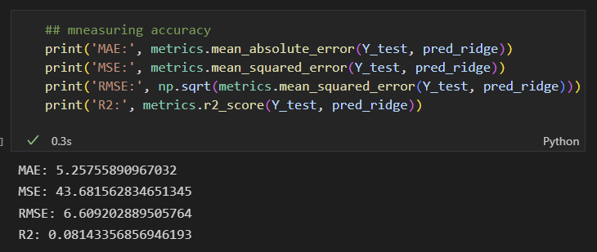
Ridge Regression: Can the variables help us predict TAXI_OUT?

Slide 31
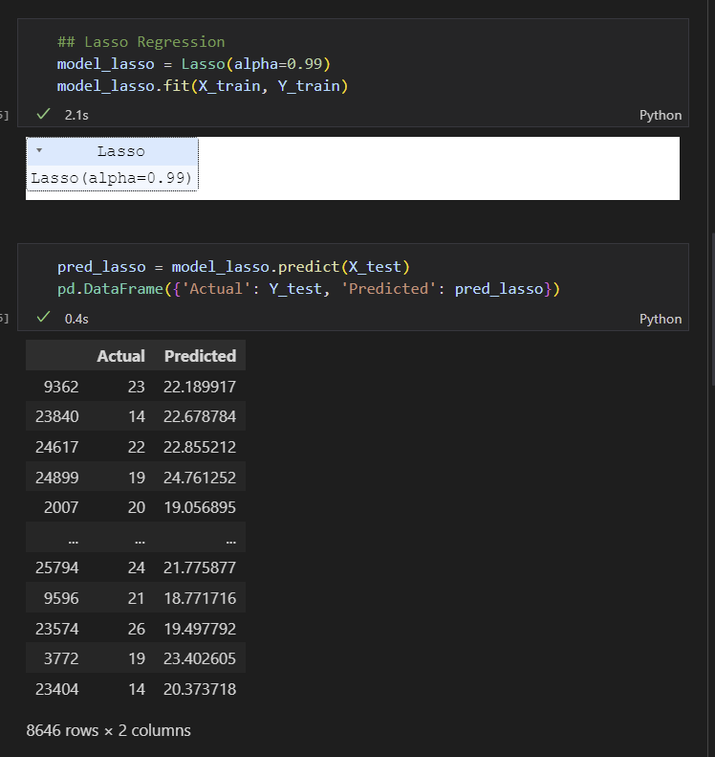
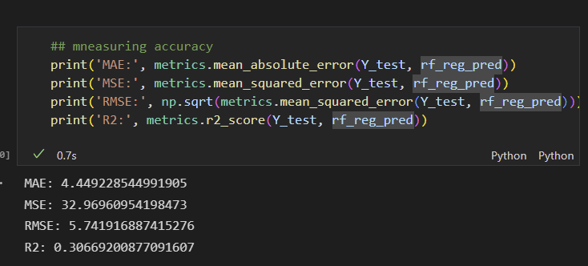
Lasso Regression: Can the variables help us predict TAXI_OUT?

Slide 32
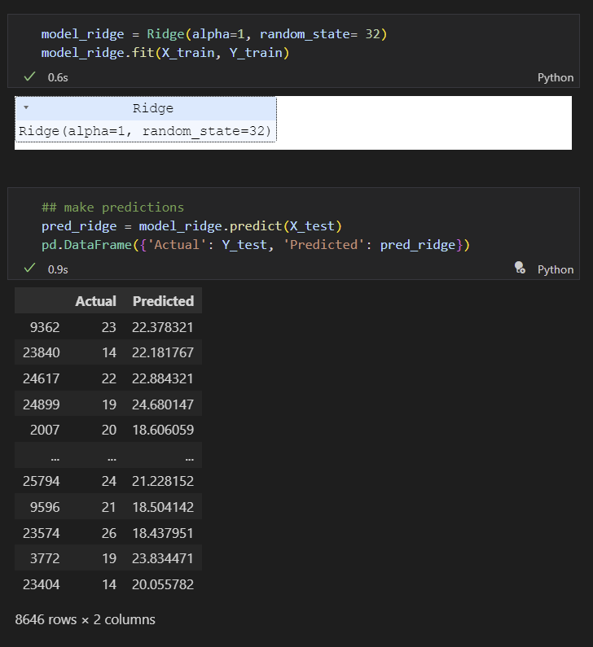
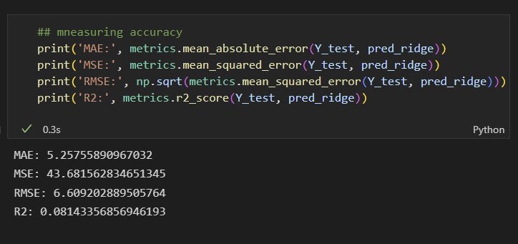
Ridge Regression: Can the variables help us predict TAXI_OUT?

Slide 33
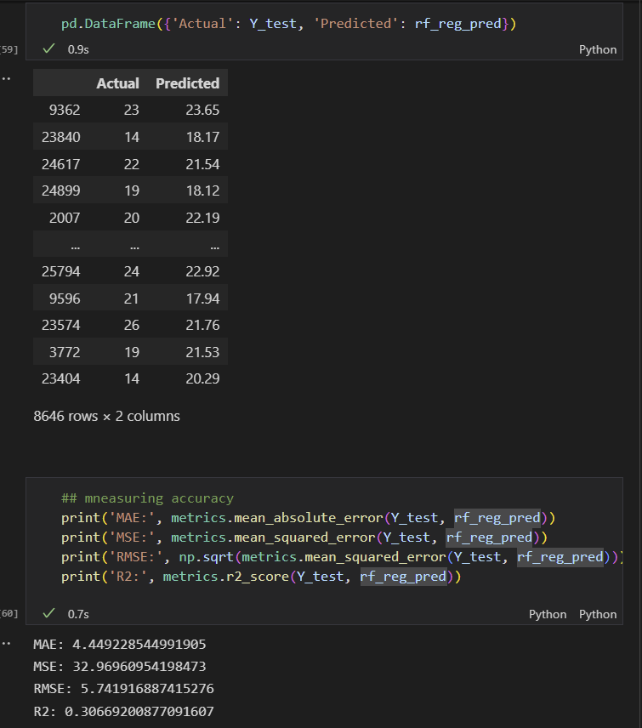
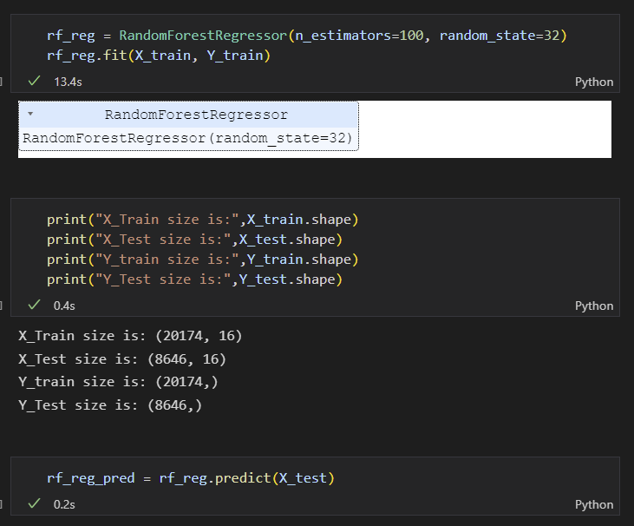
Random Forest Regressor: Can the variables help us predict TAXI_OUT?

Slide 34
?
Conclusions & Lessons learn
Modelling Results limitative. Random Forest was the best model. 30% of the variation of the Taxi_Out is explained by the predicted variables.
I should have started early and spend more time on modelling: I underestimated the time this takes.
Next week: I will start on Monday, not Thursday.
If I had more time: I should have classified Time_Out into different categories ( delay, not delay) to predict if delayed occur instead of time.
I need to spend more time understanding results.

