Slide 1
Text Based Adventure Game
Data Science Bootcamp
Assignment 4
Game 2: Escape Hunted ward 13 to bring food to Sofia
Group 3

Slide 2

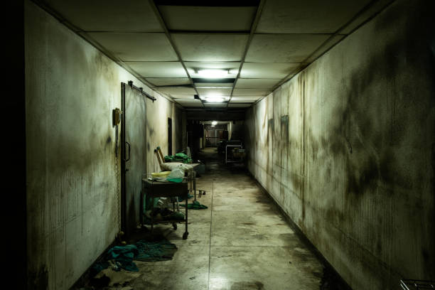

Game 2 Goal: You goal is to leave ward 13 and reach ward 14 to feed Sofia.
Asked to bring food to Grandma Sofia in Hospital
Ends up in ward 13 – the hunted ward
Room 1: Question 1
Room 2: Question 2
Room 3: Question 3
Room 4: Question 4
Ward 14
If you answer incorrectly - Room 5
If you refuse you leave the game

Slide 3
Main Functions
Strings
Variables
Input/Output
If/Else Statements (4)
Print
List
Integers

Slide 4
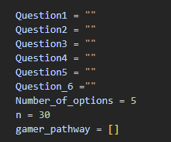
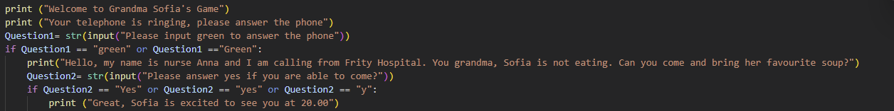
Code is divided in 3 Parts: Defining Variables and pre-hospital
Prior coding, I have planned the game on a paper,
Defined the variables needed as I went along.
Setting up the option to accept to play the game or not

Slide 5
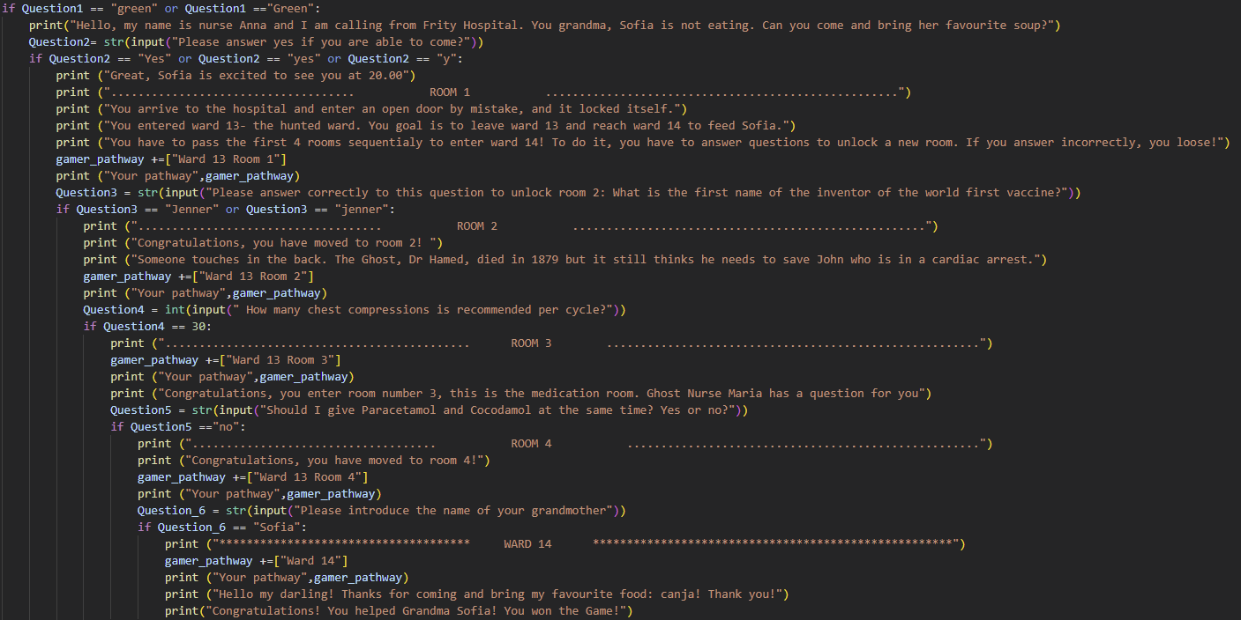
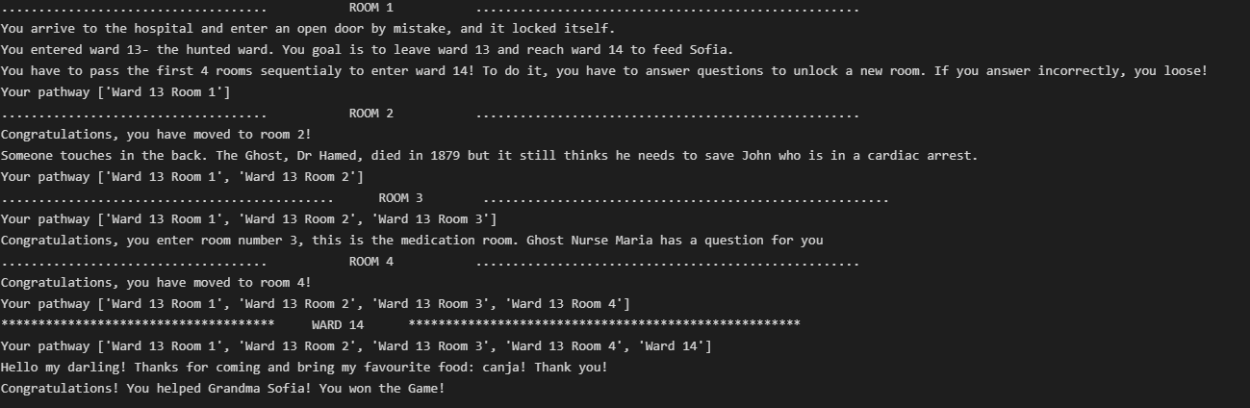
Code is divided in 3 Parts: Defining the room questions and move through the rooms if correct
I define a question to each room.
I used questions related to healthcare.
If they answer the question correctly, they will pass to the other room.
Challenge: create a list that will tell the game where they were

Slide 6
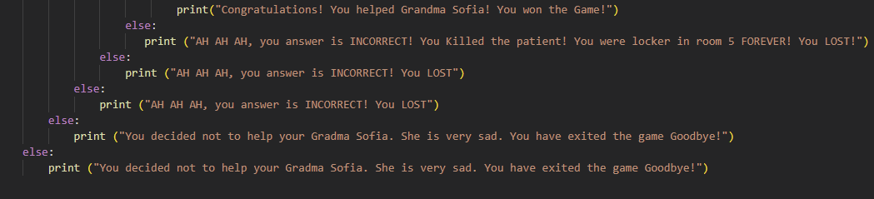
Code is divided in 3 Parts: Else parts
Challenges:
to understand how to do else with some many if’s
The alignment of else
Limitations & areas for improvement:
Have multiple attempts
How do I account the total number of attempts
Give multiple combinations of rooms

