Slide 1

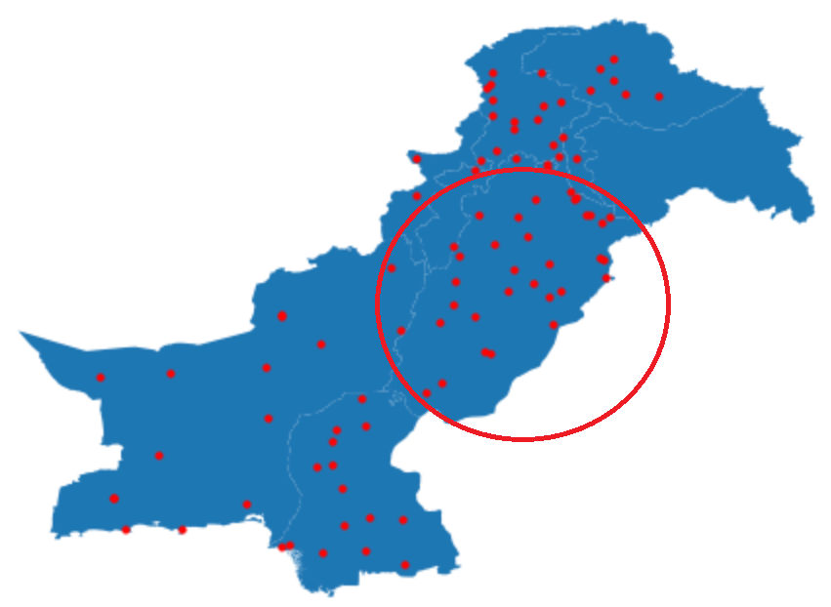

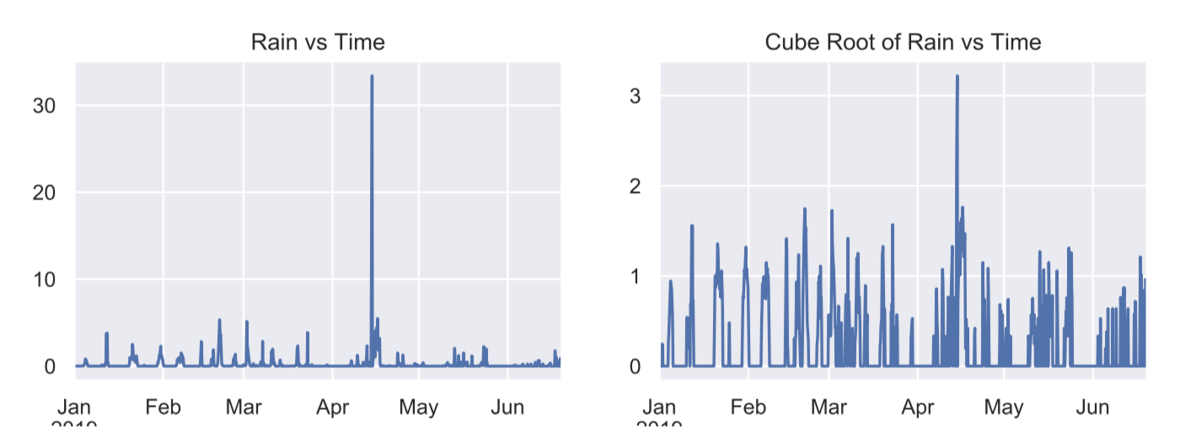
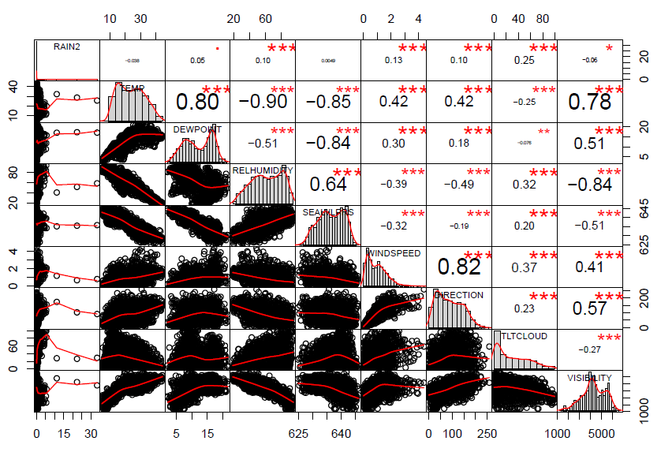
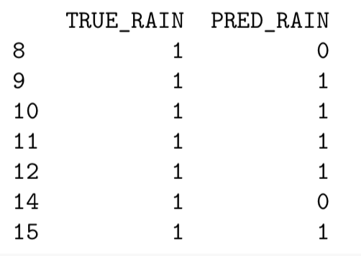
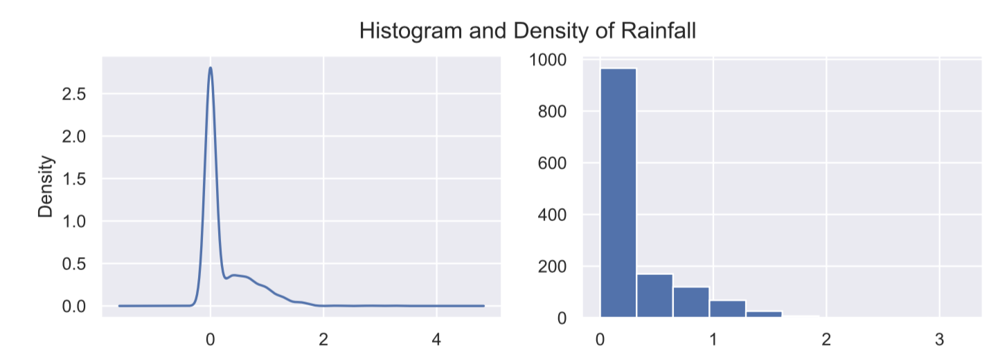
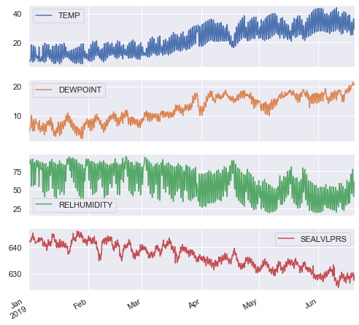
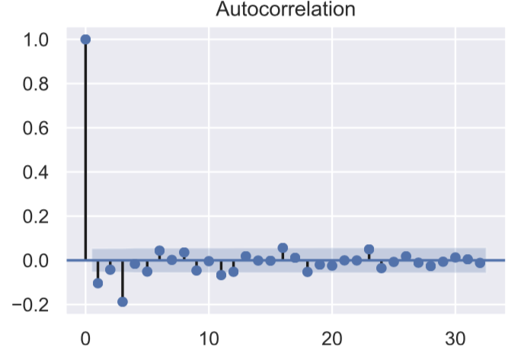
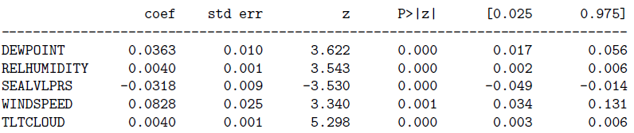
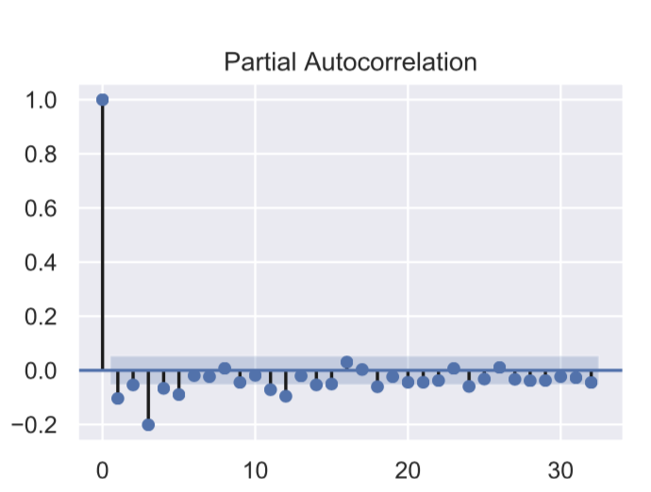
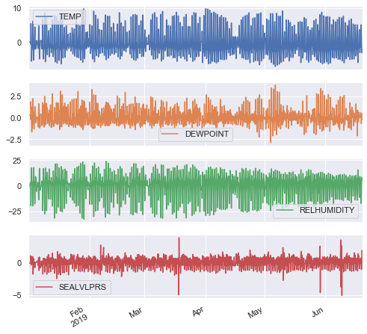
DATA3001 DATA SCIENCE AND DECISIONS Rainfall in Pakistan Authors: Eu Shaun Lim, Rachel Ha
Objective
Exploratory Data Analysis
Result
To improve the rainfall forecast.
Our model helps to predict whether the stations around Punjab have heavy rainfall.
Testing period: 15 April 2019 – 21April 2019
Overall Methodology
Data Cleaning
Exploratory Data Analysis
Data Modelling
Evaluation/Result
TRUE_RAIN: heavy rain in testing set
PRED_RAIN: predicted heavy rain by our model
Data Description
Dataset consists of average values of all variables for all stations in Punjab.
Observations recorded at 3 hour interval
Response: RAIN
Predictors: TEMP, DEWPOINT, RELHUMIDITY, SEALVLPRS, WINDSPEED, DIRECTION, TLTCLOUD, VISIBILITY
ARIMA Model
Conclusion/Future Research
1
Differencing
ACF and PACF
3
Model Selection
Given that heavy rain has occurred, our model predicted heavy rain with a 71% accuracy.
The “heavy rain” predicted is moderate rain, as we have little observations on heavy rain.
Have yearly data instead of a few months data
Walk forward validation provide more thorough validation method.
Different models should be considered in the future i.e. Artificial Neural Networks
2
Before
Provides values of auto-correlation in each series with the lagged values.
Data Cleaning
Before shifting
Replace -9999 values with NaN values (i.e. null value)
Remove missing date rows
After
Finds the correlation of the residuals with the next lagged value.
Stepwise regression → forward/backward selection → AIC = -146.422
Grid Search → RMSE = 0.217 → p = 6, q = 2
After shifting
Shifting: shift the rainfall observations three hours back
Used linear interpolation to fill in the missing values

