Slide 1

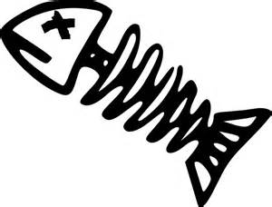
Phishing
not dead, not obvious
… and what it has to do with fishing

Slide 2
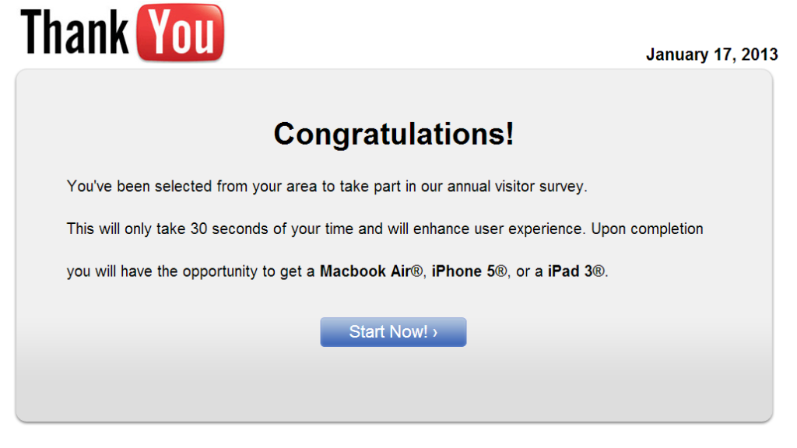
Notes:
How many of you have seen messages like these? Have you ever clicked any of them? Did you ever “get hacked” or tricked into installing software you did not want?
This specific example is not exactly phishing - but it is what most people think of when they hear the term phishing as it contains some features that are normally found in phishing sites. Thus the misconception that phishing is obvious and only fools fall for it.

Slide 3
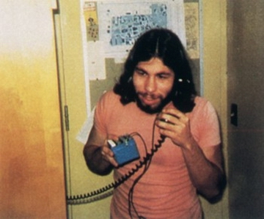
Terminology
Phreaking - “phone” + “breaking”
Hacking telecomm networks
Started in the 1950s
Golden age 60s-70s
Phishing = phreaking + fishing
1st mention - 1987
<>< and bait
A form of social engineering
Steve Wozniak, Apple co-founder
Notes:
Phishing on AOL was closely associated with the warez community that exchanged unlicensed software and the black hat hacking scene that perpetrated credit card fraud and other online crimes. AOL enforcement would detect words used in AOL chat rooms to suspend the accounts individuals involved in counterfeiting software and trading stolen accounts. The term was used because '<><' is the single most common tag of HTML that was found in all chat transcripts naturally, and as such could not be detected or filtered by AOL staff. The symbol <>< was replaced for any wording that referred to stolen credit cards, accounts, or illegal activity. Since the symbol looked like a fish, and due to the popularity of phreaking it was adapted as 'Phishing'.

Slide 4
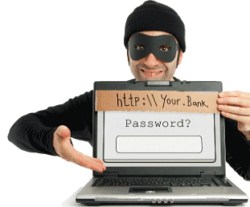
What exactly is phishing?
Phishing is the attempt to obtain sensitive information by disguising as a trustworthy entity in an electronic communication.
Typically carried out by emails, instant messaging and social media, directing users to enter personal information at fake websites who look and feel nearly identical to the real ones.
Sometimes this also involves malware.
Notes:
If the definition seems fuzzy - you will see some examples in a second.

Slide 5
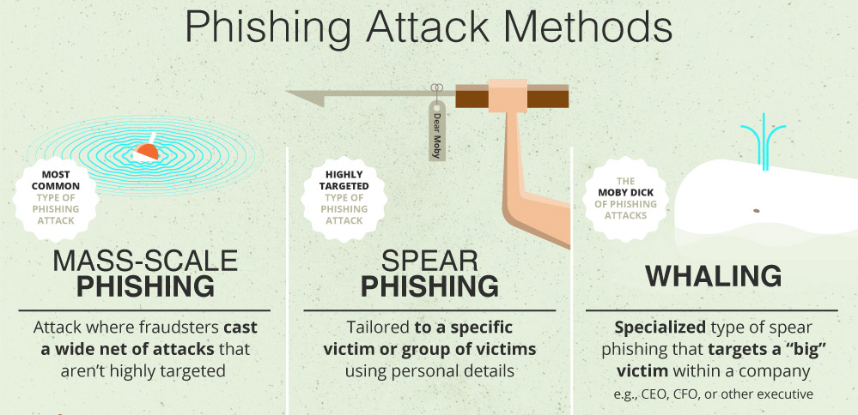
http://www.visualistan.com/2016/10/how-to-recognize-phishing-attacks.html
Notes:
There are three main ways phishing is conducted. The first one, mass-scale phishing aims at anyone. The criminals send out spam emails or post links in public spaces, e.g. forums in the hopes of getting anyone hooked on. This is the most common type of phishing and the easiest to detect - success rates for hackers are low.
Spear phishing is a more advanced technique, targeting a specific group of individuals. For example, it might even target you - you could get an email/message or even a physical letter that’s tailored specifically for Bearsden Academy students, asking for personal details. This has a much higher success rate because it’s more believable. However, it also requires more effort on the hackers side. Such attacks are more sophisticated.
Whaling is the rarest and the most dangerous method. It is very difficult to execute, requires inside knowledge and is usually targeted at “big fishes”. A lot of the times it involves impersonating someone the target knows. Imagine that you’re the hacker - and you’re trying to get J. Cameron’s personal email account. What’s the best way to do it? An ideal (but highly unlikely scenario), you send his secretary an email with a phishing website to her personal facebook account, if she falls for it - you get access to her email. Then you message James Cameron saying that he has to fill in a form that’s due tomorrow, with a yet another phishing site and bam - his email account is yours.

Slide 6
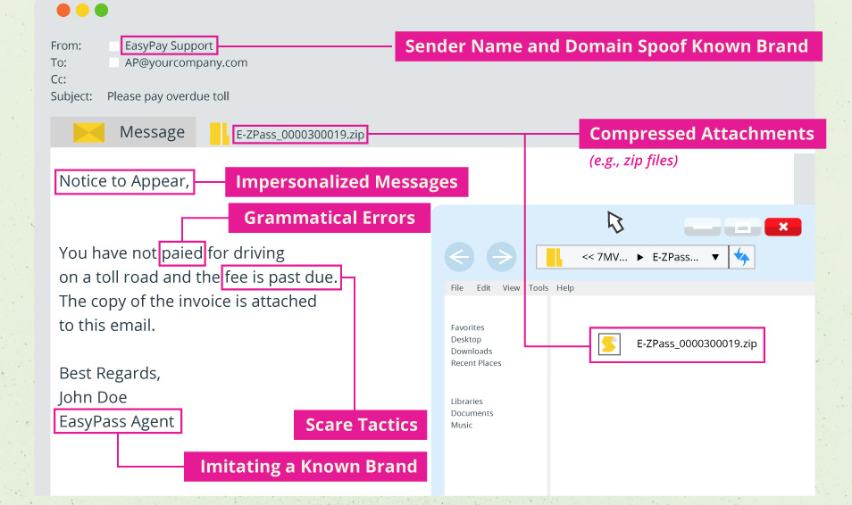
Emails
Address spoofing
Dear customer
Appeal to emotion
Spelling
Links
http://www.visualistan.com/2016/10/how-to-recognize-phishing-attacks.html
Notes:
This is a particularly easy-to-catch example but sometimes the quality of these emails is just as good as the originals.
However, it is very easy to fake where the email came from - technique called ‘email spoofing’. That is due to email servers not having an authentication layer. There are some solutions but seldom used. It’s been estimated that 9-50% of emails have no form of domain authentication.
Things that should arouse suspicion:
Very often the email is directed not at you but “Dear customer”.
Look for spelling mistakes and be wary of people trying to hurry you or projecting fear (e.g. your account might be compromised).

Slide 7
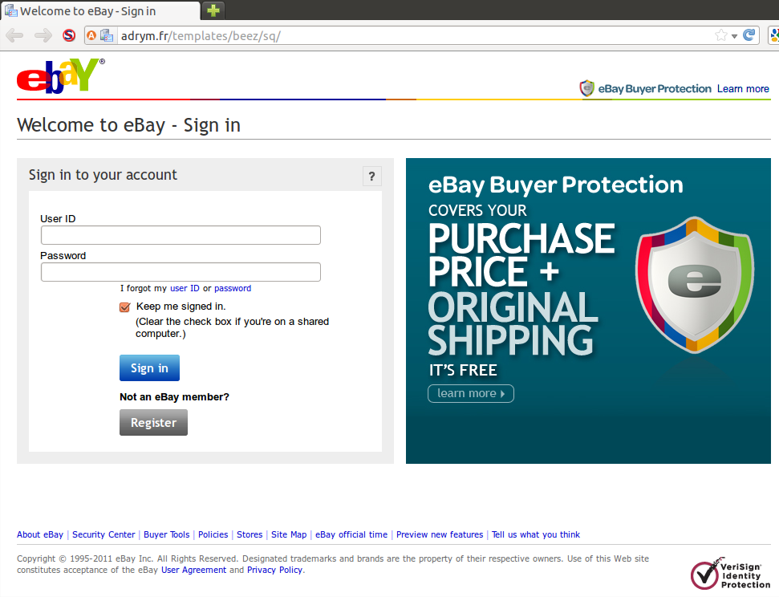
Websites
URL
SSL certificate
Spelling
Request details
Outdated
Links
Notes:
Always check the URL and SSL certificate, be attentive to spelling mistakes. Check if any of the links work - most hackers don’t bother cloning whole websites, it’s usually just a single page. Be aware if the website requests your details. Also, usually at the bottom there’s a date, e.g. copyright ebay 2010-2012, a lot of the times attackers forget to update small details.

Slide 8
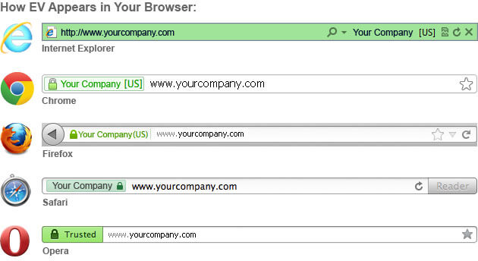

Slide 9
Question: the golden age for phishing?
1980s
1990s
2000s
Now

Slide 10
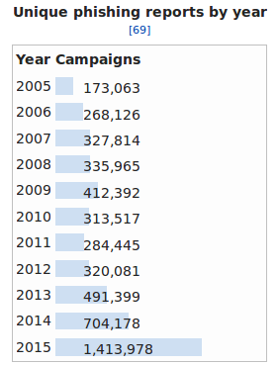
Question: the golden age for phishing?
1980s
1990s
2000s
Now
https://en.wikipedia.org/wiki/Phishing
Notes:
You’d think that we’d have ridden of phishing by now - there are lots of preventative measures. But no, it’s the complete opposite

Slide 11
Prevention is difficult
Everyone has to undergo personal training
Whereas exploits can be patched by professionals
Everyone has to be cautious
People overestimate their ability to detect such attacks
Notes:
Phishing relies on exploiting human cognition. Since it is a social engineering technique, it is difficult to prevent. Just like snake oil salesman - 100s of years ago.

Slide 12
demo demo demo demo demo
Notes:
https://github.com/eustaceb/phishing-examples
Run these two examples, explain how they work

Slide 13
Quiz time
https://www.sonicwall.com/phishing/phishing-quiz-question.aspx
https://www.opendns.com/phishing-quiz/
Or lookup “phishing quiz” using your search engine.

Slide 14
References
https://cheapsslsecurity.com/blog/documents-required-ev-ssl-certificate-validation/
https://en.wikipedia.org/wiki/Phishing
https://www.jitbit.com/alexblog/256-targetblank---the-most-underestimated-vulnerability-ever/
https://github.com/anttiviljami/browser-autofill-phishing

Slide 15
Graphics
https://hackingstuffs.com/attacks/phishing-attack/
https://www.extremetech.com/extreme/94647-black-hat-down-what-happened-to-the-most-famous-hackers/6
http://www.visualistan.com/2016/10/how-to-recognize-phishing-attacks.html

