Slide 1

www.nature.com/npjschz
All rights reserved 2334-265X/16
ARTICLE
OPEN
Schizophrenia interactome with 504 novel protein
–
protein
interactions
Madhavi K Ganapathiraju
1,2
, Mohamed Thahir
1,2
, Adam Handen
1
, Saumendra N Sarkar
3,4
, Robert A Sweet
5,6
, Vishwajit L Nimgaonkar
5,7
,
Christine E Loscher
8
, Eileen M Bauer
9,10
and Srilakshmi Chaparala
1
Genome-wide association studies of schizophrenia (GWAS) have revealed the role of rare and common genetic variants, but the
functional effects of the risk variants remain to be understood. Protein interactome-based studies can facilitate the study of
molecular mechanisms by which the risk genes relate to schizophrenia (SZ) genesis, but protein
–
protein interactions (PPIs) are
unknown for many of the liability genes. We developed a computational model to discover PPIs, which is found to be highly
accurate according to computational evaluations and experimental validations of selected PPIs. We present here, 365 novel PPIs of
liability genes identi
ﬁ
ed by the SZ Working Group of the Psychiatric Genomics Consortium (PGC). Seventeen genes that had no
previously known interactions have 57 novel interactions by our method. Among the new interactors are 19 drug targets that are
targeted by 130 drugs. In addition, we computed 147 novel PPIs of 25 candidate genes investigated in the pre-GWAS era. While
there is little overlap between the GWAS genes and the pre-GWAS genes, the interactomes reveal that they largely belong to the
same pathways, thus reconciling the apparent disparities between the GWAS and prior gene association studies. The interactome
including 504 novel PPIs overall, could motivate other systems biology studies and trials with repurposed drugs. The PPIs are made
available on a webserver, called Schizo-Pi at http://severus.dbmi.pitt.edu/schizo-pi with advanced search capabilities.
npj Schizophrenia
(2016)
2,
Article number: 16012; doi:10.1038/npjschz.2016.12; published online 27 April 2016
INTRODUCTION
domains, its function was unknown.
10,11
Once its protein
–
protein
Schizophrenia (SZ) is a common, potentially severe psychiatric
interactions
12
(PPIs)
were
determined
using
yeast
2-hybrid
disorder that af
ﬂ
icts all populations.
1
Gene mapping studies
technology,
investigators successfully linked DISC1 to cAMP
suggest that SZ is a complex disorder, with a cumulative impact of
signaling, axon elongation, and neuronal migration, and accelera-
variable genetic effects coupled with environmental factors.
2
As
ted the research pertaining to SZ in general, and DISC1 in
many as 38 genome-wide association studies (GWAS) have been
particular.
13
Typically such studies are carried out on known
reported on SZ out of a total of 1,750 GWAS publications on 1,087
protein
–
protein interaction (PPI) networks, or as in the case
traits or diseases reported in the GWAS catalog maintained by the
of DISC1, when there is a speci
ﬁ
c gene of interest, its PPIs are
National Human Genome Research Institute of USA
3
(as of April
determined by methods such as yeast 2-hybrid technology.
2015), revealing the common variants associated with SZ.
4
The SZ
Knowledge of human PPI networks is thus valuable for
Working Group of the Psychiatric Genomics Consortium (PGC)
accelerating discovery of protein function, and indeed, biomedical
identi
ﬁ
ed 108 genetic loci that likely confer risk for SZ.
5
While the
research in general. However, of the hundreds of thousands of
role of genetics has been clearly validated by this study, the
biophysical PPIs thought to exist in the human interactome,
14,15
functional impact of the risk variants is not well-understood.
6,7
o
100,000 are known today (Human Protein Reference Database,
Several of the genes implicated by the GWAS have unknown
HPRD
16
and
BioGRID
17
databases).
Gold
standard
experi-
functions and could participate in possibly hitherto unknown
mental methods for the determination of all the PPIs in human
pathways.
8
Further, there is little or no overlap between the genes
interactome are time-consuming, expensive and may not even be
identi
ﬁ
ed through GWAS and
‘
candidate genes
’
proposed in the
feasible, as about 250 million pairs of proteins would need to be
pre-GWAS era.
9
tested overall; high-throughput methods such as yeast 2-hybrid
Interactome-based
studies
can
be
useful
in
discovering
have important limitations for whole interactome determination
the functional associations of genes. For example,
disrupted in
as they have a low recall of 23% (i.e., remaining 77% of true
schizophrenia 1
(DISC1), an SZ related candidate gene originally had
interactions need to be determined by other means), and a low
no known homolog in humans. Although it had well-characterized
precision (i.e., the screens have to be repeated multiple times
protein domains such as coiled-coil domains and leucine-zipper
to achieve high selectivity).
18,19
Computational methods are
1
Department of Biomedical Informatics, School of Medicine, University of Pittsburgh, Pittsburgh, PA, USA;
2
Intelligent Systems Program, School of Arts and Sciences, University of
Pittsburgh, Pittsburgh, PA, USA;
3
Department of Microbiology and Molecular Genetics, School of Medicine, University of Pittsburgh, Pittsburgh, PA, USA;
4
Cancer Virology
Program, University of Pittsburgh Cancer Institute, Pittsburgh, PA, USA;
5
Department of Psychiatry, School of Medicine, University of Pittsburgh, Pittsburgh, PA, USA;
6
Department
of Neurology, School of Medicine, University of Pittsburgh, Pittsburgh, PA, USA;
7
Department of Human Genetics, Graduate School of Public Health, University of Pittsburgh,
Pittsburgh, PA, USA;
8
Immunomodulation Research Group, School of Biotechnology, Dublin City University, Dublin, Ireland;
9
Department of Surgery, School of Medicine,
University of Pittsburgh, Pittsburgh, PA, USA and
10
Vascular Medicine Institute, University of Pittsburgh, Pittsburgh, PA, USA.
Correspondence: MK Ganapathiraju (madhavi@pitt.edu)
Received 21 October 2015; revised 17 February 2016; accepted 23 February 2016
© 2016 Schizophrenia International Research Society/Nature Publishing Group

Slide 2
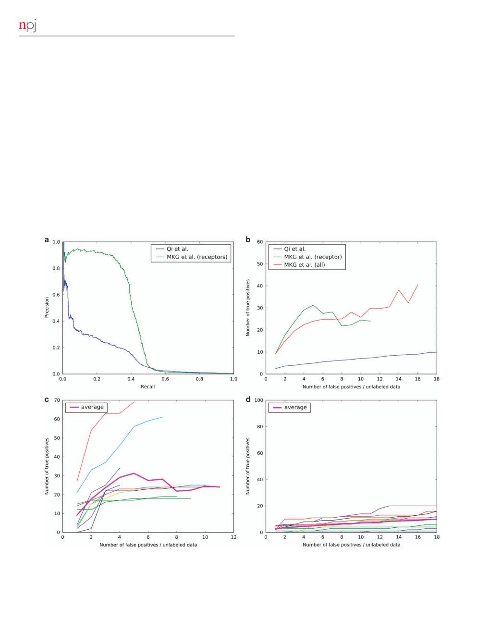
Schizophrenia interactome with novel interactions
2
MK Ganapathiraju
et al
therefore necessary to complete the interactome expeditiously.
con
ﬁ
dent novel PPIs in the SZ interactome, shedding new light
Algorithms have begun emerging to predict PPIs using statistical
onto several uncharacterized genes that are associated with SZ.
machine learning on the characteristics of the proteins, but these
algorithms are employed predominantly to study yeast. Two
RESULTS
signi
ﬁ
cant computational predictions have been reported for
human interactome; although they have had high false positive
We developed a computational model called HiPPIP to predict
rates, these methods have laid the foundation for computational
PPIs (see Methods and Supplementary File 1). The model has been
prediction of human PPIs.
20,21
evaluated by computational methods and experimental valida-
Con
We have created a new PPI prediction model called High-
tions and is found to be highly accurate. Evaluations on a held-out
ﬁ
dence Protein
–
Protein Interaction Prediction (HiPPIP) model.
test
data
showed
a
precision
of
97.5%
and
a
recall
of
Novel interactions predicted with this model are making trans-
5%. 5% recall out of 150,000 to 600,000 estimated number of
lational impact. For example, we discovered a PPI between OASL
interactions in the human interactome corresponds to 7,500
–
and DDX58, which on validation showed that an increased
30,000 novel PPIs in the whole interactome. Note that, it is likely
expression of OASL could boost innate immunity to combat
that the real precision would be higher than 97.5% because in this
in
ﬂ
uenza by activating the RIG-I pathway.
22
Also, the interactome
test data, randomly paired proteins are treated as non-interacting
of the genes associated with congenital heart disease showed that
protein pairs, whereas some of them may actually be interacting
the disease morphogenesis has a close connection with the
pairs with a small probability; thus, some of the pairs that are
structure and function of cilia.
23
Here, we describe the HiPPIP
treated as false positives in test set are likely to be true but
model and its application to SZ genes to construct the SZ
hitherto unknown interactions. In Figure 1a, we show the
interactome. After computational evaluations and experimental
precision versus recall of our method on
‘
hub proteins
’
where
validations of selected novel PPIs, we present here 504 highly
we considered all pairs that received a score
4
0.5 by HiPPIP to be
Figure 1.
Computational evaluation of predicted protein
–
protein interactions on hub proteins: (
a
) precision recall curve. (
b
) True positive
versus false positives in ranked lists of hub type membrane receptors for our method and that by Qi
et al.
True positives versus false positives
are shown for individual membrane receptors by our method in (
c
) and by Qi
et al.
in (
d
). Thick line is the average, which is also the same as
shown in (
b
). Note:
x
-axis is recall in (
a
), whereas it is number of false positives in (
b
–
d
). The range of
y
-axis is observed by varying the
threshold from 1.0
–
0 in (
a
), and to 0.5 in (
b
–
d
).
npj Schizophrenia (2016) 16012
© 2016 Schizophrenia International Research Society/Nature Publishing Group

Slide 3
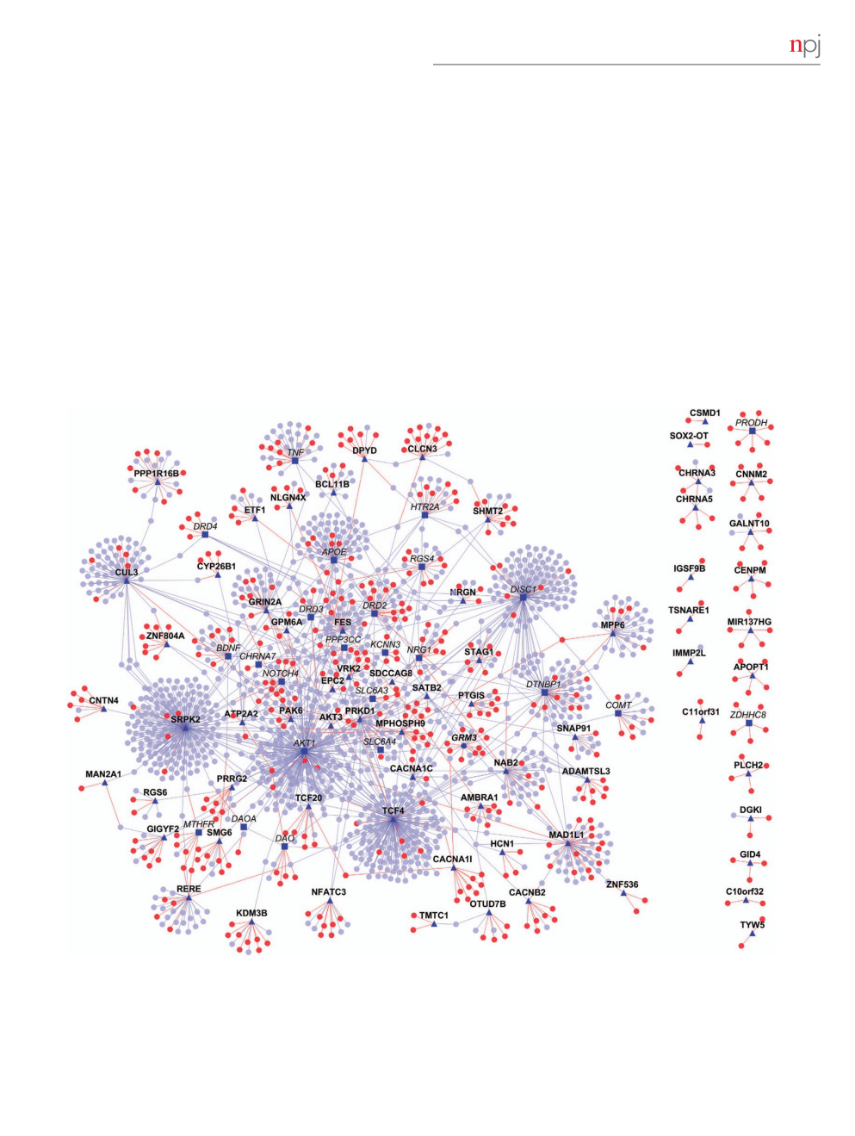
Schizophrenia interactome with novel interactions
MK Ganapathiraju
et al
3
novel interactions. In Figure 1b, we show the number of true posi-
PPIs. Only the PPIs predicted with a score
4
0.5 are included in the
tives versus false positives observed in hub proteins. Both these
interactome.
ﬁ
gures also show our method to be superior in comparison to
the prediction of membrane-receptor interactome by Qi
et al
’
s.
24
SZ interactome
True positives versus false positives are also shown for individual
By applying HiPPIP to the GWAS genes and Historic (pre-GWAS)
hub proteins by our method in Figure 1c and by Qi
et al
’
s.
23
in
genes, we predicted over 500 high con
ﬁ
dence new PPIs adding to
Figure 1d. These evaluations showed that our predictions contain
about 1400 previously known PPIs. Many genes that had no
mostly true positives. Unlike in other domains where ranked lists
known PPIs previously have several novel PPIs following our
are commonly used such as information retrieval, in PPI prediction
analyses. Figure 2 shows the network of protein
–
protein inter-
the
‘
false positives
’
may actually be unlabeled instances that are
actions between SZ genes, where a gene is shown as a square or
indeed true interactions that are not yet discovered. In fact, such
circular node and a protein
–
protein interaction between two
unlabeled pairs predicted as interactors of the hub gene HMGB1
genes is shown as a line (also called
‘
edge
’
) between the genes.
(namely, the pairs HMGB1-KL and HMGB1-FLT1) were validated by
SZ-associated genes are shown as square shaped dark blue nodes,
experimental methods and found to be true PPIs (See the Figures
of which those with bold labels are GWAS genes, and those with
e
–
g in Supplementary File 3). Thus, we concluded that the protein
italicized labels are Historic genes. Genes that are novel interactors
pairs that received a score of
⩾
0.5 are highly con
ﬁ
dent to be true
are shown as red colored nodes and those that are known
interactions. The pairs that receive a score less than but close to
interactors as blue colored nodes. Novel PPIs are shown as red
0.5 (i.e., in the range of 0.4
–
0.5) may also contain several true PPIs;
edges and known PPIs as blue edges. The interactome
ﬁ
gures
however, we cannot con
ﬁ
dently say that all in this range are true
presented here have been generated with Cytoscape.
25
There are
Figure 2.
Schizophrenia interactome: network view of the schizophrenia interactome is shown as a graph, where genes are shown as nodes
and PPIs as edges connecting the nodes. Schizophrenia-associated genes are shown as dark blue nodes, novel interactors as red color nodes
and known interactors as blue color nodes. The source of the schizophrenia genes is indicated by its label font, where Historic genes are
shown italicized, GWAS genes are shown in bold, and the one gene that is common to both is shown in italicized and bold. For clarity, the
source is also indicated by the shape of the node (triangular for GWAS and square for Historic and hexagonal for both). Symbols are shown
only for the schizophrenia-associated genes; actual interactions may be accessed on the web. Red edges are the novel interactions, whereas
blue edges are known interactions. GWAS, genome-wide association studies of schizophrenia; PPI, protein
–
protein interaction.
© 2016 Schizophrenia International Research Society/Nature Publishing Group
npj Schizophrenia (2016) 16012

Slide 4
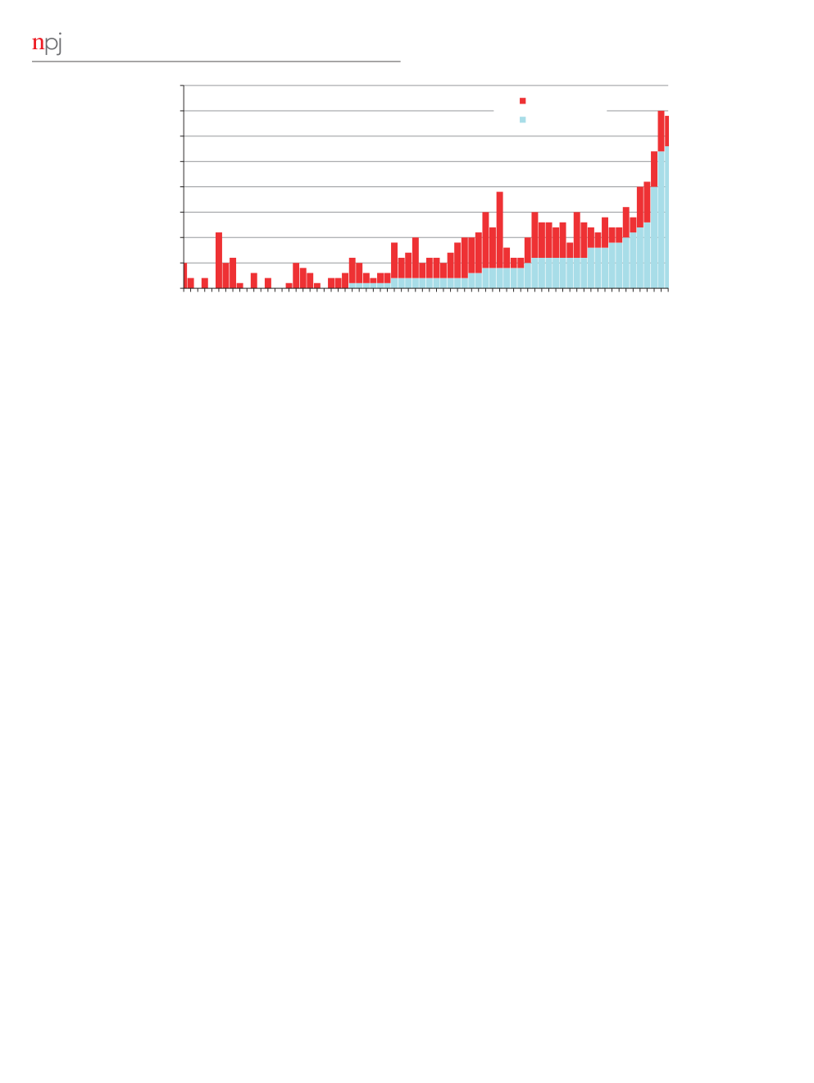
Schizophrenia interactome with novel interactions
4
MK Ganapathiraju
et al
40
Hub genes with more than 30 interactions are not shown
Novel PPIs
35
Known PPIs
Number of Interactions
30
25
20
15
10
5
0
APOPT1
C10orf32
C10orf32-ASMT
C11orf31
C3orf49
CACNA1I
CENPM
CNNM2
CSMD1
EP300-AS1
GID4
GRAMD1B
IGSF9B
LINC01470
LOC100507431
LOC642484
MIR137HG
PLCH2
SDCCAG8
SOX2-OT
TMX2-CTNND1
TSNARE1
TYW5
ZNF536
CHRNA5
CYP26B1
DGKI
IMMP2L
MAN2A1
TMTC1
CACNB2
CHRNA3
CNTN4
DPYD
EPC2
GALNT10
GPM6A
HCN1
NLGN4X
PRRG2
ZNF804A
PTGIS
SMG6
CLCN3
KDM3B
MPHOSPH9
OTUD7B
RGS6
SATB2
ETF1
GRM3
ADAMTSL3
AMBRA1
GIGYF2
NFATC3
NRGN
SHMT2
STAG1
AKT3
SNAP91
TCF20
ATP2A2
BCL11B
VRK2
CACNA1C
PPP1R16B
PAK6
RERE
GRIN2A
MPP6
Figure 3.
Genes
Number of novel and known PPIs of GWAS genes. For each gene, the number of known PPIs is shown in light blue color and novel
PPIs is red color. GWAS, genome-wide association studies of schizophrenia; PPI, protein
–
protein interaction.
altogether 101 SZ genes (77 GWAS genes and 25 Historic genes
involved in adhesion-mediated signaling.
27
Interestingly, there is
with 1 gene in common). We predicted 504 novel PPIs adding to
evidence for altered focal adhesion dynamics in SZ.
28
STX3 and
1,397 previously known PPIs. The lists of GWAS and Historic genes
STX4 are members of the SNARE family of proteins which are
and the number of interactions for each of them are given in
known to be involved in facilitating secretion from a wide variety
Supplementary File 2. Figure 3 shows the number of known and
of cell types including neuronal cells. Furthermore, syntaxin
novel PPIs for each of the GWAS genes; it may be seen that novel
proteins have been implicated in SZ;
29
and MAPK genes have
PPIs have been predicted for several genes that previously had
been shown to have altered activity in SZ.
30
MCAM, which is
few known PPIs.
predicted to interact with STT3A, has been shown to have strong
We calculated the average distance (average length of shortest
effects on learning in mice.
31
Another predicted and validated
paths) between pairs of SZ genes with and without predicted
STT3 interactor, RPS25, has also been found to be downregulated
interactions, and compared them with those of random pairs of
in some mental disorders.
30,32
genes. The average distance dropped by 4.1 edges when novel
PPIs are included (average distance was 5.6 vs 9.7 edges,
Webserver of SZ interactome
respectively, with and without novel PPIs). For a set of random
We have made the known and novel interactions
of all
genes, the drop in average distance was 3.4 edges (average
SZ-associated genes available on a webserver called Schizo-Pi, at
distance was 9.4 vs 12.8 edges, respectively, with and without
the address http://severus.dbmi.pitt.edu/schizo-pi. This webserver
predicted PPIs), averaged over 1,000 trials. The drop in average
is similar to Wiki-Pi
33
which presents comprehensive annotations
distance between the SZ genes was signi
ﬁ
cantly higher than
of both participating proteins of a PPI side-by-side. The difference
the drop in average distance between random genes, with a
between Wiki-Pi which we developed earlier, and Schizo-Pi, is the
P
value
o
0.005 (i.e., the predicted interactions make SZ genes
inclusion of novel predicted interactions of the SZ genes into the
come closer to each other than they do random genes).
latter. Novel PPIs are shown highlighted in yellow in search results.
Experimental validations of predicted interactions
For each protein in a PPI, annotations of pathways, other GWAS
We carried out experimental validations of nine predicted PPIs
associations, Gene Ontology (GO), diseases, drugs, and other such
namely STT3A-RPS25, STT3A-MCAM, STT3A-SCN4B, HMGB1-KL,
annotations are shown. Schizo-Pi allows users to search for
HMGB1-FLT1 and STX3-LPXN with a score of 0.6, STX4-MAPK3 and
interactions by specifying criteria about both the proteins
STT3A-SYCP3 with score 0.5, and DDX58-OASL with score 0.4.
involved, in ways that were not possible with search engines on
Seven of the interactions were studied with co-immunoprecipi-
other databases. Queries can be constructed to include or exclude
tation and two by co-localization. Supplementary File 3 shows the
any
ﬁ
eld of annotations such as GO annotations, diseases, drugs,
validation results of the six interactions, while the remaining three
and/or pathways for either gene involved in an interaction. For
validations along with protocol details for all the experiments are
example, a user may search for
‘
interactions between one protein
presented in Supplementary File 1. Forward and reciprocal co-
that is associated with SZ and the other protein that is associated
immunoprecipitation was performed for each protein pair in
with cilium
’
to obtain these results: http://severus.dbmi.pitt.edu/
question and it provided strong evidence for each of these
schizo-pi/index.php/search/adv?a-all = schizophrenia&b-all = cilium&
a-any= &b-any = &a-none = cilium&b-none=.
interactions. All validations tested positive. Validation at 100% hit-
Schizo-Pi currently includes novel PPIs of the GWAS genes,
rate of all the selected predicted interactions in addition to the
Historic genes, as well other genes listed in the OMIM database to
computational validations further supports that these predicted
be SZ-associated genes. The functional role of the associated SNPs
interactions are highly con
ﬁ
dent to be true interactions. While
in regulating expression of the set of 77 genes is a work in
some validated interactions are those of SZ-associated gene
progress. A recent comprehensive analysis indicated that non-
STT3A,
26
some of the other interactions were of proteins that have
coding variants from many GWAS studies function as cis-acting
previously been reported to be associated with SZ: LPXN is
regulators of adjoining coding regions.
34
Many genetic risk factors
npj Schizophrenia (2016) 16012
© 2016 Schizophrenia International Research Society/Nature Publishing Group

Slide 5

Schizophrenia interactome with novel interactions
MK Ganapathiraju
et al
5
for SZ remain to be identi
ﬁ
ed, particularly the rare variants. Our
in
ﬂ
ammation were previously shown to be dysregulated in SZ
motivation to pick the genes identi
ﬁ
ed in the recent Psychiatric
through proteomic studies.
39
Genomic Consortium
’
s GWAS genes analysis was to use a set of
We observed that while all the signi
ﬁ
cant pathways are
SNPs and related genes about which there is broad consensus in
retrieved even when the interactome with only known PPIs is
the
ﬁ
eld. As additional genes are identi
ﬁ
ed, their novel PPIs will be
used, inclusion of novel PPIs reveals more connections of the SZ
predicted and presented on Schizo-Pi. To facilitate this, we have
genes with these pathways. For example,
RAR
activation pathway
added a feature on the website where a user may submit
is retrieved even when the interactome with only known PPIs is
information about other genes that should be included in the
analyzed; however, including the novel PPIs in the analysis shows
webserver. The user would need to provide the gene symbol and
that GWAS genes connect to eight more genes of this pathway
a publication that describes its relevance to SZ. Each month, we
through novel interactions (
PTEN, CRABP1, GTF2H2, PRKAR1B,
will verify this information and include the PPIs of these newly
RDH5, SRA1, GNAS, PRKAG1
) and Historic genes connect to two
submitted genes to the website.
additional genes (
ADCY10
and
CRABP2
) through novel PPIs. RAR
signaling pathways have been linked to synaptic plasticity,
DISCUSSION
dopamine regulation, and learning and memory de
ﬁ
cits.
40,41
Despite the many advances in biomedical research, identifying the
Some of these novel interactors such as PTEN, PRKAR1B in
this pathway are shown to be associated with neurodegenerative
molecular mechanisms underlying the disease is still challenging.
and neuropsychiatric disorders such as autism.
42,43
Therefore, the
Studies based on protein interactions were proven to be valuable
interactors of RAR activation pathway may have a potential role
in identifying novel gene associations that could shed new light
in neuronal function such as neurotransmission. Supplementary
on disease pathology.
35
The interactome including more than 500
File 4 which lists the interactors and the genes involved in each
novel PPIs will help to identify pathways and biological processes
of the pathways, respectively, serves as a valuable resource for
associated with the disease and also its relation to other complex
prioritizing of genes for future research. Speci
ﬁ
cally, 17 genes of
diseases. It also helps identify potential drugs that could be
axonal guidance signaling (
ERAP2, PDGFB, FZD3, PRKAR1B, GNAS,
repurposed to use for SZ treatment.
PRKAG1, PDIA3, ARPC3, ADAMTS8, EPHA2, TUBA1C, RTN4R, ADAM23,
RND1, SEMA7A, NRP1, MYL9
), and 10 genes of dopamine-related
Functional and pathway enrichment in SZ interactome
pathways (
KCNJ3, ADCY10, KCNJ4, PRKAG1, GNAS, PDIA3, PPP1R11,
When a gene of interest has little known information, functions of
CREM, PRKAR1B, SLC18A1
) are discovered to be interactors of SZ
its interacting partners serve as a starting point to hypothesize its
genes, in addition to the 73 and 41 genes from these pathways,
own function. We computed statistically signi
ﬁ
cant enrichment of
respectively, that were known to interact previously.
GO biological process terms among the interacting partners of
SZ interactome also showed an overlap of pathways related to
each of the genes using BinGO
36
(see online at http://severus.
other diseases, most notably cancer. Cancer-associated pathways
dbmi.pitt.edu/schizo-pi).
such as molecular mechanisms of cancer, colorectal cancer
For example, for the GWAS genes MPHOSPH9 and PRRG2 that
metastasis signaling, breast cancer regulation by stathmin1,
have no known GO terms, we predicted several enriched GO
ovarian cancer signaling, prostate cancer signaling, small cell lung
terms by including their interacting partners. The terms include
cancer signaling and thyroid cancer signaling are signi
ﬁ
cantly
regulation of ion channels, sodium ion transport, sodium ion
enriched in both the GWAS and Historic gene interactomes.
transmembrane transport, negative regulation of voltage-gated
Cancer pathways often show association to several disease gene
calcium channel activity, which could be very relevant as voltage-
networks owing to the fact that these pathways are not only very
gated ion channels have important role in neurotransmission and
heavily represented in the databases but also because they consist
synaptic plasticity in the nervous system and are known to be
of genes that carry out basic cellular functions that are central
involved in major neuropsychiatric disorders like SZ and bipolar
to all biological processes. However, the
P
value computation
disorders.
37
The GO term enrichment analysis of Historic gene
accounts for the total size of the pathway in the database, while
PRODH
revealed that the neuronal terms like synaptic vesicle
considering its overlap with the gene set. The observed
P
values
targeting, regulation of synaptic vesicle transport and exocytosis,
for these cancer pathways are found to be highly signi
ﬁ
cant in
and parasympathetic nervous system development are enriched
the interactome. It is not only the statistical signi
ﬁ
cance of the
among the interacting partners. Synaptic vesicles are regarded as
pathway that is revealed in this analysis, but also speci
ﬁ
cally
key organelles in synaptic function and release of neuro-
the novel interconnections of SZ genes with cancer pathway-
transmitters.
38
These
ﬁ
ndings further support the role of these
associated genes. These
ﬁ
ndings through interactome analyses
novel genes in nervous system development and neurotrans-
further strengthen the link between cancer and SZ, and highlight
mission.
speci
ﬁ
c proteins for future investigation (Supplementary File 4).
Next, we identi
ﬁ
ed the pathways that have highly signi
ﬁ
cant
There are previous studies that suggested that there is a close
overlap with SZ interactome using IPA (Ingenuity Systems, www.
relationship between some cancers and psychiatric diseases
ingenuity.com). Supplementary File 4 shows the pathways that are
such as depression.
44,45
It is interesting to note that two
associated with the interactomes with their
P
values and pathway-
more pathways that are associated with sex hormones, estrogen
associated genes. Pathways related to neuronal function and
receptor signaling, and androgen signaling, are also asso-
development, including synaptic plasticity and neurotransmission,
ciated with the interactomes. These pathways are particularly
are found signi
ﬁ
cantly enriched in the interactome. Examples
interesting, as clinical data has long suggested a link between
are synaptic long-term potentiation, neuropathic pain signaling
sex and SZ. Increased serum levels of testosterone have been
in dorsal horn neurons, dopamine
–
DARPP32 feedback in cAMP
linked to impaired cognitive function in men with SZ.
46
There is
signaling, neuregulin signaling, reelin signaling, CREB signaling
also evidence to suggest that estrogen is protective and/or
in neurons, calcium signaling, 14-3-3-mediated signaling, and
therapeutic in women with SZ
47
and there is an interest
eNOS signaling.
There are 15 novel
interactors
associated
in leveraging this to develop compounds for men.
48
Finally,
with dopamine signaling, 17 with axonal guidance signaling,
some studies have linked estrogen receptor alleles to risk for
8 with synaptic pathways. In addition, other immune system
diseases.
49
Our
ﬁ
ndings provide another link between genetic risk
and in
ﬂ
ammation-related pathways were also observed with high
for SZ and protein interactors within these sex hormone signaling
statistical signi
ﬁ
cance. These processes such as neurotransmission,
pathways, and highlight speci
ﬁ
c genes and PPIs for future
synaptic
plasticity,
calcium
signaling,
immune
system
and
hypothesis testing.
© 2016 Schizophrenia International Research Society/Nature Publishing Group
npj Schizophrenia (2016) 16012

Slide 6
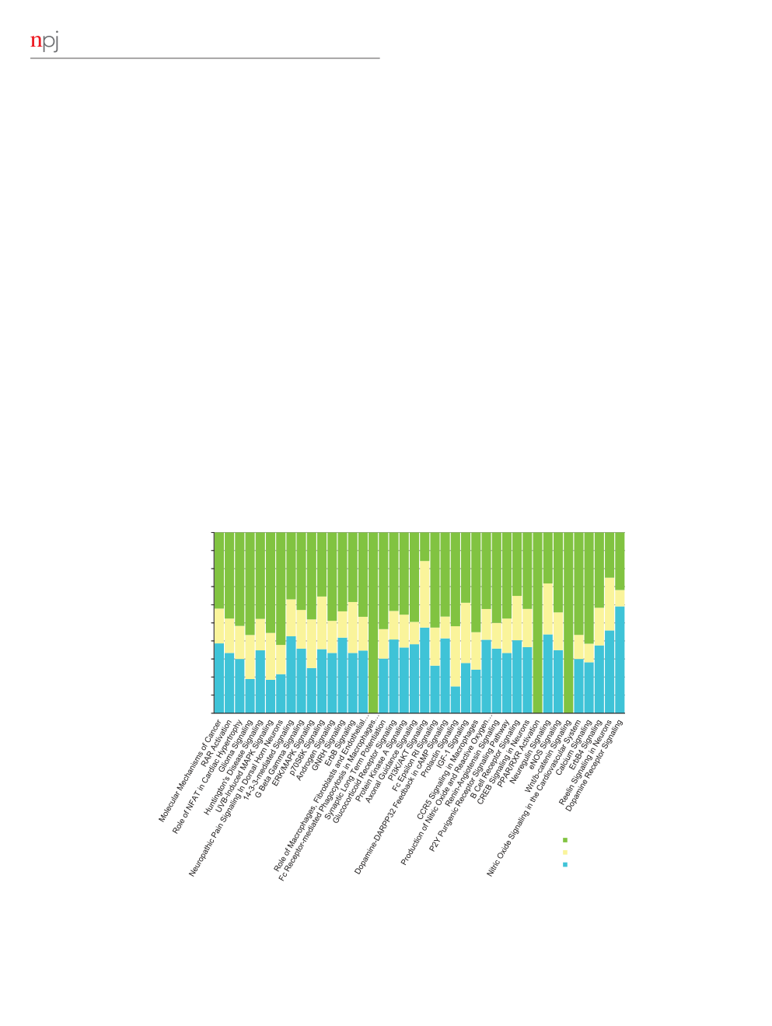
Schizophrenia interactome with novel interactions
6
MK Ganapathiraju
et al
GWAS versus Historic (pre-GWAS) risk genes of SZ
all of the pathways are associated with both the interactomes;
We used the interactome analyses to study the apparent
further, the common pathway association arises not only because
disconnectedness between the SZ risk genes identi
ﬁ
ed through
of the shared interactors but also because of unique genes in each
GWAS studies and those considered as risk genes in pre-GWAS
interactome. For example, consider the
RAR
activation path-
era. We compiled the interactomes of the 77 GWAS genes and the
way; while 12 genes that are common to both interactomes
25 Historic genes separately. HiPPIP predicted 365 novel PPIs of
are associated with it, 30 genes that are unique to the GWAS
GWAS genes adding to 819 previously known PPIs. Correspond-
interactome and 21 genes that are unique to the Historic gene
ingly, HiPPIP predicted 147 high con
ﬁ
dence new PPIs of Historic
interactome are also associated with it. In summary, although
genes adding to 519 previously known PPIs (see Supplementary
GWAS and Historic gene sets appear to be distinct, they share a
Files 5 and 6). Seventeen GWAS genes that had no known PPIs
signi
ﬁ
cant number of interactors, and show a signi
ﬁ
cant overlap
now have altogether 58 novel PPIs. Two Historic genes (
PRODH
of functional pathways. Our analyses thus help to reconcile an
and
ZDHHC8
) that had previously no known PPIs now have
ongoing, vigorous debate in the SZ genetics community regarding
12 novel PPIs. Although there is only one gene overlap bet-
the pathogenic signi
ﬁ
cance of research in the pre-GWAS era. We
ween GWAS and Historic gene sets, there is a highly signi
ﬁ
cant
repeated this approach with two randomly chosen sets of genes
overlap between their interactomes; 109 genes are common
of same sizes, and found that there was no visible relation
to the 2 interactomes, leading to a statistical signi
ﬁ
cance of
between them. As IPA analysis is cumbersome and the software
P
value
o
10
−
21
. We compared the shortest path distances from
license permits computation of only two such sets a day, we did
each of the GWAS genes to its closest Historic gene. With the
not repeat this large number of times to compute statistical
inclusion of novel PPIs, 16 GWAS genes that previously had no
signi
ﬁ
cance.
connecting paths to the Historic genes now get connected with
Overlap of the interactome with proteomic studies
2 to 4 edges between them. The histogram of shortest path
distances with and without novel PPIs is shown in Supplementary
Some recent reviews of proteomics studies have cataloged the
File 7. Could it be that although the gene sets are different, they
proteins reported as differentially expressed in one or more
are related in biological functionality? To study this, we computed
studies of SZ, explaining the common pathways or functions that
the pathways associated with the two interactomes separately
were recovered in various proteomic studies.
39,50
We found that
and then compared the overlap. We
ﬁ
nd that the overlap is
only one Historical gene (
DISC1
) and none of the GWAS genes
far richer than the simple overlap of the two interactomes
were found in these proteomic studies. We evaluated whether
themselves. Figure 4 shows the top 30 pathways of the GWAS
proteins identi
ﬁ
ed in these reviews were represented in our
interactome and some additional SZ relevant pathways, and the
interactome. Of the differentially expressed proteins in the gray
number of genes associated with each of the pathways from
matter of SZ postmortem brains,
50
34 were found as known
GWAS interactome only (green), Historic gene interactome only
interactors and 7 as novel interactors in the interactome, with
(blue), and common to both (yellow). It may be seen that almost
statistical signi
ﬁ
cance of
P
-value
o
10
−
8
by hypergeometric test.
100%
9
90%
20 18 25
17
24 15
14
20
11
6 7
80%
48 30 31 21
33
15 23
22
35
23
33 40 48
20
27
14
16
25
21
20
22
19
17 24
10
Number of Genes
70%
21
7
2
60%
11
14
11
50%
22
12
12
9
14
8
8 11 14
27
12 16 12
7
12
10
6 8
11
32
9
30
5
40%
11
9
7 6
14
7
8
9
6
4 4
30%
2315
23
313237
27
24
2415142319
17
11
13
20%
442118
24
5
8
13
1715
13
26
13
10
10 7
15
9 11
9
10%
7
4
0%
GWAS
Common
Historical
Pathways
Figure 4.
Overlap of signi
ﬁ
cant pathways from GWAS interactome and Historic gene interactome. Pathway associations are computed with
Ingenuity Pathway Analysis. Pathways shown are the top 30 pathways in the GWAS interactome, and additionally, some of the pathways that
are known to be associated with SZ. Number of genes associated with GWAS interactome is shown in green, with Historic gene interactome in
blue and common to both in yellow. GWAS, genome-wide association studies of schizophrenia; PPI, protein
–
protein interaction.
npj Schizophrenia (2016) 16012
© 2016 Schizophrenia International Research Society/Nature Publishing Group

Slide 7
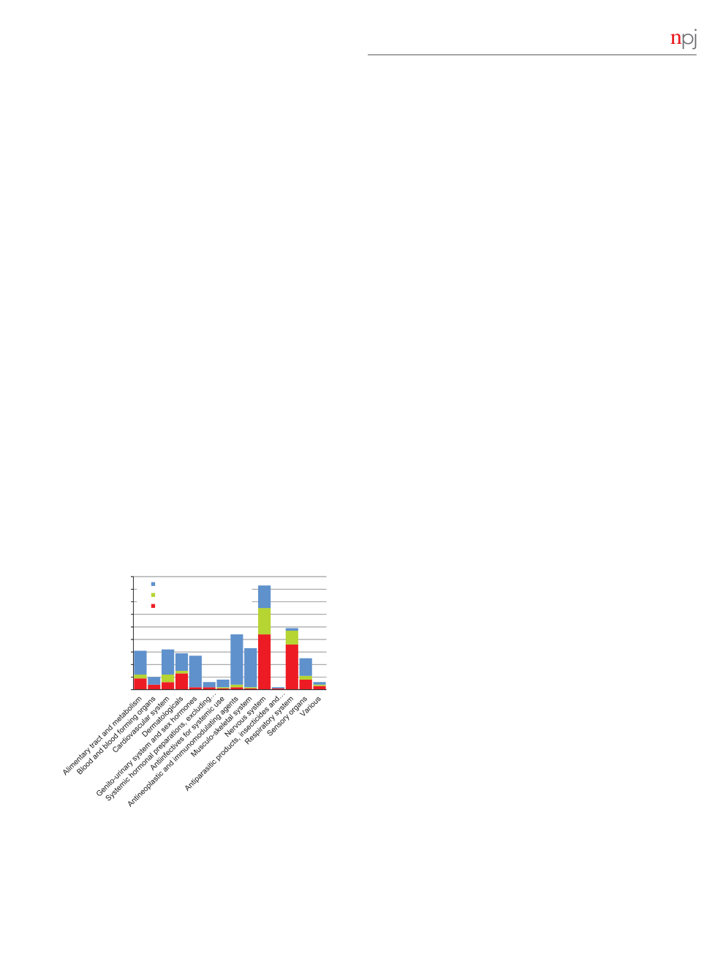
Schizophrenia interactome with novel interactions
MK Ganapathiraju
et al
7
Of the genes that were differentially expressed in the white matter
into more than 1 category). Of the nervous system drugs that
of SZ postmortem brains,
50
18 were known interactors and 3 were
target novel interactors, 6 drugs are antiepileptics, 34 are calming
novel interactors in the interactome. Four gray matter proteins
or stimulating drugs (i.e., psycholeptics and psychoanaleptics),
(ATP6V1B2, DPYSL2, NEFL and TUBA1C) and six white matter
2 are anesthetics, 2 are anti-Parkinson drugs, and 2 are other
proteins (ATP6V1B2, DPYSL2, NEFL, NEFM, STX1A and TUBB2A)
nervous system drugs. Corresponding
ﬁ
gure for drugs that target
from the interactome were previously implicated at mRNA level in
Historic gene interactome is shown in Supplementary File 9.
SZ brains.
50
Of the genes cataloged to be found in the proteome
Detailed network of drugs and their targets among SZ
of SZ,
39
16 genes associated to neuronal transmission and
interactome genes is shown in Figure 6, in which genes are
synaptic function, calcium homeostasis and signaling, energy
colored and labeled same as in Figure 2, while drugs are shown as
metabolism, oxidative stress, cytoskeleton, immune system and
green colored nodes. Nervous system drugs are shown in larger
in
ﬂ
ammation were found to be known interactors (statistical
size; thus presenting a birds-eye view of other (non-nervous
signi
ﬁ
cance of the overlap in comparison to all the proteins
system) drugs that can be potentially repurposed for SZ. To
reviewed with hypergeometric test was
P
-value
o
0.0003). Thus,
highlight this, we labeled the drugs that are already in clinical
we
ﬁ
nd that a common theme emerges through the interactome
trials for SZ with purple-color labels and it may be seen that a
which connects the GWAS genes and Historical genes to each
number of them are indeed non-nervous system-related drugs.
other and to a signi
ﬁ
cant number of genes found through
The
ﬁ
gure also visually presents drugs that interact with multiple
proteomic studies. A complete list of genes from the interactome
SZ risk genes as potential candidates for repurposing. Examples
that were found in these proteomics studies are given in
are sargramostim, regorafenib, theophylline, which are cancer and
Supplementary File 8.
respiratory drugs. List of all the drugs that target various genes in
the SZ interactome are shown in Supplementary File 10, with
Novel PPIs connect SZ genes to 20 drug target genes
detailed characterization of their ATC codes and whether they
The possibility and the immense value of drug repurposing are
target GWAS or Historic risk genes or their known or novel
well-understood today. In 2010, it was shown that the drug
interactors. Supplementary File 10 also shows drugs that are found
Comtan (active component: entacapone) that treats Parkinson
’
s
to be signi
ﬁ
cantly connected to SZ genes (see methods in
disease can potentially be repurposed to treat multidrug-resistant
Supplementary File 1).
and extremely-drug resistant forms of tuberculosis.
51
Comtan is an
We further explored the genes in the GWAS interactome that
inhibitor of COMT, which is one of the SZ-associated genes.
are targeted by nervous system drugs to identify potential drug
We analyzed which of the genes in the interactomes are drug
targets for SZ. The list includes 5 novel interactors HRH1, GRIA2,
targets, and what diseases these drugs treat. In GWAS inter-
KCNJ3, SCN1A, and CACNA1H and 6 known interactors GRIN3A,
actome, there are 74 genes that are targets of 307 unique drugs
GRIN1, CALM3, BCL2, PDE4B, and PTGS1. We predicted novel
(of which 20 are new interactors that are targeted by 131 drugs).
interactors of these drug targets (see Supplementary File 11), and
Figure 5 shows categorization of these 307 drugs by the Anatomic
found that seven of these drug targets had few known
category of the Anatomic, Therapeutic and Chemical (ATC)
interactions but many novel interactions. HRH1 with 12 novel
classi
ﬁ
cation of the drugs: Nervous system (83 drugs), alimentary
interactions, SCN1A with 6, PDE4B with 4, PTGS1 with 6, CACNA1H
tract and metabolism (31 drugs), musculoskeletal system (33
with 9, and KCNJ3 with 8 novel interactors. It is interesting to note
drugs), cardiovascular system (32 drugs), respiratory system (47
that NAB2, a GWAS gene, is predicted to interact with two of these
drugs), antineoplastic and immunomodulating agents (44 drugs),
novel genes HRH1 and SCN1A that are targeted by nervous
and genitourinary and sex hormones (27 drugs) (some drugs fall
system drugs. SCN1A is known to be associated with neuronal
disorder epilepsy, and HRH1 is a histamine receptor that belongs
to the family of G protein coupled receptors associated with
90
neurotransmission. Furthermore, HRH1 is targeted by not only
80
Target Known Interactors
nervous system drugs but also many respiratory drugs. Therefore,
Both
18
these genes, NAB2, HRH1 and SCN1A can be tested further to
Number of Drugs
70
Target Novel Interactors
identify their therapeutic value to SZ treatment.
60
21
50
11
Conclusions and future investigations
40
We developed an algorithm to predict protein
–
protein interac-
30
19
20 14
40
44
tions of genes and presented the novel interactions that are
20
25
31
36
14
deemed to be highly accurate according to computational
10
13
evaluations and experimental evaluations on some of the novel
0
PPIs. We then identi
ﬁ
ed novel interactions of SZ risk genes, from
which we identi
ﬁ
ed the pathways that are enriched in their
interactome, identi
ﬁ
ed drugs that target the interactors, and
enriched their GO term associations. Our analysis illustrates that
despite the disparity of genes/proteins found in various studies to
characterize SZ, a commonality emerges through the interaction
network and the pathways associated with the interactome. We
developed a search-enabled website which presents the PPIs with
comprehensive information about the genes involved in the PPIs.
It would be meaningful to validate the novel PPIs of SZ risk genes
Anatomical Category of Drugs
in postmortem brain tissues, as the experimental evaluations that
Figure 5.
Number of drugs that target the genes in the GWAS
we carried out were in non-CNS tissues. An important next step
interactome: the numbers are shown separated by the anatomic
will be to validate these predictions at the level of protein network
category of the drugs (Anatomic, Therapeutic and Chemical
alterations within brain tissue from subjects with SZ.
52
Protein
classi
ﬁ
cation) and also separated by whether they target known
interactome of SZ genes would be useful in carrying out network-
interactors (blue) or novel interactors (red) or both (green). GWAS,
based systems biology studies, while each predicted interaction
genome-wide association studies of schizophrenia.
would itself have a potential to advance SZ research.
© 2016 Schizophrenia International Research Society/Nature Publishing Group
npj Schizophrenia (2016) 16012

Slide 8
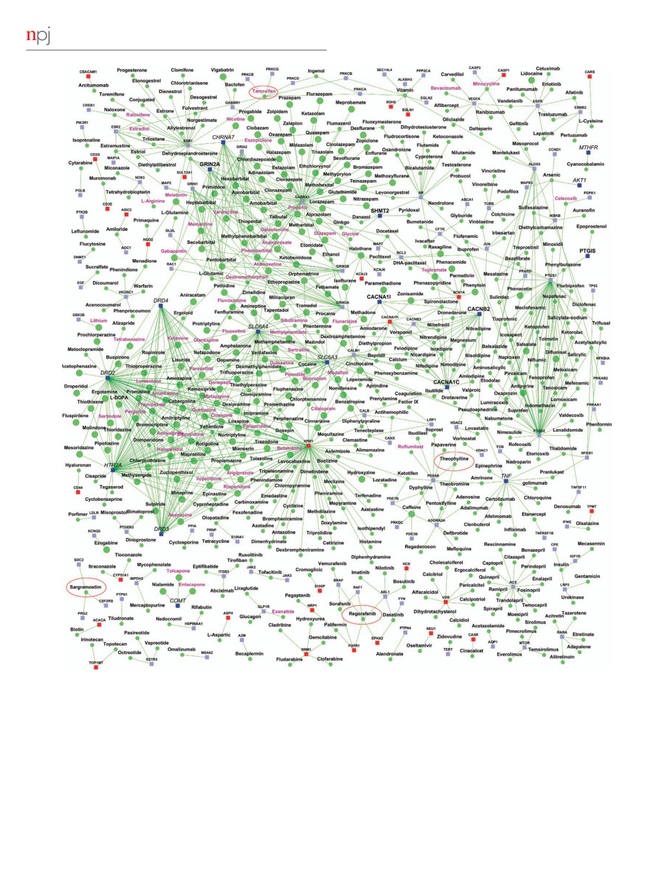
Schizophrenia interactome with novel interactions
8
MK Ganapathiraju
et al
Figure 6.
Gene
–
drug interactome. The network shows the drugs that target genes from the schizophrenia interactome. Drugs are shown as
round nodes colored in green and genes as square nodes colored in dark blue (schizophrenia genes), light blue (known interactors), and red
(novel interactors). Nervous system drugs (based on Anatomic category of ATC classi
ﬁ
cation) are shown as larger size green colored nodes
compared with other drugs. Drugs that are in clinical trials for schizophrenia are labeled purple. ATC, anatomic, therapeutic and chemical
classi
ﬁ
cation.
MATERIALS AND METHODS
genes that are believed to be SZ-associated from pre-GWAS era, which
Data
were recently evaluated for their continued relevance to the disease.
9
The
The SZ Working Group of the PGC recently combined and re-assessed the
two gene sets, which will be referred to as GWAS genes and Historical
data from the various GWAS available for SZ, and identi
ﬁ
ed 108 genomic
genes, respectively, had an overlap of only one gene (i.e., GRM3).
loci likely to be associated with SZ.
5
These loci corresponded to single
Random genes sets used in shortest path comparisons were sampled
nucleotide polymorphisms in 77 genes. In addition, we considered 25
from about 20,000 human proteins listed in Ensembl database (www.
npj Schizophrenia (2016) 16012
© 2016 Schizophrenia International Research Society/Nature Publishing Group

Slide 9
Schizophrenia interactome with novel interactions
MK Ganapathiraju
et al
9
ensembl.org). Drugs, and their ATC codes and drug targets were
of Mental Health of National Institutes of Health (NIMH/NIH) of USA. The content is
downloaded from DrugBank (www.drugbank.ca/). Drugs that are currently
solely the responsibility of the authors and does not necessarily represent the of
ﬁ
cial
in clinical trials were downloaded from ClinicalTrials.gov with the following
views of the National Institute of Mental Health, the National Institutes of Health.
query: condition: SZ and intervention: drug; withdrawn studies were not
M.K.G. thanks Naoki Orii and Suyoun Kim for assistance in software programming. C.E.L.
used here.
thanks Nadia Ben Larbi for assistance in carrying out co-localization experiments.
For algorithm development of PPI prediction, the training data were
composed of 20,000 known interactions collected from HPRD, mixed with
80,000 random pairs, making sure that the random pairs do not contain
CONTRIBUTIONS
any of the known PPIs. The fraction of known interactions in the test set
M.K.G. designed methods for interactome prediction and carried out all computa-
was kept low more realistically at 0.3% in a total of 160,000 pairs. We
tional analysis including pathway, drug and functional analysis, and designed website
considered all the proteins that had more than 50 known PPIs as hub
for dissemination. M.T. developed software methods for interactome prediction.
proteins for evaluations.
A.H. developed software methods for hosting Schizo-Pi data on Wiki-Pi webserver.
Prediction model
—
HiPPIP
E.M.B. and S.N.S. validated 6 and 1 protein
–
protein interactions, respectively, by
PPIs were predicted by computing features of protein pairs and developing
co-immunoprecipitation. C.E.L. validated 2 protein
–
protein interactions by co-
a random forest model to classify the pairwise features as interacting or
localization. V.L.N. and R.A.S. provided consultation for SZ gene selection and in
non-interacting. Protein annotations that were used in this work are:
manuscript preparation. S.C. assisted M.K.G. in pathway analysis and in editing the
cellular localization, molecular function and biological process member-
manuscript.
ship, location of the gene on the genome, gene expression in hundreds of
microarray experiments, protein domains and tissue membership of
COMPETING INTERESTS
proteins. Computation of features of protein pairs is described earlier in the
The authors declare no con
ﬂ
ict of interest.
study by Thahir
et al.
53
A random forest with 30 trees was trained using the
feature offering maximum information gain out of 4 random features to
split each node; minimum number of samples in each leaf node was set to
REFERENCES
be 10. The random forest outputs a continuous valued score in the range
of [0,1]. The threshold to assign a
ﬁ
nal label was varied over the range of
1. Perala, J.
et al.
Lifetime prevalence of psychotic and bipolar I disorders in
the score for positive class (i.e., 0 to 1) to
ﬁ
nd the precision and recall
a general population.
Arch. Gen. Psychiatry
64
, 19
–
28 (2007).
combinations that are observed (Figure 1). This prediction model is
2. Corvin, A. P. Two patients walk into a clinic...a genomics perspective on the
referred to as HiPPIP model.
future of schizophrenia.
BMC Biol.
9
, 77 (2011).
3. Hindorff, L. A.
et al.
Potential etiologic and functional implications of genome-
Evaluation of PPI prediction model
wide association loci for human diseases and traits.
Proc. Natl Acad. Sci. USA
106
,
Evaluations on a held-out test data showed a precision of 97.5% and a
9362
–
9367 (2009).
recall of 5% at a threshold of 0.75 on the output score. Next, we created
4. Girard, S. L., Dion, P. A. & Rouleau, G. A. Schizophrenia genetics: putting all the
ranked lists for each of the hub genes (i.e., genes that had
4
50 known
pieces together.
Curr. Neurol. Neurosci. Rep.
12
, 261
–
266 (2012).
PPIs), where we considered all pairs that received a score
4
0.5 to be novel
5. Schizophrenia Working Group of the Psychiatric Genomics Consortium. Biological
interactions. The predicted interactions of each of the hub genes are
insights from 108 schizophrenia-associated genetic loci.
Nature
511
, 421
–
427
arranged in descending order of the prediction score, and precision versus
(2014).
83
recall is computed by varying the threshold of predicted score from 1 to 0.
6. Need, A. C. & Goldstein, D. B. Schizophrenia genetics comes of age.
Neuron
,
Next, by scanning these ranked lists from top to bottom, the number of
760
–
763 (2014).
true positives versus false positives was computed.
7. Arion, D., Unger, T., Lewis, D. A., Levitt, P. & Mirnics, K. Molecular evidence for
increased expression of genes related to immune and chaperone function in the
prefrontal cortex in schizophrenia.
Biol. Psychiatry
62
, 711
–
721 (2007).
Novel PPIs in the SZ interactome
8. Hirschhorn, J. N. Genomewide association studies--illuminating biologic path-
Each SZ gene, say Z, is paired with each of the other human genes (G
1
, G
2
,
ways.
N. Engl. J. Med.
360
, 1699
–
1701 (2009).
…
, G
N
), and each pair is evaluated with the HiPPIP model. The predicted
9. Farrell, M. S.
et al.
Evaluating historical candidate genes for schizophrenia.
interactions of each of the SZ genes (namely, the pairs whose score
Mol. Psychiatry
20
, 555
–
562 (2015).
is greater than the threshold 0.5) were extracted. These PPIs, combined
10. Harrison, P. J. & Weinberger, D. R. Schizophrenia genes, gene expression, and
with the previously known PPIs of SZ genes collectively form the SZ
neuropathology: on the matter of their convergence.
Mol. Psychiatry
10
,
interactome.
40
–
68, image 45 (2005).
Note that 0.5 is the threshold chosen not because it is the midpoint
11. Millar, J. K.
et al.
Genomic structure and localisation within a linkage hotspot of
between the two classes, but because the evaluations with hub proteins
Disrupted In Schizophrenia 1, a gene disrupted by a translocation segregating
showed that the pairs that received a score
4
0.5 are highly con
ﬁ
dent to
with schizophrenia.
Mol. Psychiatry
6
, 173
–
178 (2001).
be interacting pairs. This aspect was further validated by experimentally
12. Camargo, L. M.
et al.
Disrupted in Schizophrenia 1 Interactome: evidence for the
validating a few novel PPIs above this score.
close connectivity of risk genes and a potential synaptic basis for schizophrenia.
Mol. Psychiatry
12
, 74
–
86 (2007).
Additional details
13. Brandon, N. J.
et al.
Understanding the role of DISC1 in psychiatric disease and
Additional details of methods are presented in Supplementary File 1.
during normal development.
J. Neurosci.
29
, 12768
–
12775 (2009).
14. Hart, G. T., Ramani, A. K. & Marcotte, E. M. How complete are current yeast and
human protein-interaction networks?
Genome Biol.
7
, 120 (2006).
Availability of data and materials
15. Stumpf, M. P.
et al.
Estimating the size of the human interactome.
Proc. Natl Acad.
The protein
–
protein interactions of SZ interactome are available on a
Sci. USA
105
, 6959
–
6964 (2008).
webserver with free access at http://severus.dbmi.pitt.edu/schizo-pi/. The
16. Peri, S.
et al.
Human protein reference database as a discovery resource for
algorithms used here are implemented with the Weka package (http://
proteomics.
Nucleic Acids Res.
32
, D497
–
D501 (2004).
sourceforge.net/projects/weka/). Features were computed with programs
17. Rual, J. F.
et al.
Towards a proteome-scale map of the human protein
–
protein
written in Java. The code for feature processing was implemented with
interaction network.
Nature
437
, 1173
–
1178 (2005).
many server con
ﬁ
gurations that are not portable for distribution. However
18. Deane, C. M., Salwinski, L., Xenarios, I. & Eisenberg, D. Protein interactions:
all novel PPIs are made available freely on the webserver and lists of
two methods for assessment of the reliability of high throughput observations.
interactors are also given as Supplementary Data.
Mol. Cell. Proteomics
1
, 349
–
356 (2002).
19. Jansen, R.
et al.
A Bayesian networks approach for predicting protein-protein
interactions from genomic data.
Science
302
, 449
–
453 (2003).
ACKNOWLEDGMENTS
20. Qi, Y.
et al.
Systematic prediction of human membrane receptor interactions.
Proteomics
9
, 5243
–
5255 (2009).
This work has been funded by the Biobehavioral Research Awards for Innovative New
21. Scott, M. S. & Barton, G. J. Probabilistic prediction and ranking of human protein-
Scientists (BRAINS) grant R01MH094564 awarded to M.K.G. by the National Institute
protein interactions.
BMC Bioinformatics
8
, 239 (2007).
© 2016 Schizophrenia International Research Society/Nature Publishing Group
npj Schizophrenia (2016) 16012

Slide 10

Schizophrenia interactome with novel interactions
10
MK Ganapathiraju
et al
22. Zhu, J.
et al.
Antiviral activity of human OASL protein is mediated by enhancing
40. Nomoto, M.
et al.
Dysfunction of the RAR/RXR signaling pathway in the
signaling of the RIG-I RNA sensor.
Immunity
40
, 936
–
948 (2014).
forebrain impairs hippocampal memory and synaptic plasticity.
Mol. Brain
5
,
23. Saia-Cereda, V. M.
et al.
Proteomics of the corpus callosum unravel pivotal players
8 (2012).
in the dysfunction of cell signaling, structure, and myelination in schizophrenia
41. Goodman, A. B. Three independent lines of evidence suggest retinoids as causal
brains.
Eur. Arch. Psychiatry Clin. Neurosci.
265
, 601
–
612 (2015).
to schizophrenia.
Proc. Natl Acad. Sci. USA
95
, 7240
–
7244 (1998).
24. Qi, Y.
et al.
Systematic prediction of human membrane receptor interactions.
42. Napoli, E.
et al.
Mitochondrial dysfunction in Pten haplo-insuf
ﬁ
cient mice with
Proteomics
9
, 5243
–
5255 (2009).
social de
ﬁ
cits and repetitive behavior: interplay between Pten and p53.
PLoS ONE
25. Kohl, M., Wiese, S. & Warscheid, B. Cytoscape: software for visualization and
7
, e42504 (2012).
analysis of biological networks.
Methods Mol. Biol.
696
, 291
–
303 (2011).
43. Wong, T. H.
et al.
PRKAR1B mutation associated with a new neurodegenerative
26. Schizophrenia Psychiatric Genome-Wide Association Study (GWAS) Consortium.
disorder with unique pathology.
Brain
137
, 1361
–
1373 (2014).
Genome-wide association study identi
ﬁ
es
ﬁ
ve new schizophrenia loci.
Nat. Genet.
44. Mayr, M. & Schmid, R. M. Pancreatic cancer and depression: myth and truth.
BMC
43
, 969
–
976 (2011).
Cancer
10
, 569 (2010).
27. Chen, P. W. & Kroog, G. S. Leupaxin is similar to paxillin in focal adhesion
45. Hinz, A.
et al.
Anxiety and depression in cancer patients compared with the
targeting and tyrosine phosphorylation but has distinct roles in cell adhesion and
general population.
Eur. J. Cancer Care
19
, 522
–
529 (2010).
spreading.
Cell Adh. Migr.
4
, 527
–
540 (2010).
46. Moore, L.
et al.
Serum testosterone levels are related to cognitive function in men
28. Fan, Y.
et al.
Focal adhesion dynamics are altered in schizophrenia.
Biol. Psychiatry
with schizophrenia.
Psychoneuroendocrinology
38
, 1717
–
1728 (2013).
74
, 418
–
426 (2013).
47. Begemann, M. J., Dekker, C. F., van Lunenburg, M. & Sommer, I. E. Estrogen
29. Wong, A. H.
et al.
Association between schizophrenia and the syntaxin 1A gene.
augmentation in schizophrenia: a quantitative review of current evidence.
Biol. Psychiatry
56
, 24
–
29 (2004).
Schizophr. Res.
141
, 179
–
184 (2012).
30. Funk, A. J., McCullumsmith, R. E., Haroutunian, V. & Meador-Woodruff, J. H.
48. Kulkarni, J., Gavrilidis, E., Worsley, R., Van Rheenen, T. & Hayes, E. The role of
Abnormal activity of the MAPK- and cAMP-associated signaling pathways in
estrogen in the treatment of men with schizophrenia.
Int. J. Endocrinol. Metab.
11
,
frontal cortical areas in postmortem brain in schizophrenia.
Neuropsycho-
129
–
136 (2013).
pharmacology
37
, 896
–
905 (2012).
49. Min, J. A.
et al.
Association of estrogen receptor genes and schizophrenia:
31. Tu, T.
et al.
CD146 deletion in the nervous system impairs appetite, locomotor
a preliminary study.
Prog. Neuropsychopharmacol. Biol. Psychiatry
36
, 1
–
4 (2012).
activity and spatial learning in mice.
PLoS ONE
8
, e74124 (2013).
50. English, J. A., Pennington, K., Dunn, M. J. & Cotter, D. R. The neuroproteomics of
32. Kumarasinghe, N.
et al.
Gene expression pro
ﬁ
ling in treatment-naive schizo-
schizophrenia.
Biol. Psychiatry
69
, 163
–
172 (2011).
phrenia patients identi
ﬁ
es abnormalities in biological pathways involving AKT1
51. Kinnings, S. L.
et al.
Drug discovery using chemical systems biology: repositioning
that are corrected by antipsychotic medication.
Int. J. Neuropsychopharmacol.
16
,
the safe medicine Comtan to treat multi-drug and extensively drug resistant
1483
–
1503 (2013).
tuberculosis.
PLoS Comput. Biol.
5
, e1000423 (2009).
33. Orii, N. & Ganapathiraju, M. K. Wiki-pi: a web-server of annotated human protein-
52. MacDonald, M. L.
et al.
Altered glutamate protein co-expression network topol-
protein interactions to aid in discovery of protein function.
PLoS ONE
7
,
ogy linked to spine loss in the auditory cortex of schizophrenia.
Biol. Psychiatry
e49029 (2012).
77
, 959
–
968 (2015).
34. Battle, A.
et al.
Characterizing the genetic basis of transcriptome diversity through
53. Thahir, M., Sharma, T. & Ganapathiraju, M. K. An ef
ﬁ
cient heuristic method for
RNA-sequencing of 922 individuals.
Genome Res.
24
, 14
–
24 (2014).
active feature acquisition and its application to protein-protein interaction
35. Schuster-Bockler, B. & Bateman, A. Protein interactions in human genetic
prediction.
BMC Proc.
6
(Suppl 7): S2 (2012).
diseases.
Genome Biol.
9
, R9 (2008).
36. Maere, S., Heymans, K. & Kuiper, M. BiNGO: a Cytoscape plugin to assess over-
representation of gene ontology categories in biological networks.
Bioinformatics
This work is licensed under a Creative Commons Attribution 4.0
21
, 3448
–
3449 (2005).
International License. The images or other third party material in this
37. Imbrici, P., Camerino, D. C. & Tricarico, D. Major channels involved in neuro-
article are included in the article
’
s Creative Commons license, unless indicated
psychiatric disorders and therapeutic perspectives.
Front. Genet.
4
, 76 (2013).
otherwise in the credit line; if the material is not included under the Creative Commons
38. Volknandt, W. The synaptic vesicle and its targets.
Neuroscience
64
, 277
–
300 (1995).
license, users will need to obtain permission from the license holder to reproduce the
39. Nascimento, J. M. & Martins-de-Souza, D. The proteome of schizophrenia.
material. To view a copy of this license, visit http://creativecommons.org/licenses/
NPJ Schizophr.
1
, 14003 (2015).
by/4.0/
Supplementary Information accompanies the paper on the
npj Schizophrenia
website (http://www.nature.com/npjschz)
npj Schizophrenia (2016) 16012
© 2016 Schizophrenia International Research Society/Nature Publishing Group

