Slide 1

6BBYN309 Memory Mechanism (2025)
Hippocampal Long-Term Depression (LTD):
Learning and Disease
Prof. Kei Cho
Professor of Neuroscience,
Synapse and Therapeutic Discovery Laboratory
kei.cho@kcl.ac.uk
20-Oct-2025 (11:00-12:00)
1

Slide 2

6BBYN309 Memory Mechanism (2025)
Hippocampal Long-Term Depression (LTD):
Learning and Disease
LTD is a long-lasting, activity-dependent reduction in the efficacy
of synaptic communication following a certain patterned stimulus.
Objectives of this lecture
:
• The importance of synapse weakening in the brain.
• The mechanism of
long-term depression
(
LTD
) in the
hippocampus.
• The physiological and pathophysiological role of LTD-like
synapse weakening.
• How aberrant LTD may cause memory deficits in Alzheimer’s
disease.
2

Slide 3
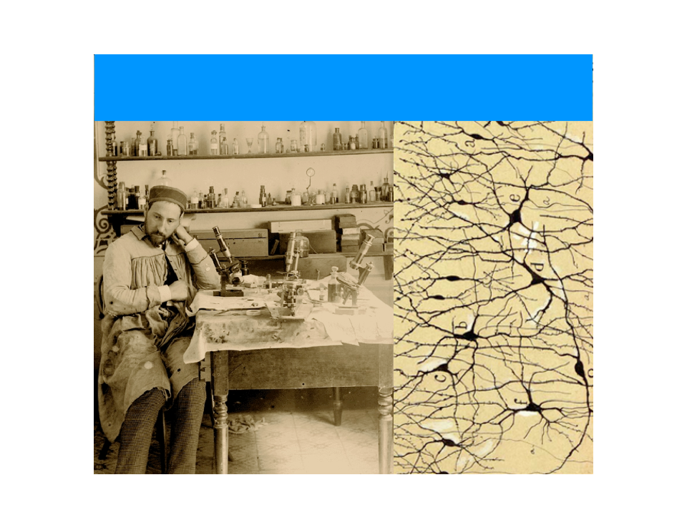
Neural networks are continuous circuits and change efficacy
Santiago Ramón y Cajal & Camillo Golgi
The Nobel Prize in Physiology or Medicine 1906 “in recognition of their
work on the structure of the nervous system”.
6BBYN309 (2025) Hippocampal LTD - Learning and Disease
3

Slide 4
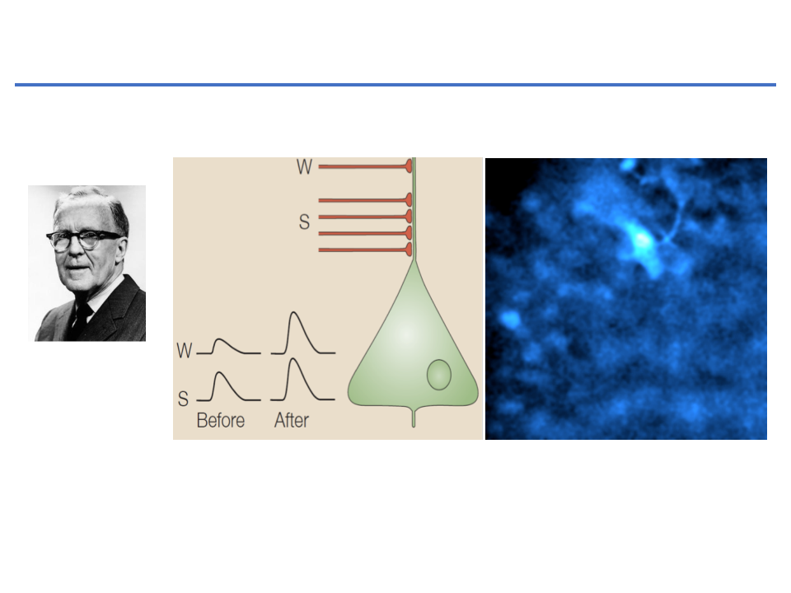
The theory of learning and memory:
Hebb’s rule (1949)
Neurons that fire together wire together
Inputs
Donald Hebb
(1904-1985)
CA1
Learning and memory would involve
synaptic strengthening
and weakening by activity (experience)
between input-output
neurons in the brain
6BBYN309 (2025) Hippocampal LTD - Learning and Disease
4

Slide 5
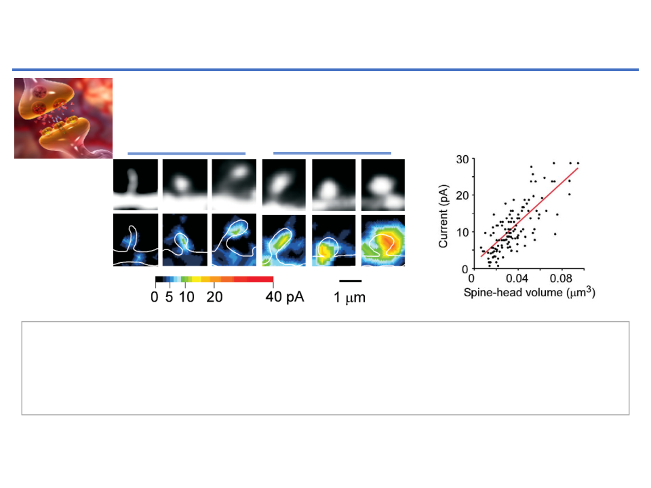
ods). The mapping system simultaneously recorded the fluorescence
D
i
s
tr
i
but
i
on of fun
c
t
i
on
a
l
AM
P
A r
e
c
e
ptor
s
i
n
v
i
v
o
a
b
c
d
e
k
on dendrites, we obtained
a
b
e
along the
z
-axis (as described
evoked by the laser irradiation used for uncaging, to detect any struc-
We then applied our methodology to hippocampal CA1 pyram
Synapse
c
d
k
along the
z
-axis (as describ
: The function of ‘
Learning
’ and the
Fig. 2c
each
z
-axis section being sepa
tural alteration in the ROI during experiments (
). Maps of
dal neurons in acute slice preparations (
Fig. 3a
and
b
). The spati
each
z
-axis section being s
Individual spines exhibited a h
© 2001 Nature Publishing Group http://neurosci.nature.c
the amplitude of 2pEPSCs represented by pseudocolor coding (
Fig.
resolution of AMPA-receptor mapping was slightly reduced com
structure of ‘
Memory’
Individual spines exhibited
in maximal glutamate sensitiv
2b
) are shown in Fig. 2d and e. The regions of glutamate sensitivity
pared with cultured neurons, 0.6
µ
m laterally and 1.4
µ
m axiall
in maximal glutamate sens
were apparently clustered along the dendrites (
Fig. 2f
) and were adja-
0.45 ± 0.11 (9 dendrites). We
because of the smaller numerical aperture (NA) of the lens use
0.45 ± 0.11 (9 dendrites).
cent to the nerve terminals stained with FM1-43 (
Fig. 2g
and
h
).
mediated currents when Mg
2+
(0.9). We therefore chose to study those dendrites in which spin
mediated currents when M
cellular solution; the distributi
Postsynaptic-dendritic spine structure and expression of
Thus, our functional mapping approach was able to detect the clus-
were relatively sparse (
∼
1 spines/
µ
m). The time course of 2pEPS
cellular solution; the distri
glutamate AMPA receptors
heterogeneous than that of AMP
tering of AMPA receptors in the postsynaptic membrane
23,32,33
.
(
Fig. 3bA–C
) is similar to spontaneous mEPSCs (
Fig. 3bE
). T
Glutamate
heterogeneous than that of A
expressed NMDA receptors (da
map the three-dimensional distribution of AMPA recepto
g
expressed NMDA receptor
f
h
i
j
on dendrites, we obtained several two-dimensional map
Thin spines
Mushroom spines
l
a
Postsynapse
g
j
b
d
e
k
i
c
f
h
l
along the
z
-axis (as described for cultured neurons), wit
F
i
g
.
4
.
S
p
i
n
e
g
e
o
m
e
tr
F
i
g
.
5
.
C
a
b
c
µ
y
a
nd
e
x
each
z
-axis section being separated by 0.8
m (
Fig. 3c–e
F
i
g
.
4
.
S
p
i
n
e
g
e
o
m
e
tr
y
a
n
r
e
c
e
ptor
s
.
F
l
uor
e
s
c
e
n
c
g
e
o
m
e
tr
y
Spine structure
e
i
m
a
g
e
s
Individual spines exhibited a high degree of heterogenei
r
e
c
e
ptor
s
.
F
l
uor
e
s
c
e
n
c
e
i
m
a
m
a
p
s
(
botto
m
)
a
r
e
s
t
i
e
s
.
A
f
(volume)
in maximal glutamate sensitivity (
Fig. 3f–h
hown
f
or
v
a
m
a
p
s
(
botto
m
), with a CV o
)
a
r
e
s
hown
f
o
p
y
r
a
m
i
d
a
l
n
e
uron
s
i
d
e
ndr
i
t
e
n h
i
ppo
c
a
m
0.45 ± 0.11 (9 dendrites). We also detected slow NMDA
i
m
a
g
p
y
r
a
m
i
d
a
l
n
e
uron
s
i
n h
i
pp
e
s
w
e
r
e
obt
a
i
n
e
d
f
ro
m
s
t
2+
i
m
a
g
e
s
w
e
r
e
obt
a
w
a
s
g
e
n
e
mediated currents when Mg
i
n
e
d
f
ro
m
r
e
s
p
was removed from the extr
e
c
t
iv
e
s
p
i
n
e
.
Th
e
g
l
ut
a
m
a
t
e
r
e
s
p
e
c
t
iv
e
s
p
i
n
e
.
i
m
a
g
e
s
.
Glutamate-
Th
e
g
l
ut
a
m
cellular solution; the distribution of these currents was le
f
ro
m
on
e
x
–
y
s
e
c
t
i
on
i
n wh
ic
h th
e
sensitivity map
f
ro
m
on
e
x
–
y
s
e
c
t
i
th
e
s
p
i
n
on
i
n wh
ic
heterogeneous than that of AMPA receptors, and most spin
f
or th
e
s
p
i
n
e
w
a
s
d
e
t
e
c
t
e
d
.
Th
e
f
or th
e
s
p
i
n
e
w
a
s
d
m
a
t
e
s
e
n
i
nt
e
rpo
l
a
t
i
on
.
Wh
i
t
e
li
n
e
t
e
c
t
e
d
.
T
expressed NMDA receptors (data not shown).
e
s
i
nd
ic
a
t
i
nt
e
rpo
l
a
t
i
on
.
Wh
i
t
s
hown
i
n
g Group http://neurosci.nature.com
s
tru
c
tur
e
s
.
R
e
pr
e
s
e
nt
a
t
e
li
n
e
s
i
nd
iv
e
d
a
t
a
g
j
s
tru
c
tur
e
s
.
R
e
pr
e
s
e
r
e
s
pond
f
h
i
l
roo
m
s
p
i
n
e
s
13
(
f
–
j
)
,
f
il
nt
a
t
iv
e
d
opod
i
a
(
k
)
roo
m
s
p
i
n
e
s
13
(
f
–
j
)
(
a
)
.
(
c
)
d
a
y-
o
l
d
a
n
i
m
a
l
(
l
)
a
r
e
s
,
f
il
opod
i
a
F
i
g
.
4
.
S
p
i
n
e
g
e
o
m
e
tr
y
a
nd
e
xpr
e
ss
i
on o
f
f
un
c
t
hown
.
i
on
a
l
AM
P
d
a
y-
o
l
d
a
n
i
m
a
l
(
l
)
a
s
p
i
n
e
-
h
e
a
r
e
s
hown
.
r
e
c
e
ptor
s
.
F
l
uor
e
s
c
e
n
c
e
i
m
a
g
e
s
(
top
)
a
nd
g
l
ut
a
m
a
t
e
-
s
e
n
s
i
t
ivi
d
1088
e
nature
s
e
n
s
i
t
ivi
t
f
neuroscience
• vo
The maximum glutamate sensitivity is significantly correlated with the volume of dendritic spine
m
a
p
s
(
botto
m
)
a
r
e
s
hown
f
or
v
a
r
i
ou
s
d
e
ndr
i
t
ic
s
p
i
n
e
s
o
f
C A
1088
nature
dr
i
t
e
s
.
(
e
head.
neuroscience
p
y
r
a
m
i
d
a
l
n
e
uron
s
i
n h
i
ppo
c
a
m
p
a
l
s
lic
e
s
.
Th
e
f
l
uor
e
s
c
e
n
c
s
p
i
n
e
-
n
e
c
• Spines with large heads are stable, express large numbers of AMPA-type glutamate receptors, and
i
m
a
g
e
s
w
e
r
e
obt
a
i
n
e
d
f
ro
m
s
t
a
c
ke
d
i
m
a
g
e
s
c
ont
a
i
n
i
n
g
th
r
e
s
p
e
c
t
iv
e
s
p
i
n
e
.
Th
e
g
l
ut
a
m
a
t
e
-
s
e
n
s
i
t
ivi
t
y
m
a
p w
a
v
o
l
u
m
e
f
contribute to strong synaptic connections
s
obt
a
i
n
e
f
ro
m
on
e
x
–
y
s
e
c
t
i
on
i
n wh
ic
h th
e
m
a
x
i
m
a
l
g
l
ut
a
m
a
t
a
uto
c
orr
• Spines with small heads are motile and unstable and contribute to weak or silent synaptic
e
s
e
n
s
i
t
ivi
f
or th
e
s
p
i
n
e
w
a
s
d
e
t
e
c
t
e
d
.
Th
e
m
a
p
s
w
e
r
e
s
m
ooth
t
ivi
t
y
(
b
l
connections
e
v
d b
y
li
n
e
i
nt
e
rpo
l
a
t
i
on
.
Wh
i
t
e
li
n
e
s
i
nd
ic
a
t
e
th
e
c
ontour
s
o
f
th
e
o
l
u
m
e
t
a
d
e
ndr
i
t
s
tru
c
tur
e
s
.
R
e
pr
e
s
e
nt
a
t
iv
e
d
a
t
a
f
ro
m
th
i
n
s
p
i
n
e
s
(
a
–
n
c
e
s
b
e
f
e
)
,
m
u
s
Adapted from Kasai et al., 2003 Trends in Neurosci 26, 360-368
ro
m
th
e
roo
m
s
p
i
n
e
s
13
(
f
–
j
)
,
f
il
opod
i
a
(
k
)
a
nd
a
m
u
s
hroo
m
s
p
i
n
e
i
n
a
d
a
y-
o
l
d
a
n
i
m
a
l
(
l
)
a
r
e
s
hown
.
i
nd
ic
a
t
e
d
1088
6BBYN309 (2025) Hippocampal LTD - Learning and Disease
5
nature
neuroscience
• volume 4 no 11 • november 200

Slide 6
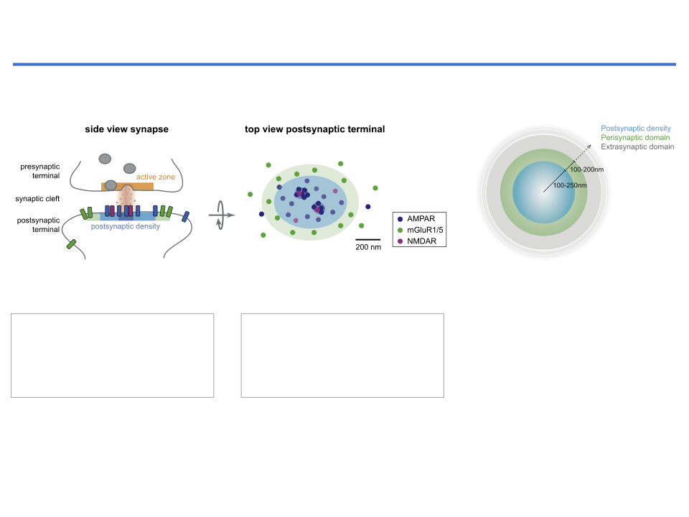
AMPA receptors
are the primary conduits of
excitatory synaptic transmission
�
��������������������������������������������������
N. Scheefhals, H.D. MacGillavry
Fig. 1. Subsynaptic segregation of glutamate receptor types at the postsynaptic membrane.
(
A
) Side view of an excitatory synapse with an active zone (orange) at the presynaptic terminal and postsynaptic density (PSD) (blue), and perisynaptic domain
(green) at the postsynaptic terminal (left). A single release event of glutamate is predicted to create a subsynaptic hotspot of maximally activated postsynaptic
glutamate receptors (dark blue shaded area) aligned with the presynaptic vesicle release site. Top view of the lateral patterning of the postsynaptic membrane with a
A single release event of
Most AMPA receptors are
central PSD (blue) containing AMPA- (dark blue) and NMDA-type (pink) receptors, and a surrounding perisynaptic domain (green) enriched in mGluR1/5 (dark
green) (right). Additionally, PSD components, most notably AMPARs, are organized in ~1
3 distinct nanodomains per synapse (dark blue shaded area).
glutamate is predicted to
localised within the central
Top view of an excitatory
–
(
B
) Top view of an excitatory postsynapse to make a clear distinction between the PSD, on average 500
–
1000 nm in diameter, the perisynaptic domain, an annulus of
100
activate postsynaptic glutamate
postsynaptic density (PSD; blue
post synapse
–
200 nm surrounding the PSD, and the extrasynaptic domain, everything beyond the perisynaptic domain.
receptors within a subsynaptic
area).
hotspot.
exogenous glutamate resulted in larger amplitude responses (
Liu et al.,
The spatial segregation of receptor types has important functional
implications as the distinct localization with respect to the presynaptic
1999
;
McAllister and Stevens, 2000
;
Pankratov and Krishtal, 2003
).
release site is predicted to greatly impact the activation kinetics of these
Even further displaced from the release site are the mGluRs, located
receptors types. As has been extensively investigated by numerous
at the perisynaptic domain surrounding the PSD, strongly constraining
Adapted from Sheefhals et al., Mol and Cellular Neursci. (2018) 91, 82-94
computational models that incorporate realistic features of glutamate
the activation probability of these receptors. The binding a
ﬃ
nity of
release and synapse geometry single release events produce a very steep
group I mGluRs for glutamate is comparable to AMPARs as measured in
peak in synaptic cleft glutamate concentration, restricted to a small
heterologous systems (
Conn and Pin, 1997
;
Traynelis et al., 2010
), and
area (< 100 nm) for only a brief period of time (~100
μ
s) (
Boucher
although one glutamate molecule is su
ﬃ
cient to activate mGluR5 di-
6BBYN309 (2025) Hippocampal LTD - Learning and Disease
6
et al., 2010
;
Franks et al., 2003
;
Raghavachari and Lisman, 2004
;
mers, occupation of both subunits is required for optimal activation
Uteshev and Pennefather
1996
;
Xie et al
1997
;
Xu Friedman and
(
Kniaze
ﬀ
et al
2004
;
Niswender and Conn 2010
) Thus these bio

Slide 7
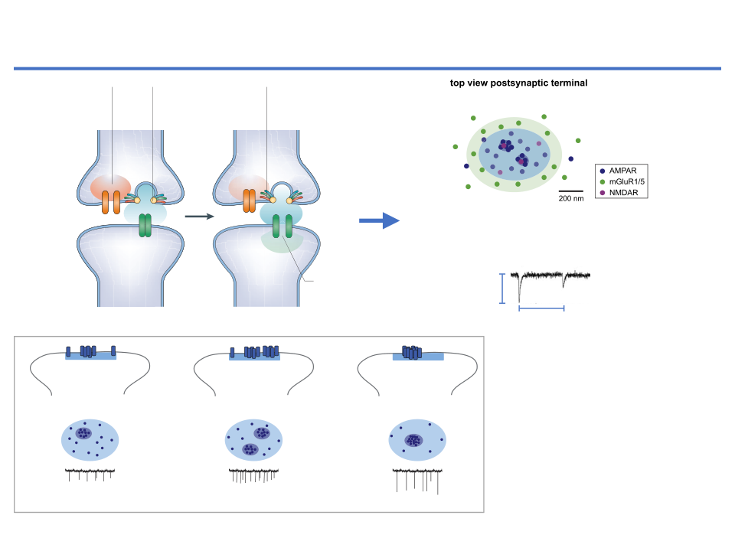
were transsynaptically aligned with postsynaptic nanodomains
spontaneous event activates receptors, and could be measured as a
�
ng et al., 2016
). Thus, evoked release is more likely to activate the
change in mEPSC
frequency
(
Fig. 2
B). Thus, while a change in mEPSC
������������
AMPA receptors
are the primary conduits of
ptors that are enriched in nanodomains, while spontaneous quantal
frequency is generally interpreted as a change in presynaptic function
N. Scheefhals, H.D. MacGillavry
nts are likely to probe a larger fraction of the postsynaptic pool of
or in the number of synaptic connections, perhaps it could also be in-
excitatory synaptic transmission
ptors, including areas that are less dense in receptors. One predic-
terpreted as a change in the functional organization of postsynaptic
from this organization is that the
variance
in the peak amplitude of
receptors. For instance, the genetic removal of individual GluA2-con-
ked EPSCs is much smaller than of mEPSCs (
MacGillavry et al.,
taining AMPA receptors signi
ﬁ
cantly reduced mEPSC frequency, but
3
), which has indeed been con
ﬁ
rmed experimentally (
Freche et al.,
not amplitude, even though both the total number of synapses and
rization
Ca
2+
elevation
Ca
2+
binds to
Glutamate passes
1
). Alignment of presynaptic release with postsynaptic nanodo-
measures of presynaptic function are not a
ﬀ
ected in (
Lu et al., 2009
).
Ca
2+
occurs in
synaptotagmin
through fusion
ns thus gives rise to more reliable synaptic transmission (
Fig. 2
).
This might suggest that in the remaining fraction of functional sy-
s
microdomain
causing opening
pore and diffuses
How could changes in postsynaptic nanodomain organization a
ﬀ
ect
napses, GluA2-lacking AMPA receptors are still capable of populating
of fusion pore
in the cleft
aptic responses? Since evoked release events are spatially aligned
subsynaptic nanodomains that can produce similar response amplitudes
h postsynaptic nanodomains, evoked EPSCs are likely more directly
Iwasato et al.
•
Cortical AC1-Dependent Barrel Cortex Development
+++++
as normal synapses. It would be of interest to investigate how the
+++++
Presynaptic
uenced by changes in receptor organization than spontaneous
subunit composition and levels of AMPARs at individual synapses is
terminal
nts. As such, an increase in the number of postsynaptic receptor
related to the molecular organization of synapses.
odomains is predicted to decrease the failure rate of evoked re-
In a recent study, GluA1-containing AMPA receptors were selec-
+
+
++
nses (
++
Fig. 2
B), while an increase in nanodomain content (i.e. more
tively recruited to the PSD by an elegant optogenetic approach. Using
ptors per nanodomain) would increase the amplitude of evoked
this recruitment assay, it was shown that adding GluA1-containing
Ca
Ca
2+
+++
2+
onses (
+++
+
Fig. 2
C).
AMPA receptors to existing synapses signi
ﬁ
cantly increased synaptic
+
Given that spontaneous release events seem to take place at random
responses as measured by evoked EPSCs, glutamate uncaging, and
tions, not preferentially aligned with postsynaptic nanodomains,
mEPSC frequency, but did not a
ﬀ
ect the amplitude of mEPSCs (
Sinnen
nges
in
nanodomain
organization
are
probably
less
directly
et al., 2017
). These experiments thus indicate that the global addition of
Miniature excitatory postsynaptic AMPA
Fig. 1. Subsynaptic segregation of glutamate receptor types at the postsynaptic membrane.
+
+
+
+
+ +
+
+
+ +
+
+
(
A
) Side view of an excitatory synapse with an active zone (orange) at the presynaptic terminal and postsynaptic density (PSD
A
B
C
receptor-mediated currents (
mEPSCs
)
+
+
(green) at the postsynaptic terminal (left). A single release event of glutamate is predicted to create a subsynaptic hotspot of
+
+
+
+
+
+
glutamate receptors (dark blue shaded area) aligned with the presynaptic vesicle release site. Top view of the lateral patterning of
organization in nanodomains
increase in nanodomain
number
increase in nanodomain
content
Amplitude
+
+
+
+
central PSD (blue) containing AMPA- (dark blue) and NMDA-type (pink) receptors, and a surrounding perisynaptic domain (g
+
Opening of
+
+
side view
side view
+
side view
green) (right). Additionally, PSD components, most notably AMPARs, are organized in ~1
–
3 distinct nanodomains per synapse
(
B
AMPA channel
) Top view of an excitatory postsynapse to make a clear distinction between the PSD, on average 500
–
1000 nm in diameter, the
+
+
+
100
+
generates EPSC
Number of
Postsynaptic
–
200 nm surrounding the PSD, and the extrasynaptic domain, everything beyond the perisynaptic domain.
f chemical synaptic transmission.
These steps occur in both vertebrates and invertebrates,
Event
active zone
dendrite
nd central synapses. Cartoons based on a drawing by J. A. Ernst and A. Brunger.
The spatial segregation of receptor types has important functional
exogenous glutamate resulted in larger
postsynaptic density
implications as the distinct localization with respect to the presynaptic
1999
;
McAllister and Stevens, 2000
;
Pa
dications that the smaller
an action potential. It was concluded that Ca
in the
Even further displaced from the rele
release site is predicted to greatly impact the activation kinetics of these
Increase in
2+
Increase in
may have found a one-
microdomain rises to 25 μM
(or 10 μM using a differ-
mEPSCs
: Spontaneous synaptic
receptors types. As has been extensively investigated by numerous
at the perisynaptic domain surrounding
Basal
25
nanodomain
nanodomain
number
content
the activation probability of these rec
napses, substantial Ca
computational models that incorporate realistic features of glutamate
2+
ent method
26
). The duration of this elevation is about
current in a postsynaptic neuron
. This
µ
release and synapse geometry single release events produce a very steep
group I mGluRs for glutamate is compar
he action potential
14
300
s
(FIG. 2b)
. In complementary experiments, the
top view
top view
top view
caused by the release of single
hannels prevent the peak
artificial production of such brief Ca
peak in synaptic cleft glutamate concentration, restricted to a small
heterologous systems (
Conn and Pin, 19
2+
signals triggered
vesicle of excitatory
becoming too positive,
area (< 100 nm) for only a brief period of time (~100
μ
s) (
Boucher
although one glutamate molecule is su
release that satisfactorily mimicked those produced by
neurotransmitter (eg., glutamate)
driving force
. For such
et al., 2010
;
Franks et al., 2003
;
Raghavachari and Lisman, 2004
;
mers, occupation of both subunits is r
15
an action potential
27
.
Uteshev and Pennefather, 1996
;
Xie et al., 1997
;
Xu-Friedman and
(
Kniaze
et al., 2004
;
Niswender and
from presynaptic terminal.
nnels must open rapidly,
Although much is now known about the structure of
ﬀ
central synapses
Regehr, 2004
). Importantly, the a
ﬃ
nity of AMPARs for glutamate is
physical properties predict that the low
mple to show that this can
(FIG. 3)
, the distance between the Ca
2+
relatively low and the number of glutamate molecules bound to AMPAR
the periphery of the synapse during sin
channels and the vesicles has not been directly meas-
Increased in
Increased in
activation. Moreover, glutamate transpo
subunits determines the open probability of the receptor (
Rosenmund
basal mEPSC
eEPSCs: decrease in failure rate
eEPSCs: increase in amplitude
Frequency
ured. The fact that Ca
2+
channels can bind directly to
Amplitude
mEPSCs: increase in frequency
Figure 7.
AMPA receptor mini-EPSCs are smaller at CxAC1KO TC synapses.
A
,
B
, Sample traces of evoked A
et al., 1998
mEPSCs: increase in amplitude
at the perisynaptic domain (
Dehnes e
in the microdomain.
As
vesicle proteins suggests that some close associations
). Initially it was thought that receptor activation requires
2. Physiological implications of AMPAR organization.
mediated current responses in Ca
2
�
-ACSF (gray) and Sr
2
�
-ACSF (black) from recordings in P9 CxAC1KO (
B
)
binding of at least two glutamate molecules, however recently it was
compete for the residual glutamate th
Adapted from Lisman et al., 2007 Nat.Review Neurosci. 8, 597-609
terminal, it can be effec-
occur
28–30
. However, the influence of exogenous Ca
2+
control (AC1
flox/
�
) (
A
) neurons. In the presence of Sr
2
�
-ACSF, responses to evoked synchronous release is low
Overview of AMPAR organization in distinct nanodomains, aligned with the presynaptic release site in side view (top), top view (middle) and the hypothetical
7
proposed that in the presence of auxiliary subunits binding of a single
cleft, which further enhances the rap
y the concentration near
buffer on release is greater than would be expected if
events (evoked mini-EPSCs) in response to asynchronous release appear. The amplitudes of these quantal event
SC trace (bottom), that is maintained throughout this
ﬁ
gure. (
B
) An increase in the number of nanodomains per synapse is likely to increase the probability that a
i C AC1KO i
C
A
f
hi
f
k d i i EPSC Th C AC1KOhi
( hi

Slide 8
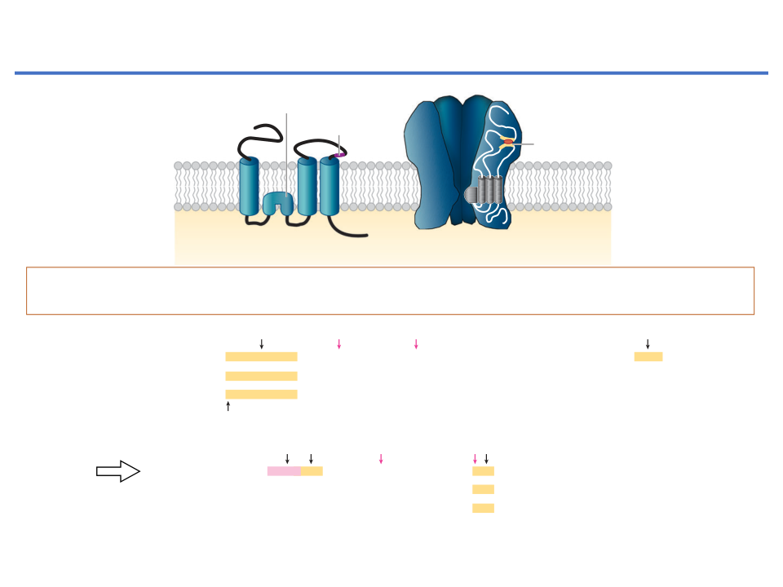
Annu. Rev. Cell Dev. Biol. 2007.23:613-643. Downloaded from www.annualrev
Access provided by University of Bristol on 12/21/14. For personal use on
Annu. Rev. Cell Dev. Biol. 2007.23:613-643. Downloaded from www.annualreviews.org
AMPA receptors
are the primary conduits of
5 pA
Access provided by University of Bristol on 12/21/14. For personal use only.
excitatory synaptic transmission
20 ms
5 pA
Q/R
20 ms
b
editing site
Glutamine (Q)-Ca2+ permeable
N
Q/R
Flip/flop
N
Arginine (R)
b
editing site
site
N
Flip/flop
N
Ligand binding
site
Ligand binding
1
1
2
*
3
4
2
1 3 4
2
*
3
4
2
1 3 4
C
C
C
C
Individual subunit
Tetrameric channel
Individual subunit
Tetrameric channel
AMPA receptors
, consist of four different subunits (GluA1, 2, 3 and 4)
which can also be
alternatively spliced and RNA edited, to
form tetrameric ion channels
.
c
Long tails
Protein 4.1N
P831
CaMKII, PKC
P845
PKA
SAP97
c
Long tails
Protein 4.1N
P831
CaMKII, PKC
P845
PKA
SAP97
GluR1
EFCYKSRSE KRMK
S
GFCLIPQQ IN
S
EAIR
TSTLPRN GAGA GG GS
S
S
G
GENGRV
VSQ
DFPK
SMQSIPSMSH
SSGM
PLG
AT L
G
GluR4
EFCYKSRAEAKRMK
-------L F
SEAIR KAR
L ITGS GENGRV TPD PKAVH
LAV A DI
GluA1
T
N
--------
S
V
L
C
TGTAIRQSSG
I S
P
GluR1
EFCYKSRSE KRMK
S
GFCLIPQQ IN
S
EAIR
TSTLPRN GAGA GG GS
S
S
G
GENGRV
VSQ
DFPK
SMQSIPSMSH
SSGM
PLG
AT L
G
GluR2 long
EFCYKSRAEAKRMK
S
R KAR
L ITGS GENGRV TP FPKAVH
GM V
TDL
-------M L DVM S
GluA4
T
--------
S
T
M
E
APYVS-PGM
N SV
S
GluR4
EFCYKSRAEAKRMK
-------L F
SEAIR KAR
L ITGS GENGRV TPD PKAVH
LAV A DI
T
N
--------
S
V
L
C
TGTAIRQSSG
I S
P
GluA2 long
Palmitoylation
GluR2 long
EFCYKSRAEAKRMK
S
R KAR
L ITGS GENGRV TP FPKAVH
GM V
TDL
-------M L DVM S
T
--------
S
T
M
E
APYVS-PGM
N SV
S
Short tails
AP-2
NSF
PKC
P863
PKC,?
P880
GRIP and PICK1
Palmitoylation
GluR2
S
S
EFCYKSRAEAKRMKVAKN QN NP SSQN QN ATY EGYNVYG E VKI
P
I
S
F
K
I
Short tails
AP-2
NSF
PKC
P863
PKC,?
P880
GRIP and PICK1
GluR3
EFCYKSRAE KRMK
KN QNF P
T
S
S
LT
T
K APAT
N QN ATYREGYNVYGTE VKI
Y
GluR4 short
EFCYKSRAEAKRMKVAK
SA T
Q FNP SSQN
T
N ATYREGYNVYGTE
S
KI
GluR2
T
H L
I
GluA2 short
S
S
EFCYKSRAEAKRMKVAKN QN NP SSQN QN ATY EGYNVYG E VKI
P
I
S
F
K
I
GluR3
GluA3 short
EFCYKSRAE KRMK
KN QNF P
T
S
S
LT
T
K APAT
N QN ATYREGYNVYGTE VKI
Y
GluR4 short
·
GluA4 short
EFCYKSRAEAKRMKVAK
SA T
Q FNP SSQN
T
N ATYREGYNVYGTE
S
KI
616
Shepherd
Huganir
T
H L
I
Adapted from Shepherd and Huganir Annu. Rev. Cell Dev. Biol (2007) 23, 613-
·
6BBYN309 (2025) Hippocampal LTD - Learning and Disease
616
Shepherd
Huganir
8

Slide 9
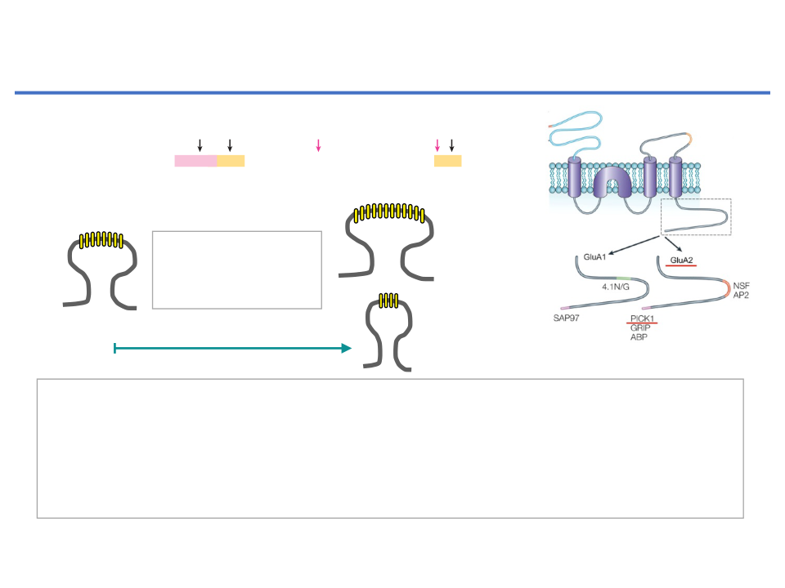
GluR1
EFCYKSRSE KRMK
S
GFCLIPQQ IN
S
EAIR
TSTLPRN GAGA GG GS
S
S
G
GENGRV
VSQ
DFPK
SMQSIPSMSH
SSGM
PLG
AT L
G
LTD: Decrease in the number of surface
GluR4
EFCYKSRAEAKRMK
-------L F
SEAIR KAR
L ITGS GENGRV TPD PKAVH
LAV A DI
T
N
--------
S
V
L
C
TGTAIRQSSG
I S
P
GluR2 long
AMPAR by
endocytotic mechanism
EFCYKSRAEAKRMK
S
R KAR
L ITGS GENGRV TP FPKAVH
GM V
TDL
-------M L DVM S
T
--------
S
T
M
E
APYVS-PGM
N SV
S
Palmitoylation
Short tails
AP-2
NSF
PKC
P863
PKC,?
P880
GRIP and PICK1
GluR2
GluA2 short
S
S
EFCYKSRAEAKRMKVAKN QN NP SSQN QN ATY EGYNVYG E VKI
P
I
S
F
K
I
GluR3
EFCYKSRAE KRMK
KN QNF P
T
S
S
LT
T
K APAT
N QN ATYREGYNVYGTE VKI
Y
GluR4 short
EFCYKSRAEAKRMKVAK
SA T
Q FNP SSQN
T
N ATYREGYNVYGTE
S
KI
AMPARs
T
H L
I
Δ AMPAR Number
616
Shepherd
·
Huganir
= Strength
LTP
Basal
GluA2 AMPARs endocytosis
LTD
•
The C-terminal tail of GluA2 AMPA receptor interacts with the PDZ domain-containing
proteins
AP2
(adaptor protein 2),
NSF
(N-ethylmaleimide-sensitive factor),
GRIP
(glutamate receptor-interacting protein),
ABP
(AMPAR binding protein)
and
PICK1
(protein interacting with C-kinase).
•
AMPA receptor interactomes play key roles in receptor surface expression /
internalisation.
Adapted from Collingridge et al, 2004 Nat Review Neurosci. 5, 954-
6BBYN309 (2025) Hippocampal LTD - Learning and Disease
9

Slide 10
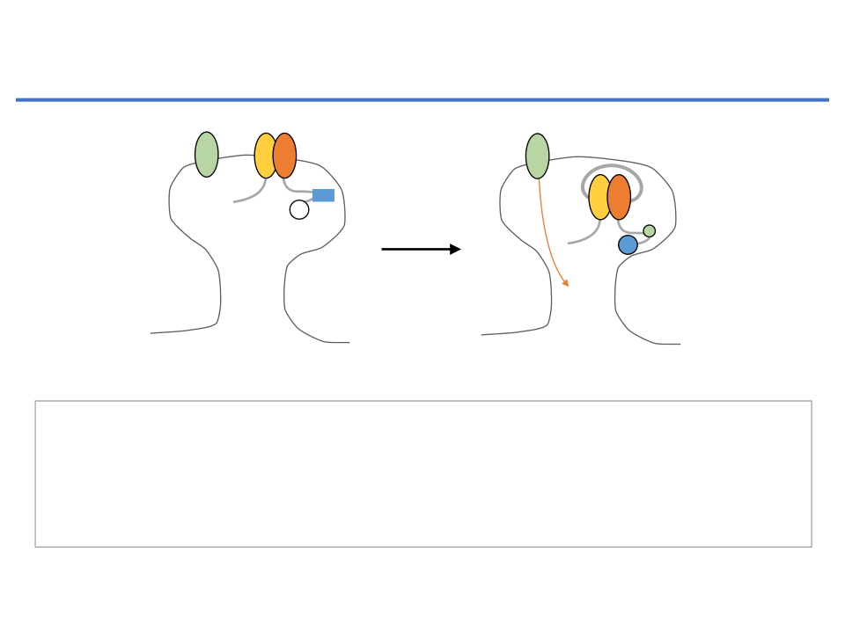
LTD: Decrease in the number of surface
AMPAR by
endocytotic mechanism
NMDA
GluA1
GluA2
NMDA
NSF
GluA1
GluA2
AP2
GRIP
-ABP
PICK1
Ca
2+
Ca
2+
Basal
Synapse weakening
1.Ca
2+
rise leads the dissociation of
NSF
(N-ethylmaleimide-sensitive factor) binding from
GluA2 receptor which is replace by
AP2
(adaptor protein 2) and initiates clathrin-mediated
endocytosis of the AMPA receptor.
2.In some circumstances, GluA2-
PICK1
(protein interacting with C-kinase1) interaction
causes dissociation of ABP (AMPA-binding protein)-GRIP (glutamate receptor interacting
protein)-ABP (AMPA-binding protein) from GluA2, this regulates endocytic process.
Adapted from Collingridge et al, 2004 Nat Review Neurosci. 5, 954-
6BBYN309 (2025) Hippocampal LTD - Learning and Disease
10

Slide 11
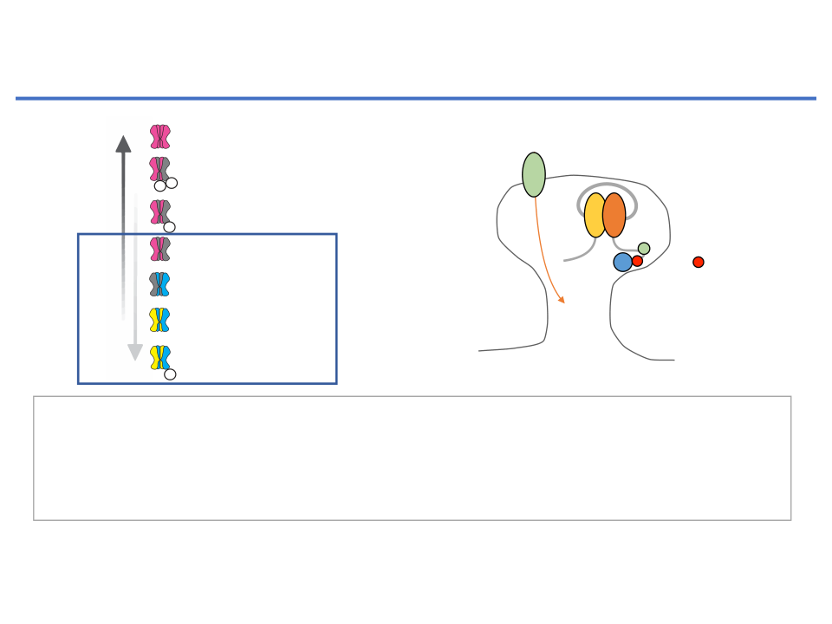
Revi
LTD: Decrease in the number of surface
AMPAR by
endocytotic mechanism
AMPAR hierarchy and PSD slots
Figure 2. The AMPAR Hierarchy a
Slot Hypothesis
A
B
LTP
LTD
(A and B) During synaptic plasticity AM
GluA1 homomer
added or subtracted from PSD/extrace
-recruitment may be
(A), which are modiﬁed in number and
highly conditional
Synapse weakening
recruited first
during LTP
NMDA
afﬁnity for AMPARs during plasticity
GluA1-containing dual-
ﬁcking AMPARs then populate these
P
P
phosphorylated S831/S845
in a hierarchy based on their (i) afﬁn
GluA1-containing
GluA1
GluA2
PSD slots and (ii) mobilization and m
mono-phosphorylated
the cell surface. AMPARs enter the
P
through
lateral
diffusion
from
extr
AP2
GluA1-containing
pools of surface receptors. During LT
-rapidly mobilized through
pools are locally enriched with GluA1-
activity-depedent trafficking
pS880
removed first
PICK1
AMPARs through activity-dependent e
during LTD
GluA2-containing
extracellular slot?
whereas during LTD surface AMPARs
depleted through endocytosis of GluA
GluA2/3
Ca
2+
ing receptors.
-targeted to synapses through
constitutive trafficking
GluA2/3 phosphorylated S880
intracellular slot affinity
slots added
-promotes interaction with
for AMPARs altered
or subtracted
tyrosine kinases (
Hayashi and
P
PICK1 and endocytosis
2004
). GluA3 is also tyrosine-ph
• During Long-term Depression (
LTD
; synapse weakening),
AMPA
lated
at
the
homologous
sit
receptors are
subtracted from synapse.
(R.L.H., unpublished data). Gluta
LTD, are expressed by a decrease in synaptic AMPAR content
ceptor agonists, including glutamate, AMPA, and NMDA
• Several studies have demonstrated that phosphorylation of GluA2 S880 regulates the
(
Huganir and Nicoll, 2013
). AMPARs must be removed from the
GluA2 tyrosine phosphorylation, which disrupts the in
PSD, allowing for lateral diffusion away from the synapse, and
between GluA2 and GRIP1/GRIP2, but not PICK1 (
Hay
interaction of GluA2 and PICK1, destabilising GluA2 within the PDZ and promoting
concomitantly, AMPARs are locally depleted from the cell sur-
Huganir, 2004
). Multiple studies have shown both in sli
GluA2 internalisation.
face by clathrin- and dynamin-dependent endocytosis (
Shep-
iology experiments and
in vivo
that treatment with a sh
herd and Huganir, 2007
).
tide mimicking the tyrosine-rich region of GluA2 (calle
Adapted from Diering and Huganir, (2018) Neuron. 100, 314-329
GluA2 plays a prominent role in LTD. Several studies have
peptide) completely blocks LTD as well as activity-de
demonstrated that GluA2 is required for the expression of cere-
GluA2 endocytosis (
Fox et al., 2007; Ahmadian et a
bellar LTD. Speciﬁcally, phosphorylation of GluA2 S880 is
while having no effect on basal synaptic transmission.
6BBYN309 (2025) Hippocampal LTD - Learning and Disease
required as knockin mutations that prevent phosphorylation of
ingly, hippocampal mGluR-mediated LTD involves the
11
this site in mice (GluA2 K882A) eliminate cerebellar LTD (
Chung
phorylation of GluA2 Y876 and is completely blo

Slide 12
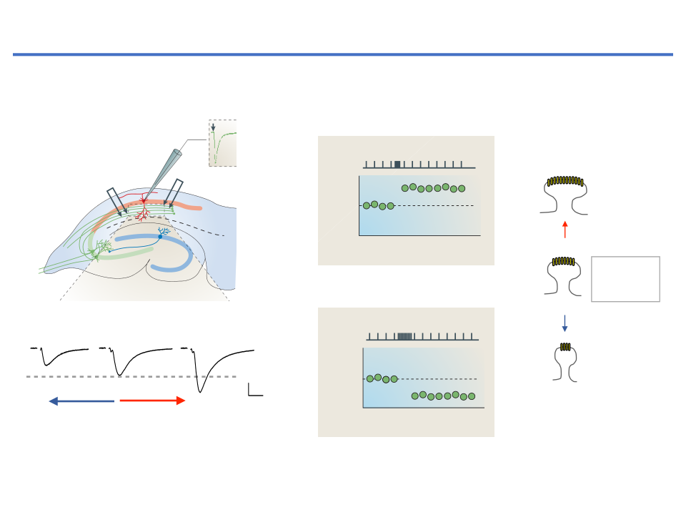
Bidirectional synaptic plasticity encodes memories
S
AMPA receptors are the primary conduits of excitatory synaptic transmission
osynaptic LTD
Homosynaptic LTD
Homosynaptic LTP
a
b
EPSC amplitude (%)
175
175
LFS
Recording
LFS
150
HFS
150
Long-term
electrode
S1
125
S1
125
potentiation
100
100
(LTP)
Stimulation
Field slope
Stimulation
75
Field slope
75
electrode S1
electrode S2
50
Stim
LTP
50
Stim
Washout
25
25
CA1
–10
0
10
20
–10
0
10
20
EPSC amplitude (%)
150
Stim
150
Stim
HFS (High
125
125
Frequency
Time
Time
100
100
Stimulation)
depression
Dentate
Time
CA3
gyrus
75
75
50
50
Δ AMPAR
25
LTD
25
Heterosynaptic LTD
Heterosynaptic LTD
naptic plasticity
0
a
0
Stim
Number =
Homosynaptic LTD
Homosynaptic LTD
ompasses several forms of synaptic
–10
0
10
20
30
40
50
–10
0
10
20
30
40
50
Strength
S2
S2
hich case it is called homosynaptic
Time (min)
LFS
Time (min)
LFS (Low
LFS
Field slope
Field slope
Frequency
Depressed
Basal
Potentiated
S1
S1
c
d
GluA2
Stimulation)
LTD occurs at the synapses of the
Field slope
GluA1
GluN1
GluN2
Field slope
phosphorylation (% control)
200
phosphorylation (% control)
200
*
r some circumstances it can be
GluA2
LTD
LTP
Time
Time
GluA1
LTD
GSK3
Active
stimulus
stimulus
150
150
Time
ssociation with LTD (see the figure,
0.5 mV
Long-term depression
10 ms
GSK3
Inactive
PP1
PP1
(LTD)
iation (LTP) (see the figure, part
a
,
Synapse
Synapse
Time
Time
weakening
strength
GluA1
GluA2
P
Active
Inactive
100
100
ceive the conditioning input and in
epotentiation
*
De novo
LTD
Inactive
Active
Akt
Akt
Heterosynaptic LTD
No synaptic plasticity
�
�
P
GSK3
GSK3
Adapted from Collingridge et al., 2010 Nat.Review Neurosci. 11, 459-473
xamples of homo- and
LFS
50
HFS
50
LFS
S2
LFS
S2
ure (part
a
Control
LTP
Control
LTD
S1
PI3K
) — the green dots
6BBYN309 (2025) Hippocampal LTD - Learning and Disease
Figure 3 |
ope
ope
12
Molecular interactions between long-term potentiation and long-term depression. a
| A schematic of
t are activated by low frequency or
pe
l
t
d
l
t f
i d
ti
f i
t
ifi l
t
t
ti ti
(LTP)
d l
t
d
i
(LTD) i CA1

Slide 13
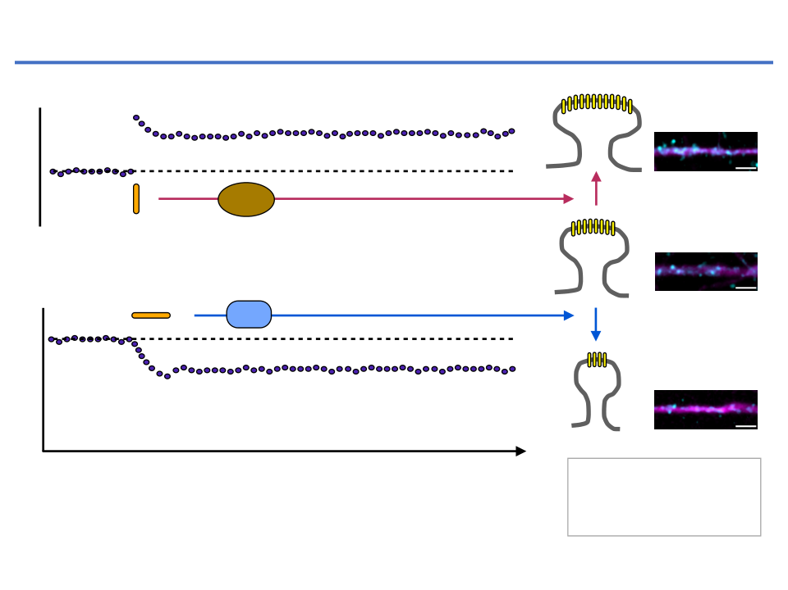
Bidirectional synaptic plasticity encodes memories
Synapse strength pathway
GluA2
MAP2
Synaptic response size
HFS (High
PKs
Long-term potentiation
Frequency
Protein Kinases
(LTP)
Stimulation)
NMDAR
Long-term synaptic plasticity
activation
LFS (Low
Protein Phosphatase
Basal
Frequency
PP1
Stimulation)
Long-term depression
(LTD)
Synapse weakening pathway
Time (h)
Δ AMPAR Number =
Strength
6BBYN309 (2025) Hippocampal LTD - Learning and Disease
13

Slide 14

Key Points - Long Term Depression in CNS
•
Long-term depression (
LTD) is expressed by
a long-lasting decrease in the
efficiency of synaptic transmission
, in particular synaptic transmission that is
mediated by the synaptic activation of glutamate
AMPARs
(α-amino-3-hydroxy-5-
methylisoxazole-4-propionic acid receptors). It may involve presynaptic and
postsynaptic mechanisms.
•
LTD can be triggered by the synaptic activation of glutamate receptors — in
particular NMDARs (
N
-methyl-D-aspartate receptors) and metabotropic glutamate
receptors (mGluRs) — or receptors for other neurotransmitters (eg., mAChR).
•
Complex signalling cascades link the induction of LTD to its induction and
expression. Key cascades involve molecular mechanism of LTD: Ca2+ sensors,
protein–protein interactions (eg.,
receptor trafficking, endocytotic protein
), protein
kinases and phosphatases, proteases and other signalling molecules (eg.,
synapse
weakening related
).
•
LTD has diverse roles in cognition, particularly in some forms of learning and
memory and in circumstances in which a flexible response is required.
•
LTD also seems to be involved in pathological states, including drug
addiction, mental retardation and neurodegenerative diseases such as
Alzheimer's disease
.
6BBYN309 (2025) Hippocampal LTD - Learning and Disease
14

Slide 15
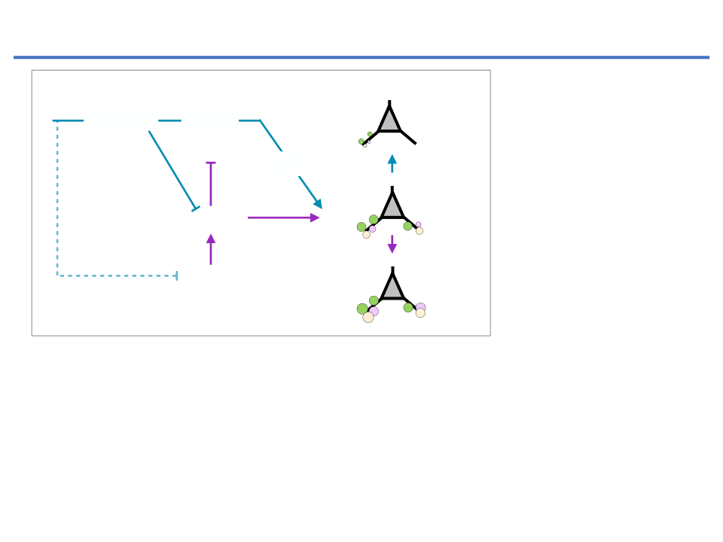
Bidirectional synaptic plasticity encodes memories
Synapse weakening pathway
(LTD stimulus)
Akt1
(Serine/Threonine
C
aspase
G
SK-3
LTD
kinase1)
(typical Tau
kinase)
pTau
GSK-3
(Glycogen synthase
kinase-3 beta)
A
kt1
Basal
PI3K
(Phosphoinositide 3-
kinase)
PI3K
LTP
pTau
(phosphorylated Tau)
Synapse strength pathway
(LTP stimulus)
• An LTD-inducing stimulus activates protein phosphatase 1 (PP1) and
casapse, which dephosphorylates GSK3β to activate it and permit the
induction of LTD.
• An LTP stimulus activates the phosphoinositide 3-kinase (PI3K)-Akt pathway,
which phosphorylates GSK3β to inhibit it, thus preventing LTD.
6BBYN309 (2025) Hippocampal LTD - Learning and Disease
15

Slide 16
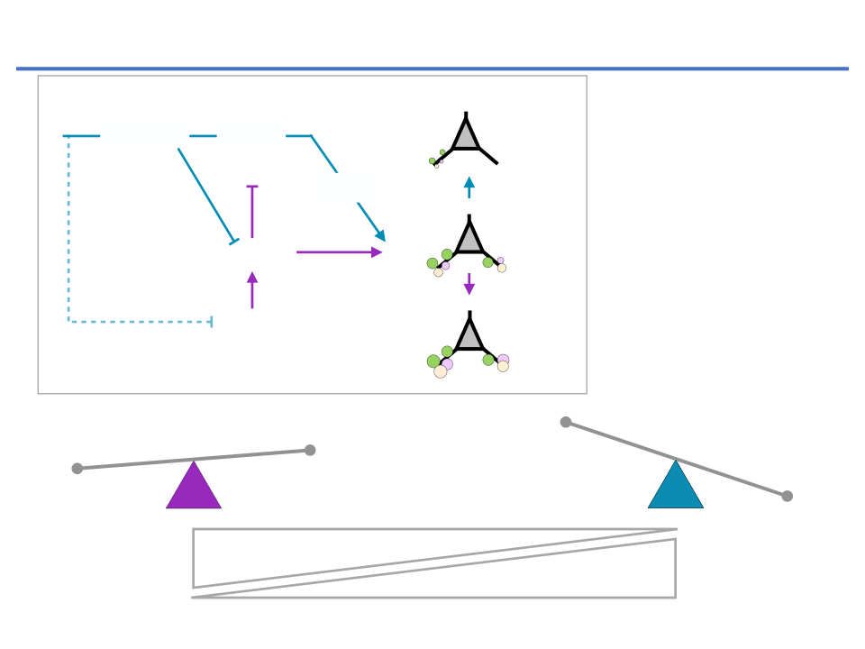
Bidirectional synaptic plasticity encodes memories
Synapse weakening pathway
(LTD stimulus)
Akt1
(Serine/Threonine
C
aspase
G
SK-3
LTD
kinase1)
(typical Tau
kinase)
pTau
GSK-3
(Glycogen synthase
kinase-3 beta)
A
kt1
Basal
PI3K
(Phosphoinositide 3-
kinase)
PI3K
LTP
pTau
(phosphorylated Tau)
Synapse strength pathway
(LTP stimulus)
LTP
LTP
LTD
LTD
Physiological Plasticity
Pathophysiological Plasticity
6BBYN309 (2025) Hippocampal LTD - Learning and Disease
16

Slide 17
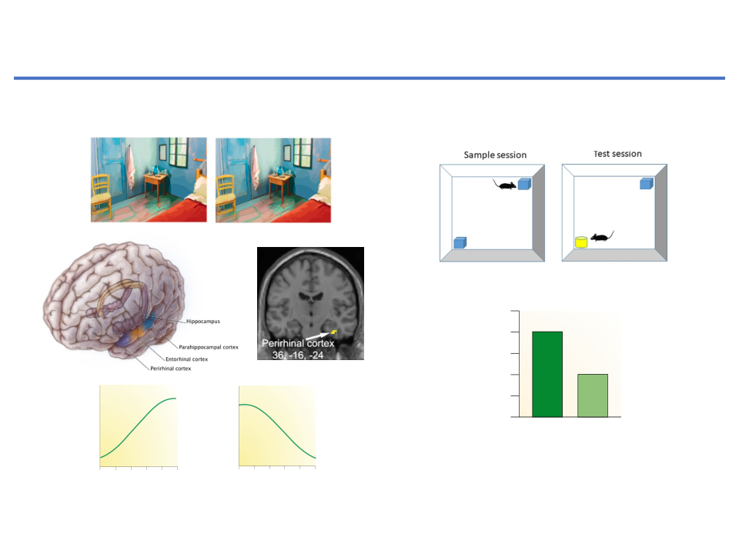
Recency
First
Repeat
First
Rep
Reduction of neuronal activity
: The function of certain
Magnitude
Magnitude
types of ‘
Learning
’
Object Recognition in Anterior-Inferior Temporal Cortex
Duration
Duration
First
Repeat
Familiarity
First
Repeat
First
Rep
Magnitude
Magnitude
A.C.H. Lee et al. / NeuroImage 33 (2006) 362
–
373
REVIEWS
a
Hippocampus
b
Perirhinal cortex
activity associated with items that will later be missed (for
Duration
Duration
examples, see
REFS 59,65
, but see
REF. 66
for an exception).
A similar pattern is evident for ‘know’ responses (or for
decisions made with low confidence) at retrieval
60–64,67
.
If these recognition responses are presumed to reflect
fMRI activity
fMRI activity
familiarity-based decisions, such a result would imply
Encoding
Novelty
that the hippocampus is not involved in familiarity
4,5
.
Neuronal Activity
First
Repeat
First
Rep
However, as described above, we propose that
the methods intended to separate recollection-based
WS
decisions from familiarity-based decisions, including
Magnitude
Magnitude
remember–know judgments, high or low confidence rat-
ings and the presence or absence of source recollection,
1
2
3
4
5
6
1
2
3
4
5
6
instead separate strong memories from weak memories.
b
Memory strength
activity associated with items that will later be missed (for
We suggest that strong memories are associated with
Hippocampus
Perirhinal cortex
examples, see
Memory strength
increased hippocampal activity, regardless of whether
c
REFS 59,65
, but see
REF. 66
for an exception).
d
they reflect strong familiarity, strong recollection or a
First
A similar pattern is evident for ‘know’ responses (or for
combination of the two. Further, weak memories are
Repeat
decisions made with low confidence) at retrieval
60–64,67
.
If these recognition responses are presumed to reflect
often not associated with detectably increased activity
fMRI activity
familiarity-based decisions, such a result would imply
in the hippocampus, regardless of whether such memo-
fMRI activity
Retrieval
fMRI activity
ries reflect weak familiarity, weak recollection or a weak
that the hippocampus is not involved in familiarity
4,5
.
However, as described above, we propose that
combination of the two. Accordingly, the failure to
Duration
Duration
the methods intended to separate recollection-based
detect increased hippocampal activity for items that are
decisions from familiarity-based decisions, including
recognized only in association with a ‘know’ response,
remember–know judgments, high or low confidence rat-
or only with low confidence or without correct source
ings and the presence or absence of source recollection,
information could have more to do with the failure to
detect weak memory than with the presence or absence
Response decrements on stimulus repetit
instead separate strong memories from weak memories.
Figure 2 |
2
3
4
5
6
1
2
1
2
3
4
5
6
1
2
3
4
5
6
of recollection. An implication of this view is that the
3
4
5
6
We suggest that strong memories are associated with
typical relationship between memory strength and neu-
Memory strength
Memory strength
Memory strength
Memory strength
separable encoding of recency and familiarity
d
Figure 5 |
increased hippocampal activity, regardless of whether
ral activity in the hippocampus (as measured by fMRI)
Characteristic nonlinear relationships between fMRI activity and
memory strength. a
they reflect strong familiarity, strong recollection or a
is nonlinear
.
| In the hippocampus, the relationship between functional MRI
(FIG. 5)
information.
Three patterns of neuronal response reduc
combination of the two. Further, weak memories are
Nature Reviews
|
Neuroscience
A neuroimaging study of associative learning illus-
Adapted from Brown & Aggleton (2001) Nat Review Neurosci 2, 51-
(fMRI) activity and memory strength at encoding is such that there is often a relatively
Adapted from Lee et al., (2006) NeuroImage 33, 362-373
often not associated with detectably increased activity
trates this point
. While being scanned, participants
steep increase in activity at the high end of the memory-strength scale (with high
68
in the hippocampus, regardless of whether such memo-
on repetition of visual stimuli have been found in the ante
fMRI activity
strength indicated by ‘remember’ responses or by hits with correct source
learned face
–
name associations and then were shown
information)
ries reflect weak familiarity, weak recollection or a weak
52,53
,
65
. Thus, the slope of the fMRI response is steeper when memory is strong
6BBYN309 (2025) Hippocampal LTD - Learning and Disease
combination of the two. Accordingly, the failure to
a studied face along with two possible choices: the cor-
than when it is weak. We suggest that this relationship reflects nonlinear properties
rect name and another name that had been presented
17
24
.
of the measurement scale that arise for reasons unrelated to the distinction
inferior temporal cortex, including the perirhinal cortex
detect increased hippocampal activity for items that are
earlier with a different face. Because the two names were
between recollection and familiarity. The same relationship has been observed even for
l
ll
ti
b
d t
k
b
recognized only in association with a ‘know’ response,
equally familiar, it is reasonable to assume that success-
68
| I th
i hi
l
t
th
l ti
hi b t

Slide 18
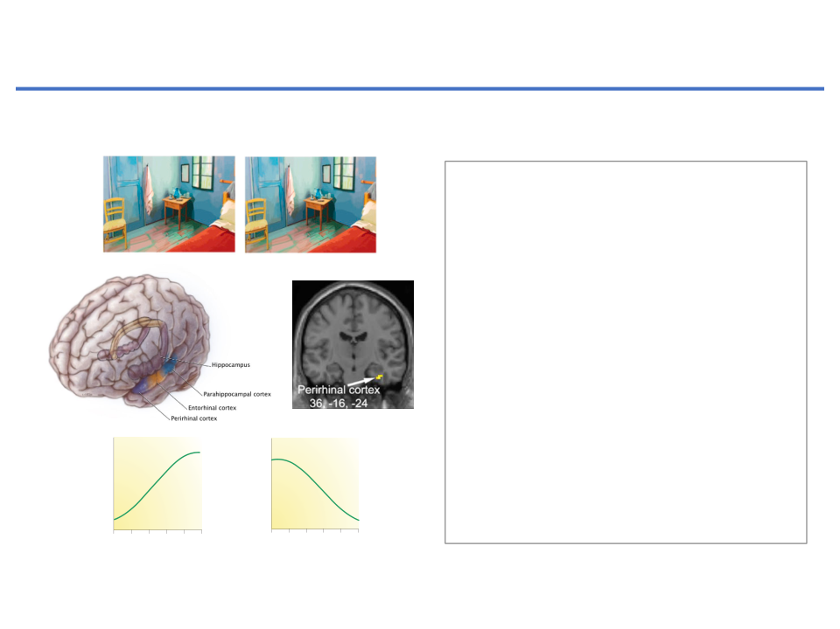
Reduction of neuronal activity
: The function of certain
types of ‘
Learning
’
Object Recognition in Anterior-Inferior Temporal Cortex
First
Repeat
• The perirhinal cortex (PRH) is
involved in recognition memory for
A.C.H. Lee et al. / NeuroImage 33 (2006) 362
–
373
objects (eg., object recognition
memory for novel/familiarity
REVIEWS
discrimination).
a
Hippocampus
b
Perirhinal cortex
activity associated with items that will later be missed (for
examples, see
REFS 59,65
, but see
REF. 66
for an exception).
A similar pattern is evident for ‘know’ responses (or for
decisions made with low confidence) at retrieval
60–64,67
.
• Response decrements in the
If these recognition responses are presumed to reflect
Encoding
fMRI activity
fMRI activity
familiarity-based decisions, such a result would imply
that the hippocampus is not involved in familiarity
4,5
.
However, as described above, we propose that
activity of PRH neurons during
the methods intended to separate recollection-based
WS
decisions from familiarity-based decisions, including
familiarity discrimination suggest
remember–know judgments, high or low confidence rat-
ings and the presence or absence of source recollection,
1
2
3
4
5
6
1
2
3
4
5
6
instead separate strong memories from weak memories.
that cellular mechanisms that are
b
Memory strength
activity associated with items that will later be missed (for
We suggest that strong memories are associated with
Hippocampus
Perirhinal cortex
examples, see
Memory strength
increased hippocampal activity, regardless of whether
c
REFS 59,65
, but see
REF. 66
for an exception).
d
they reflect strong familiarity, strong recollection or a
consistent with LTD-like synapse
First
A similar pattern is evident for ‘know’ responses (or for
combination of the two. Further, weak memories are
Repeat
decisions made with low confidence) at retrieval
60–64,67
.
If these recognition responses are presumed to reflect
often not associated with detectably increased activity
fMRI activity
familiarity-based decisions, such a result would imply
in the hippocampus, regardless of whether such memo-
weakening in the PRH may be
fMRI activity
Retrieval
fMRI activity
ries reflect weak familiarity, weak recollection or a weak
that the hippocampus is not involved in familiarity
4,5
.
However, as described above, we propose that
combination of the two. Accordingly, the failure to
the methods intended to separate recollection-based
detect increased hippocampal activity for items that are
involved in object recognition
decisions from familiarity-based decisions, including
recognized only in association with a ‘know’ response,
remember–know judgments, high or low confidence rat-
or only with low confidence or without correct source
information could have more to do with the failure to
ings and the presence or absence of source recollection,
memory.
instead separate strong memories from weak memories.
detect weak memory than with the presence or absence
2
3
4
5
6
1
2
1
2
3
4
5
6
1
2
3
4
5
6
of recollection. An implication of this view is that the
3
4
5
6
We suggest that strong memories are associated with
typical relationship between memory strength and neu-
Memory strength
Memory strength
Memory strength
Memory strength
d
Figure 5 |
increased hippocampal activity, regardless of whether
ral activity in the hippocampus (as measured by fMRI)
Characteristic nonlinear relationships between fMRI activity and
memory strength. a
they reflect strong familiarity, strong recollection or a
is nonlinear
.
| In the hippocampus, the relationship between functional MRI
(FIG. 5)
combination of the two. Further, weak memories are
Nature Reviews
|
Neuroscience
A neuroimaging study of associative learning illus-
(fMRI) activity and memory strength at encoding is such that there is often a relatively
Adapted from Lee et al., (2006) NeuroImage 33, 362-373
often not associated with detectably increased activity
trates this point
. While being scanned, participants
steep increase in activity at the high end of the memory-strength scale (with high
68
in the hippocampus, regardless of whether such memo-
fMRI activity
strength indicated by ‘remember’ responses or by hits with correct source
learned face
–
name associations and then were shown
information)
ries reflect weak familiarity, weak recollection or a weak
52,53
,
65
. Thus, the slope of the fMRI response is steeper when memory is strong
6BBYN309 (2025) Hippocampal LTD - Learning and Disease
combination of the two. Accordingly, the failure to
a studied face along with two possible choices: the cor-
than when it is weak. We suggest that this relationship reflects nonlinear properties
rect name and another name that had been presented
18
of the measurement scale that arise for reasons unrelated to the distinction
detect increased hippocampal activity for items that are
earlier with a different face. Because the two names were
between recollection and familiarity. The same relationship has been observed even for
l
ll
ti
b
d t
k
b
recognized only in association with a ‘know’ response,
equally familiar, it is reasonable to assume that success-
68
| I th
i hi
l
t
th
l ti
hi b t

Slide 19
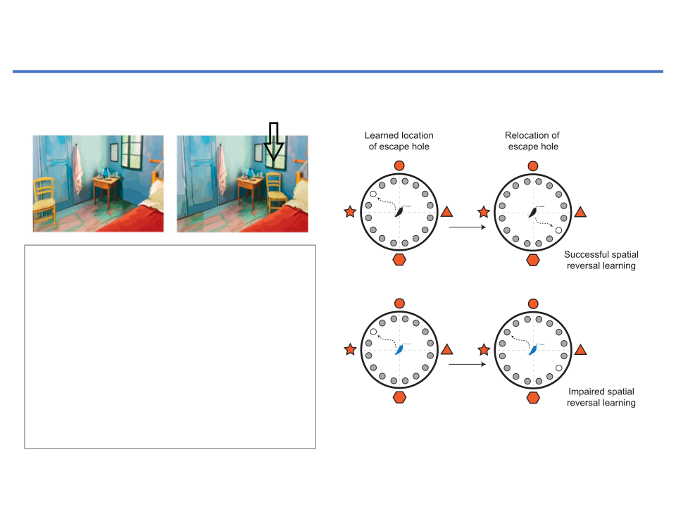
Reduction of neuronal activity
: The function of certain
types of ‘
Learning
’
6
The N
Reversal learning in the hippocampus
Box 2
.
Tau and Cognition
LTD
• Reversal learning: the ability to form
new memory and functional
plasticity to erase/suppress old
memory.
No
LTD
• Hippocampus is essential centre for
encoding the initial information and
reversal learning for new memory.
• LTD-like synapse weakening may
require “reversal learning”.
Studies have shown that tau knockout (KO) mice have normal cognition in spatial learning tasks such as Y-maze, T-maze, and wate
(Morris and others 2011). What then, is the underlying relevance of the finding that tau is required for LTD? Conceptually, LTD-like
synapse weakening is thought to contribute to information encoding and discrimination, and is considered to be a fundamental cellul
Regan et al., J. of Neurosci. 35, 4804-4812 (2015)
in certain cognitive processes such as novelty discrimination and tasks requiring behavioral flexibility (Kemp and Manahan-Vaughan 2
and others 2008). Accordingly, a behavioral task such as spatial reversal learning—the ability to forget one location and learn anothe
6BBYN309 (2025) Hippocampal LTD - Learning and Disease
specific context—depends on hippocampal LTD (Dong and others 2013; Nicholls and others 2008). Using the Barnes maze test to a
19
form of learning, tau KO mice took significantly longer to adapt to the relocation of an escape hole, indicative of impaired reversal le
b h
i
l fl
ibili
(R
d
h
2015) Thi fi di
i
i
f
i
h
KO
i
hibi d fi i
i
i i

Slide 20
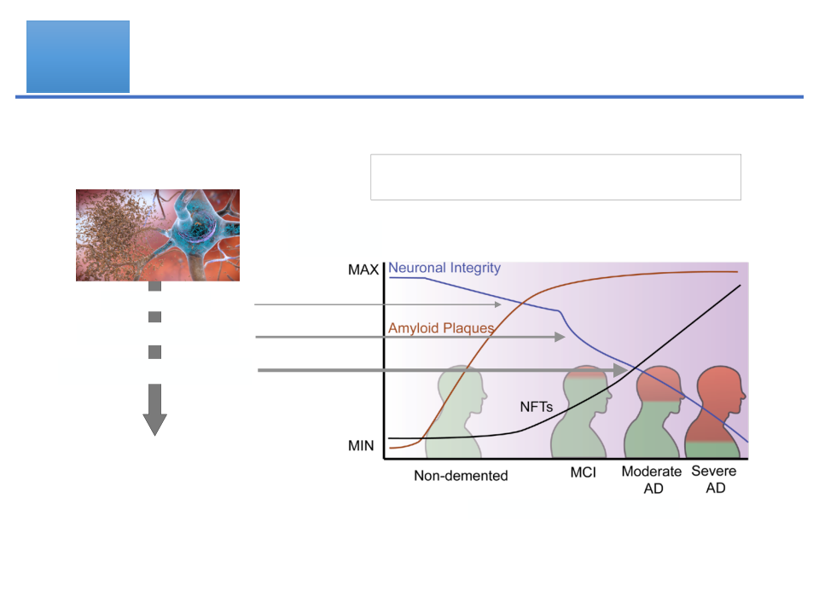
Medical
Aberrant ‘
Synapse Weakening
’ causes
Problem
synapse dysfunction and dementia
Risk Factors
Weakening of Neuronal Integrity =
Synapse Deficits
Amyloid
Plaque
Memory
Neurofibrillary
Performance
Tau tangle
Pathophysiology
Synapse weakening
Synapse dysfunction
Dementia
(Memory deficit)
Progression of Disease
6BBYN309 (2025) Hippocampal LTD - Learning and Disease
20

Slide 21
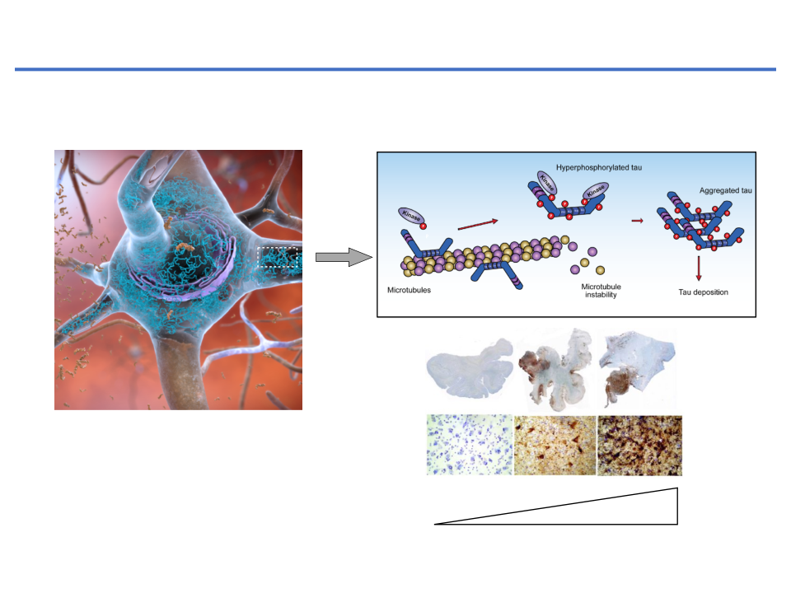
Microtubule-associated protein tau (Tau) and Tauopathies
Neurofibrillary Tangles (
NFTs
) are composed of
hyperphosphorylated
,
aggregated
tau and lead to neurodegeneration in the brain
Paired-Helical
Filaments
Normal
Late stage
ageing
of
Neurofibrillary Tangles
Alzheimer
6BBYN309 (2025) Hippocampal LTD - Learning and Disease
21

Slide 22
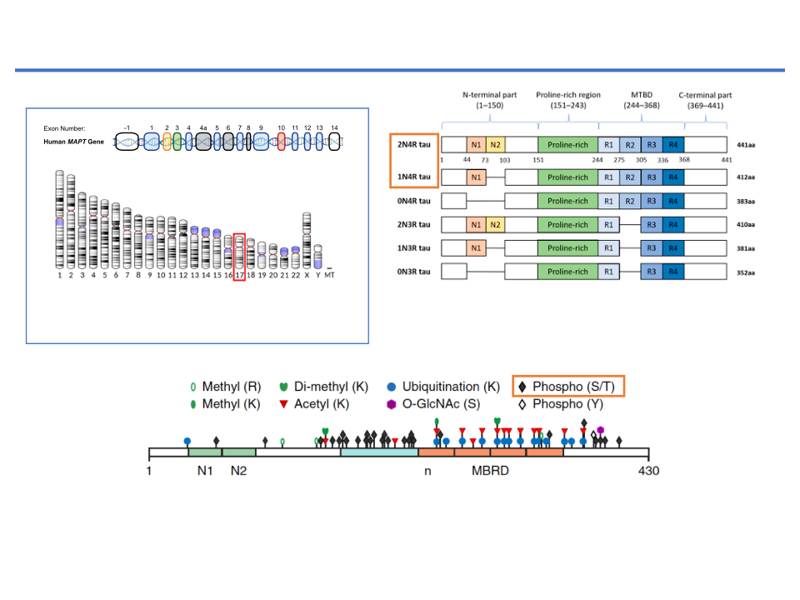
expressed by peripheral neurons [
13
], and more recently, tau immunoreactivity was also
expressed by peripheral neurons [13], and more recently, tau immunoreactivity was also
found in the human submandibular gland and sigmoid colon tissues [
14
]. Human tau
found in the human submandibular gland and sigmoid colon tissues [14]. Human tau
Putative model for the role of microtubule-associated protein tau (Tau) and
protein is encoded by
MAPT
gene localized on chromosome 17q21 and consists of 16 exons.
protein is encoded by
MAPT
gene localized on chromosome 17q21 and consists of 16 ex-
In the adult human brain, six tau isoforms are expressed ranging from 352 to 441 amino
ons. In the adult human brain, six tau isoforms are expressed ranging from 352 to 441
acids (see Figure
2
). Three decades ago, it was proposed that individual tau isoforms may
amino acids (see Figure 2). Three decades ago, it was proposed that individual tau
tau phosphorylation (pTau) during the synapse weakening
have different functions since they are differently expressed in the fetal and developed
isoforms may have different functions since they are differently expressed in the fetal and
brain [
15
–
17
]. Now, it is known that alternative splicing even varies across neuronal cell
developed brain [15–17]. Now, it is known that alternative splicing even varies across
types and during neuronal maturation [
18
,
19
].
140
The Neuroscientist 23(2)
neuronal cell types and during neuronal maturation [18,19].
Box 1.
Tau Protein Isoforms
Figure 2.
Schematic representation of six human tau protein isoforms and their domains. The N-terminal part is more acidic
Figure 2.
Schematic representation of six human tau protein isoforms and their domains. The N-terminal part is more
Tau protein isoforms are generally denoted by their
acidic due to N1 and N2 inserts. The microtubule-binding domain (MTBD) is composed of repeats R1–R4. The number of
Human Tau proteins are encoded by the MAPT
due to N1 and N2 inserts. The microtubule-binding domain (MTBD) is composed of repeats R1–R4. The number of repeats
repeats and N-terminal inserts varies according to the type of tau protein isoform.
and N-terminal inserts varies according to the type of tau protein isoform.
gene (chromosome 17)
combination of N-terminal inserts and C-terminal repeats.
Tau protein is distinctly divided into the N-terminal part, proline-rich region (PRR),
MTBD
: microtubule-binding domain
Tau protein is distinctly divided into the N-terminal part, proline-rich region (PRR),
microtubule-binding domain (MTBD), and C-terminus. The N-terminal domain length
microtubule-binding domain (MTBD), and C-terminus. The N-terminal domain length is
is dependent on alternative splicing of exons 2 and 3 which encode acidic amino acids.
dependent on alternative splicing of exons 2 and 3 which encode acidic amino acids. In
In MTBD, the splicing-dependent manner of exon 10 results in either 3 (3R) or 4 (4R)
MTBD, the splicing-dependent manner of exon 10 results in either 3 (3R) or 4 (4R) micro-
microtubule-binding repeats which are essential for binding of tau to individual tubulin
tubule-binding repeats which are essential for binding of tau to individual tubulin heter-
heterodimers, and through this interaction tau stabilizes microtubules (MT) [
20
].
odimers, and through this interaction tau stabilizes microtubules (MT) [20].
Despite the MT-stabilizing function of tau, its removal or modiﬁcation had no sig-
Despite the MT-stabilizing function of tau, its removal or modification had no signif-
niﬁcant impact on microtubule stability, cellular function, or cognition in mouse mod-
icant impact on microtubule stability, cellular function, or cognition in mouse models [21–
els [
21
–
25
]. It was shown that the MT-stabilizing function of tau protein is replaceable
25]. It was shown that the MT-stabilizing function of tau protein is replaceable by micro-
by microtubule-associated proteins MAP1a [
22
,
26
] or MAP1b [
5
]. However, experiments
tubule-associated proteins MAP1a [22,26] or MAP1b [5]. However, experiments per-
performed by several other groups on tau-knockout mice revealed that tau can inﬂuence
Tau refers to a group of closely related proteins found primarily in the central nervous system (CNS). These proteins were initially identified
formed by several other groups on tau-knockout mice revealed that tau can influence the
when they co-purified with the microtubule subunit–forming protein tubulin (Weingarten and others 1975) and were hence classified as
the regulation of neuronal activity [
27
], synaptic plasticity [
28
], neurogenesis [
29
], iron
microtubule-associated proteins (MAPs) that regulate microtubule stability (Drechsel and others 1992). Human tau proteins are encoded by
regulation of neuronal activity [27], synaptic plasticity [28], neurogenesis [29], iron export
export from neurons [
30
], and long-term depression of synapses [
31
,
32
]. Along with other
the
MAPT
gene (chromosome 17) containing 16 exons that, with the exception of exons 4a, 6, and 8, are all transcribed to generate the primary
from neurons [30], and long-term depression of synapses [31,32]. Along with other animal
animal disease models where the tau levels were reduced, it was found that depletion of tau
tau mRNA transcript. Exons -1 and 14 are not part of the final mRNA product, while exons 2, 3, and 10 are subject to alternative splicing
disease models where the tau levels were reduced, it was found that depletion of tau pro-
(Andreadis and others 1992). The primary structure of human CNS tau protein isoforms, which range from 352 to 441 amino acids in length,
protein had a protective effect on neurons against amyloid-beta (A
β
) induced excitotoxicity
tein had a protective effect on neurons against amyloid-beta (A�) induced excitotoxicity
is thus determined by the presence or absence of mRNA elements encoded by these exons. All tau proteins contain at least three amino acid
or by other excitotoxins in mice over-expressing amyloid precursor protein (APP) and
repeat regions toward the C-terminus that are considered to be the primary sites of interactions with microtubules. Together with a central
or by other excitotoxins in mice over-expressing amyloid precursor protein (APP) and
presenilin 1 [
33
–
37
]. In chemically induced seizure models, hyperexcitability of neurons
Tau contains multiple phosphorylation sites.
presenilin 1 [33–37]. In chemically induced seizure models, hyperexcitability of neurons
proline-rich region and a C-terminal flanking region, these repeat sequences form the ‘microtubule-binding domain’ of tau. In some isoforms,
was reduced in mice with attenuated tau expression [
38
]. This suggests that endogenous
this domain is extended by the inclusion of exon 10, which dictates the presence of a fourth microtubule-binding repeat region. In contrast, a
was reduced in mice with attenuated tau expression [38]. This suggests that endogenous
stretch of ~120 amino acids constitutes a “projection domain” at the N-terminal region of tau. This domain is modifiable by the inclusion of
tau is integral for regulating, or rather, upregulating neuronal hyperexcitability in diseased
an amino acid sequence encoded by exon 2 or by exons 2 and 3. Thus, tau protein isoforms are generally denoted by their combination of
tau is integral for regulating, or rather, upregulating neuronal hyperexcitability in dis-
Adapted from Regan et al, 2017 The Neuroscientist. 23, 137-151; Morris et al., (2015)
animals. In addition, in mice with impaired function of voltage-dependent sodium and
Nature Neuroscience
18, 1183–1189.
N-terminal inserts and C-terminal repeats, of which there are six possibilities; 0N3R, 0N4R, 1N3R, 1N4R, 2N3R and 2N4R (full-length) tau.
eased animals. In addition, in mice with impaired function of voltage-dependent sodium
tau can come to be located in these distinct cellular
and others 2014) opens up the possibility that local trans-
domains. This diffusion barrier is reported to be ineffec-
6BBYN309 (2025) Hippocampal LTD - Learning and Disease
tive at sorting phosphorylated tau, or tau detached from
lation could provide the source of dendritic tau, mitigat-
22
microtubules (Li and others 2011), lending weight once
ing the effects of any axonal barrier to protein diffusion.
Alternatively, local trans-synaptic uptake of tau protein

Slide 23
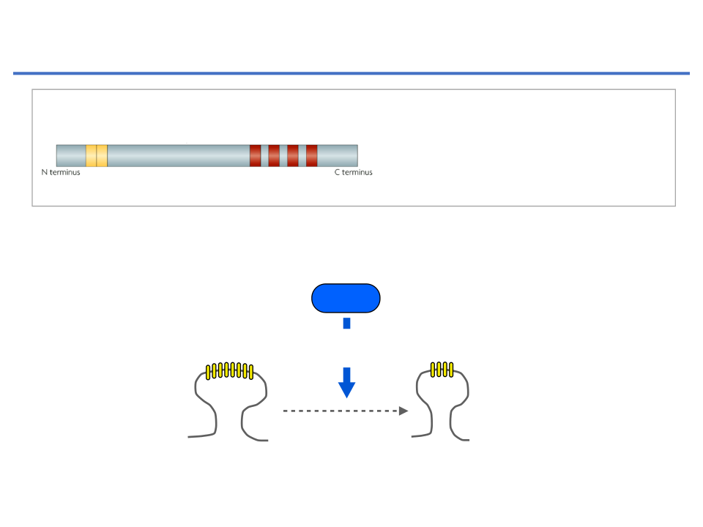
The consequences of tau phosphorylation (pTau) on synaptic function:
synapse weakening in the hippocampus
Tau
S199
S202
T205
S396
S404
Phosphorylation of Tau residues by GSK3β
Proline rich
microtubule-
domain
binding domain
• Tau phosphorylation at
serine 396
(S396) residue is critical molecular event during LTD
• S396 is phosphorylated by GSK-3β
GSK-3β
phosphorylation of
Tau at S396
Synapse
Weakening
(LTD)
Regan et al., (2015) J. of Neurosci. 35, 4804-4812
6BBYN309 (2025) Hippocampal LTD - Learning and Disease
23

Slide 24
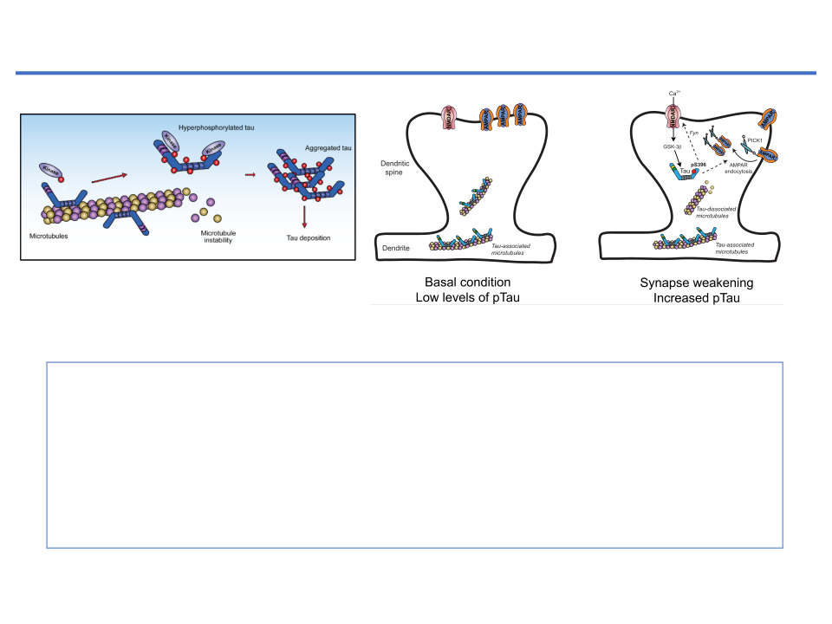
Putative model for the role of microtubule-associated protein tau (Tau) and
tau phosphorylation (pTau) during the synapse weakening
144
The Neuroscientist 23(2)
Figure 1.
Putative model for the role of tau and tau phosphorylation during synaptic weakening. During basal conditions
GSK-3β: glycogen synthase kinase-3β
(left) tau is present in dendrites and dendritic spines, where it is most likely bound to microtubules and has low levels of
phosphorylation (pTau). A synaptic weakening stimulus (right) triggers Ca
2+
influx through NMDARs that activates signaling
PICK1: protein interacting with C kinase 1
cascades involving the serine/threonine kinase GSK-3
�
. GSK-3
�
mediates the transient phosphorylation of tau at serine 396,
which is a critical event for subsequent AMPAR internalization. Downstream effects of tau phosphorylation depend on its specific
interacting partners at the synapse, but may involve changes to microtubule stability and/or the regulation of NMDARs via
Fyn trafficking, ultimately regulating the association of an AMPAR-PICK1 complex. AMPAR =
�
-amino-3-hydroxy-5-methyl-4-
1. During the basal conditions tau is present in dendrites and dendritic spines (low
isoxazolepropionic acid receptors; GSK-3
�
= glycogen synthase kinase–3
�
; NMDAR =
N
-methyl-
D
-aspartate receptors;
levels of pTau).
PICK1 = protein interacting with C kinase 1.
2. Brief rising Ca
events (Cho and Johnson 2004; Ding and others 2006;
paired-helical filaments, which then aggregate to form
2+
activates GSK-3β-mediated pTau at serine 396, which is critical
Mondragón-Rodríguez and others 2008) and is associ-
insoluble intra-neuronal NFTs (Goedert and others 1988;
ated with synaptic dysfunction and memory impairment
Grundke-Iqbal and others 1986; Kosik and others 1986).
event for subsequent AMPA receptor endocytosis through GluA2-PICK1 protein
(Kim and others 2015; Zhao and others 2015). This facet
It is generally considered that (a) leads to (b) and (c) to
interaction.
of tau regulation is particularly intriguing given the roles
bring about tau pathology. Although amyloid pathology
of both caspase and GSK-3β in LTD signaling (Li and
precedes this tau pathology in patients with AD, correla-
others 2010; Peineau and others 2009). Resolving the
tive studies have shown that it is the extent of tau pathol-
relationship between these PTMs and tau function
ogy that closely mirrors, and appears to dictate the extent
3. Synapse weakening mechanisms may involve changes to microtubule stability and/or
remains a clear and fundamental challenge to enhancing
of, neuronal loss and cognitive decline (Murray and oth-
our understanding of tau pathophysiology.
ers 2015; Nelson and others 2012). However, it has now
the regulation of NMDA receptors vis Fyn trafficking.
become evident that NFTs themselves are actually disso-
A Pathological Perspective for
ciated from the decline in neuronal and cognitive func-
Synaptic Tau
tion, and are neither necessary nor sufficient for
Adapted from Regan et al, 2017 The Neuroscientist. 23, 137-151
neurotoxicity (Guerrero-Muñoz and others 2015), argu-
Tau pathology, which is evident in tauopathies such as
ing against their use as therapeutic targets. In light of this,
AD, is generally characterized by three main hallmarks:
it is now necessary to elucidate precisely how the hyper-
(a) tau becomes hyperphosphorylated, with the levels of
phosphorylation of tau can evoke neurotoxicity or synap-
6BBYN309 (2025) Hippocampal LTD - Learning and Disease
tau-associated phosphate roughly tripling in AD brains
tic dysfunction.
24
compared with healthy adult brains (Köpke and others
A long-standing debate concerns whether neurotoxic-
1993) (b) tau is re-distributed to the somatodendritic
ity is triggered by the generation of a pathological species

Slide 25
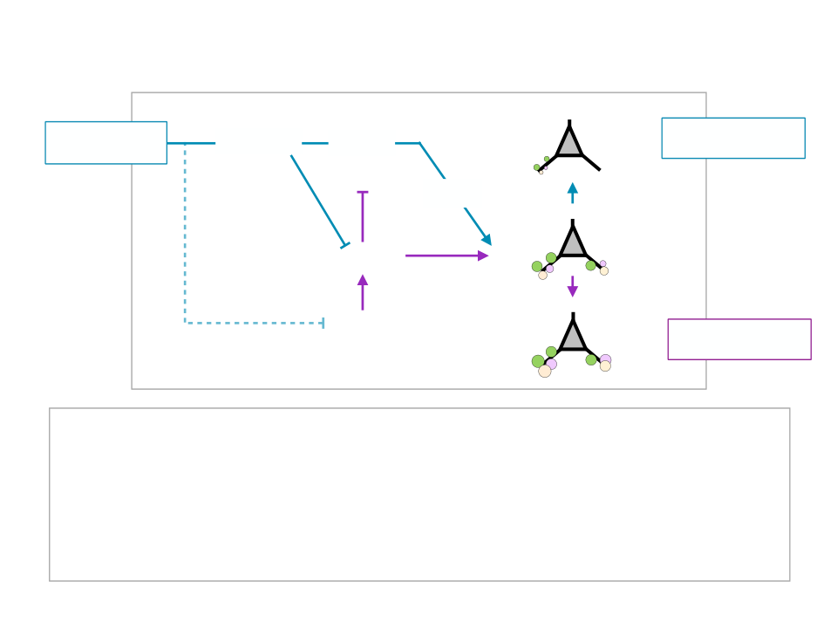
Aberrant ‘
Synapse Weakening
’ causes synapse dysfunction and
dementia
Synapse weakening pathway
Amyloid-
β
C
aspase
G
SK-3
LTD
Synapse loss
(or Pathogens)
Memory loss
(typical Tau
kinase)
pTau
A
kt1
Basal
PI3K
Synapse strength
LTP
Memory formation
Synapse strength pathway
• Neurotoxic pathogens aberrantly activate a synapse weakening Caspase-3-
GSK-3β signalling cascade
• Simultaneously inhibit synapse strengthening pathways.
• Activated GSK-3β causes the phosphorylation of tau (
pTau
).
•
pTau
at the synapse drives excessive synapse weakening, resulting in a shift
from the basal state toward aberrant synaptic plasticity (eg., synapse loss).
6BBYN309 (2025) Hippocampal LTD - Learning and Disease
25

Slide 26
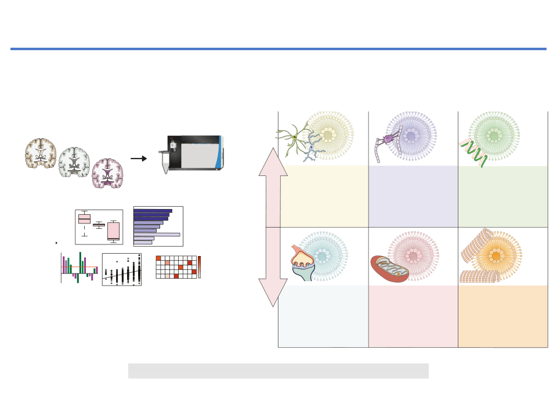
Unbiased network analysis
System-based proteomics to identify biological target and discover
Module enrichment
•
Cell type
Network analysis
•
Biological pathways and
e.g. WGCNA
Gene Ontology
therapeutic candidate
ontologies
M1
•
Systems-based proteomics to resolve the biology of Alzheimer
’
s disease. . .
Genetic risk factors (GWAS)
•
S Rayaprolu et al.
Protein-protein interactions
Module-Trait association
MAGMA score
Braak (Tangle extent)
Neu
101
•
Micro
Demographics
Astro
•
Oligo
Cognition
Protein modules
Endo
•
Neuropathology
Systems-based proteomics to resolve the biology of Alzheimer
’
s disease. . .
1. Mass spectrometry-based proteomics
2. Identification of targets and candidates
trometry-based proteomics
S Rayaprolu et al.
Discovery DDA
101
AD-Associated modules
•
Label-Free (LFQ)
•
Isobaric labeling
Mass spectrometry-based proteomics
(e.g. TMT, iTRAQ)
Discovery DDA
Control
•
Discovery DIA
Label-Free (LFQ)
www.nature.com/npp
•
AsymAD
•
Isobaric labeling
SWATH-MS
(e.g. TMT, iTRAQ)
RNA Binding/
AD
Quantitative proteomics
Inflammatory
Myelination
Splicing
Discovery DIA
•
SWATH-MS
Quantitative proteomics
Increased in AD
Cell type:
Microglia,
Cell type:
Oligodendrocyte
Cell type:
No enrichment
Human post-mortem brain
Astrocyte, & Endothelial
OPEN
sed network analysis
NEUROPSYCHOPHARMACOLOGY REVIEWS
Other ontologies:
Other ontologies:
Other ontologies:
Carbohydrate and nucleoside
Nucleoplasm, Chromosome,
Innate immunity, Carbohydrate
Systems-based proteomics to resolve the biology
DNA binding & metabolism
alysis
Unbiased network analysis
metabolism, Extracellular matrix
metabolism
enrichment
Gene Ontology
Common hubs:
Common hubs:
Common hubs:
NA
of Alzheimer
CD44, GFAP, MSN, PDRX1
MAG, MOG, PLP1, SIRT2
SNRPD2, HDGFRP2, HNRNPA2B1
pe
M1
Network analysis
’
s disease beyond amyloid and tau
ical pathways and
e.g. WGCNA
Gene Ontology
gies
M1
ecreased in AD
ic risk factors (GWAS)
Sruti Rayaprolu
1,2
, Lenora Higginbotham
1,2
, Pritha Bagchi
2,3
, Caroline M. Watson
1,2
, Tian Zhang
2,3
, Allan I. Levey
1,2
,
n-protein interactions
Braak (Tangle extent)
1,2
1,2,3
MAGMA score
Srikant Rangaraju
and Nicholas T. Seyfried
Neu
Braak (Tangle extent)
Trait association
Micro
Astro
MAGMA score
Neu
graphics
Oligo
Micro
odules
Endo
Astro
Synaptic
Mitochondrial
Cytoskeleton
tion
Protein modules
Oligo
The repeated failures of amyloid-targeting therapies have challenged our narrow understanding of Alzheimer
’
s disease (AD)
pathology
Endo
D
pathogenesis and inspired wide-ranging investigations into the underlying mechanisms of disease. Increasing evidence indicate
Cell type:
Neuronal
Cell type:
Neuronal
Cell type:
No enrichment
that AD develops from an intricate web of biochemical and cellular processes that extend far beyond amyloid and tau
Other ontologies:
Other ontologies:
Other ontologies:
Associated modules
Neurotransmitter release,
Hydrolase activity, Oxidative
accumulation. This growing recognition surrounding the diversity of AD pathophysiology underscores the need for holistic system
AD-Associated modules
Calmodulin binding, Dendrite,
phosphorylation, ATP catabolic
Microtubule, Protein targeting,
Protein complex assembly
based approaches to explore AD pathogenesis. Here we describe how network-based proteomics has emerged as a powerful to
Endocytosis
process
Common hubs:
Common hubs:
Common hubs:
and how its application to the AD brain has provided an informative framework for the complex protein pathophysiology
AP2B1, ATP6V0A1, RPH3A, SYT1
ACO2, ATPase subunits, NDUFs
CCT5, DCTN1, TUBB4B
underlying the disease. Furthermore, we outline how the AD brain network proteome can be leveraged to advance additional
scienti
ﬁ
c and translational efforts, including the discovery of novel protein biomarkers of disease.
transition from label-free to isobaric-labeling approaches. In label-
analyzed across samples. Variability in mass measurem
Neuropsychopharmacology
(2021) 46:98
–
115; https://doi.org/10.1038/s41386-020-00840-3
RNA Binding/
peptide retention times may also introduce incon
RNA Binding/
free quantitation (LFQ), each sample is prepared and analyzed
precursor peptide selection and quanti
cation. This cr
Inflammatory
individually by LC-MS/MS. Though MS1 peptide selection is biased
ﬁ
1234567890();,:
Myelination
Splicing
Myelination
Splicing
toward the most intense signals [
72
], the inherently stochastic
described
“
missing value
”
problem that ultimately
Cell type:
nature of DDA impacts the consistency of peptides chosen and
number of quanti
ﬁ
able proteins in a given LFQ data
Microglia,
Cell type:
6BBYN309 (2025) Hippocampal LTD - Learning and Disease
Astrocyte, & Endothelial
Oligodendrocyte
Cell type:
No enrichment
26
type:
Oligodendrocyte
Cell type:
No enrichment
Other ontologies:
Other ontologies:
Other ontologies:
INTRODUCTION
Neuropsychopharmacology (2021) 46:98 – 115
involving a variety of cell types Thus some have postulated

Slide 27

6BBYN309 (2025) Hippocampal LTD - Learning and Disease
Summary of LTD Lecture
• Changes to the synaptic expression of AMPA receptors (AMPAR) are
considered a major component of synaptic plasticity and synaptic
connectivity.
• Long-term depression (LTD) is a physiological form of synaptic
plasticity which leads to a reduction of synaptic transmission.
• AMPAR endocytosis is a key molecular mechanism of LTD.
• The glycogen synt
hase kinase-3 beta (GSK-3β)-mediated
phosphorylation of Tau (pTau) may be a general pathway to regulate
physiological LTD.
• Alzheimer’s disease associated pathogens can cause pathological
plasticity (eg., aberrant-excess LTD expression), this leads inhibition
of long-term potentiation (LTP) and a simultaneous increase in LTD in
the hippocampus resulting in synapse weakening.
27

Slide 28

6BBYN309 (2025) Hippocampal LTD - Learning and Disease
Objectives of this lecture
:
• The importance of synapse weakening in the brain.
• The mechanism of
long-term depression
(
LTD
) in the
hippocampus.
• The physiological and pathophysiological role of LTD-like
synapse weakening.
• How aberrant LTD may cause memory deficits in
Alzheimer’s disease.
28

Slide 29
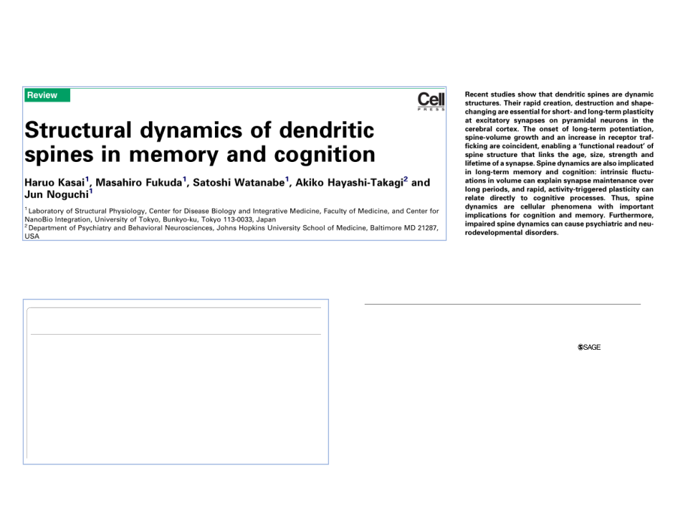
spines in memory and
Haruo Kasai
1
1
Haruo Kasai
, Masahiro Fukuda
Masahiro Fukuda
, Satoshi Watan
6BBYN309 (2025) Hippocampal LTD - Learning and Disease
1
Satoshi Watan
Jun Noguchi
Previous
PDF
Next
PDF
Jun Noguchi
Recommended Articles
Further Reading
1
Laboratory of Structural Physiology, Center for Disease Biology and Inte
NanoBio Integration, University of Tokyo, Bunkyo-ku, Tokyo 113-0033, Jap
2
Department of Psychiatry and Behavioral Neurosciences, Johns Hopkins
https://doi.org/10.1016/j.tins.2010.01.001
USA
Interactions between estradiol,
dendritic spines in promoting m
Review
Recent studies show that dendritic spines are dynamic
report
V. Luine and M. Frankfurt
structures. Their rapid creation, destruction and shape-
with L
Neuroscience
• 3 June 2013
changing are essential for short- and long-term plasticity
indicat
Structural dynamics of dendritic
at excitatory synapses on pyramidal neurons in the
level o
Preview
View PDF
cerebral cortex. The onset of long-term potentiation,
ﬁrmed
spine-volume growth and an increase in receptor traf-
(LTD)
spines in memory and cognition
ﬁcking are coincident, enabling a ‘functional readout’ of
induce
spine structure that links the age, size, strength and
dritic b
Dendritic spine changes associa
lifetime of a synapse. Spine dynamics are also implicated
Giv
in long-term memory and cognition: intrinsic ﬂuctu-
axonal
1
1
1
2
normal aging
that go
Haruo Kasai
ations in volume can explain synapse maintenance over
Haruo Kasai
, Masahiro Fukuda
Masahiro Fukuda
, Satoshi Watanabe
Satoshi Watanabe
, Akiko Hayashi-Takagi
1
Akiko Hayashi-Takagi
and
long periods, and rapid, activity-triggered plasticity can
major r
Jun Noguchi
Jun Noguchi
D.L. Dickstein, …
+2
… , P.R. Hof
[34,35]
relate directly to cognitive processes. Thus, spine
[34,35]
dynamics are cellular phenomena with important
nated e
1
Laboratory of Structural Physiology, Center for Disease Biology and Integrative Medicine, Faculty of Medicine, and Center for
Neuroscience
• 22 October 2013
been su
NanoBio Integration, University of Tokyo, Bunkyo-ku, Tokyo 113-0033, Japan
implications for cognition and memory. Furthermore,
–
[35
–
[35
38
2
Department of Psychiatry and Behavioral Neurosciences, Johns Hopkins University School of Medicine, Baltimore MD 21287,
impaired spine dynamics can cause psychiatric and neu-
38
USA
REVIEWS
rodevelopmental disorders.
Preview
View PDF
import
Kasai et al., 2003 Trends in Neurosci 26, 360-368
Dendritic spines
cortex
On pyramidal neurons in the cerebral cortex, excitatory
It is
Recent studies show that dendritic spines are dynamic
reports showed that spine enlargements are associated
Dendritic spine pathology in
include
structures. Their rapid creation, destruction and shape-
synapses terminate at spines, which are short protrusions
include
with LTP in single identiﬁed spines (
Figure 1
joined to the main dendrite by a thin neck. Discovered in
Figure 1
a)
[21]
[21]
,
42]
633439
NRO
XXX10.1177/1073858416633439The Neuroscientist
Regan et al.
schizophrenia
42]
, an
changing are essential for short- and long-term plasticity
research-article
2016
the 19th century and intensely scrutinized in the 20th
https://doi.org/10.1038/nrn2867
indicating that Hebb’s learning rule applies even at the
https://doi.org/10.1177/1073858416633439
century, dendritic spines are found in higher animals
(descri
at excitatory synapses on pyramidal neurons in the
level of a single synapse. Many studies have since con-
J.R. Glausier and D.A. Lewis
spines
Review
[1,2]
[1,2]
and some insects
[3,4]
cerebral cortex. The onset of long-term potentiation,
ﬁrmed that the induction of LTP or long-term depression
[3,4]
. Spines exist only on certain
polyme
Neuroscience
• 22 October 2013
types of neurons, including pyramidal neurons in the
LTP in
spine-volume growth and an increase in receptor traf-
(LTD), another form of activity-dependent plasticity,
The Neuroscientist
Long-term depression in the CNS
Physiological and Pathophysiological
2017, Vol. 23(2) 137 –151
ﬁcking are coincident, enabling a ‘functional readout’ of
induces structural plasticity of spines in stimulated den-
cortex, medium spiny neurons in the basal ganglia and
contin
Preview
© The Author(s) 2016
Purkinje cells in the cerebellum. Spines are more abundant
–
Implications of Synaptic Tau
Reprints and permissions:
View PDF
These
dritic branches
[22
–
[22
30]
spine structure that links the age, size, strength and
30]
.
sagepub.com/journalsPermissions.nav
in higher brain regions and highly variable in shape.
electro
lifetime of a synapse. Spine dynamics are also implicated
Given the apparent stability
in vivo
of dendritic and
DOI: 10.1177/1073858416633439
Graham L. Collingridge*
‡§
, Stephane Peineau*
||¶#
, John G. Howland** and
journals.sagepub.com/home/nro
–
Moreover, dendritic spines are the most actin-rich struc-
The
axonal arbors at low magniﬁcation
[31
–
[31
33]
in long-term memory and cognition: intrinsic ﬂuctu-
33]
, the properties
Yu Tian Wang
‡‡§§
tures in the brain
[5,6]
ations in volume can explain synapse maintenance over
that govern spine dynamics over the long-term could play a
[5,6]
, and their morphology and density
on spi
Philip Regan
1
, Daniel J. Whitcomb
1,2
, and Kwangwook Cho
1,2
.
are abnormal in several mental disorders
[7]
Abstract | Long-term depression (LTD) in the CNS has been the subject of intense
major role in reorganizing cortical circuitry throughout life
[7]
spectru
long periods, and rapid, activity-triggered plasticity can
The best-known example of input-speciﬁc, activity-de-
the rel
investigation as a process that may be involved in learning and memory and in various
[34,35]
relate directly to cognitive processes. Thus, spine
[34,35]
. In fact, spines are frequently generated and elimi-
pendent synaptic plasticity—Donald Hebb’s canonical
functio
pathological conditions. Several mechanistically distinct forms of this type of synaptic
nated even in the adult neocortex, and these events have
dynamics are cellular phenomena with important
basis for learning and memory
[8]
plasticity have been identified and their molecular mechanisms are starting to be unravelled.
Abstract
[8]
—is long-term poten-
spine s
tiation (LTP) of spine synapses in the hippocampus
[9]
implications for cognition and memory. Furthermore,
been suggested as substrates for stable memory formation
[9]
. The
ment o
Tauopathies encompass a broad range of neurodegenerative diseases featuring extensive neuronal death and cognitive
link between LTP and spine structure was suggested by
–
decline. However, research over the past 30 years has failed to significantly advance our understanding of how tau
[35
–
[35
38]
impaired spine dynamics can cause psychiatric and neu-
38]
. Both formation and enlargement of spines are
aptic
Most studies have focused on forms of LTD that are triggered by synaptic activation of either
causes dementia, limiting the design of rational therapeutics. It has become evident that we need to expand our
the pos
rodevelopmental disorders.
important during synaptic rearrangements in the visual
the ﬁnding that the size of the postsynaptic density (PSD)
and co
nt of
NMDARs (
N
-methyl-�-aspartate receptors) or metabotropic glutamate receptors (mGluRs).
understanding of tau in physiology, in order to delineate how tau may contribute to pathology. This review discusses
is related to the size of the spine head
[10]
cortex that follow sensory deprivation
[39]
[10]
and the number
[39]
.
Medical
Converging evidence supports a crucial role of LTD in some types of learning and memory
recent evidence that has uncovered a novel aspect of tau function, based on its previously uncharacterized localization
–
of AMPA-type glutamate receptors within it
[11
–
[11
13]
Walk,
Dendritic spines
13]
. These
.
and in situations in which cognitive demands require a flexible response. In addition, LTD
It is important to note that spine structural dynamics
to the synapse. Here, multiple streams of evidence support a critical role for synaptic tau in the regulation of synapse
Activit
ultrastructural studies, however, could not determine the
re,
On pyramidal neurons in the cerebral cortex, excitatory
include broader phenomena than LTP/LTD. Namely, they
physiology. In particular, long-term depression, a form of synaptic weakening, is dependent on the presence of tau
may underlie the cognitive effects of acute stress, the addictive potential of some drugs of
in hippocampal neurons. The regulation of tau by specific phosphorylation events downstream of GSK-3
�
activation
synapses terminate at spines, which are short protrusions
–
iatry,
include the generation and elimination of spines
[31,32,40
–
[31,32,40
abuse and the elimination of synapses in neurodegenerative diseases.
appears to be integral to this signaling role. We also describe how the regulation of synapse physiology by tau and its
joined to the main dendrite by a thin neck. Discovered in
42]
phosphorylation may inform our understanding of tauopathies and comorbid diseases. This work should provide a
, British
the 19th century and intensely scrutinized in the 20th
42]
, and long-term, activity-independent ﬂuctuations
platform for future tau biology research in addition to therapeutic design.
(described in detail below) (
Figure 1
Figure 1
b) [42]
Canada.
The two major forms of long-lasting synaptic plasticity
In this Review, we first discuss the mechanisms
[42]
. In addition,
n and
century, dendritic spines are found in higher animals
spines become larger in response to the force of actin
eoul
in the mammalian brain —
long-term potentiation
(LTP)
that are involved in the generation of LTD, classified
Keywords
[1,2]
Collingridge et al., (2010) Nat.Review Neurosci. 11, 459-473
Regan et al., (2015) The Neuroscientist 35, 4804-4812
[1,2]
and some insects
[3,4]
[3,4]
. Spines exist only on certain
polymerization
[43]
[43]
, which occurs within seconds
[21]
Seoul,
[21]
of
and
long-term depression
(LTD) — are characterized by
according to their induction, expression and signal-
tau, synapse, synaptic plasticity, long-term depression, glutamate receptors, phosphorylation, neurodegeneration,
types of neurons, including pyramidal neurons in the
LTP induction
[44]
�
[44]
. Spines seem to display expansive force
tal
a long-lasting increase or decrease in synaptic strength,
ling mechanisms. We then focus on the role of LTD in
tauopathy, dementia, Alzheimer’s disease, GSK-3
29
cortex, medium spiny neurons in the basal ganglia and
continuously to maintain their shape and function
[43]
.
ent Ecran
respectively. Both processes are thought to be involved
physio logical and pathological processes in different
[43]
Purkinje cells in the cerebellum. Spines are more abundant
evard
in information storage and therefore in learning and
regions of the CNS
These ﬁndings suggest that spine synapses are not just

