Slide 1
Puncturable PRF Key Optimization

Slide 2
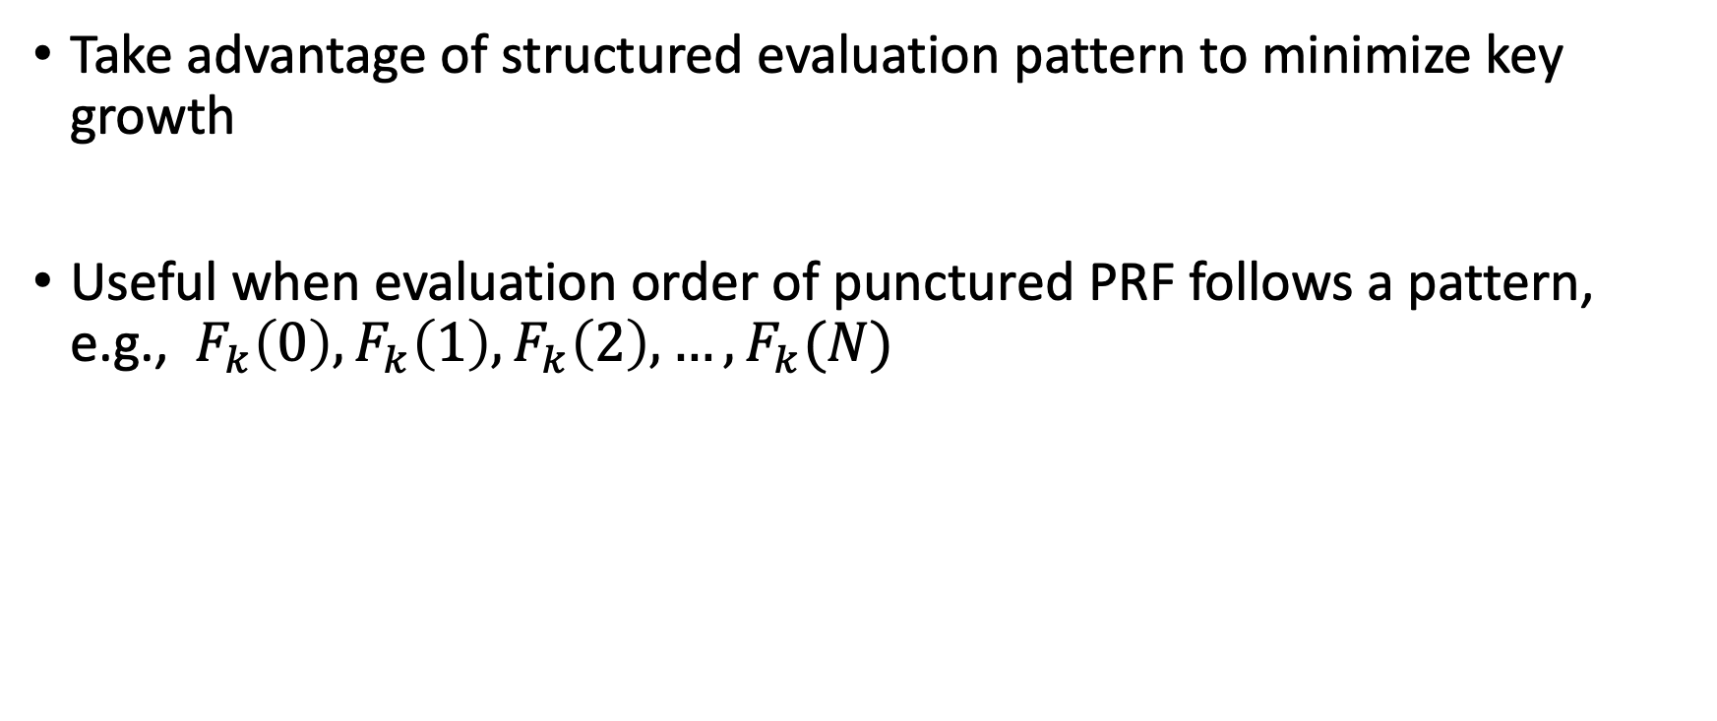
Idea
Take advantage of structured evaluation pattern to minimize key growth
Useful when evaluation order of punctured PRF follows a pattern, e.g., $F_{k}\left(0\right), F_{k}\left(1\right), F_{k}\left(2\right),…,F_{k}(N)$

Slide 3
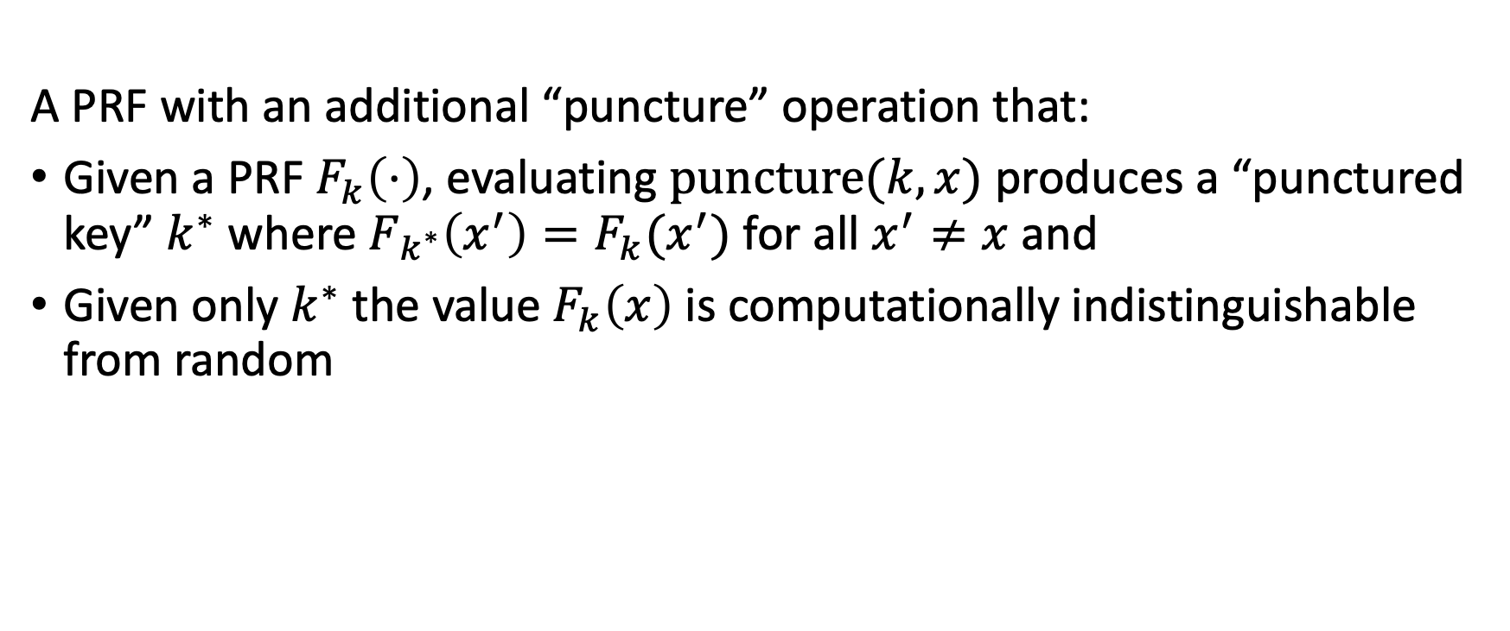
Puncturable Pseudorandom Functions (PPRF)
A PRF with an additional “puncture” operation that:
Given a PRF $F_{k}\left(⋅\right)$, evaluating $\text{puncture}(k,x)$ produces a “punctured key” $k^{∗}$ where $F_{k^{∗}}\left(x^{′}\right)=F_{k}(x^{′})$ for all $x^{′}≠x$ and
Given only $k^{∗}$ the value $F_{k}\left(x\right)$ is computationally indistinguishable from random

Slide 4


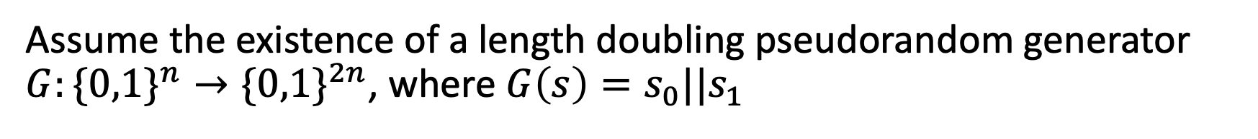

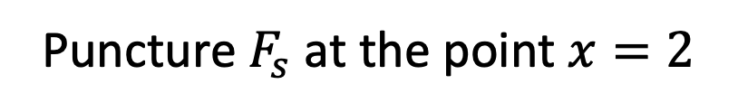

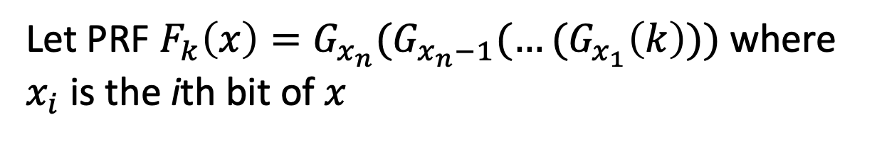




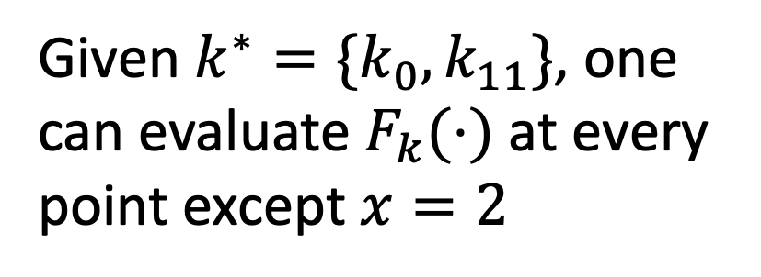
GGM’86 Puncturable PRF
Assume the existence of a length doubling pseudorandom generator $G:\{0,1\}^{n}→\{0,1\}^{2n}$, where $G\left(s\right)=s_{0}||s_{1}$
Let PRF $F_{k}\left(x\right)=G_{x_{n}}(G_{x_{n}−1}(…(G_{x_{1}}\left(k\right)))$where $x_{i}$ is the ith bit of $x$
$$k$$
$$k_{0}$$
$$k_{1}$$
Given $k^{∗}=\{k_{0},k_{11}\}$, one can evaluate $F_{k}(⋅)$ at every point except $x=2$
$$k_{00}$$
$$k_{01}$$
$$k_{10}$$
$$k_{11}$$
New key $s^{∗}$ are the neighbors along the path from $x=2$ to the root $k$
Goldreich, O., Goldwasser, S., & Micali, S. (1986). How to construct random functions. Journal of the ACM (JACM), 33(4), 792-807.
Puncture $F_{s}$ at the point $x=2$
Notes:
The GGM’86 PRF construction

Slide 5








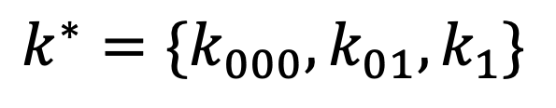









$$k$$
$$k^{∗}=\{k_{000},k_{01},k_{1}\}$$
$$k_{0}$$
$$k_{1}$$
$$k_{00}$$
$$k_{01}$$
$$k_{10}$$
$$k_{11}$$
$$k_{000}$$
$$k_{001}$$
$$k_{010}$$
$$k_{011}$$
$$k_{100}$$
$$k_{101}$$
$$k_{110}$$
$$k_{111}$$
$$F_{k}(0)$$
$$puncture(2)$$
$k^{∗}$ is growing by $O(\text{depth} \text{of} \text{tree})$ with each puncture
Idea: Prune the tree!
Notes:
The GGM’86 PRF construction

Slide 6
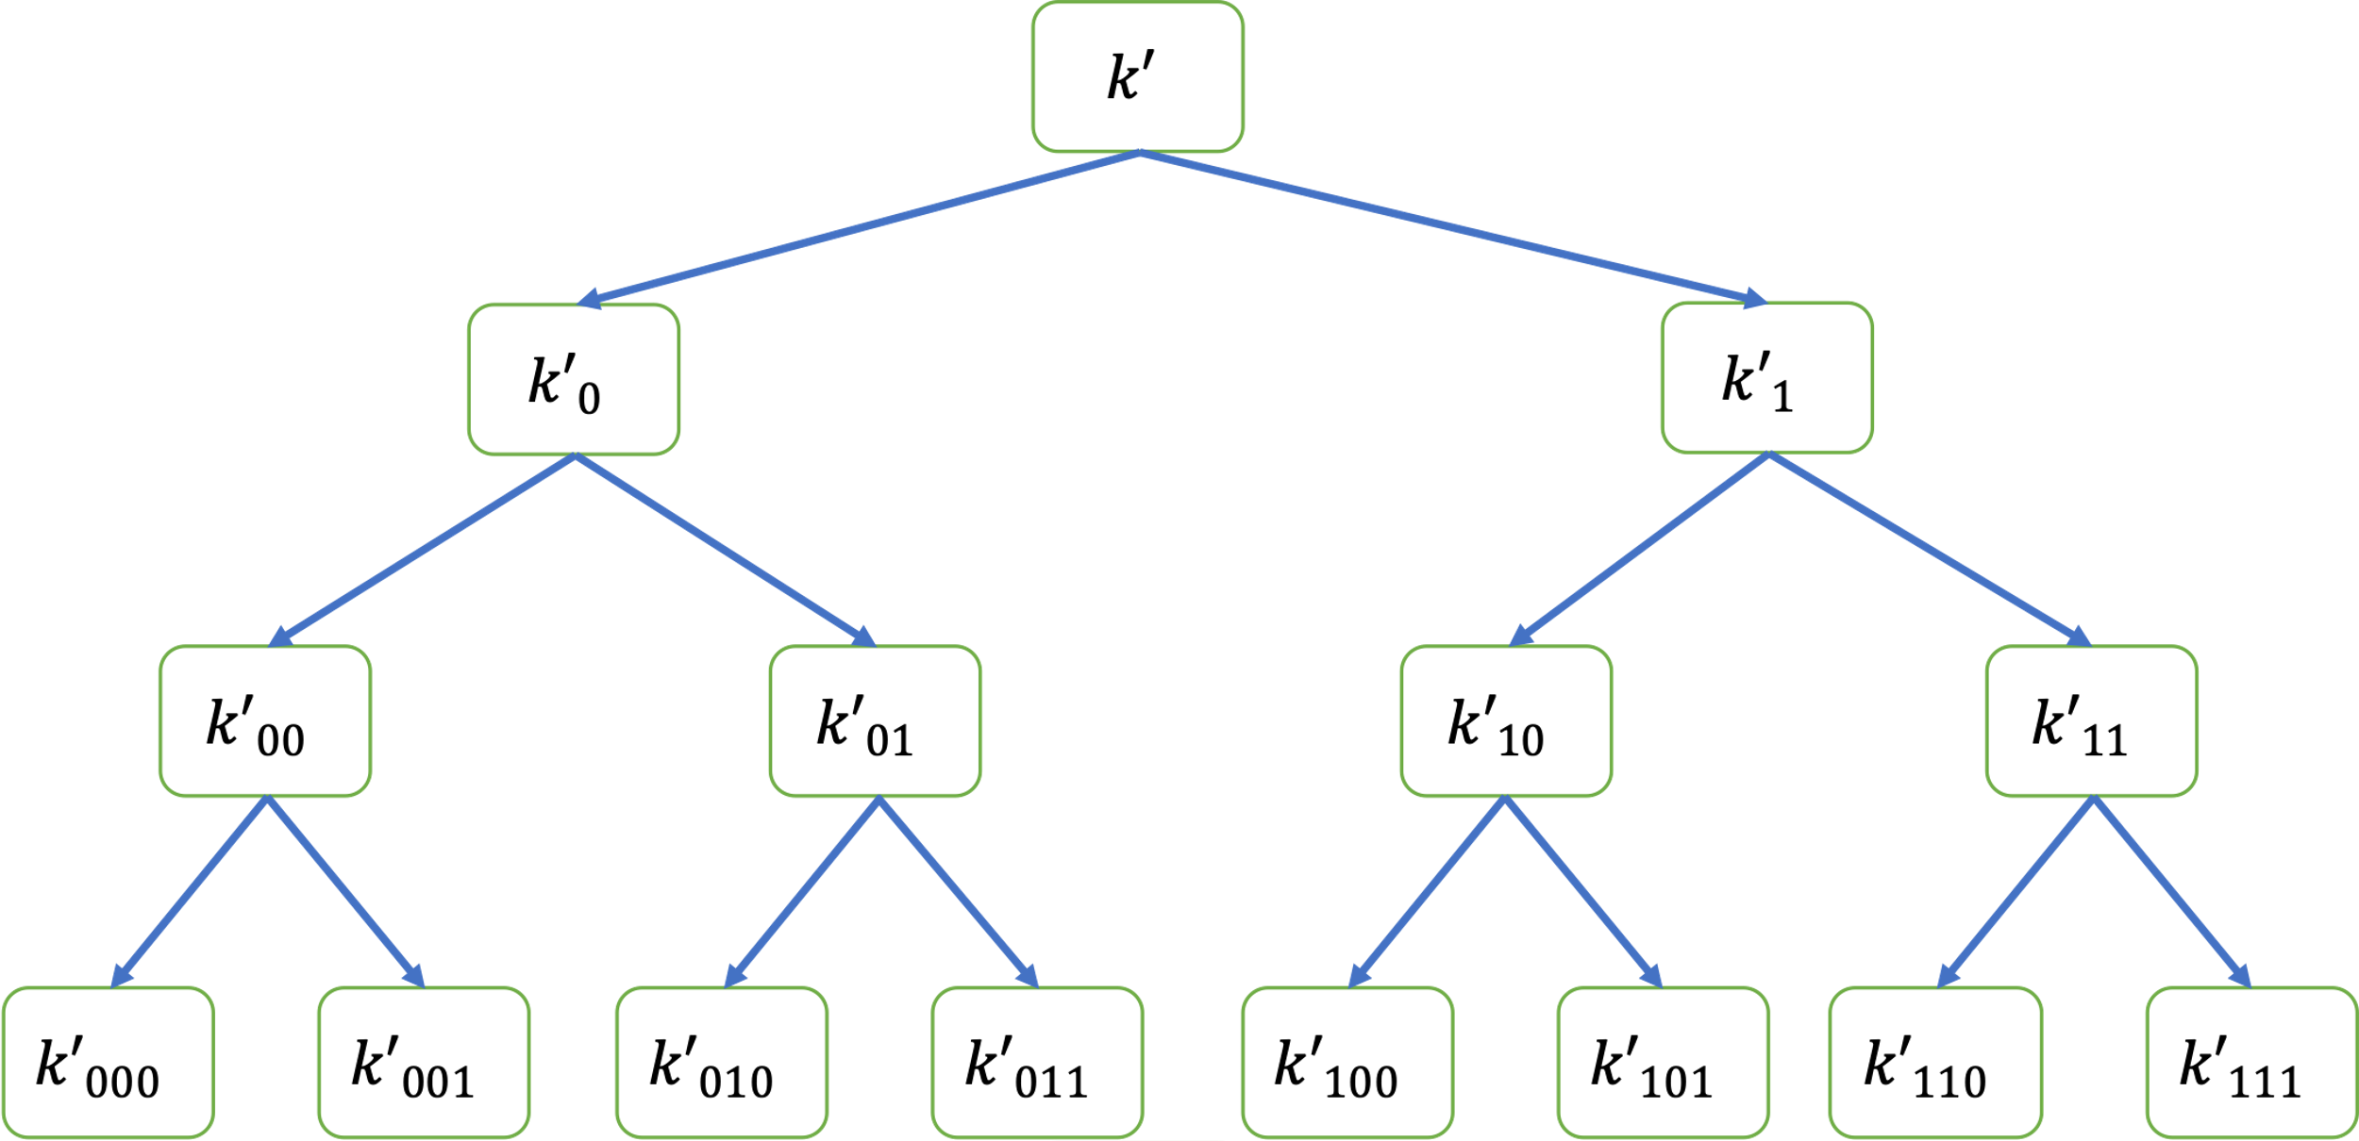














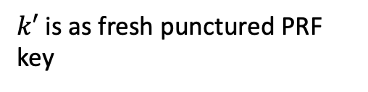





Optimization For Structured Evaluations
$$k$$
$$k^{∗}=\{k_{00}, k′\}$$
$$k_{0}$$
$$k_{1}$$
$$k_{00}$$
$$k_{01}$$
$$k_{10}$$
$$k_{11}$$
$k′$ is as fresh punctured PRF key
$$k_{000}$$
$$k_{001}$$
$$k_{010}$$
$$k_{011}$$
$$k_{100}$$
$$k_{101}$$
$$k_{110}$$
$$k_{111}$$
$$F_{k}(0)$$
$$puncture(2)$$
$$F_{k}(1)$$
Notes:
The GGM’86 PRF construction

