Slide 1
Accessing a File

Slide 2
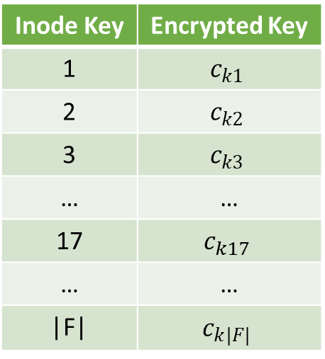

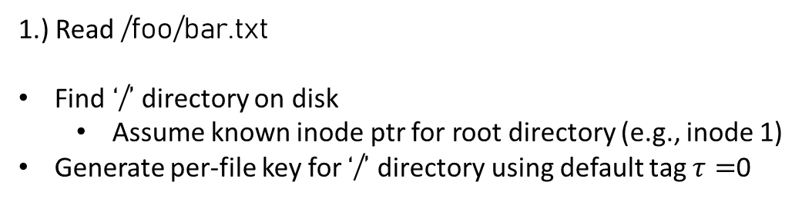


1.) Read /foo/bar.txt
Find ‘/’ directory on disk
Assume known inode ptr for root directory (e.g., inode 1)
Generate per-file key for ‘/’ directory using default tag $τ=$0
Inode Key Table
Inode 1
On Disk Data for ‘/’ Directory (encrypted)
PPRF
File inode tag Ptrs
/foo 17 1049 [p1]
/var 3 24
/xyz 42 599
$$F_{K}$$
$$τ=0$$
$$k_{1}$$

Slide 3
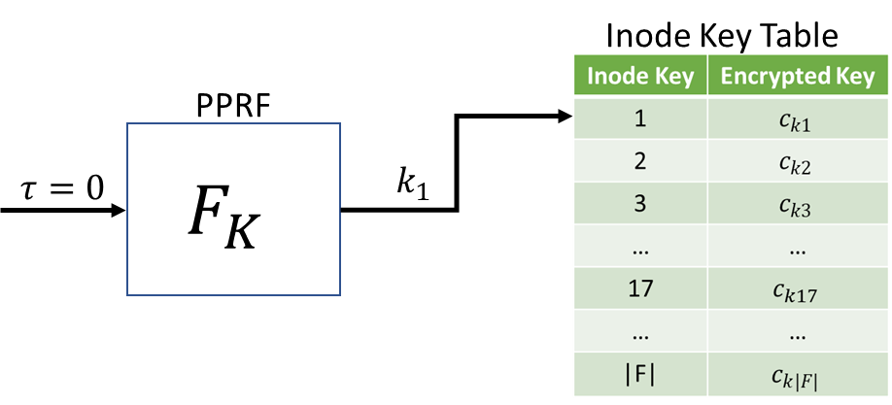
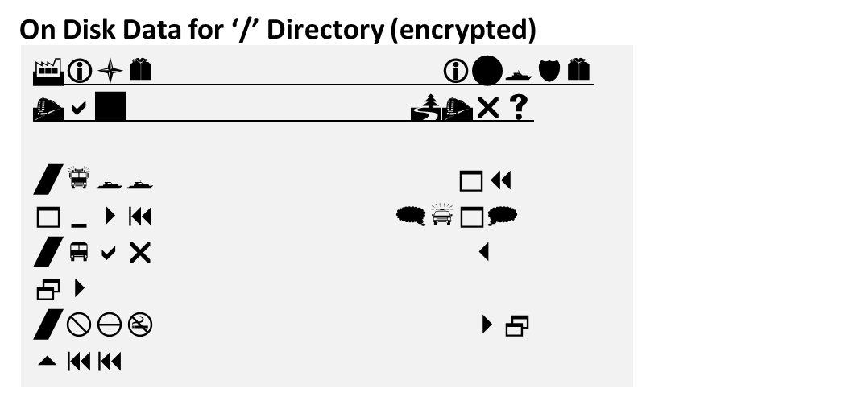
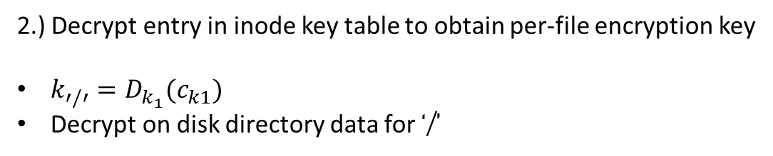

2.) Decrypt entry in inode key table to obtain per-file encryption key
$k_{′/′}=D_{k_{1}}(c_{k1})$
Decrypt on disk directory data for ‘/’
$$k_{′/′}$$
On Disk Data for ‘/’ Directory (decrypted)
File inode tag Ptrs
/foo 17 1049 [p1]
/var 3 24 …
/xyz 42 599 …

Slide 4
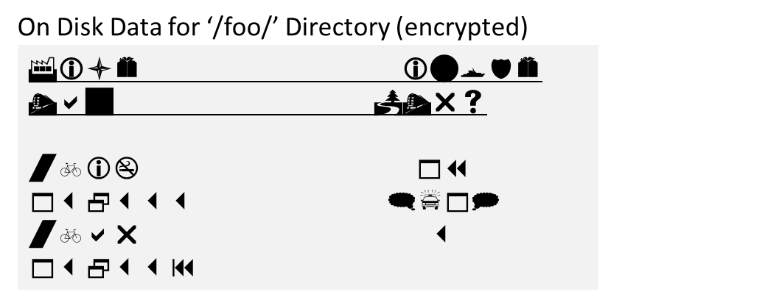




3.) Traverse directory to continue searching for /foo/bar.txt
Follow pointer to /foo data
Use tag associated with inode to generate per-file key
Decrypt /foo directory
On Disk Data for ‘/’ Directory
File inode tag Ptrs
/foo 17 1049 [p1]
/var 3 24
/xyz 42 599
Inode Key Table
PPRF
On Disk Data for ‘/foo/’ Directory (decrypted)
$$F_{K}$$
$$τ=1049$$
$$k_{17}$$
File inode tag Ptrs
bar.txt 144 132333 [p1, p2]
xyz 302 132339 …
$$k_{′/foo′}$$

Slide 5
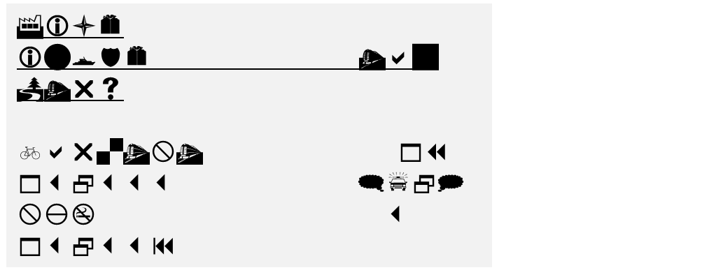


3.) Access /foo/bar.txt
Follow pointer to /foo/bar.txt inode
Use tag associated with inode to generate per-file key
Decrypt /foo/bar.txt data blocks
On Disk Data for ‘/foo/bar.txt’ (encrypted)
On Disk Data for ‘/foo/’ Directory
File inode tag Ptrs
bar.txt 144 132333 [p2, p3]
xyz 302 132339
Inode Key Table
PPRF
$$F_{K}$$
$$τ=132333$$
$$k_{132333}$$
On Disk Data for ‘/foo/bar.txt’ (decrypted)
HELLO WORLD!

Slide 6
Deleting a File

Slide 7
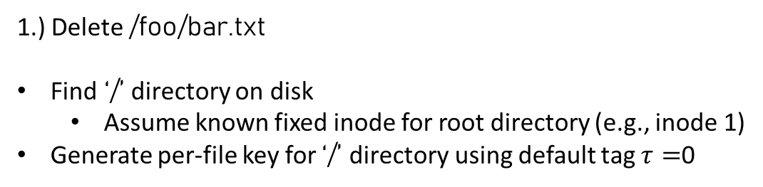
1.) Delete /foo/bar.txt
Find ‘/’ directory on disk
Assume known fixed inode for root directory (e.g., inode 1)
Generate per-file key for ‘/’ directory using default tag $τ=$0
Inode Key Table
Inode 1
On Disk Data for ‘/’ Directory (encrypted)
PPRF
File inode tag Ptrs
/foo 17 1049 [p1]
/var 3 24
/xyz 42 599
$$F_{K}$$
$$τ=0$$
$$k_{1}$$

Slide 8
2.) Decrypt entry in inode key table to obtain per-file encryption key
$k_{′/′}=D_{k_{1}}(c_{k1})$
Decrypt on disk directory data for ‘/’
$$k_{′/′}$$
On Disk Data for ‘/’ Directory (decrypted)
File inode tag Ptrs
/foo 17 1049 [p1]
/var 3 24 …
/xyz 42 599 …

Slide 9
3.) Traverse directory to continue searching for /foo/bar.txt
Follow pointer to /foo data
Use tag associated with inode to generate per-file key
Decrypt /foo directory
On Disk Data for ‘/’ Directory
File inode tag Ptrs
/foo 17 1049 [p1]
/var 3 24
/xyz 42 599
Inode Key Table
PPRF
On Disk Data for ‘/foo/’ Directory (decrypted)
$$F_{K}$$
$$τ=1049$$
$$k_{17}$$
File inode tag Ptrs
bar.txt 144 132333 [p1, p2]
xyz 302 132339 …
$$k_{′/foo′}$$

Slide 10

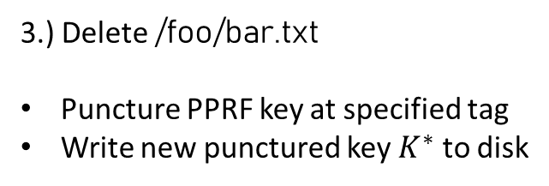


3.) Delete /foo/bar.txt
Puncture PPRF key at specified tag
Write new punctured key $K^{∗}$ to disk
PPRF
$$F_{K}$$
Puncture($132333$)
$$K^{∗}$$
On Disk Data for ‘/foo/’ Directory
File inode tag Ptrs
bar.txt 144 132333 [p2, p3]
xyz 302 132339

Slide 11
Paranoia…
On Disk Data for ‘/foo/’ Directory
File inode tag Ptrs
bar.txt 144 132333 [p2, p3]
xyz 302 132339
Since /foo/ has not been
deleted, we must assume
that this metadata about
bar.txt is recoverable…
We can still recover metadata about the deleted file from the parent directory

Slide 12



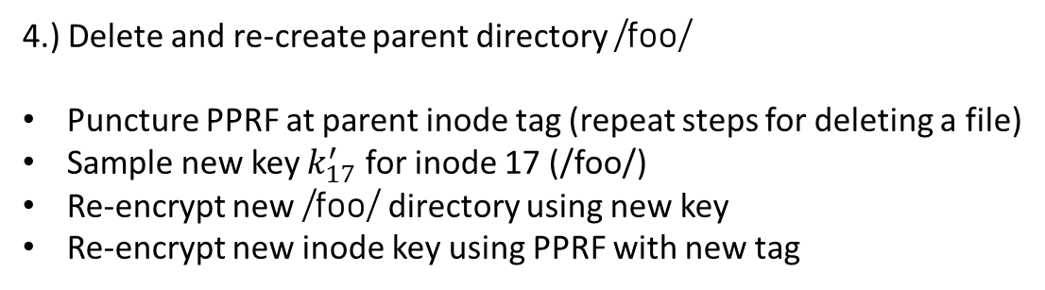



4.) Delete and re-create parent directory /foo/
Puncture PPRF at parent inode tag (repeat steps for deleting a file)
Sample new key $k_{17}^{′}$ for inode 17 (/foo/)
Re-encrypt new /foo/ directory using new key
Re-encrypt new inode key using PPRF with new tag
New on Disk Data for ‘/foo/’ Directory (decrypted)
Inode 17
File inode tag Ptrs
xyz 302 132339 …
Encrypt using new key $k_{17}^{′}$
Inode Key Table
New on Disk Data for ‘/foo/’ Directory (encrypted)
$$c_{k17}=E_{k_{17}}\left(k_{17}^{′}\right)$$
PPRF
$$F_{K}$$
$$k_{17}$$
$$τ=176$$

