Slide 1
Ideas for Cryptographic Erasure

Slide 2

Puncturable Encryption
Public key encryption scheme $(\text{KeyGen}\text{, }\text{Encrypt}\text{, }\text{Decrypt})$ with one extra routine:
$\text{puncture}\left(sk,ct\right)→sk_{ct}$
Given a secret key $sk$ and a ciphertext $ct$, outputs a new secret key $sk_{ct}$ that can decrypt all ciphertexts $sk$ can decrypt EXCEPT for $ct$

Slide 3
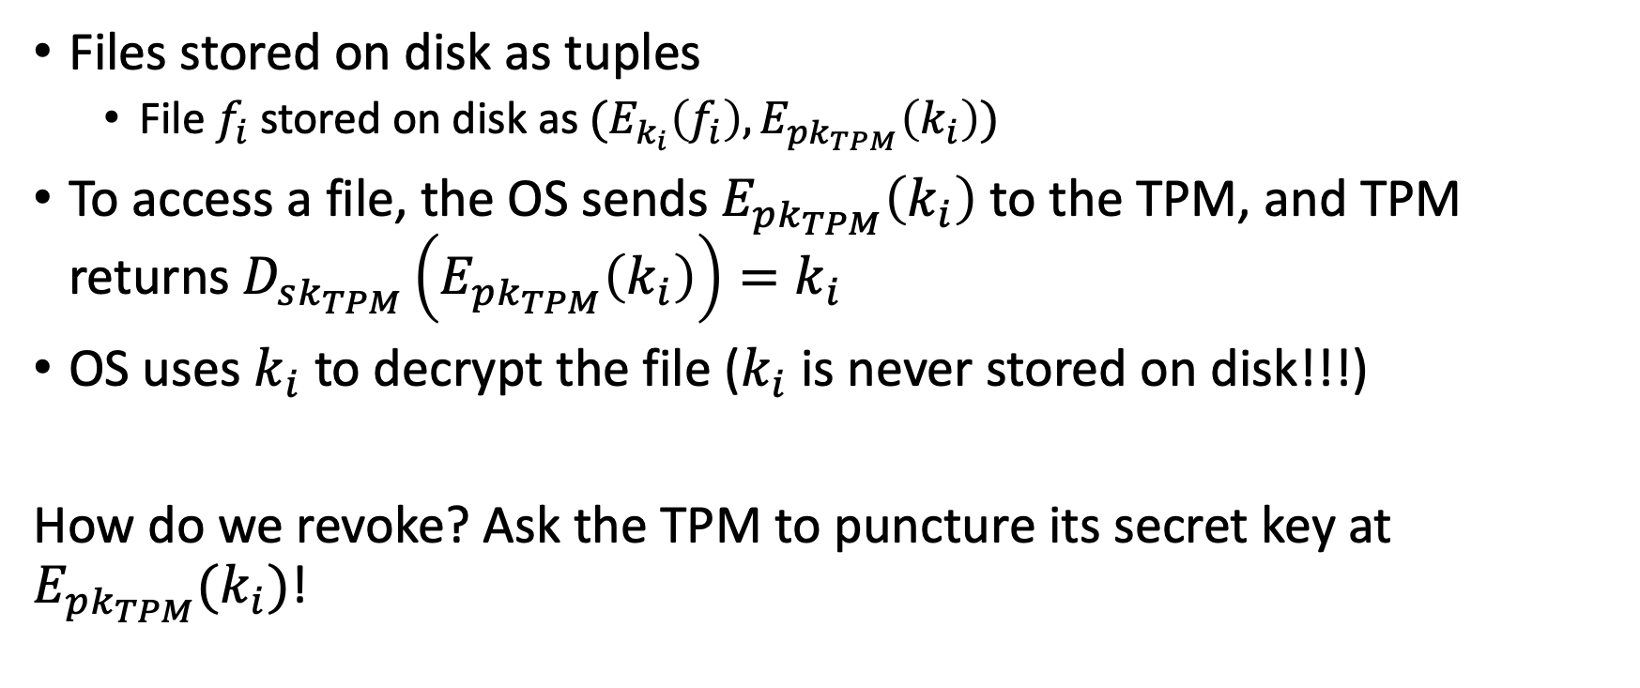
Idea 1: Use PE scheme to revoke decryption keys at a per file granularity
Files stored on disk as tuples
File $f_{i}$ stored on disk as $(E_{k_{i}}\left(f_{i}\right), E_{pk_{TPM}}\left(k_{i}\right))$
To access a file, the OS sends $E_{{pk}_{TPM}}\left(k_{i}\right)$ to the TPM, and TPM returns $D_{sk_{TPM}}\left(E_{pk_{TPM}}\left(k_{i}\right)\right)=k_{i}$
OS uses $k_{i}$ to decrypt the file ($k_{i}$ is never stored on disk!!!)
How do we revoke? Ask the TPM to puncture its secret key at $E_{pk_{TPM}}(k_{i})$!

Slide 4
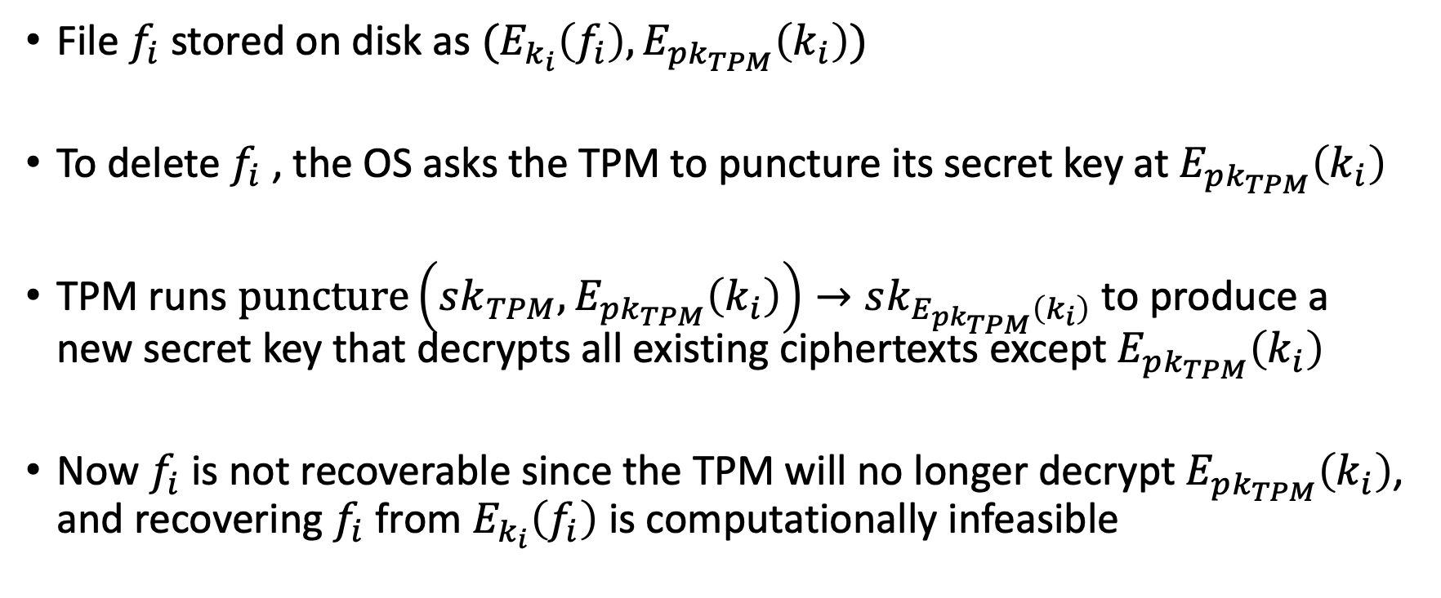
Idea 1: Continued… secure deletion
File $f_{i}$ stored on disk as $(E_{k_{i}}\left(f_{i}\right), E_{pk_{TPM}}\left(k_{i}\right))$
To delete $f_{i}$, the OS asks the TPM to puncture its secret key at $E_{pk_{TPM}}\left(k_{i}\right)$
TPM runs $\text{puncture}\left(sk_{TPM},E_{pk_{TPM}}\left(k_{i}\right)\right)→sk_{E_{pk_{TPM}}\left(k_{i}\right)}$ to produce a new secret key that decrypts all existing ciphertexts except $E_{pk_{TPM}}\left(k_{i}\right)$
Now $f_{i}$ is not recoverable since the TPM will no longer decrypt $E_{pk_{TPM}}\left(k_{i}\right)$, and recovering $f_{i}$ from $E_{k_{i}}\left(f_{i}\right)$ is computationally infeasible

Slide 5

Idea 1: Problems
Known PE schemes require keys that are behemoths. The TPM can’t store these keys, so we are dead in the water.
BFE scheme: To support $P$ punctures and have decryption fail with probability $2^{−λ}$, the secret key size is $λP$group elements

Slide 6
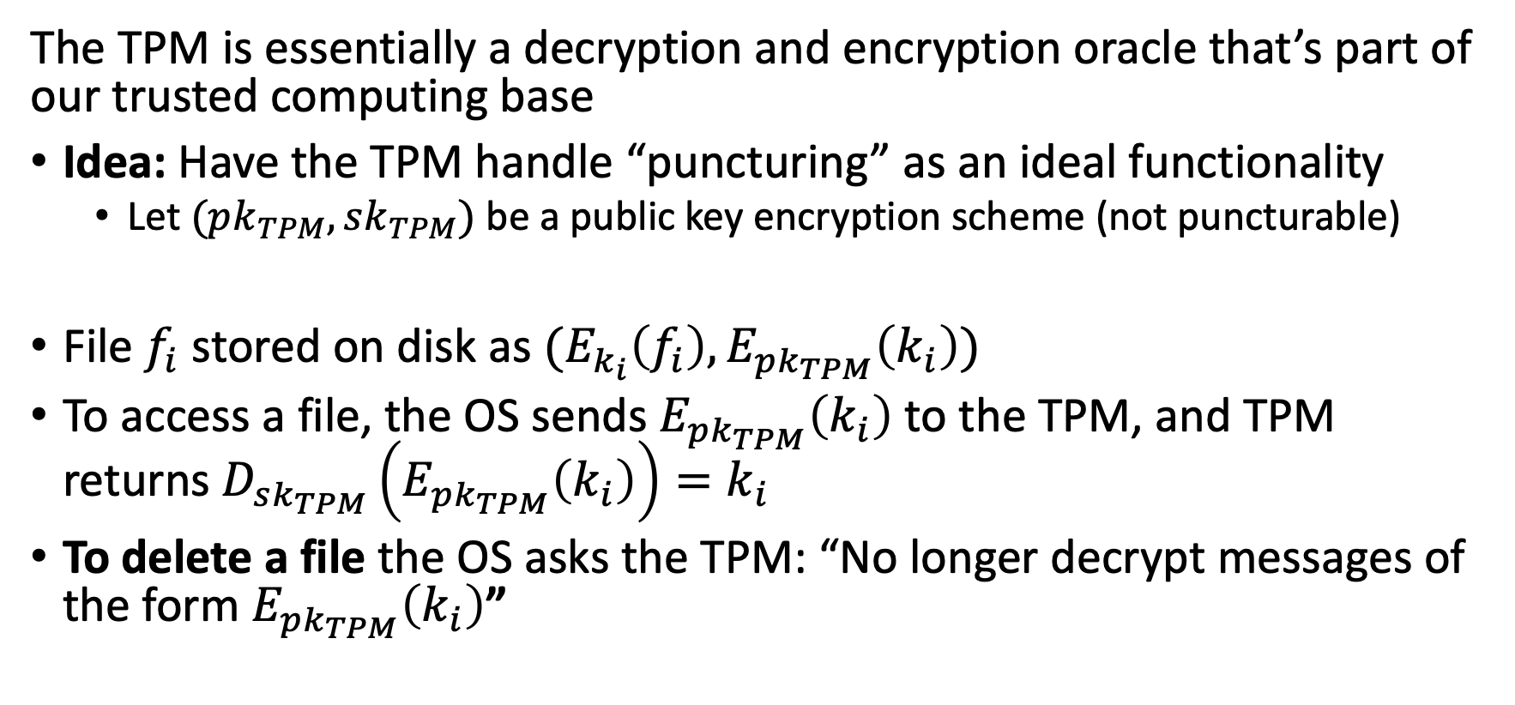
Idea 2: Quasi-PE
The TPM is essentially a decryption and encryption oracle that’s part of our trusted computing base
Idea: Have the TPM handle “puncturing” as an ideal functionality
Let $(pk_{TPM},sk_{TPM})$ be a public key encryption scheme (not puncturable)
File $f_{i}$ stored on disk as $(E_{k_{i}}\left(f_{i}\right), E_{pk_{TPM}}\left(k_{i}\right))$
To access a file, the OS sends $E_{{pk}_{TPM}}\left(k_{i}\right)$ to the TPM, and TPM returns $D_{sk_{TPM}}\left(E_{pk_{TPM}}\left(k_{i}\right)\right)=k_{i}$
To delete a file the OS asks the TPM: “No longer decrypt messages of the form $E_{pk_{TPM}}\left(k_{i}\right)$”

Slide 7
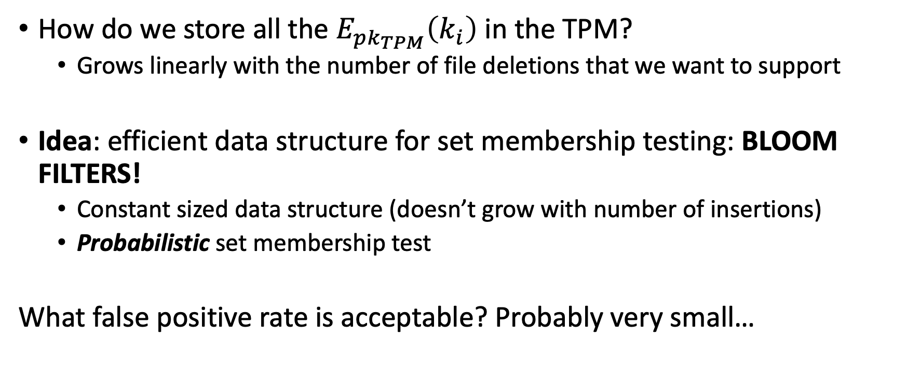
Idea 2: Quasi-PE… continued
How do we store all the $E_{pk_{TPM}}\left(k_{i}\right)$ in the TPM?
Grows linearly with the number of file deletions that we want to support
Idea: efficient data structure for set membership testing: BLOOM FILTERS!
Constant sized data structure (doesn’t grow with number of insertions)
Probabilistic set membership test
What false positive rate is acceptable? Probably very small…

Slide 8
What happens with a false positive?
Can you recover a deleted file with a false positive? NO!
False positive says “You told me to delete this file” when you actually didn’t…
This means file that was not deleted, is not recoverable :(
BUT – there are never false negatives! This is good, deleted files are NEVER recoverable!
How do we make false positives really small?
1.) Existing bounds on bloom filter false positives
2.) Can we sort of bootstrap the false positive problem

Slide 9
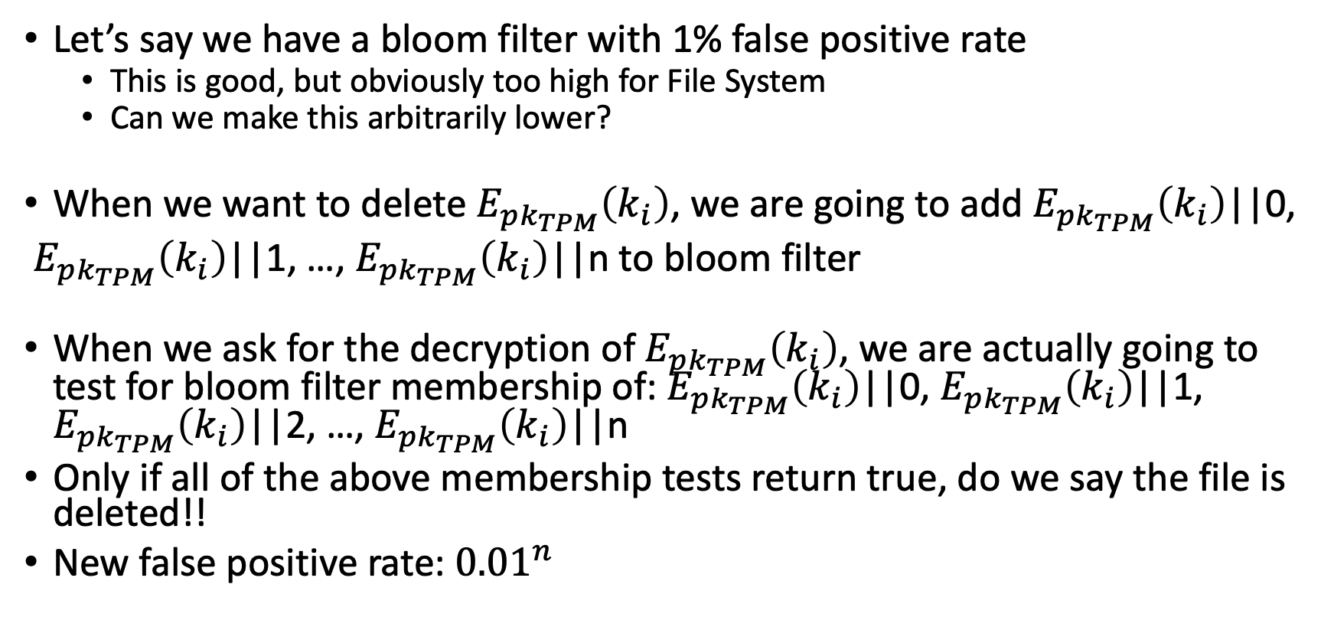
Bloom Filter Idea
Let’s say we have a bloom filter with 1% false positive rate
This is good, but obviously too high for File System
Can we make this arbitrarily lower?
When we want to delete $E_{pk_{TPM}}\left(k_{i}\right)$, we are going to add $E_{pk_{TPM}}\left(k_{i}\right)$||0,
$E_{pk_{TPM}}\left(k_{i}\right)$||1, …, $E_{pk_{TPM}}\left(k_{i}\right)$||n to bloom filter
When we ask for the decryption of $E_{pk_{TPM}}\left(k_{i}\right)$, we are actually going to test for bloom filter membership of: $E_{pk_{TPM}}\left(k_{i}\right)$||0, $E_{pk_{TPM}}\left(k_{i}\right)$||1, $E_{pk_{TPM}}\left(k_{i}\right)$||2, …, $E_{pk_{TPM}}\left(k_{i}\right)$||n
Only if all of the above membership tests return true, do we say the file is deleted!!
New false positive rate: ${0.01}^{n}$

Slide 10
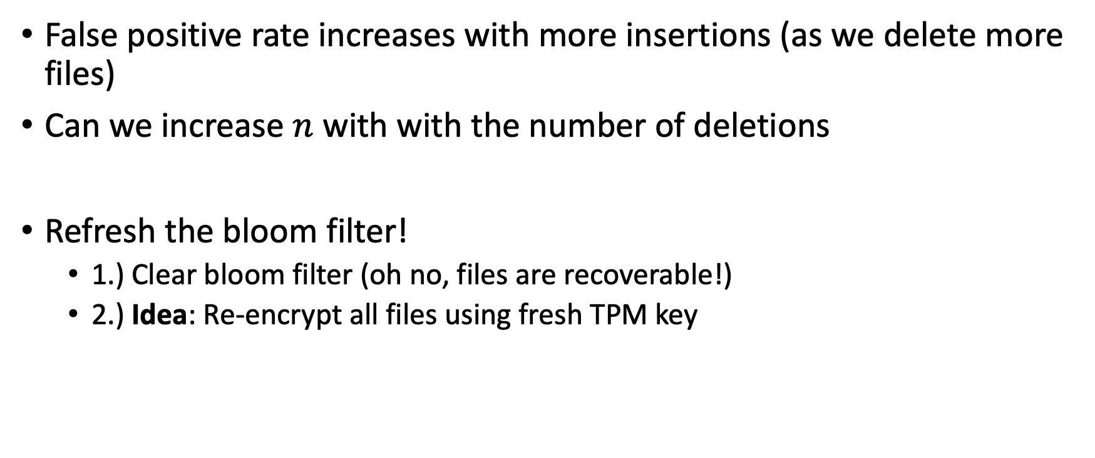
Bloom Filter Caveat
False positive rate increases with more insertions (as we delete more files)
Can we increase $n$ with with the number of deletions
Refresh the bloom filter!
1.) Clear bloom filter (oh no, files are recoverable!)
2.) Idea: Re-encrypt all files using fresh TPM key

Slide 11
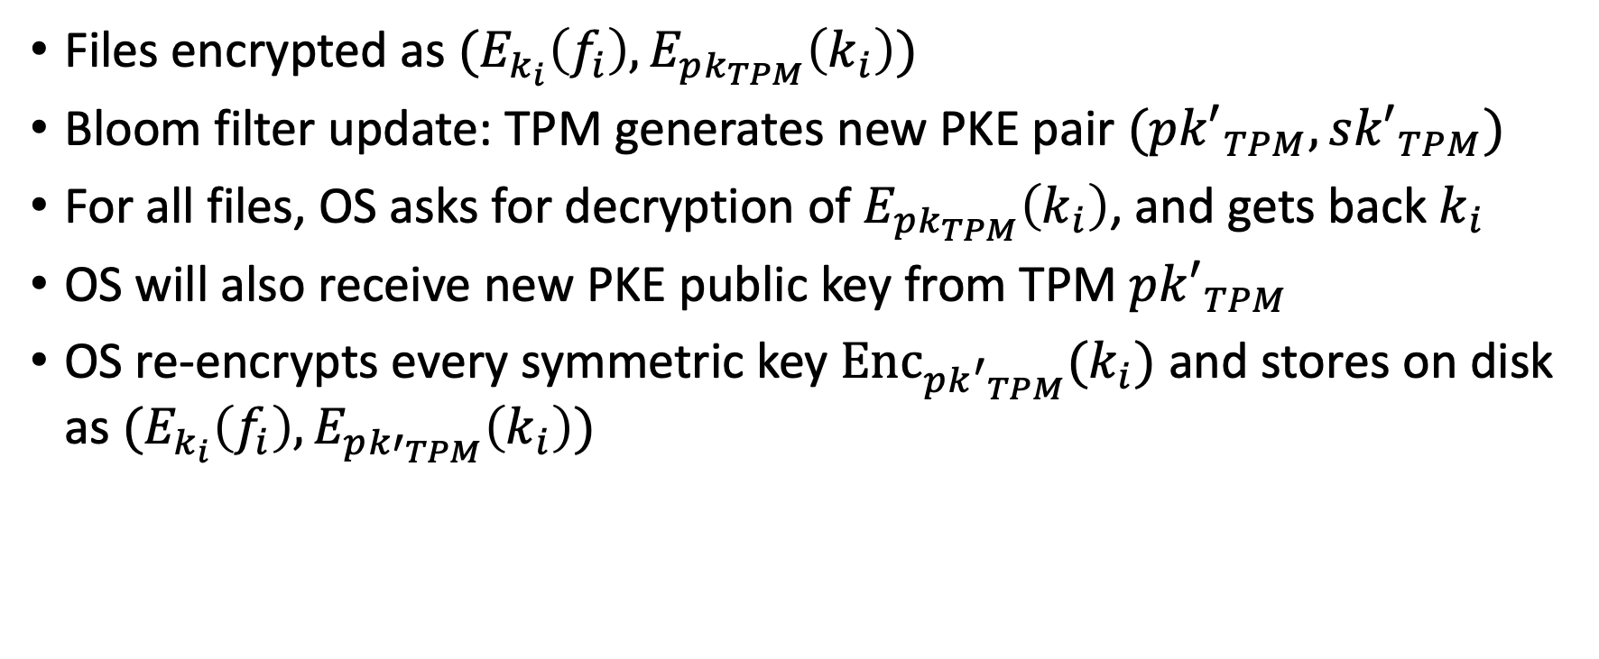
Bloom Filter Refreshing
Files encrypted as $(E_{k_{i}}\left(f_{i}\right), E_{pk_{TPM}}\left(k_{i}\right))$
Bloom filter update: TPM generates new PKE pair $(p{k′}_{TPM},s{k′}_{TPM})$
For all files, OS asks for decryption of $E_{pk_{TPM}}\left(k_{i}\right)$, and gets back $k_{i}$
OS will also receive new PKE public key from TPM $p{k′}_{TPM}$
OS re-encrypts every symmetric key ${Enc}_{p{k^{′}}_{TPM}}(k_{i})$ and stores on disk as $(E_{k_{i}}\left(f_{i}\right), E_{p{k′}_{TPM}}\left(k_{i}\right))$

