Slide 1
Perceptual Hash
Presented by:
Furkan Tufekci
Toby Toubiya
Vincent Petrella
Vaselyne Rassokhin

Slide 2
Problem statement
Main goal: generate a perceptual hash of an image (2D matrix)
Advantage of a perceptual hash: slight changes in input data imply small changes in output hash (opposed to cryptographic hashes)
Hashes can be confined to databases where we can quickly query similarities between images
Focus of the project is to compute the hash efficiently in parallel using openCL for the image FFT and openMP for the hash computations.

Slide 3

Fast fourier transform
The hash doesn’t run directly on the image, it runs on the frequency representation of the image.
To compute the Fourier transform of the image, we implemented a 2D Fast Fourier Transform on GPU using the OpenCL API for all-purpose computing on GPUs.
We used the Cooley-Tukey implementation of FFT, which has complexity N $\log_{2}{N}$ for the 2D implementation.

Slide 4
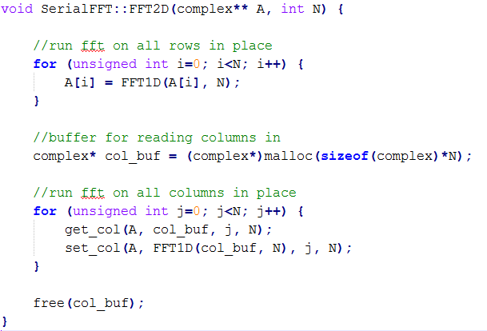

SERIAL FFT implementation
The 1D version is implemented using Cooley-Tukey 2-radix algorithm in $Nlog_{2}N$ time.
The 2D version simply runs the 1D algorithm on each column and then on each row of the matrix, resulting in $Mlog_{2}N$, where M = N*N, the total number of elements.
We end up with 2D complex matrix with the frequency representation of the image.

Slide 5
FFT on the gpu using opencl
FFT operation is a great fit to un on GPUs:
By linearity of the Fourier transform operation, data can be computed independently and coalesced later.
Our algorithm computes the 1D FFT on each row of the image. Each computation can be done independently.
Simple arithmetic operations, which the GPUs are built to crunch.

Slide 6
Results - FFT

Slide 7
Perceptual Hash
Once the frequency domain is computed using FFT, the hashing algorithm is performed on the resulting matrix.
Gives bigger importance to lower frequency components since they contain a large amount of information from the image.
These components will stay stable if image changes slightly. This is not usually the case for spatial domain.

Slide 8
Perceptual Hash Algorithm
Associate each frequency with a prime number and multiply it’s values by that number.
Sum up each of these results.
Hypothesis: by associating lower frequencies with larger prime numbers, we are going to get hashes closer to each other for similar images.
float counter = 0; for(int i = 0; i < imgFFT.size(); i++) { for(int j = 0; j < imgFFT[i].size(); j++){ int max = i > j ? i : j; counter += imgFFT[i][j] * primes[max]; } }

Slide 9
Parallelism
For the parallelization of the hashing algorithm, we decided to use OpenMP since the hash computation isn’t very time consuming, transferring the data to the GPU would have been a large overhead.
float counter = 0; #pragma omp parallel for schedule(dynamic) shared(counter) num_threads(_num_parallel) for(int i = 0; i < imgFFT.size(); i++) { float temp = 0; for(int j = 0; j < imgFFT[i].size(); j++){ int max = i > j ? i : j; temp += imgFFT[i][j] * primes[max]; } #pragma omp critical counter += temp; }

Slide 10
Results – Hashing – I7 Processor

Slide 11
conclusion
An improvement to our algorithm would be to implement the Fisher faces algorithm for facial.
It’s more performant to parallelize the FFT process
Using OpenMP to parallelize the hashing part is not worth it since the parallelized computations are very simple (multiplication) and the communication overhead is too large.

