Slide 1
spanish

Slide 2
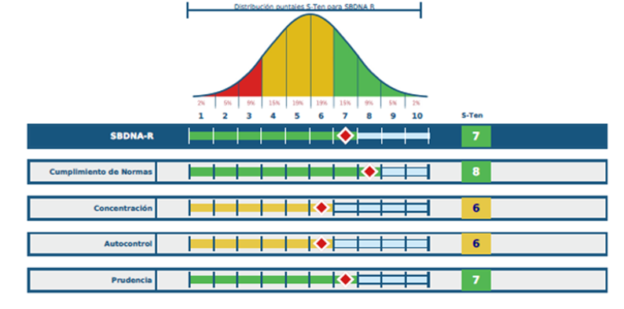
Sbdna r report

Slide 3
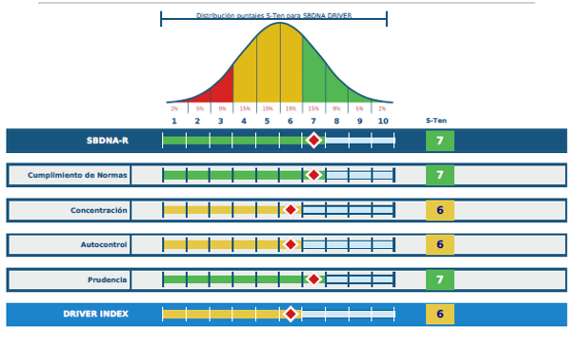
Sbdna r driver report

Slide 4
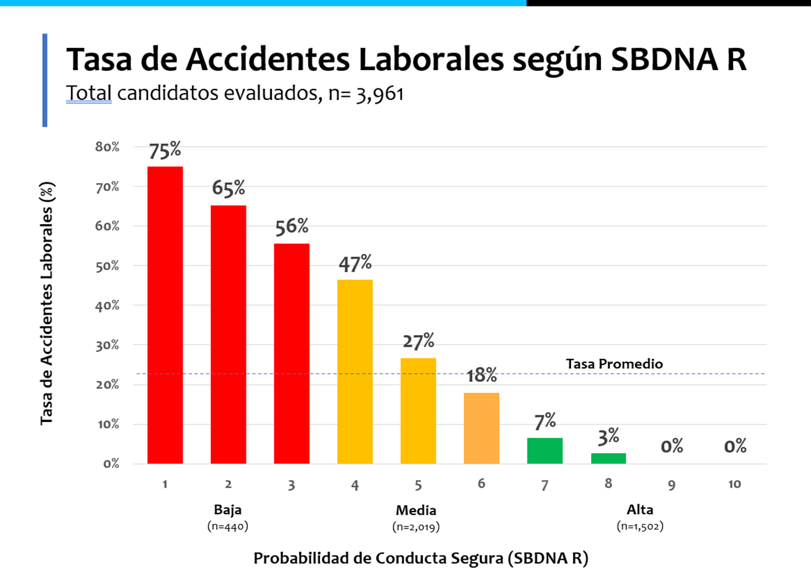
Sbdna r graph

Slide 5
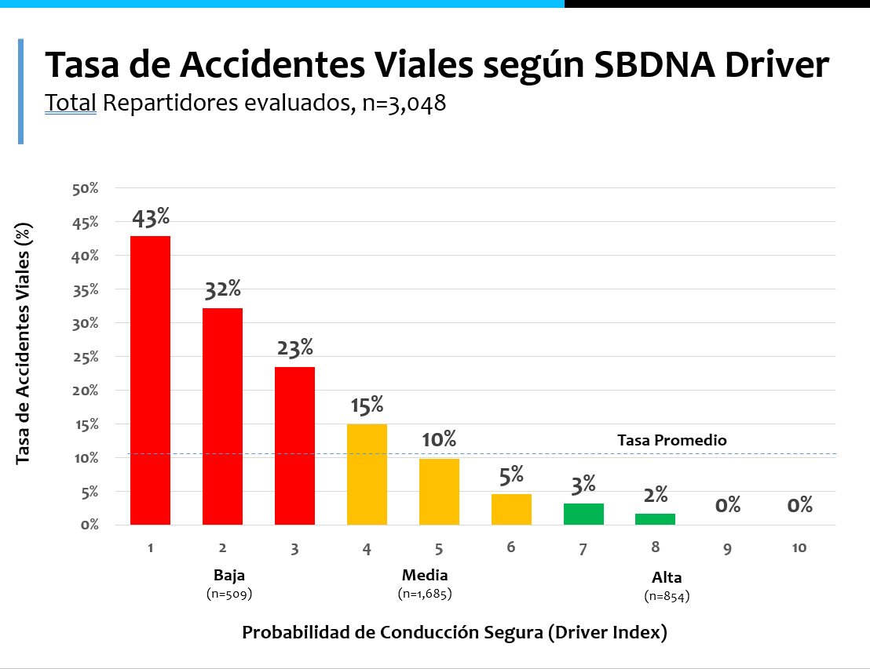
Sbdna driver graph

Slide 6
portuguese

Slide 7
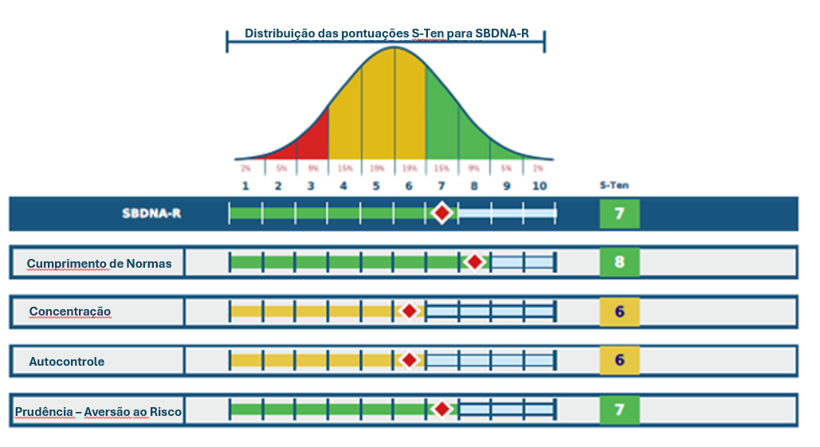
Sbdna r report

Slide 8
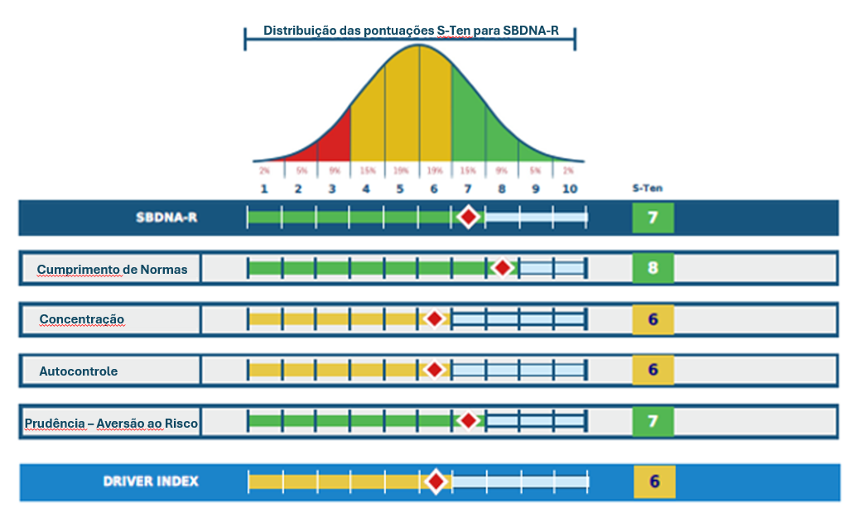
Sbdna r driver report

Slide 9
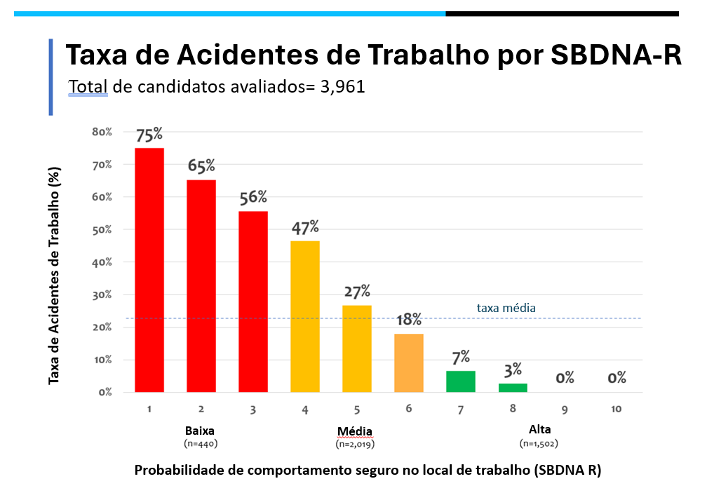
Sbdna r graph

Slide 10
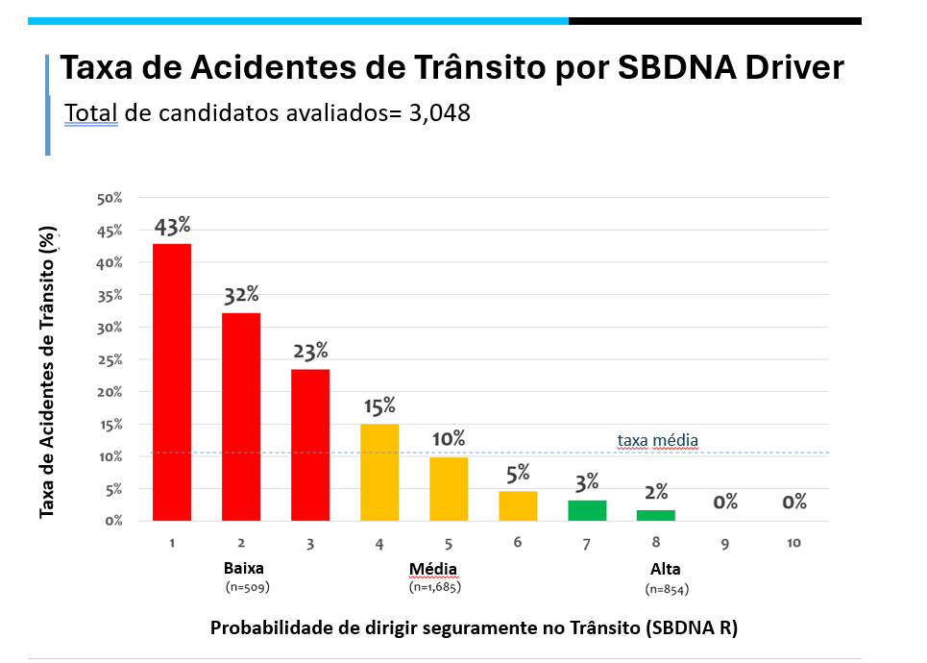
Sbdna driver graph

Slide 11
english

Slide 12
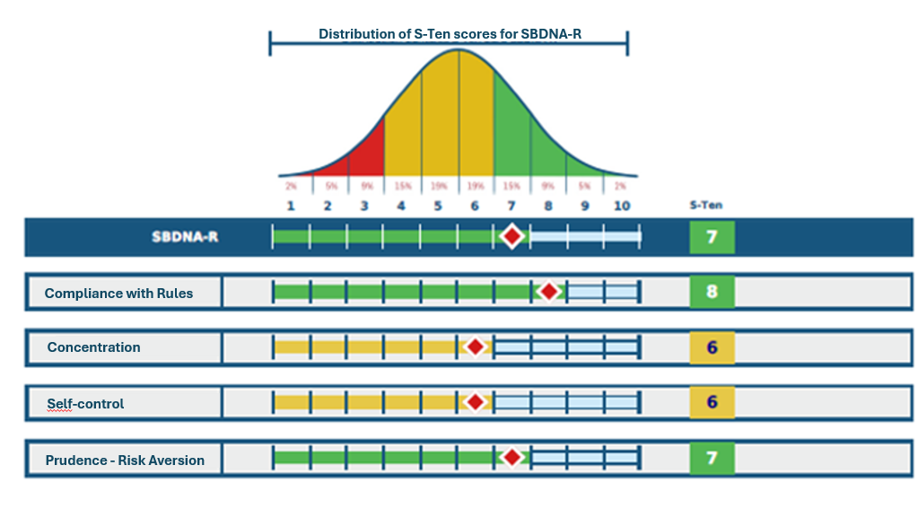
Sbdna r report

Slide 13
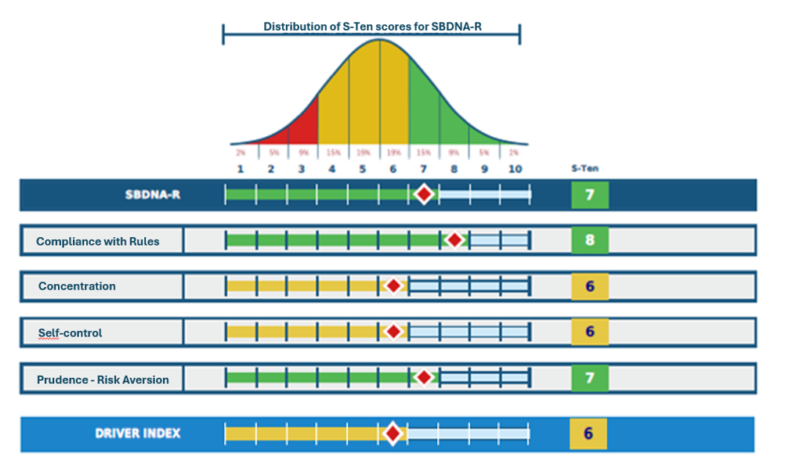
Sbdna r driver report

Slide 14
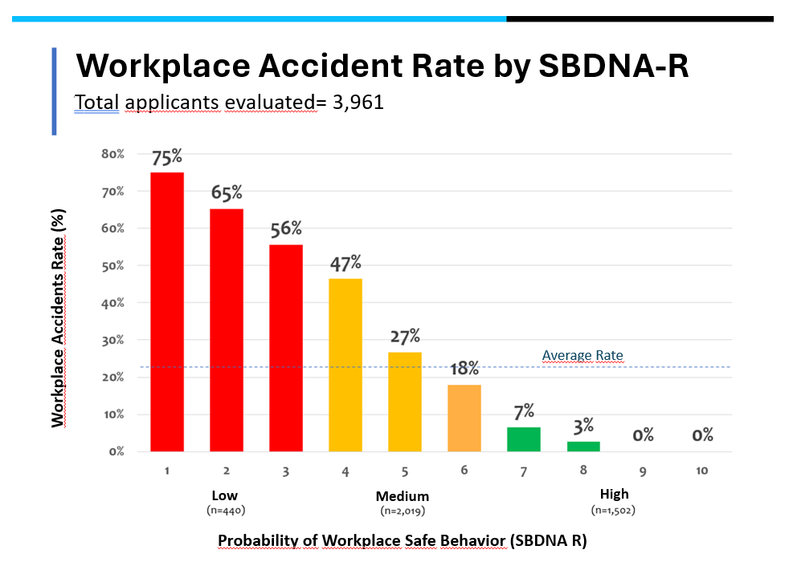
Sbdna r graph

Slide 15
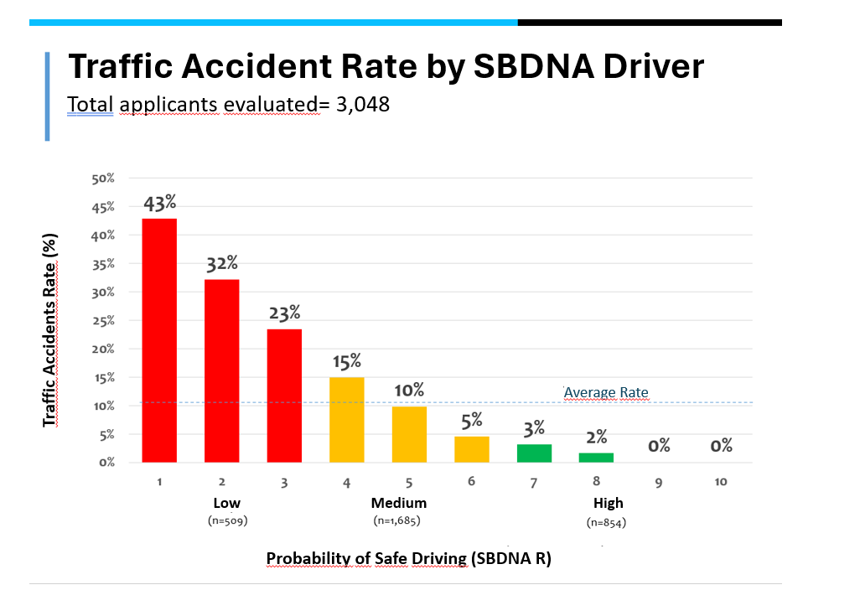
Sbdna driver graph

