Slide 1

tsGOMP
Current choices of implementation

Slide 2
Algorithm tsGOMP(V,target)
Start with S = {target}, model target <-- S
Repeat:
Compute the model residuals
For each variable not in S, compute ASSOCIATION(variable, residuals)
Select best variable, put in S
Train new model on S
Until new model is as/less significant than previous

Slide 3
Learning Models

Slide 4
Notations Definitions
y_{t} (lower case): univariate time series (scalar).
X_{t} (upper case): multivariate time series (vector of scalars), each vector component being a univariate time series.
E_{t} or e_{t}: white noise scalar or vector
y_{t-i} : lag i of a variable y_{t}

Slide 5
Notations Definitions
A series X_{t} is stationary if the distribution of Xt is identical to the distribution of X_{t'} for all t,t'.
A series X_{t} is trend stationary if there exists a deterministic series U_{t}, such that X_{t}-U_{t} is stationary.
In other words, the distribution of the series is nearly identical at each timestamp, with only difference that the mean of the distribution shifts.
Quadratic trend: there are vectors D₀,D₁,D₂ such that U_{t} = D₀ + D₁t + D₂t²
Seasonal trend: there is a period s, such that forall t, U_{t} = U_{t-s}

Slide 6
Notations Definitions
Single step forecasting vs multi steps forecasting:
Single step: predict Y_{t} in function of p lags Y_{t-1}...Y_{t-p}
Multi step: predict Y_{t},… Y_{t+m} in function of p lags Y_{t-1}...Y_{t-p}
Pros vs Cons:
Single step prediction is generally less challenging
The learning objective function of most models uses single step forecasting.
Multi-step is often done by applying single step forecasting repetitively on previous predicted values, thus accumulating errors.
Models built for multi-step forecasting are more precise than single step ones on several steps ahead accuracy.

Slide 7
Forecasting models simple taxinomy
Univariate vs Multivariate
Single step vs Multi step
Predicted variable type
Explainable vs Black box
Local vs Global:
Local models predict a target with observations that are close in time. Global models take into account long term interactions.
In the following, we focus on multivariate, single step, quantitative, local, linear (explainable) models.

Slide 8
VAR(p) model
Linear model of a vector X_{t}=A₁X_{t-1}+…+A_{p}X_{t-p} + E_{t}
Selection of p with AIC, BIC, or logLikelyhood
Usual work assumptions:
Noise E_{t} is multivariate gaussian with semidefinite positive covariance matrix
Noise terms at different timestamps are independent
Stationary time series

Slide 9
AutoRegressive Distributed Lags (ARDL)
Linear model of a univariate time series with exogeneous time series with lags
y_{t}= Σa_{j}.y_{t-j} + ΣB_{j}.X_{t-j} + Σg_{i}I_{{t=i mod s}} + D.(1,t,t²) + e_{t}
y_{t}: predicted variable
Σa_{j}.y_{t-j} : the autoregressive term on previous values up to p lags
ΣB_{j}.X_{t-j} : the autoregressive term on all exogeneous variables
Σg_{i}I_{{t=i mod s}} : the seasonal component of period s
D.(1,t,t2) : the quadratic trend component.
No lag selection in the model.
Usual work assumptions:
0 mean gaussian residuals, non correlated in time
If at least one exogeneous TS, data must be rank 2 at least
No large outlier (4th moment of each variable is finite)
Depending on optimization routines, homoscedasticity required
Stationary, trend stationary (up to two differenciations) or seasonal stationary data

Slide 10
Vector AutoRegressive Moving Average (VARMA)
Linear model of a vector with moving average errors: A₀X_{t}=A₁X_{t-1}+…+A_{p}X_{t-p} + E_{t} + M₁E_{t-1} +…+ M_{p}E_{t-p}
X_{t} is the vector to predict, E_{t} is the associated noise vector
Noise has a direct effect on future values, distinct from that of the predicted vector.
Usual working assumptions:
The noise vectors at different timesteps are not correlated
The noise vectors follow a multivariate normal distribution.
The process is stationary.
There are other set of assumptions that relax the normality and stationarity (roots of the characteristic polynomials outside the unit circle, finite fourth moment of the noise...) but make computation more tedious. Estimating structural VARMA models with uncorrelated but non-independent error terms, Boubacar Mainassara, Yacouba and Francq, Christian

Slide 11
Comparison
ADVANTAGES AND LIMITATIONS
VAR | ARDL | VARMA
Quantitative | Quantitative | Quantitative
Lag selection with AIC or BIC | No lag selection | No lag selection
Fast (OLS) | Quite fast (OLS) | Slow (Kalman Filters)
Precise (OLS convergence guarantee) | Precise (OLS convergence guarantee), single predictive target variable | Convergence of MLE approximation might fail
Simplistic: stationary data only | Supports trend-stationary and season-stationary | Supports moving average errors
Model can be applied repetitively to predict future values | Cannot apply model repetitively | Model can be applied repetitively to predict future values
Complexity analysis and convergence guarantees are generally complex. I am still looking for references.

Slide 12
Stopping Criterion

Slide 13
Increase in AIC
For models where Akaike Information Criterion is available :
Aic = 2k – loglikelyhood, where k is the number of parameters of the model.
Loglikelyhood is directly computed (which is the case in the previous 3 models, and most statistical models)
The lower the aic the better.
Depend on the log-likelyhood, which is correctly estimated when the model assumptions are respected.
When the aic between two consecutive models decreases less than a given threshold, stop the algorithm.

Slide 14
F-test on model significance
For consecutive models where one is a restricted version of the other.
For models where the sum of squared errors is available
For models where the degree of freedom is available
Residuals must be normal and independent (usually an assumption of the models).
We compute the F-statistic (Sse1-Sse2)*Dof2/Sse2/(Dof1-Dof2), obtain a p-value (H0: both models are identical). We continue the tsGOMP algorithm as long as the p-value is below a given threshold.

Slide 15
Comparison
AIC | F-test
Might stop very early or very late (see exps) | Usually stops appropriately
Few assumptions | Depending on model, difficult to apply (VARMA implemention does not provide direct access to it, and it might change depending on options).
Can be transformed in AICC for few observations | Too few observations might lead to early termination

Slide 16
Association Methods

Slide 17
Pearson Correlation
Measures the linear relation between two variables
Usual working assumptions:
Variables are quantitative normal distributed
No outliers in the data
Data is stationary, trend stationary or season stationary.
Computes either a correlation coefficient or a p-value
H0: correlation coefficient = 0
No specific lag-selection method, so the returned value is the highest correlation / smallest p-value among lags.

Slide 18
Spearman Correlation
Measures the monotonic relationship between two variables
Usual working assumptions
The tested variable is quantitative or ordinal
At least 10 observations are required for a correlation coefficient, 500 observations are recommended for a reasonable p-value.
Compute either a correlation coefficient or an approximate p-value
P: approximate probability that an uncorrelated dataset has this spearman correlation
No specific lag-selection method, so the returned value is the highest correlation / smallest p-value among lags.

Slide 19
Experiments

Slide 20
Linear causal graph
Create VAR model with 100 variables and 5 lags:
Reminer: X_{t}=A₁X_{t-1}+…+A_{p}X_{t-p} + E_{t}
Each variable is dependent on its past 5 values, and one lag of 5 other variables.
Initial coefficients give strong autocorrelations (0.5->0.9), and weaker correlations with other 5 variables (0.1->0.5)
The generated matrix is multiplied by a 0.95 until the process becomes stationary.
The noise is a centered multivariate gaussian with identity covariance matrix.
The parents (true causes) of each variables are the 5 correlated variables.
3500 observations are generated.

Slide 21
Parents of a variable y_{t}
y_{t-5}
y_{t-4}
y_{t-3}
y_{t-2}
y_{t-1}
y_{t}
x¹_{t-5}
x¹_{t-4}
x¹_{t-3}
x¹_{t-2}
x¹_{t-1}
x_{t}¹
x²_{t-5}
x²_{t-4}
x²_{t-3}
x²_{t-2}
x²_{t-1}
x_{t}²
x³_{t-5}
x³_{t-4}
x³_{t-3}
x³_{t-2}
x³_{t-1}
x_{t}³
x⁴_{t-5}
x⁴_{t-4}
x⁴_{t-3}
x⁴_{t-2}
x⁴_{t-1}
x_{t}⁴
x⁵_{t-5}
x⁵_{t-4}
x⁵_{t-3}
x⁵_{t-2}
x⁵_{t-1}
x_{t}⁵

Slide 22
Evaluation metrics
Precision: proportion of selected variables that are part of the true causes (aka parents)
Sensitivity: proportion of the true causes (aka parents) that were selected by the algorithm.
Experimental protocol:
For each variable in the data, run the tsGOMP algorithm.
Get the selected variables after tsGOMP end, compute precision and sensitivity.
Report the distribution of precision and sensitivity across the dataset as a boxplot.

Slide 23
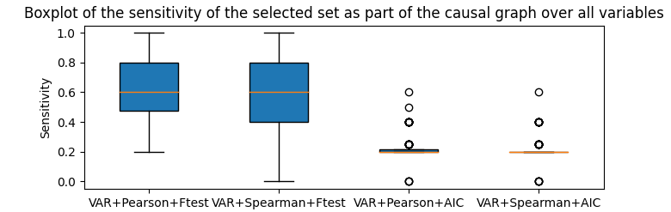
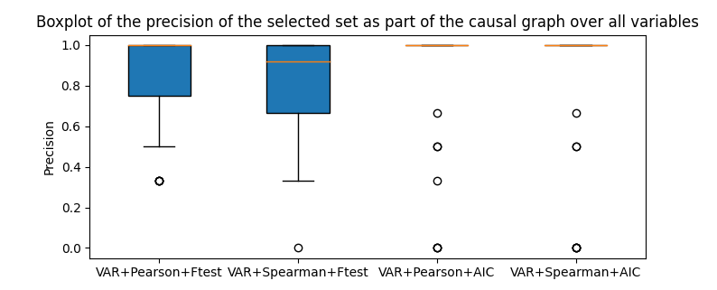
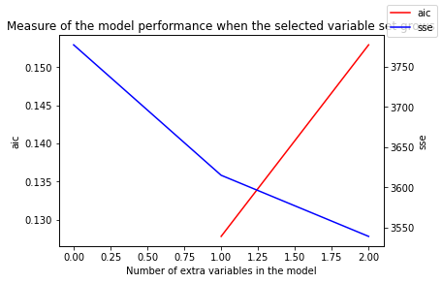
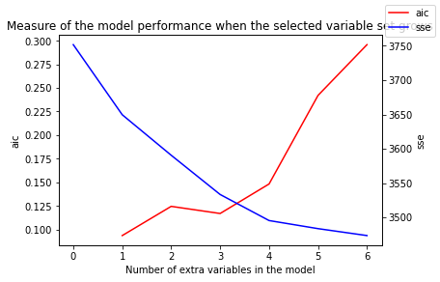
VAR

Slide 24
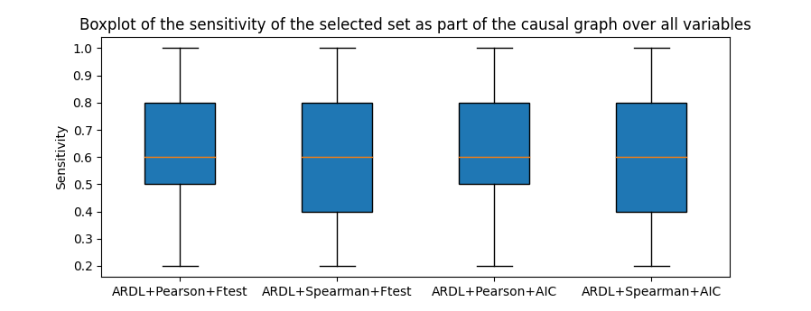
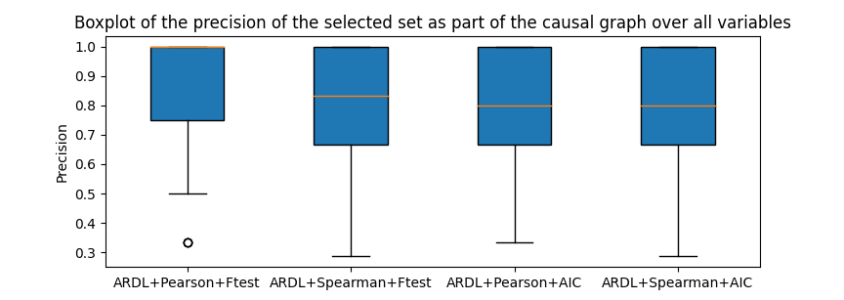
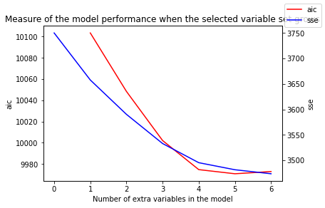
ARDL

Slide 25
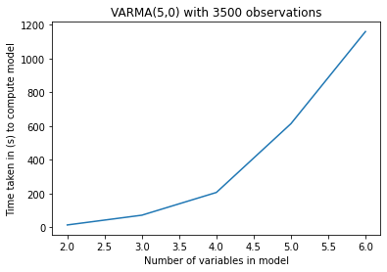
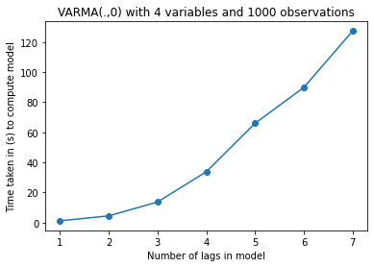
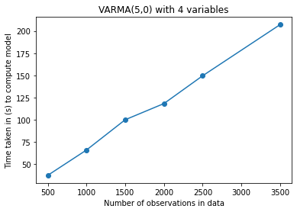
Problem: Computation time of VARMA
Illustrations that VARMA does not scale well with the number of variables and the number of lags
Reference point:
VAR(5) model takes 0.2s to fit 100 variables and 3500 observations
ARDL(5) model takes 0.4s to fit 100 variables and 3500 observations

Slide 26
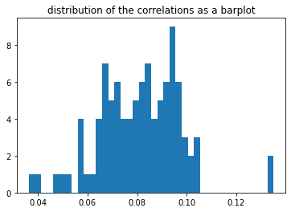
Step by step illustration of tsGOMP with ARLD + Pearson + F-test
Step 0: model 7<-7, true parents: 43,31,15,81,50
P-values of parameters:
const 6.806600e-06 trend 7.188861e-02 7.L1 1.558677e-22 7.L2 5.360140e-35 7.L3 6.914913e-16 7.L4 5.268566e-31 7.L5 6.927966e-16
{81 < 50}
Selected variable: 50

Slide 27
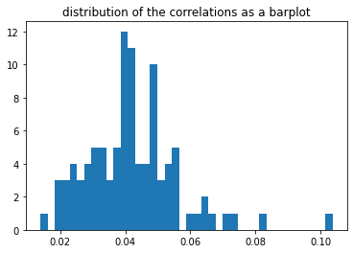
Step by step illustration of tsGOMP with ARLD + Pearson + F-test
Step 1: model 7<-7,50 true parents: 43,31,15,81,50
P-values of new parameters:
50.L1 1.070240e-08
50.L2 8.074956e-01
50.L3 8.998713e-01
50.L4 2.924204e-02
50.L5 4.594231e-01
{81}
Selected variable: 81

Slide 28
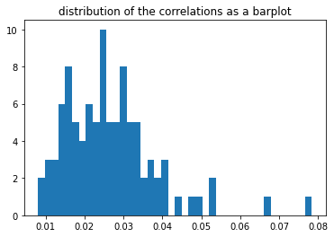
Step by step illustration of tsGOMP with ARLD + Pearson + F-test
Step 2: model 7<-7,50,81 true parents: 43,31,15,81,50
P-values of new parameters:
81.L1 3.150311e-01 81.L2 5.332620e-02 81.L3 3.498051e-01 81.L4 4.058919e-08 81.L5 1.730416e-01
{31}
Selected variable: 31

Slide 29
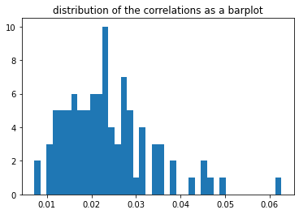
Step by step illustration of tsGOMP with ARLD + Pearson + F-test
Step 3: model 7<-7,50,81,31 true parents: 43,31,15,81,50
P-values of new parameters:
31.L1 9.986871e-06 31.L2 9.397191e-01 31.L3 6.833805e-01 31.L4 1.333772e-01 31.L5 1.712361e-01
{85}
Selected variable: 85

Slide 30
Step by step illustration of tsGOMP with ARLD + Pearson + F-test
Step 4: model 7<-7,50,81,31,85 true parents: 43,31,15,81,50
P-values of new parameters:
85.L1 5.602141e-01 85.L2 9.117737e-01 85.L3 5.446528e-01 85.L4 9.482517e-01 85.L5 1.196525e-01
F-test: concludes that the previous models isn't significatively different from the new model, excludes 85 from the selected set and stops the algorithm with selected variables {7,50,81,31}
Precision: 1.0
Sensitivity: 0.6

Slide 31
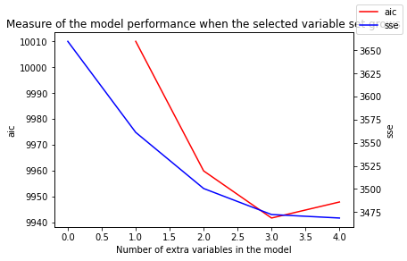
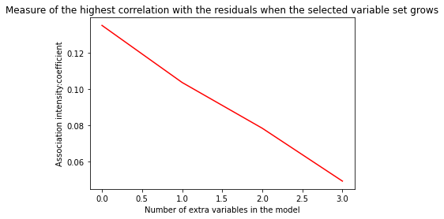
Step by step illustration of tsGOMP with ARLD + Pearson + F-test
Overall progression:
Total time spent fitting ARDL models: 0.14602 s
Total time spent computing correlations: 10.43637 s
While 85 is not a parent of 7, it is a parent of 43 which is a parent of 7.

Slide 32
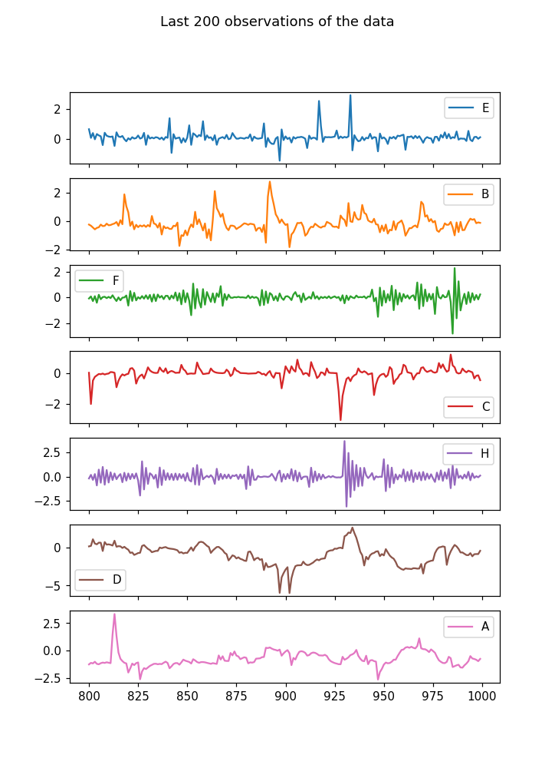
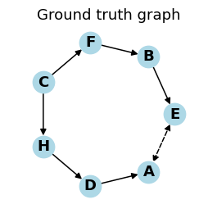
Nonlinear dataset
ASSAAD, Karim; DEVIJVER, Emilie; GAUSSIER, Eric, 2020, "7ts2h structure"
Autoregressive linear term with lag 1
Nonlinear dependency in the parent with lag 1 (sin,cos,tanh,abs)
1000 observations
Hidden confounders
Stationary w.r. to the generating model, with independent centered normal errors.

Slide 33
Nonlinear Dataset (Equations given)
This structure is generated by the following equations:
H^{(8)}_t = a_{88}^{t-1} * H^{(8)}_{t - 1} + b_{8}^{t} * \eps^8_t
H^{(9)}_t = a_{99}^{t-1} * H^{(9)}_{t - 1} + b_{9}^{t} * \eps^9_t
V^{(1)}_t = a_{91}^{t-1} * f10(H^{(9)}_{t - 1}) + a_{11}^{t-1} * V^{(1)}_{t - 1} + a_{21}^{t-1} * f1(V^{(2)}_{t - 1}) + b_{1}^{t} * \eps^1_t
V^{(2)}_t = a_{82}^{t-1} * f9(H^{(8)}_{t - 1}) + a_{22}^{t-1} * V^{(2)}_{t - 1} + a_{32}^{t-1} * f2(V^{(3)}_{t - 1}) + b_{2}^{t} * \eps^2_t
V^{(3)}_t = a_{33}^{t-1} * V^{(3)}_{t - 1} + a_{43}^{t-1} * f3(V^{(4)}_{t - 1}) + b_{3}^{t} * \eps^3_t
V^{(4)}_t = a_{44}^{t-1} * V^{(4)}_{t - 1} + b_{4}^{t} * \eps^4_t
V^{(5)}_t = a_{55}^{t-1} * V^{(5)}_{t - 1} + a_{45}^{t-1} * f5(V^{(4)}_{t - 1}) + b_{5}^{t} * \eps^5_t
V^{(6)}_t = a_{96}^{t-1} * f11(H^{(9)}_{t - 1}) + a_{66}^{t-1} * V^{(6)}_{t - 1} + a_{56}^{t-1} * f6(V^{(5)}_{t - 1}) + b_{6}^{t} * \eps^6_t
V^{(7)}_t = a_{87}^{t-1} * f8(H^{(8)}_{t - 1}) + a_{77}^{t-1} * V^{(7)}_{t - 1} + a_{67}^{t-1} * f7(V^{(6)}_{t - 1}) + b_{7}^{t} * \eps^7_t
We present below the characteristics of each dataset in the following form: (f10(), f9(), f11, f8(), f1(), f2(), f3(), f5(), f6(), f7(), a_{88}^{t-1} b_{8}^{t} a_{99}^{t-1} b_{9}^{t} a_{11}^{t-1} b_{1}^{t} a_{22}^{t-1} b_{2}^{t} a_{33}^{t-1} b_{3}^{t} a_{44}^{t-1} b_{4}^{t} a_{55}^{t-1} b_{5}^{t} a_{66}^{t-1} b_{6}^{t} a_{77}^{t-1} b_{7}^{t} a_{91}^{t-1} a_{82}^{t-1} a_{96}^{t-1} a_{87}^{t-1} a_{21}^{t-1} a_{32}^{t-1} a_{43}^{t-1} a_{45}^{t-1} a_{56}^{t-1} a_{67}^{t-1})
Dataset 1: (cos, cos, tanh, cos, cos, tanh, sin, sin, cos, cos, 0.4690047938595834 0.1 0.9479395907855845 0.1 -0.29836394982267844 0.1 0.6166910968112946 0.1 -0.7607663922852423 0.1 0.48472191233851225 0.1 -0.8291799516287115 0.1 0.4364828031175205 0.1 0.5268354929774564 0.1 -0.19300869563585188 -0.12191052050753881 0.992930439066902 -0.19300869563585188 0.2855027465512183 0.6459192165734338 0.2713659185844768 0.20383470102736645 -0.796545823357069 -0.3399476272107236)

Slide 34
Experimental protocol
Experimental protocol:
For each variable in the data, run the tsGOMP algorithm.
Get the selected variables after tsGOMP end, set them as parents of the target variable
Plot the summary graph of the (parent,child) associations found by the algorithm.

Slide 35
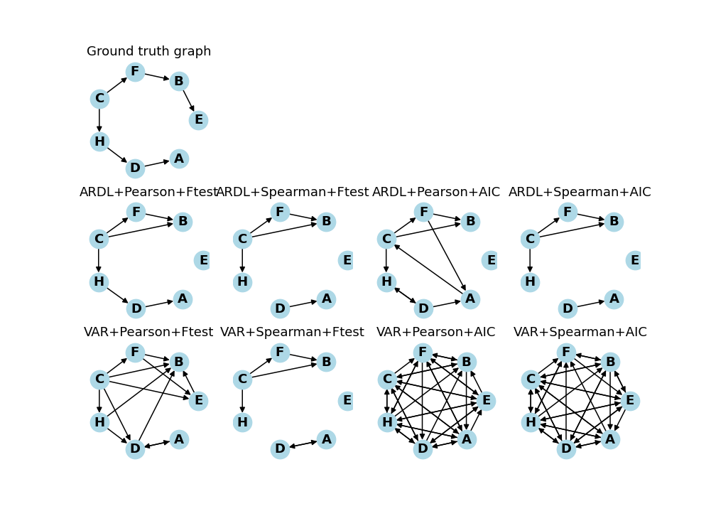
Discovered Causal Graphs

Slide 36
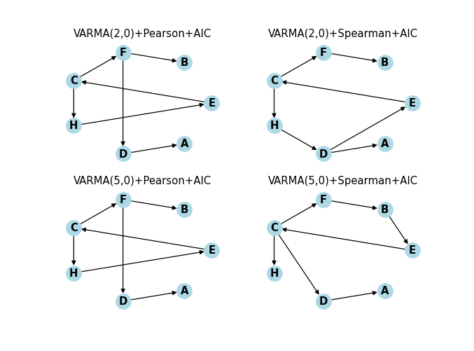
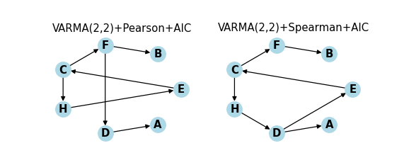
VARMA results

Slide 37
Conclusion, Perspectives, Limitations

Slide 38
Conclusions
What step counts more toward performance?
ARDL is mostly stable when the stop and association change
VAR in its best configuration is as good as ARDL
AIC has irregular performance when applied to different models. Ftest gives similar performances between models.
Pearson seems better in the linear case.
Trade-offs between model expressivity and efficiency
Current association metrics and models are fast and have low expressivity.
The bottleneck for a high number of time series is the association step, by a factor of 100 in the linear experiment.
The usual taxinomy of Feature Selection algorithms reviewed on synthetic datasets suggests that even methods with low expressivity might achieve good performances.
A review of feature selection methods on synthetic data Verónica Bolón-Canedo · Noelia Sanchez-Marono · Amparo Alonso-Betanzos

Slide 39
Limitations Perspectives
Currently, datasets are simplistic: synthetic, stationary, linear or nonlinear with simple interactions.
Models are linear with low expressivity
Associations do not efficiently or cleverly compare lags
No SES are returned.
Use more complex data, or real data
Compare performance with other MTS feature selection algorithms
Add more complex models
Exponential Smooting for exponential trends
GARCH for heterosckedasticity
Profet for multiple seasonal trends

