Slide 1
tsGOMP

Slide 2
Algorithm components
Models
VAR
ARDL
(VARMA) (estimation takes a long time)
DeepAR (LSTM)
Stopping criterion
F-test (VAR, ARDL, VARMA)
Likelyhood ratio test (VAR, ARDL, VARMA)
SSE with bootstrapping (LSTM)
Association
Pearson correlation (accelerated with MASS)
Spearman correlation

Slide 3
DeepAR

Slide 4
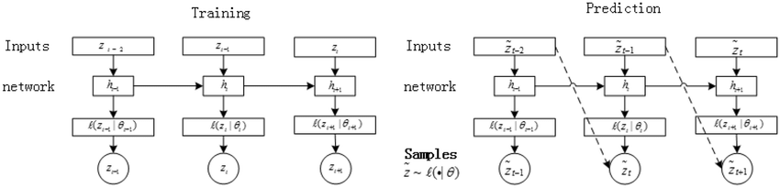
DeepAR
Input Covariates X_{t}
Input previous z_{t-1}
Hidden state
LSTM
Hidden state
Full Connected
z_{t} distribution parameters

Slide 5
DeepAR
Multihorizon: the number of predicted timesteps can be set for combined training.
Training on all outputs / future outputs: if the task is to predict z_t...z_t+k with data starting from z_t-i, it is possible to:
Use the distributions generated for z_t-i, … z_t+k to compute an average log-likelyhood
Use only the distributions generated for z_t...z_t+k.
Use different parametrized output distributions. By default, gaussian.

Slide 6
Open problems
and design questions

Slide 7
Open problems
Which component (model type, association type, stopping criterion) has greater impact on the algorithm?

Slide 8
Open problems
Models:
Can linear models be used in practice on nonlinear data?
In linear models, metrics/residuals are usually computed over the training set. But for models prone to overfitting, a separate validation split is necessary.
Using the training set for linear models and a train/val split for overfit-prone models has sample size effects: on model fit, stopping criterion uncertainty estimate, association uncertainty estimate --> it makes algorithm component studies difficult
Using a same train/val split reduces the power of linear models, especially when we have low number of samples.

Slide 9
Open problems
Stopping criterion
Some models (LSTM) have high variance, how to compute the stopping criterion in that case?
For DNN models, the degree of freedom isn't easily defined. How to test model significance in that case?
=> suggestion:
Use a validation set of size N to compute residuals (or per sample conditional outcome likelyhood if the model is probabilistic)
Always use the same validation set for successive models
Use bootstrapping with replacement (draw N entry, repeat K times) to sample residuals/sample likelyhoods
Use the same bootstrap sampling for the current model and previous model.
Compute the desired metric (SSE, average likelyhood), we obtain a list of pairs of size K
Use paired wilcoxon signed rank test to test the significativity of a model compared to another.

Slide 10
Open problems
Stopping criterion
Do we need to deal with multiple hypothesis testing? After all the probability of having taken a wrong decision for termination, increases with the number of selected variables.
Association
Same question, more complicated since the decision to include a variable relies not on a p-value, but on the minimum between several p-value.
If we relied on a single p-value, it would represent the risk that the selected variable should not be selected.
How to compute the risk we take by selecting a variable when we use the minimum of several p-values?

Slide 11
Open problems
Association:
Can p-values obtained from different tests be compared? Tests might not have the same power w.r.t. the number of samples
How to best accelerate computation
==> Current version: Pearson correlation computes multiple lags efficiently with MASS.

Slide 12
Some experiment results

Slide 13
Datasets
7ts2h: 7 variables, nonlinear (sin, cos, abs), gaussian noise, 2000 timesteps
CLIM: 5 variables, linear, time aggregated, gaussian noise, 250 timesteps
fMRI: 5 variables, nonlinear (exponential). Depending on time series, high correlation for many lags, or lag 1 correlation, 200 to 2000 timesteps
FINANCE: full data description not open access, Fama-French 3 factor model, 4000 timesteps

Slide 14
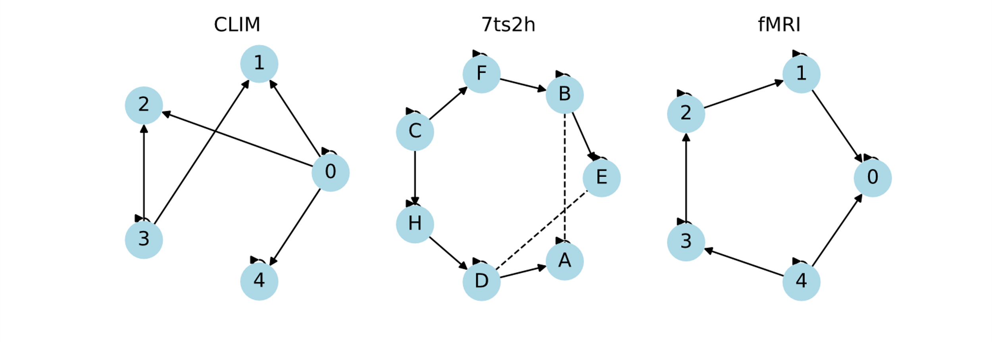
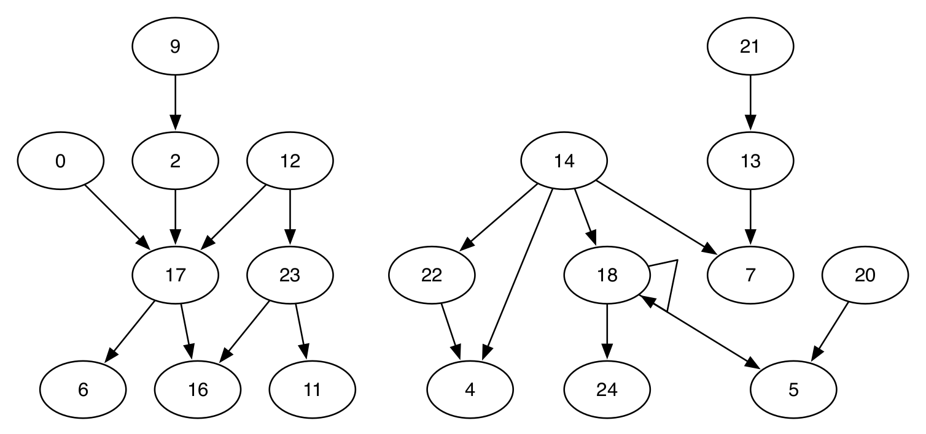
Datasets
Finance

Slide 15
Procedure
For each MTS instance in a dataset family
For each target variable in a dataset family
Apply the tsGOMP algorithm
Use "all available data" policy: ARDL and VAR models use all data to train and compute residuals, LSTM uses a data split with 0.7 training, 0.3 validation
Stopping criterion is the f-test for ARLD and VAR, and the SSE bootstrapping for LSTM.
Association is Spearman for nonlinear datasets and Pearson for linear datasets
Output the set of selected features
Compute metrics

Slide 16
Metrics
Precision (TP/(TP+FP)), Recall (TP/(TP+TN)) of the selected feature set versus the ground truth causal feature set
Average Precision (document retrieval metric) (sum_k(TP_k/(TP_k+FP_k)*Ind[last selected is TP])
Structural Hamming Distance (number of deletion, insertion, flip, to transform a graph into another) between the produced causal graph and the ground truth causal graph.

Slide 17
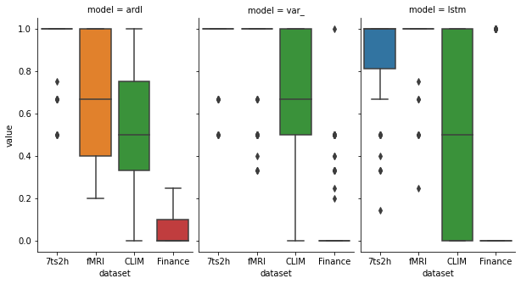
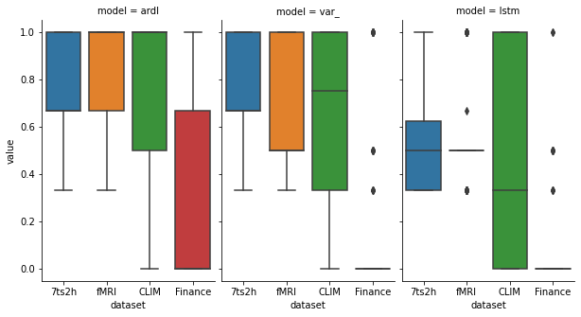
Results
Precision of the selected variables for each model (top)
Recall of the selected variables for each model (bottom)

Slide 18
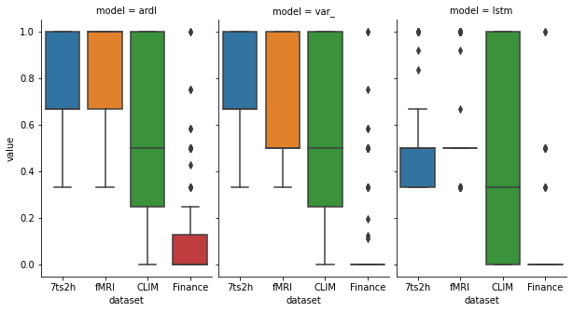
Results
AP of the selected variables for each model

Slide 19
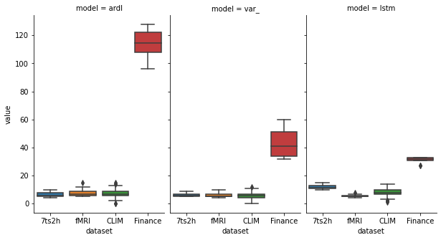
Results
Structural Hamming Distance.

