Slide 1
Experiments

Slide 2
Running with oracles given a causal set
Algorithm :
1) Compute model on current selected set
2) Compute residuals and associations
3) Find highest association variable :
  - If it is part of the causal set, include in selected set
  - If not part of the causal set and there are still nonselected variables in the causal set, include one of the causal set variables in the selected set
4) Compute the stopping criterion but keep running the algorithm until no variables are left.

Slide 3
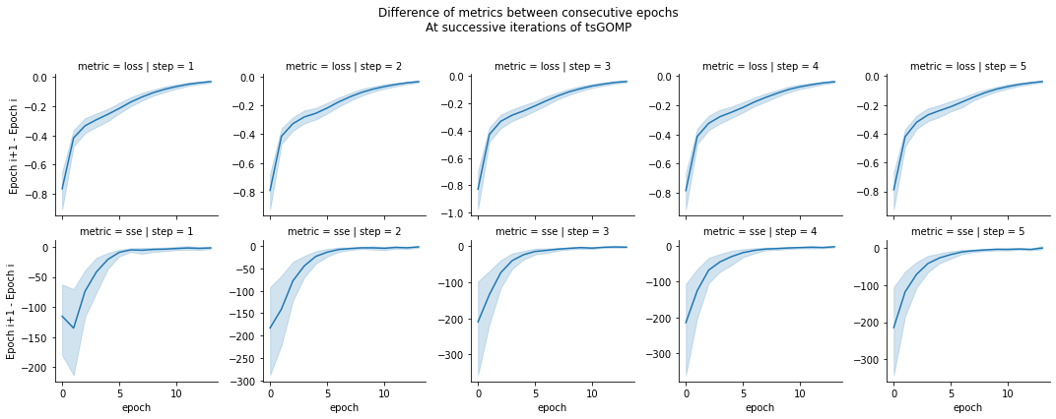
LSTM model - Convergence
FMRI dataset.
The model is improving when the differenciation is negative,
and stops improving when it reaches 0.

Slide 4
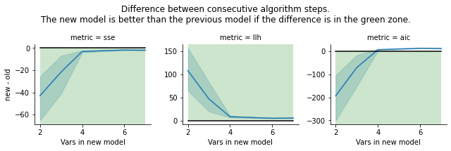
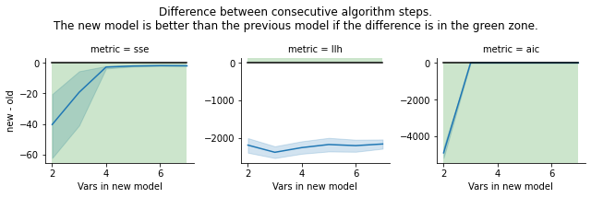
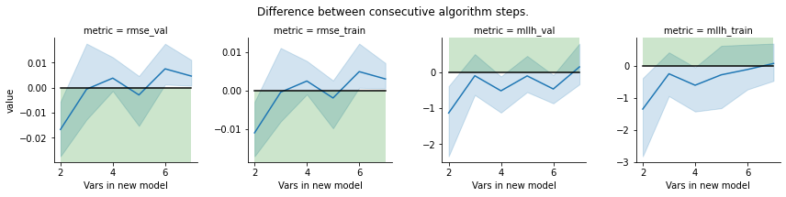
Are models improving as we add variables? (7ts2h)
ARDL model
VAR model
LSTM model

Slide 5






Causal Selection : is the variable with highest association in the causal set?
LSTM
ARDL
VAR
LSTM
At each step of the algorithm, number of time the highest association is causal
(agree with the causal set) versus number of time the highest association isn’t
part of the causal set (disagree).
Top is the 7ts2h dataset, Bottom is the fMRI dataset.
LSTM
ARDL
VAR

Slide 6
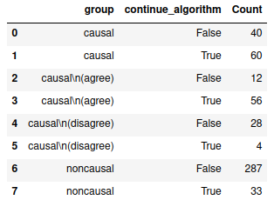
Stopping criterion
Would the algorithm keep going when a causal variable is added to the selected set ? Would it stop when a non-causal variable is added ?
Number of cases where the algorithm would
stop or continue, when the selected variable
is :
- causal (part of the causal set)
- causal, and it has the highest association
(agree)
- causal, but the highest association isn’t
part of the causal set (disagree)
- noncausal (not part of the causal set)
ARDL model, 7ts2h

Slide 7
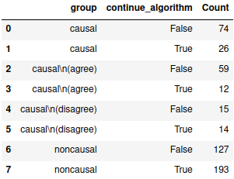
Stopping criterion
Would the algorithm keep going when a causal variable is added to the selected set ? Would it stop when a non-causal variable is added ?
Number of cases where the algorithm would
stop or continue, when the selected variable
is :
- causal (part of the causal set)
- causal, and it has the highest association
(agree)
- causal, but the highest association isn’t
part of the causal set (disagree)
- noncausal (not part of the causal set)
LSTM model, 7ts2h

Slide 8
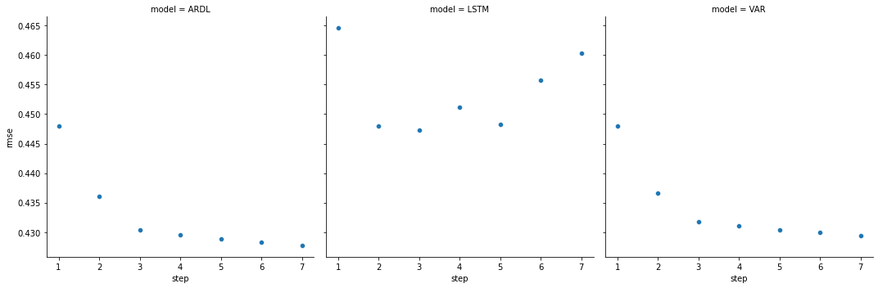
Model performances on 7ts2h
Average RMSE of the trained models at each step of the algorithm.
There are 1 selected variables at step 1, 2 selected variables at step 2...

Slide 9
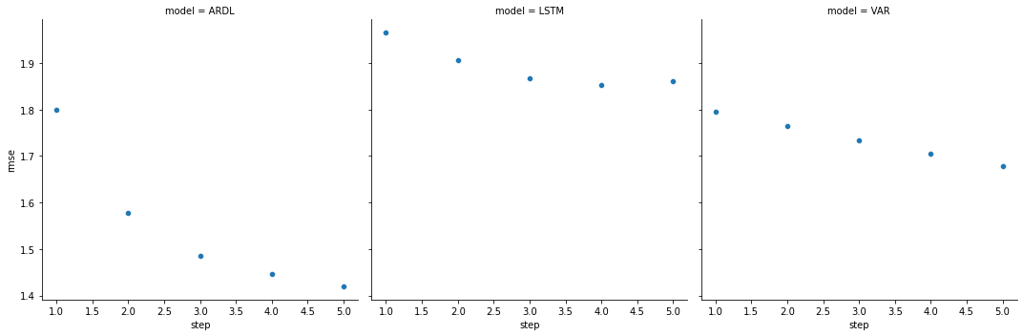
Model performances on fMRI
Average RMSE of the trained models at each step of the algorithm.
There are 1 selected variables at step 1, 2 selected variables at step 2...

Slide 10
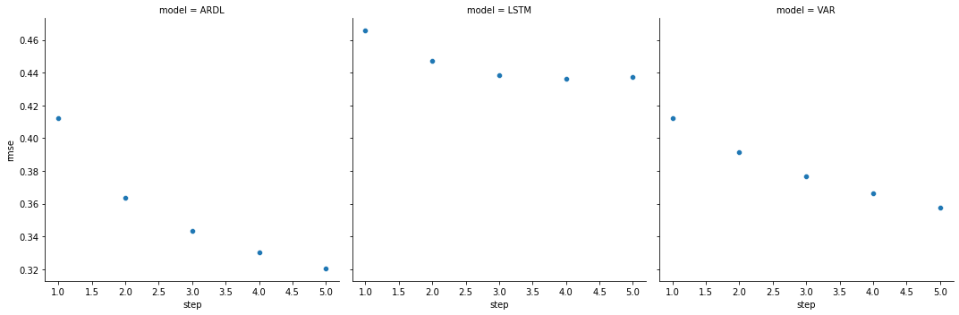
Model performances on CLIM
Average RMSE of the trained models at each step of the algorithm.
There are 1 selected variables at step 1, 2 selected variables at step 2...

Slide 11
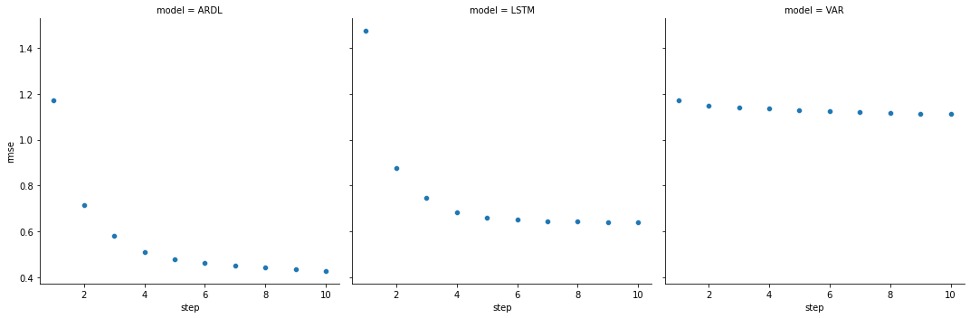
Model performances on Finance
Average RMSE of the trained models at each step of the algorithm.
There are 1 selected variables at step 1, 2 selected variables at step 2...

