Slide 1
Presentation 19 june

Slide 2
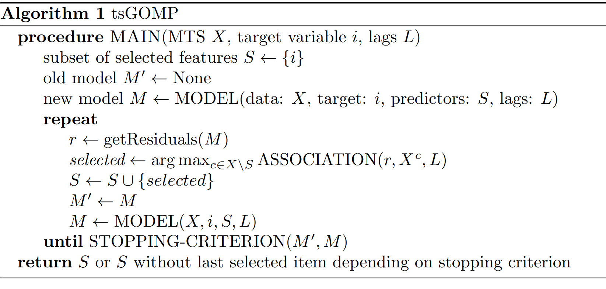
Algorithm description

Slide 3
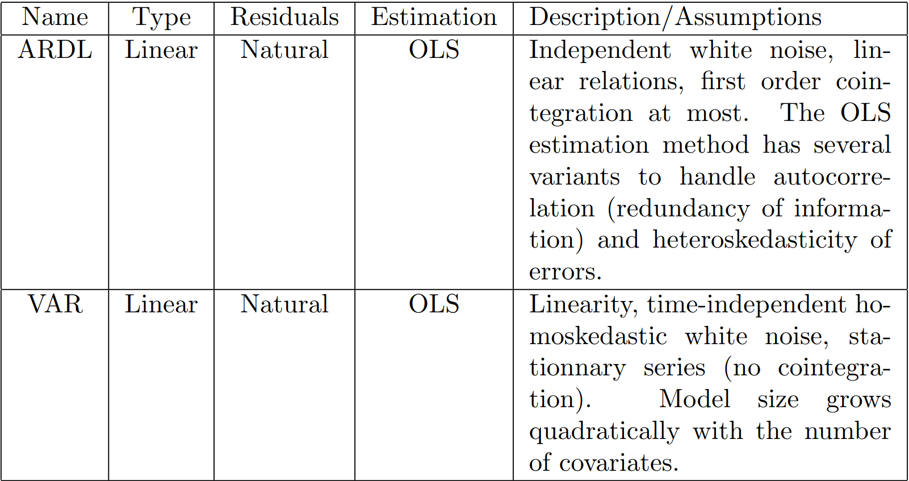

Slide 4
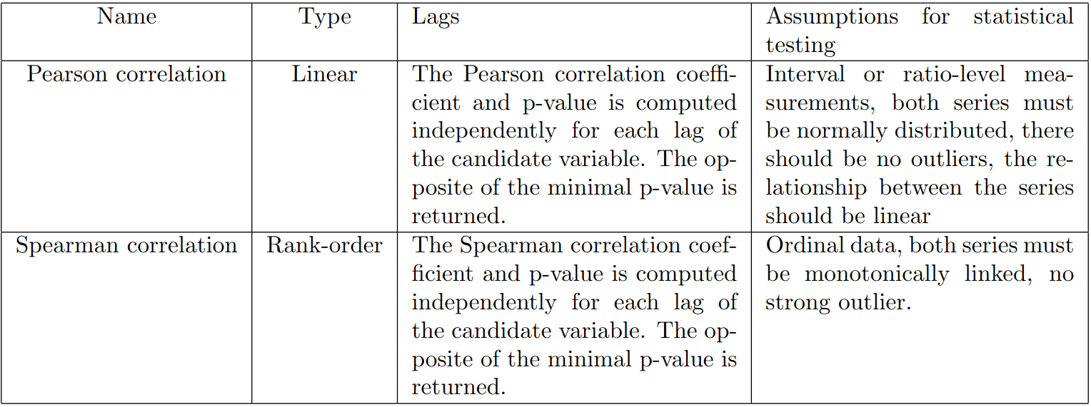

Slide 5
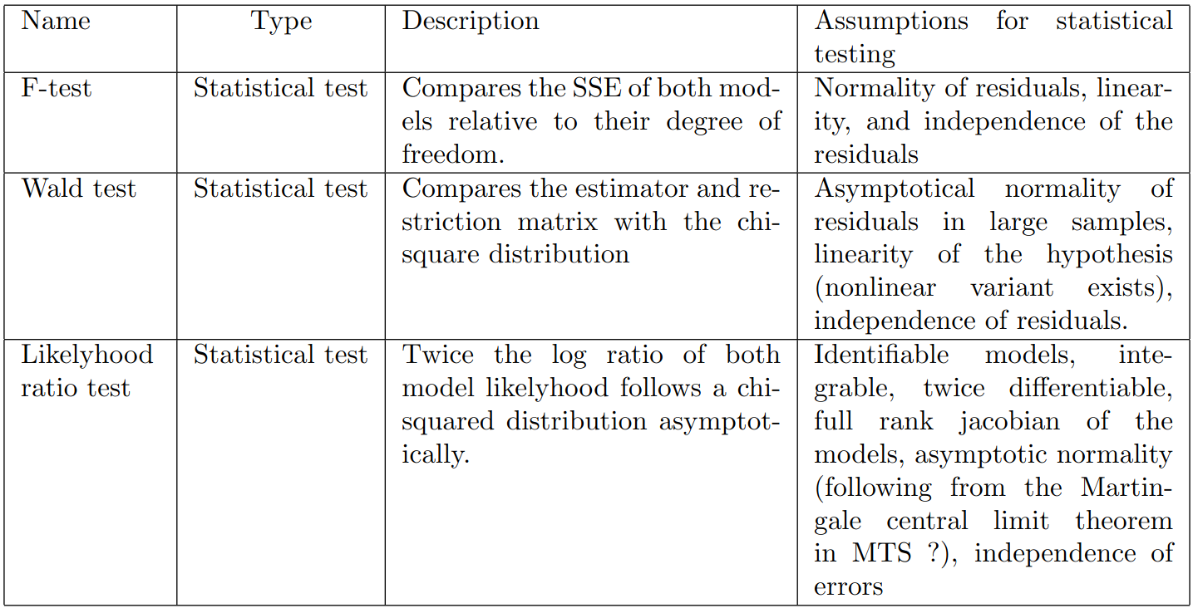

Slide 6
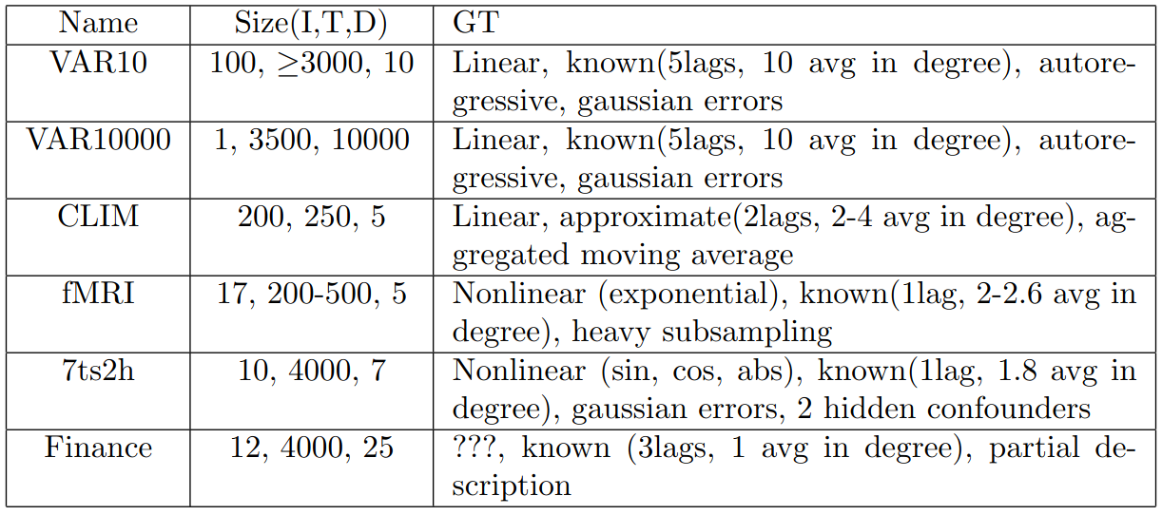

Slide 7
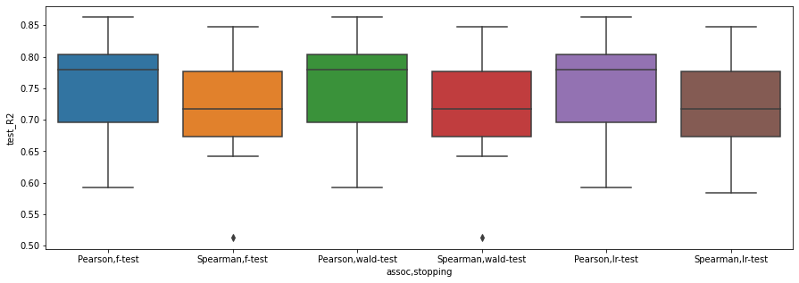
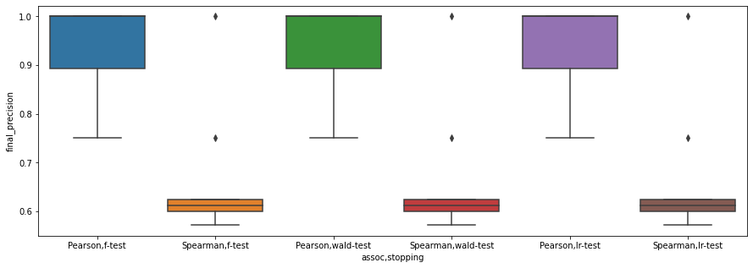
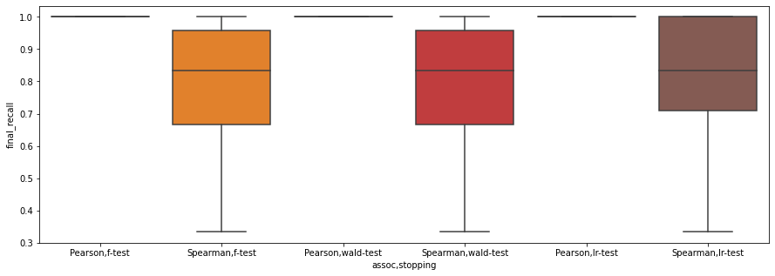
R2
Results on dataset VAR10
Precision
Recall

Slide 8
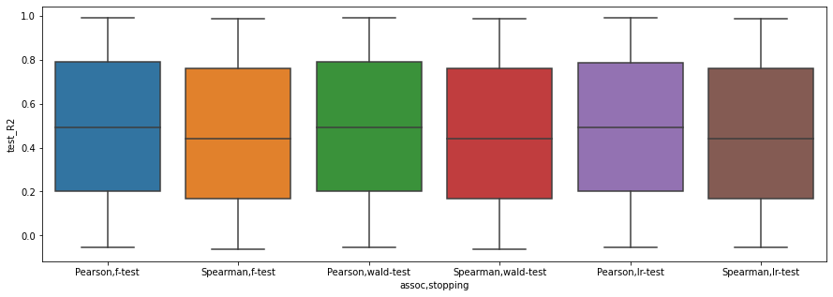
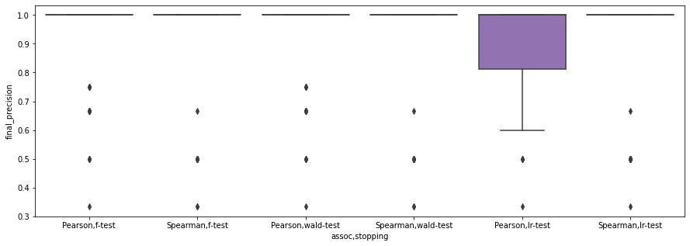
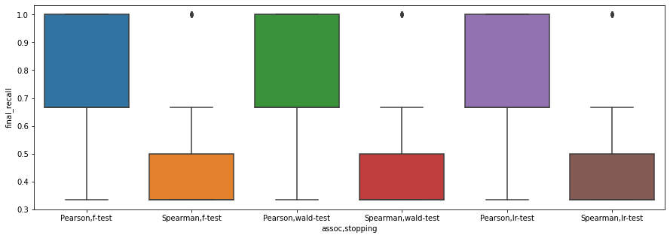
R2
Results on dataset 7ts2h
Precision
Recall

Slide 9
Baseline
Bivariate Granger (Sun, 2015)
- Create VAR model (covariate, target) for each covariate
- if causality covariate → target and if lack of causality target → covariate : add covariate to selected set

Slide 10
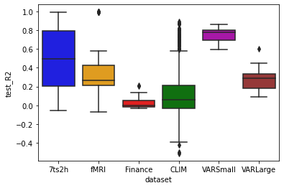
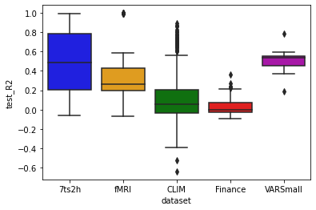
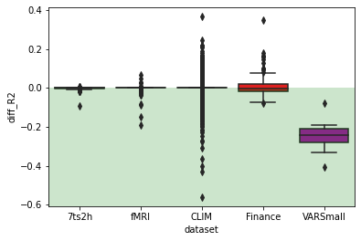
Performance - R2
R2 of ARDL model trained on features selected by tsGOMP with Pearson, ARDL, f-test
R2 of ARDL model trained on features selected by BG baseline
R2 of BG baseline minus R2 of tsGOMP final ARDL model
Green correspond to area where tsGOMP is better.

