Slide 1
Controled experiments on linear models

Slide 2
Dataset
VAR(5) process with 100 variables, each caused by itself and 5 others.
The total autocorrelation coefficients is on expectation equal to the total VAR coefficients of the 5 other variables.
3500 timesteps.

Slide 3
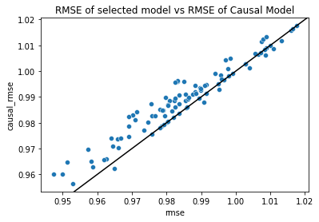
RMSE of final selected model vs RMSE of cause-only model
Using wilcoxon signed rank test:
p-value of test H0: rmse of selected model <= rmse causal model: 1.293823686365518e-13
Causal models are on average significanly worse than selected models
Selected

Slide 4
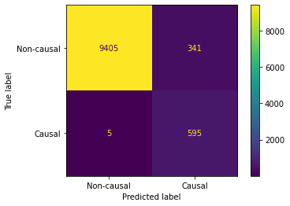
Algorithm Causal discovery performance
Compare the final selected variables with the causal variables.

Slide 5
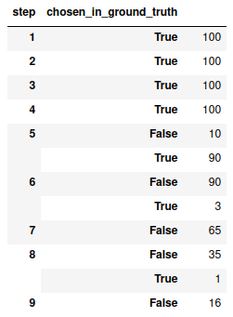
Finer causal discovery performance
Distinguish at each step how many variables were correctly and incorrectly selected.
No wrong decision

Slide 6
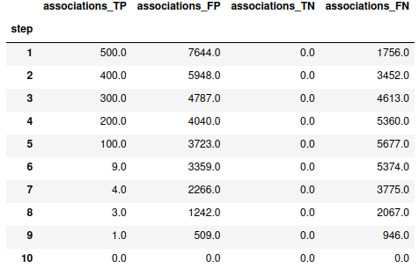
Repartition of p-values at each step
TP : causal variable has pvalue <0.05
FP : noncausal variable has pvalue<0.05

Slide 7
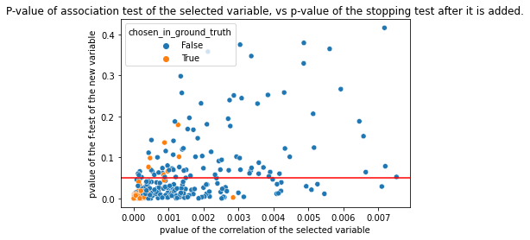
Lowest Association p-value vs
Next stopping criterion p-value

