Slide 1
Current state of the experiment

Slide 2
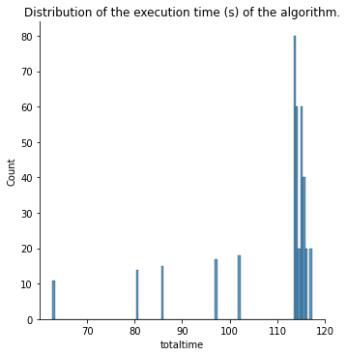
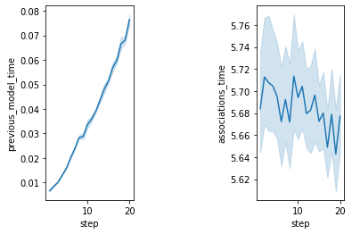
Data with 10000 covariates
Execution time
Time to train one
model
Time to compute all
correlations at a step

Slide 3
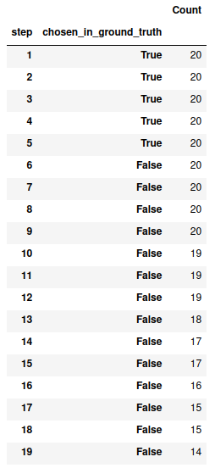
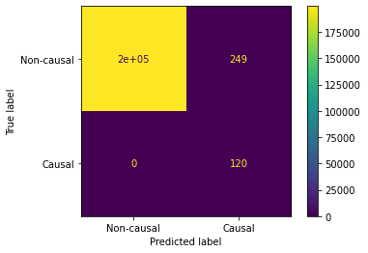
Data with 10000 covariates
At each step,
how many
of the chosen
variables were
causal and
non causal.
Final itemset
Causal variables
found at the
beginning
Aggregated over 20 evaluations of the algorithm.
6 causal variables per target, including
target itself

Slide 4
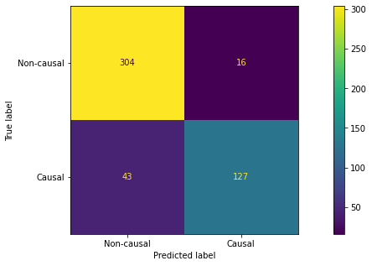
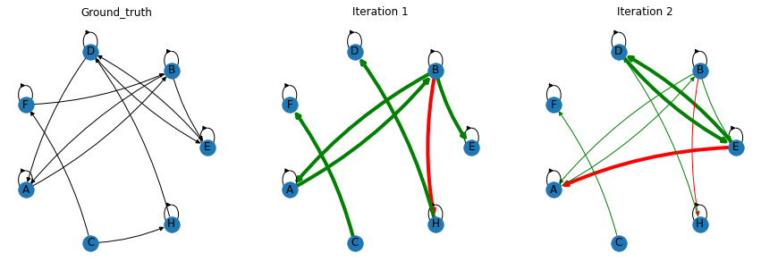
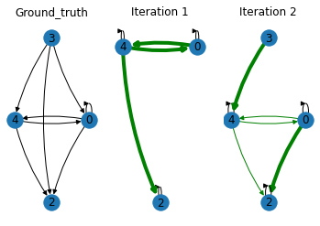
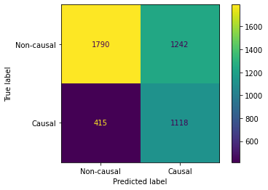
Causal graph construction (small datasets)
7ts2h
CLIM

Slide 5
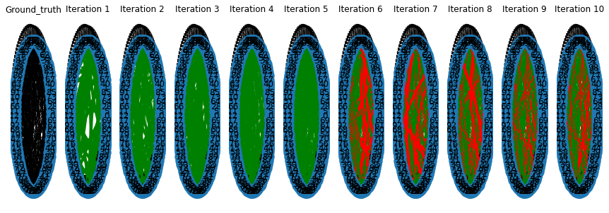
Causal graph construction (large data)
VARProcess with 100 variables

Slide 6
Problem setting in usual works
2 approaches :
- Flatten the MTS into a single feature vector, apply the Feature Selection algorithm
The selected features are pairs (covariate, lags)
- (Align the time series then) use Feature Selection algorithms on data from the same timestep, without caring about lag information

Slide 7
Competitors
Scalable approaches :
- Filters (package fsmts ?)
- RreliefF (filter method based on nearest neighbours)
Methods that train a model over all covariates
- Minimal redundancy maximal relevance
- Recursive Feature Elimination (SVM, random forest)
- LASSO
- Random forest importance
Causal discovery methods (not scalable)
- PCMCI
- SVAR-FCI

Slide 8
Competitors
Sun2015 | Bivarite granger causality | RFE, PCA
Hmamouche2017 | Bivariate granger then PAM (expensive) | Univariate F-test, PCA
Kathirgamanathan20 | Bivariate 1-Nearest Neighbour score then MRMR | None
Tsagris2018 | SES algorithm with GLMM, GES (no lag consideration) | LASSO-type methods (not temporal)
Wang2013 (univariate) | 1) Select max correlation feature with minimum lag 2) Compute model+residuals 3) Select MRMR feature 4) Repeat until RMSE stops | Correlation-type
Mastakouri2021 | Causal discovery in O(n), but assumption of lag1 dependency only and acyclic summary graph

