Slide 1
THE IMPORTANCE OF Core Values
FTC 9873

Slide 2
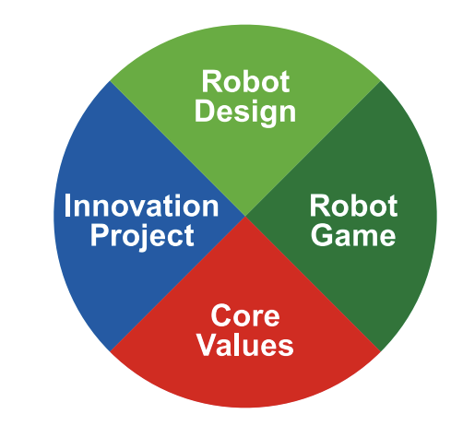
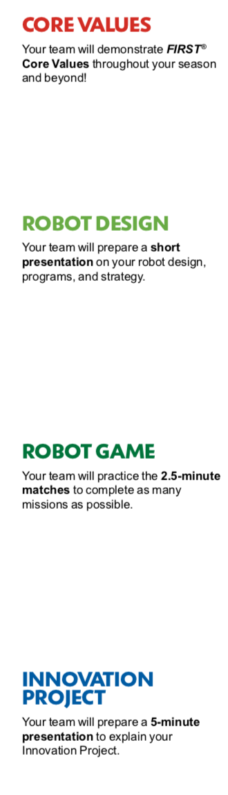
Core values: HoW IT FITS TOGETHER
The Robot Design, Innovation Project and Robot Game are what teams DO.
The Core Values are how they do it.

Slide 3
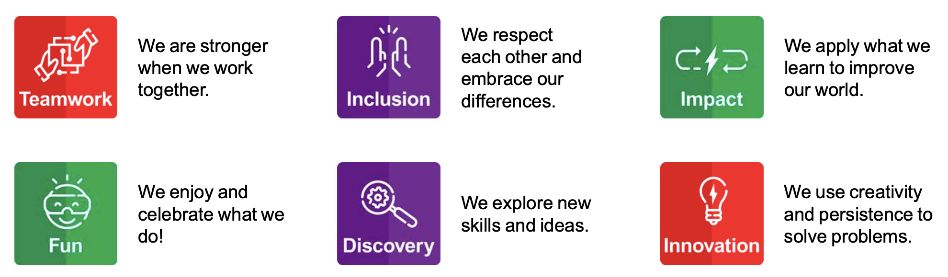
FIRST CORE VALUES
There are six Core Values that are applied through all the FIRST programs

Slide 4
LEARN THE TERMS USED in the CORE VALUES
We express the FIRST philosophies of Gracious Professionalism and Coopertition through our Core Values:
Discovery: We explore new skills and ideas.
Innovation: We use creativity and persistence to solve problems.
Impact: We apply what we learn to improve our world.
Inclusion: We respect each other and embrace our differences.
Teamwork: We are stronger when we work together.
Fun: We enjoy and celebrate what we do!
Notes:
Have examples for each?
Animate that teamwork is judged by teamwork activity, other parts are judged using poster/presentation

Slide 5
WHAT iS Gracious professionalism?
“Learn and compete like crazy, but treat one another with respect and kindness”
Dr. Woodie Flowers, FIRST Distinguished Advisor

Slide 6
WHAT IS Coopertition?
“ Teams can and should help and cooperate with each other even as they compete”
Dr. Woodie Flowers, FIRST Distinguished Advisor

Slide 7
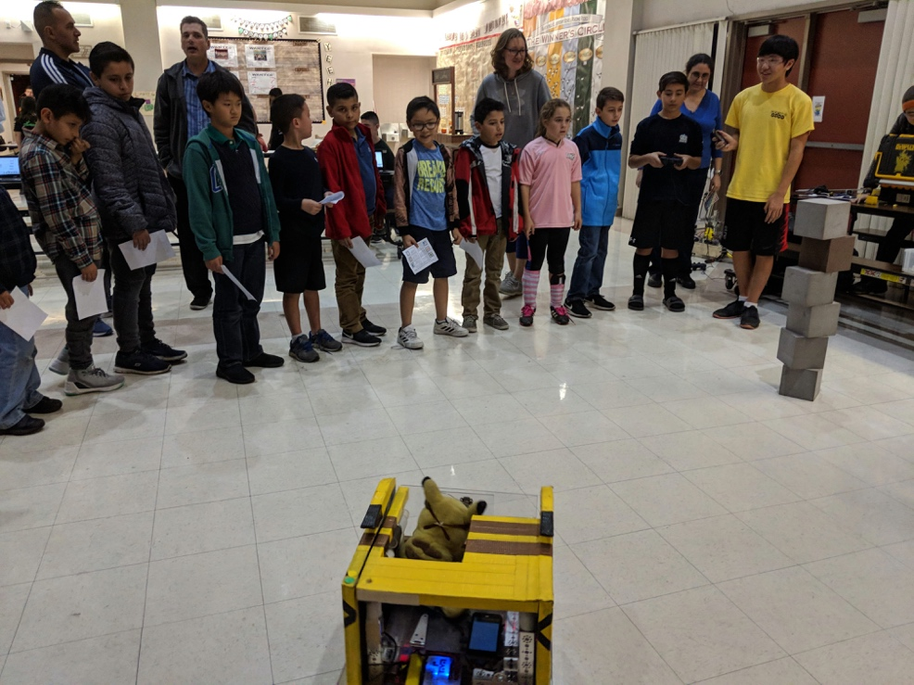
WHY IS COOPERTITION important?
It encourages learning from your teammates, competitors, and mentors
It is what makes the FIRST program different
Many ways to show Coopertition
Lending a team a part if they need it, even if it helps them to score higher
Inviting teams to your house to teach them how to make better projects and teach them your robotics skills
You don’t solve the challenge for them and provide solutions. Instead, you inspire them and show them how to discover their own solutions

Slide 8
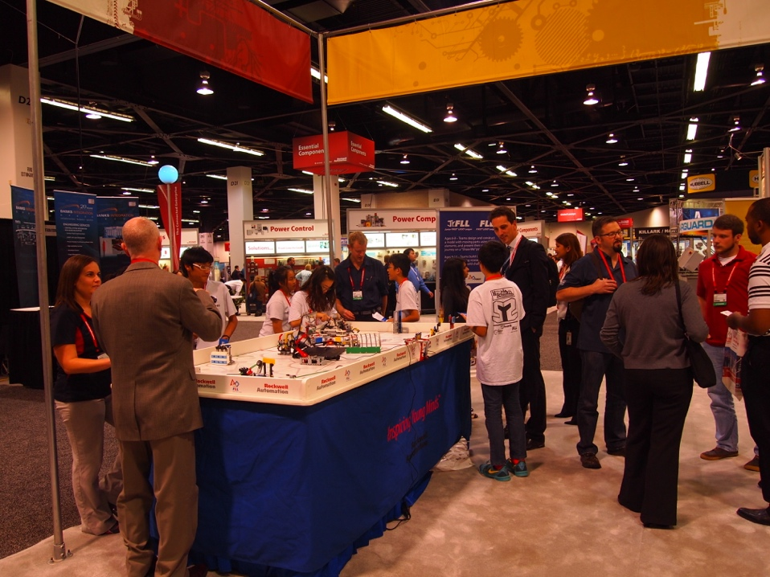
MOST IMPORTANT: Embrace CORE VALUES
Core Values is not just something you do.
It is a way, a METHOD of doing things that builds character and guides us throughout the whole experience
It should be something you implement every day and at every meeting, not just for the judges!
8

Slide 9
HOW DO YOU APPLY THESE CORE VALUES?
Here are some ideas for getting started:
Gracious Professionalism: Be kind to others on the team, thank volunteers, help set-up at events, etc.
Coopertition: Help your competitors when they need it
Discovery: Try new things. Be willing to learn.
Innovation: Persevere even when one of the missions is hard and find a solution to the problem (e.g. think of a new way to solve that mission)
Impact: Take what you have learnt and use it to educate/help someone else? (e.g. maybe you taught a programming camp in your community)
Inclusion: Make sure that everyone on the team is involved and feels valued, and include everyone in judging presentations
Teamwork: Make decisions together, share the workload
Fun: Come up with a team identity and do something fun together.
Notes:
Have examples for each?
Animate that teamwork is judged by teamwork activity, other parts are judged using poster/presentation

Slide 10
CREDITS
The primary author of this lesson is Vicky Zhai from FTC 9873. Additional information from Christopher Haines and Chris Baker was incorporated into the lesson.
More lessons for FIRST LEGO League are available at www.flltutorials.com
Creative Commons Attribution-NonCommercial-ShareAlike 4.0 International License

