Slide 1
HOW DO YOU RESEARCH?
BY SESHAN BROTHERS

Slide 2
Why TEACH THE PROCESS?
Most students in FIRST LEGO League Challenge have not been taught how to do research.
Discussing how to research is an important first step before sending students to the library or Internet to being their Innovation Project Research.
Online safety is also a concern.

Slide 3
FIVE MAIN PARTS OF RESEARCH
Develop Keywords/Search Terms
Select Reliable Sources
Learn to Take Notes
Cite Your Sources
Share Information/Results

Slide 4
SELECTING KEYWORDS
What keywords you use in your search matters
While adults may be familiar with search terms, young students may not be.
Go through the Challenge prompt together and highlight important terms that can be used in keyword searches
Have a coach do some sample searches together to see what sources show up.
Watch this video: https://www.youtube.com/watch?v=ttaPomA5xUE&feature=youtu.be

Slide 5
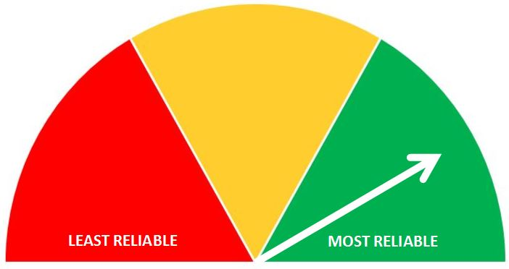
using reliable sources
Not all sources are equal. Some sources are just opinions (e.g. Twitter post, personal blog) and others have been validated by research (e.g. scientific paper)
For a young team, a coach might create a subset of resources that are reliable
Watch this: https://www.youtube.com/watch?v=E_JsBhN2dDM
Watch this: https://www.youtube.com/watch?v=Zss-ya_QVZQ
Image Source: University of Washington

Slide 6

TAKING NOTES
Taking notes is a skill – you don’t want to write too much or too little.
You also want to learn the difference between quoting someone and parapharasing their work
Watch this: https://www.youtube.com/watch?v=Q3S1chdLhhw
Watch this: https://www.youtube.com/watch?v=4Xox8MgzXo0
Image Source: Learn and Lead

Slide 7
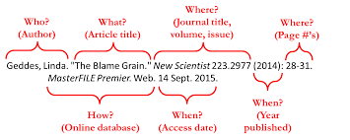
Cite your sources
Citations are how you can give credit to someone else for the idea, the words, etc.
You can cite websites, articles, experts, other teams, etc.
In FIRST LEGO League, citations do not have to follow any particular format.
Keeping track of the author and website/links is a great place for a young student to start.
Read this: https://guides.lib.uw.edu/research/citations/citationwhat
Image Source: https://guides.library.unk.edu/c.php?g=710678&p=5051044

Slide 8
PRESENTING YOUR RESEARCH
Being able to communicate what you found during your research is an important part of FIRST LEGO League
You need to be able to communicate information to your teammates, experts, and judges.
There are many different ways to communicate information you have found.
Some information such as existing solutions may be best presented in a comparison table.
A pie chart might be useful for other information.
If you are sharing survey data, you must include how many people responded to your survey.

Slide 9

Credits
This lesson was written by Arvind and Sanjay Seshan
More lessons are available on www.ev3lessons.com and www.flltutorials.com

