Slide 1
CORE VALUES JUDGING
Bayou Builders AND SESHAN BROTHERS

Slide 2
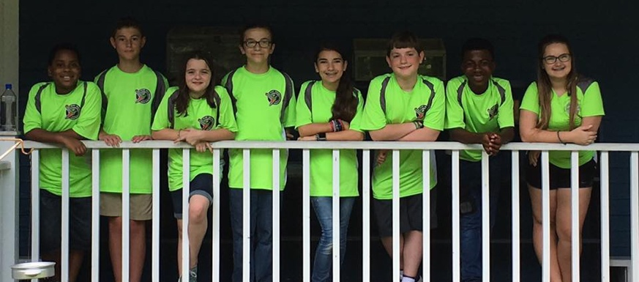
MEET THE AUTHORS
Bayou Builders are a 10-person, community-based team in Hammond, Louisiana.
They have won a Champions’ or Champion’s Runner-up award every year in their state and attended the North American Open, Razorback Open and World Festival.
In 2017, they were also nominated for the Global Innovation Award from Louisiana.
Bayou Builders are very involved in their community, giving hundreds of hours to outreach activities each year

Slide 3
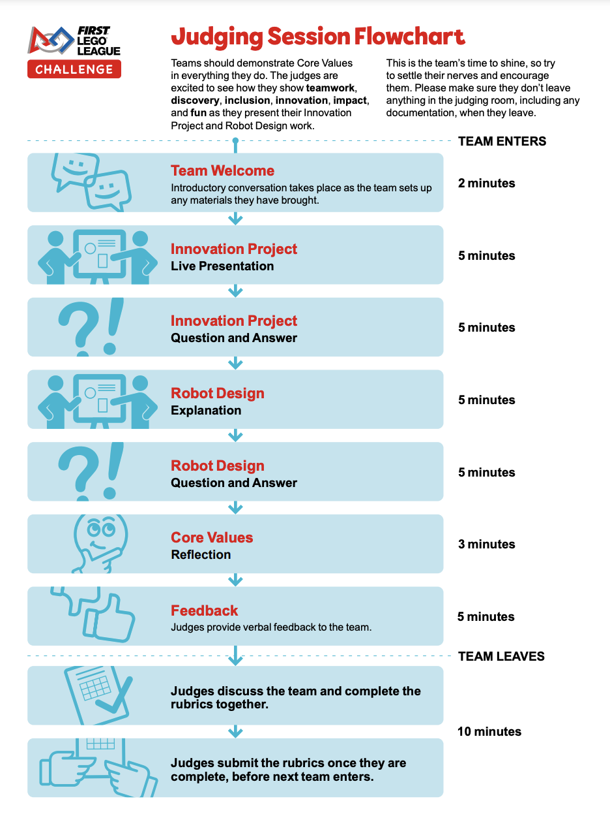
WHAT IS A TYPICAL JUDGING SESSION LIKE?
The consolidated 30-minute judging session has a specified Core Values Reflection time (3mins)
During this time, judges will ask questions to help them fill out parts of the Core Values rubric
Most regions will not allow you to give a formal presentation during this time.
Core Values judges will be listening during the entire session so make sure you talk about Core Values during the Team Welcome, Innovation Project and Robot Design.

Slide 4
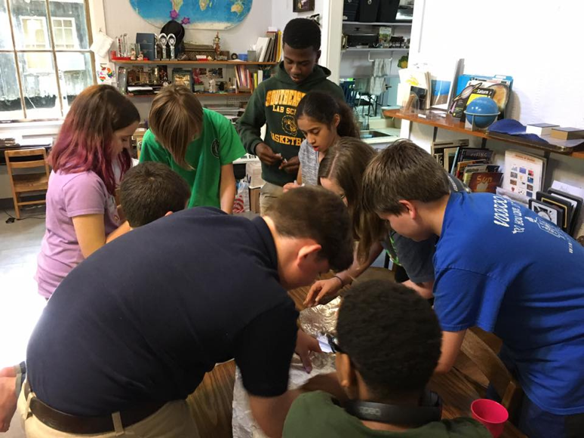
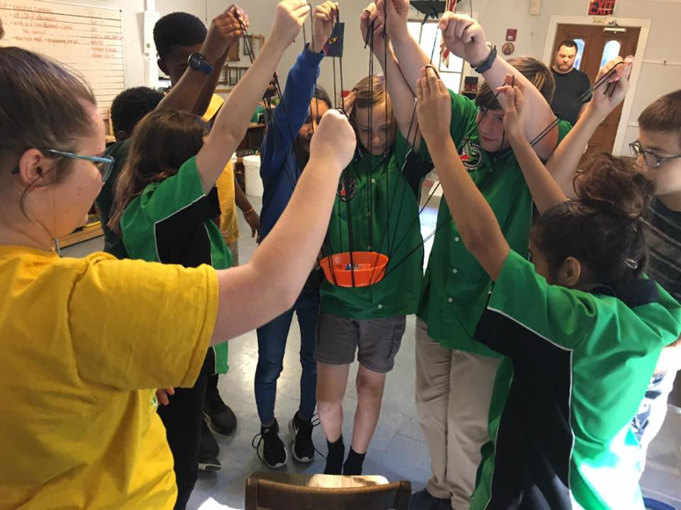
CORE VALUEs JUDGING OBJECTIVES
Core Values judging is a lot of fun. It is your team’s chance to share its identity.
It is your chance to share your team goals and why being a part of FLL is important to you. These are some things you can cover in the Team Welcome.

Slide 5
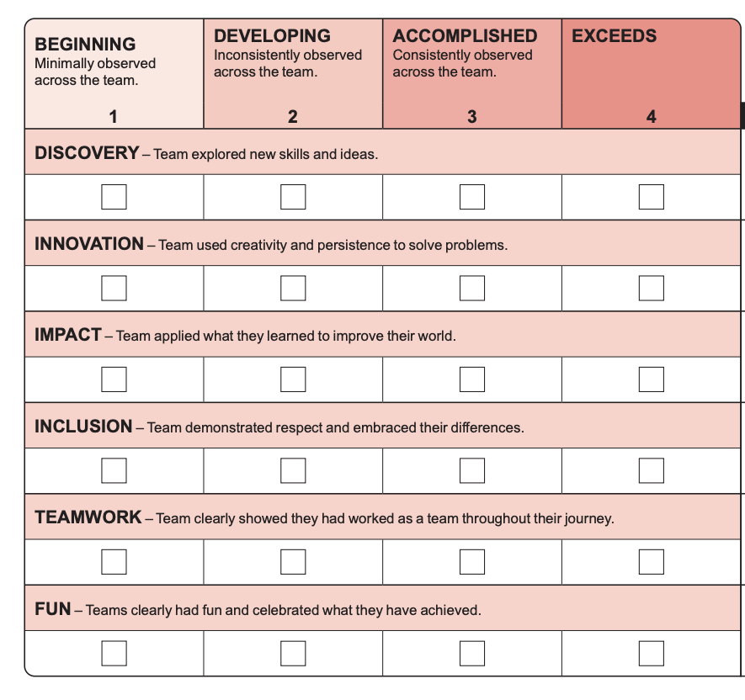
PREPARING YOUR CORE VALUES JUDGING
Make sure to reference the Core Values Judging Rubric
Be sure to cite specific examples of how your team used or applied each of the Core Values during the season
Make sure that multiple students can give examples
Make sure that your examples go beyond just sharing your project (Impact) or learning a programming language (Discovery)

Slide 6
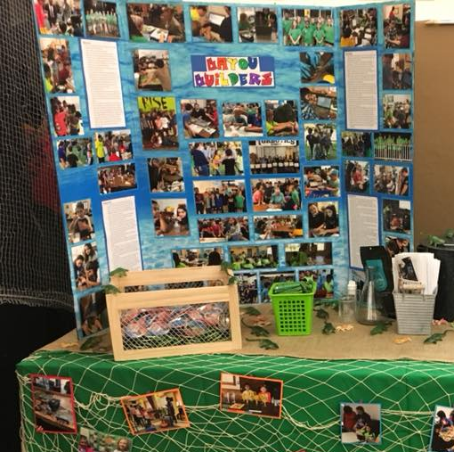
DOCUMENTING CORE VALUES
You may create a Core Values Poster to help you remember your season or as a visual for your judges.
You may also consider a Core Values Journal where you document your team’s activities

Slide 7
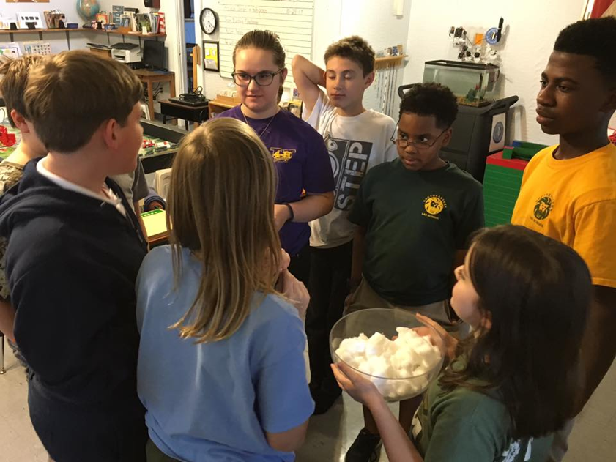
TEAM BUILDING ACTIVITY
In the past, teams had to do a teamwork activity live during judging.
This is no longer used.
However, such activities can help your team learn to work together better and are a good way for your team to practice Core Values during the season.

Slide 8
FAQs
Will we get to give a presentation during the Core Values Reflection component?
No. Judges are supposed to ask your team questions during this period. Ask ahead of time if presentations are allowed.
Then how can I tell the judge about about our team’s Core Values?
You should include examples through the entire 30mins – e.g. how you picked a project topic together, how you resolved a problem during robot building, how you helped another team, program, etc.
Do we need to have a tri-fold or poster?
No. Some teams will bring one (if allowed). They are not required and simply extra props a team chooses to have.
What type of documentation is useful?
Posters with photographs and a Core Values journal documenting all your activities are common among teams.

Slide 9
SAMPLE JUDGE QUESTIONS
Questions will focus on the rubric categories that the judge has not been able to complete during the rest of your judging session.
Remember to include everyone and give multiple examples.
Remember to go beyond just the robot game and innovation project where possible.
Describe a challenge your team faced this season and how you overcame it.
What was something your team did for fun?
Did you have any disagreements this season? How did you resolve it?
What is one thing you learned this season?
Did you have the opportunity to collaborate with or help another team?

Slide 10

CREDITS
This lesson was written by the Bayou Builders (https://www.bayoubuilders.org/) and the Seshan Brothers
More lessons for FIRST LEGO League are available at www.flltutorials.com
Creative Commons Attribution-NonCommercial-ShareAlike 4.0 International License

