Slide 1
CORE VALUES POSTER
BY PENNSYLVANIA’s FINEST ROBOTICS

Slide 2
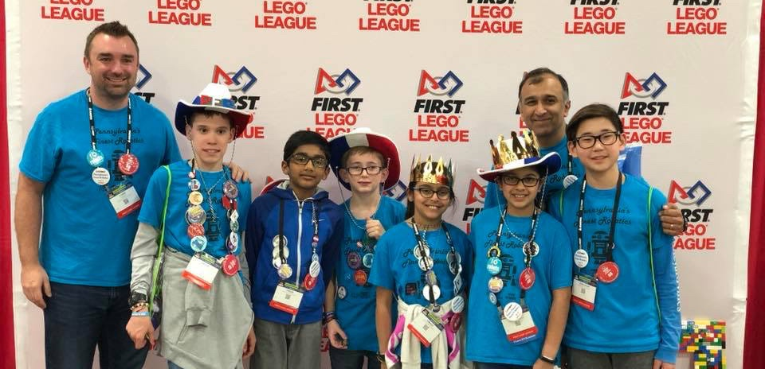
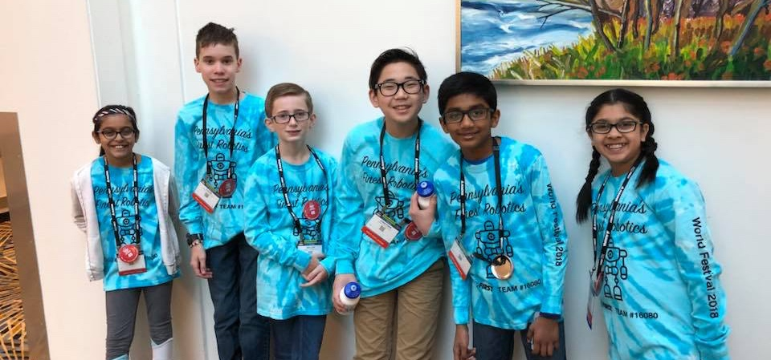
MEET THE AUTHORS
6 members, 5th grade – 8th grade
1st place Champion’s at 2016 Central PA
1st place Champion’s at 2017 Southeast PA
1st place Champion’s at 2018 East PA
3rd place trophy in Teamwork at World Festival 2017
Our favorite core values are ”We are a Team” and ”We have fun”!

Slide 3
WHY ARE CORE VALUES POSTERS USED?
Core Values posters are not required but can be used to share your team story!
Every team’s journey is unique, and judges want to know what makes your journey special.
Posters can serve as a point of reference and a way to remember details from your long season – do not read from your poster
During judging sessions, you only have a few minutes to share your story. The poster can have additional images and detail that you can point out during Q&A.

Slide 4
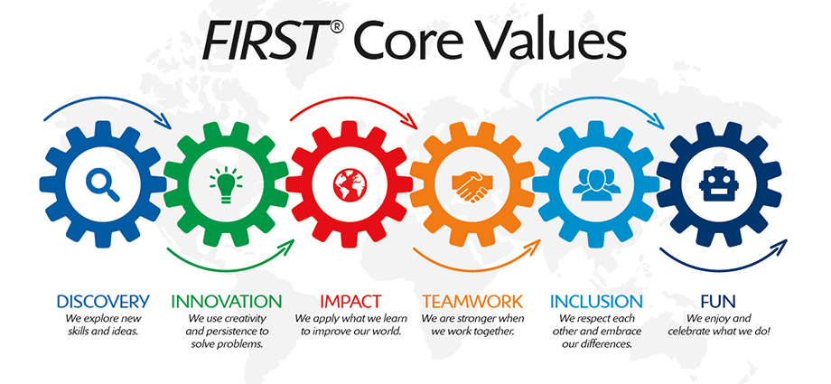
WHAT SHOULD YOU HAVE ON YOUR POSTER?
Base your poster on the Core Values Rubrics
Include anything that highlights the Core Values your team demonstrated throughout the season
Describe what the team did, but as they say, “a picture is worth 1,000 words”. So include photos as well

Slide 5
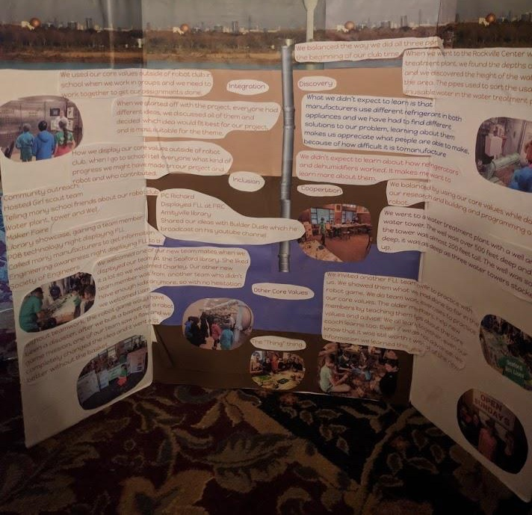
POSTER DESIGN CONNECTED TO TEAM PROJECT
The Seaford Sea Lions designed their poster to look like the layers of soil and aquafer under Long Island, NY
They connected their Core Values poster to the season’s theme/their project

Slide 6
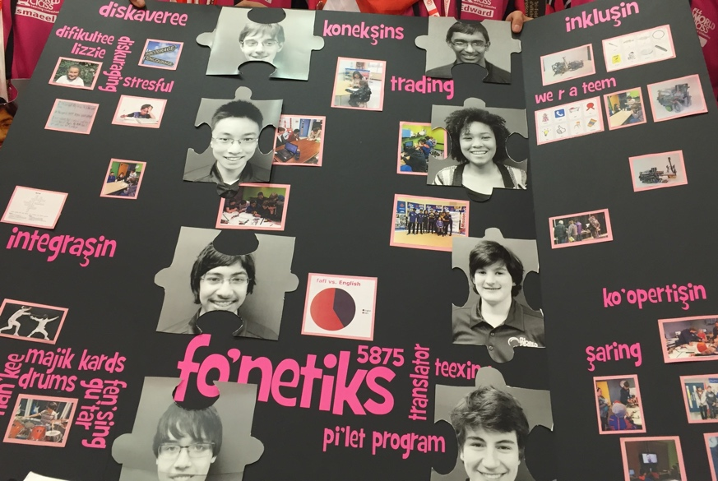
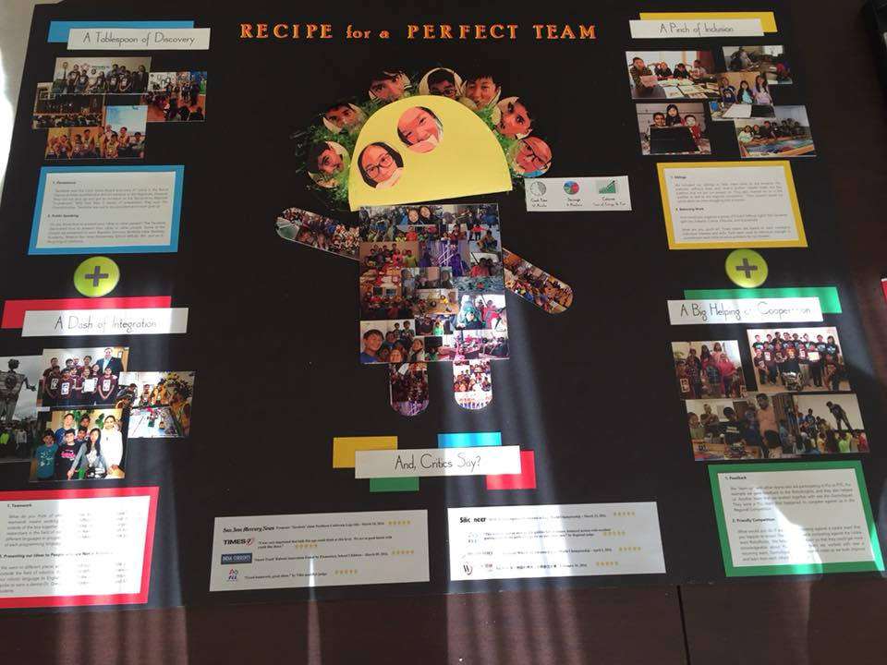
POSTER DESIGN CONNECTED TO TEAM NAME
Tacobots
fonetiks

Slide 7
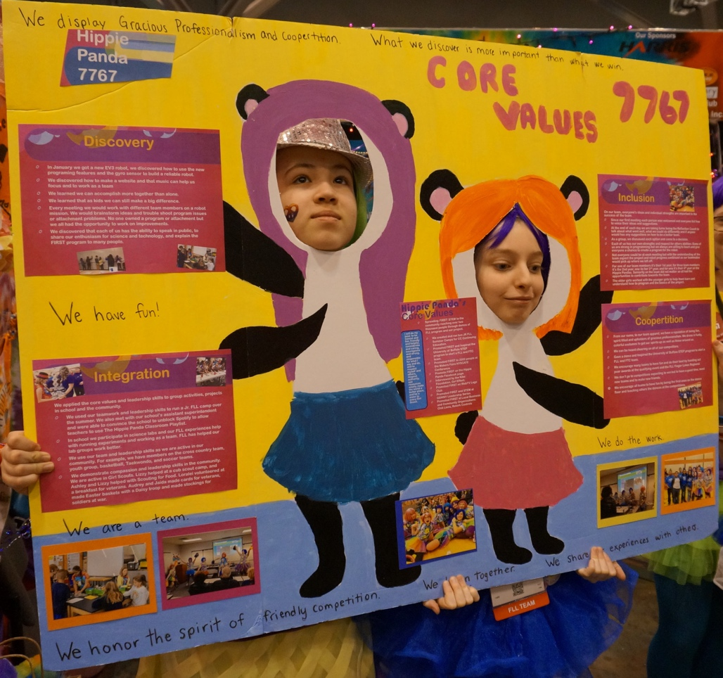
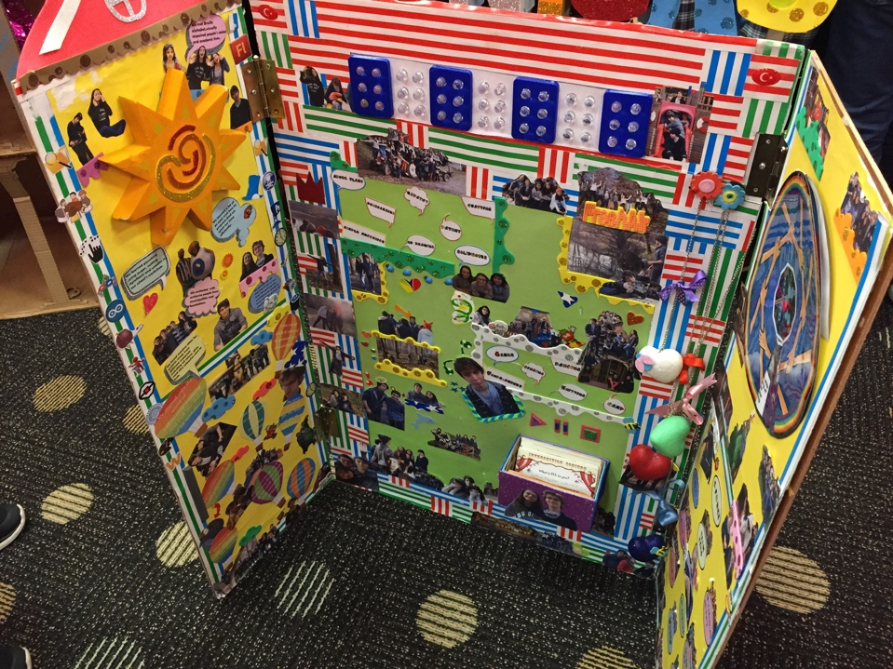
COLORFUL posters
Have fun with your posters!

Slide 8
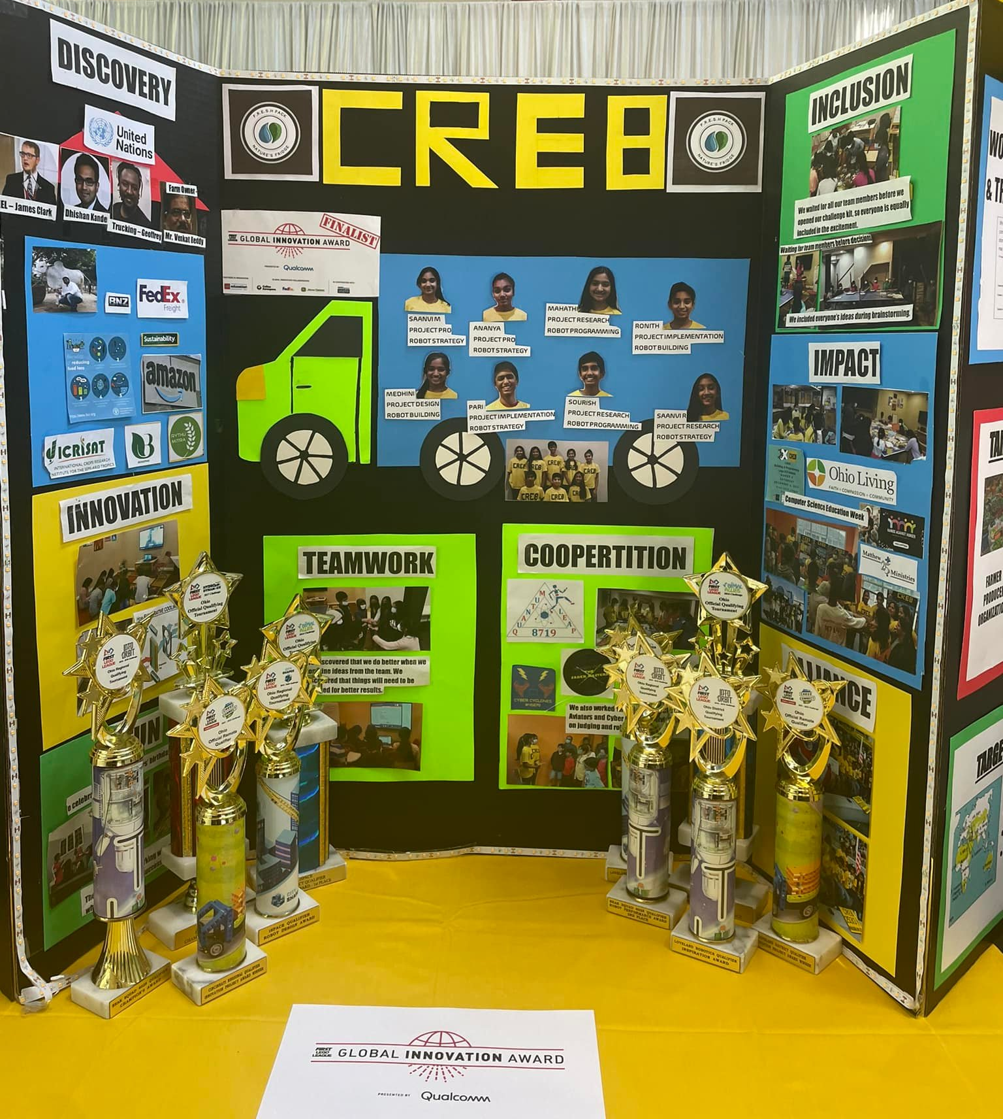
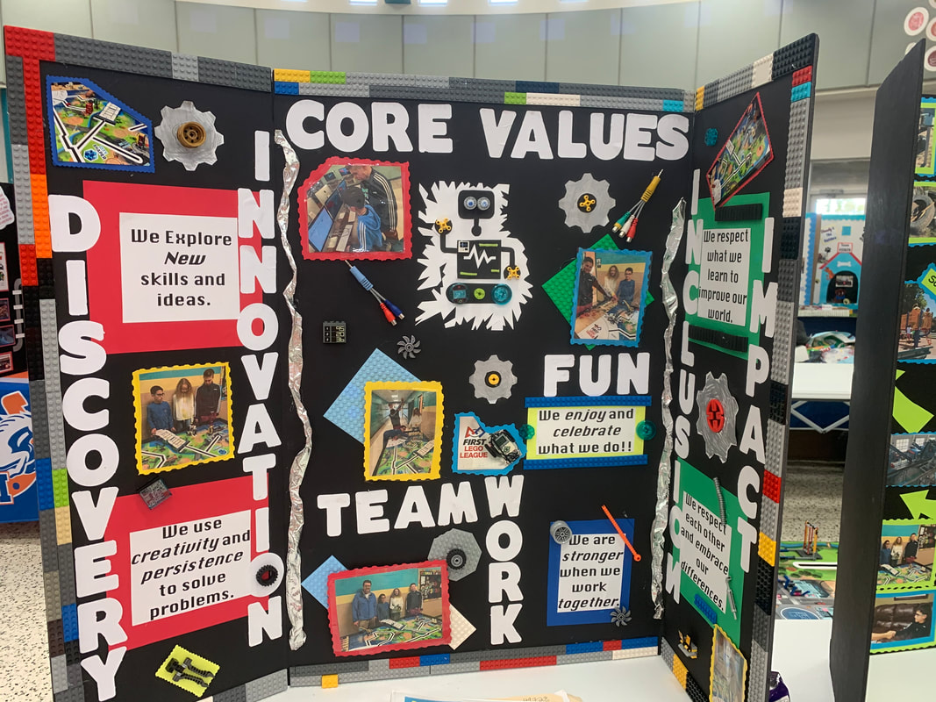
TIP: follow the Rubric
Source: Galaxy Gears
Source: Ohio FLL Facebook

Slide 9
CREDITS
This lesson was written by PA’s Finest Robotics Team
More lessons for FIRST LEGO League are available at www.flltutorials.com
Creative Commons Attribution-NonCommercial-ShareAlike 4.0 International License

