Slide 1
SelECTING A TEAM NAME
SANJAY & ARVIND SESHAN

Slide 2
COMING TO A CONSENSUS
The team should decide how they will select the team name
Will the majority vote win? Will there be compromises and names will be combined? What if someone’s idea is not selected? How should they react? Can the coach or a team leader veto the idea?
Use this opportunity to determine how you will make decisions as a team this season? Selecting a team name is just one decision in a long list of decisions your team will have to make. Coming up with a process early on will help make the process much easier and reduce hurt feelings.

Slide 3
START BRAINSTORMING
Name of your street, your school, or city
Favorite person or animal
Movie name, movie characters
An adjective that represents everyone on the team
A random word
A team mascot
Words related to LEGO (brick, LEGO, stud) or robots (bot, droid, tech, gear)

Slide 4
SOME SAMPLE TEAM NAMES FOR INSPIRATION
Electric LEGOs
Space Oddity
Code Crashers
DJ Robotics
City Savers
Digital Dolphins
Foothill Robotics
Golden Storm Troopers
Cheez Puffer Fish
FBI (Fascinating Bot Intelligence)
Invincible Engineers
Hi-Tech Auto Bots
Rockin' Robots
Banana Splits
Ultimate Flopping Caterpillars
LEGO Legion
Lightning Bots
The Last Digit of Pi
Space Coconuts
Blue Oranges
Midnight Girls
LEGO Pandas
BrickByBrick
The Outsiders
Alphabots
IncredGirls
Jumping Jelly Beans
Wave Makers 2020
Howl Bout It
Gucci Einsteins
The Falcons
Gears in Motion
The Inventors
Fantastic Four
Planet Robotics
No Limits
Untitled 1
Sharon Tiger Techs
The Five Elements
Part 25994
Some Assembly Required
Exit 6 Robotics
TechBlaze
Golden Flares
Brainy Yaks
Move Your Feet
The Brickbeards
Mystery Machinery
Brave Robots 3000
Incredibots
Not the Droids You are Looking For
Cryptic Cookies Bits ‘n Bots
Masterminds
CrossBots
Techie Po-tater Bots
Red Hot Chili Apples
TechnoSharks
The Honubots
Snow White and the Critter Crrew
Phoenix Cubitects
Cyber Crocs
Inevitable
The Warf Rats
Fantastic Five
Constant Deviation

Slide 5
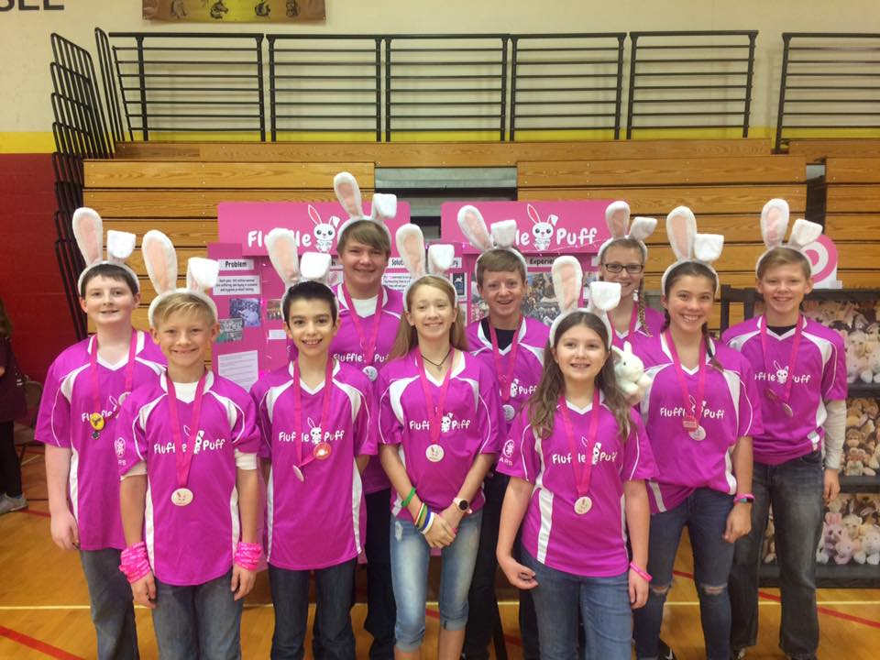
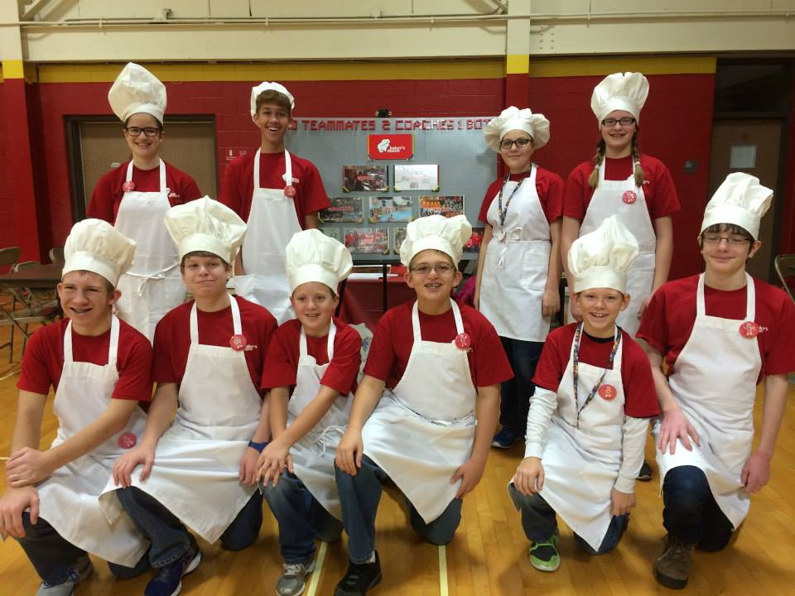
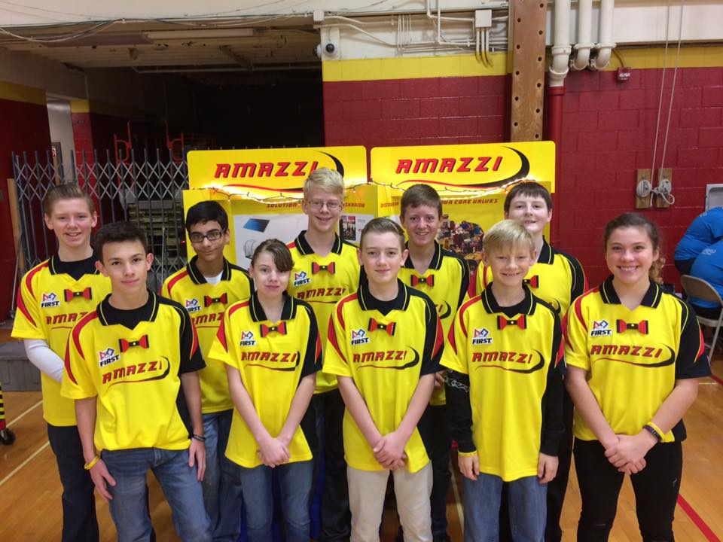
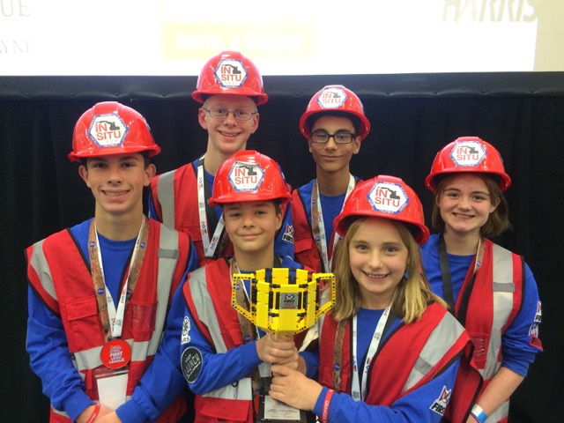
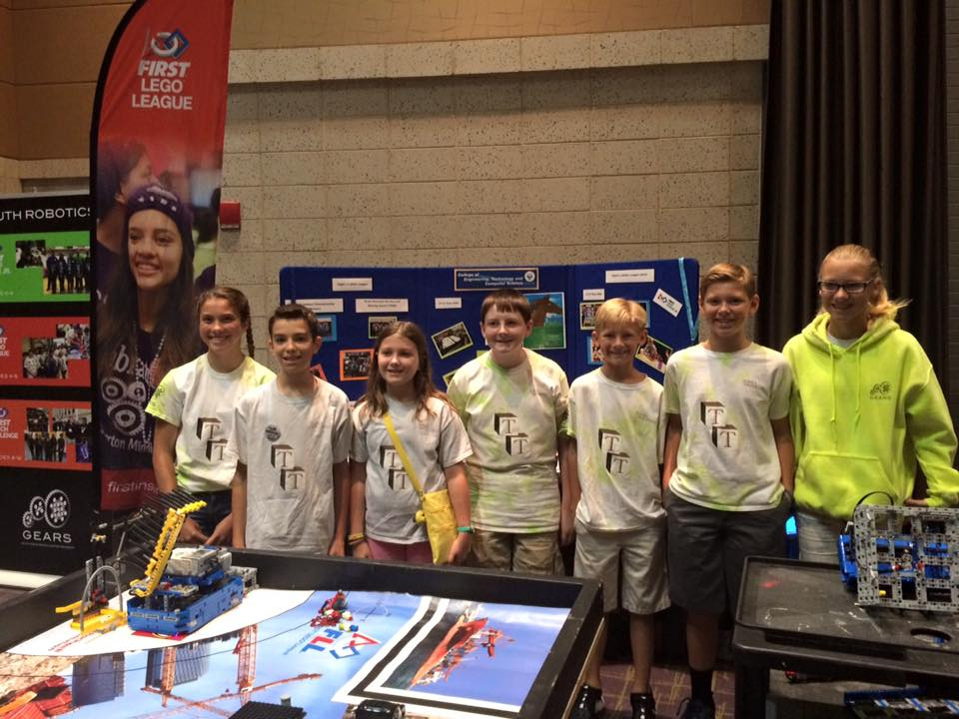
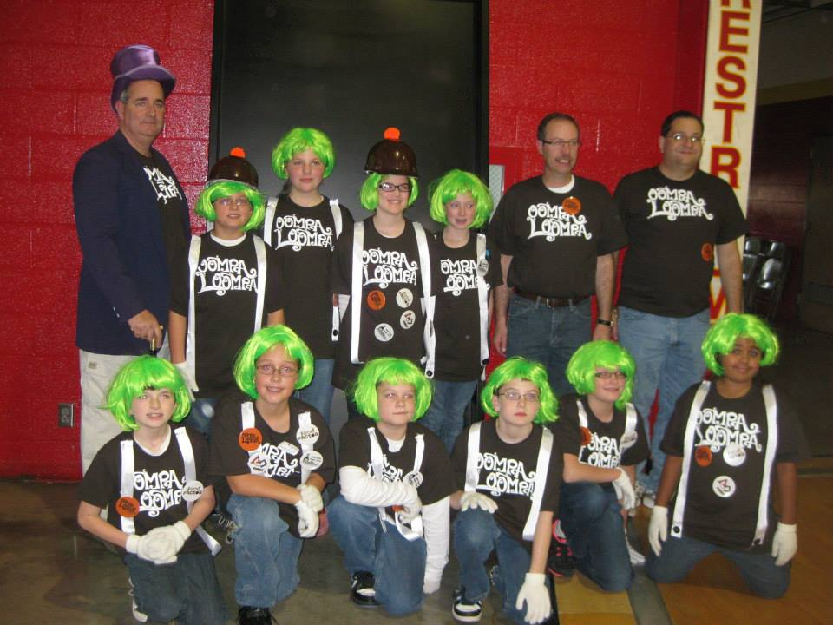
SOME TEAMS CHANGE NAMES EVERY SEASON
Some teams like to change their name to match the season theme and their team’s solution. Above are images of FLL 1920 from different seasons.

Slide 6
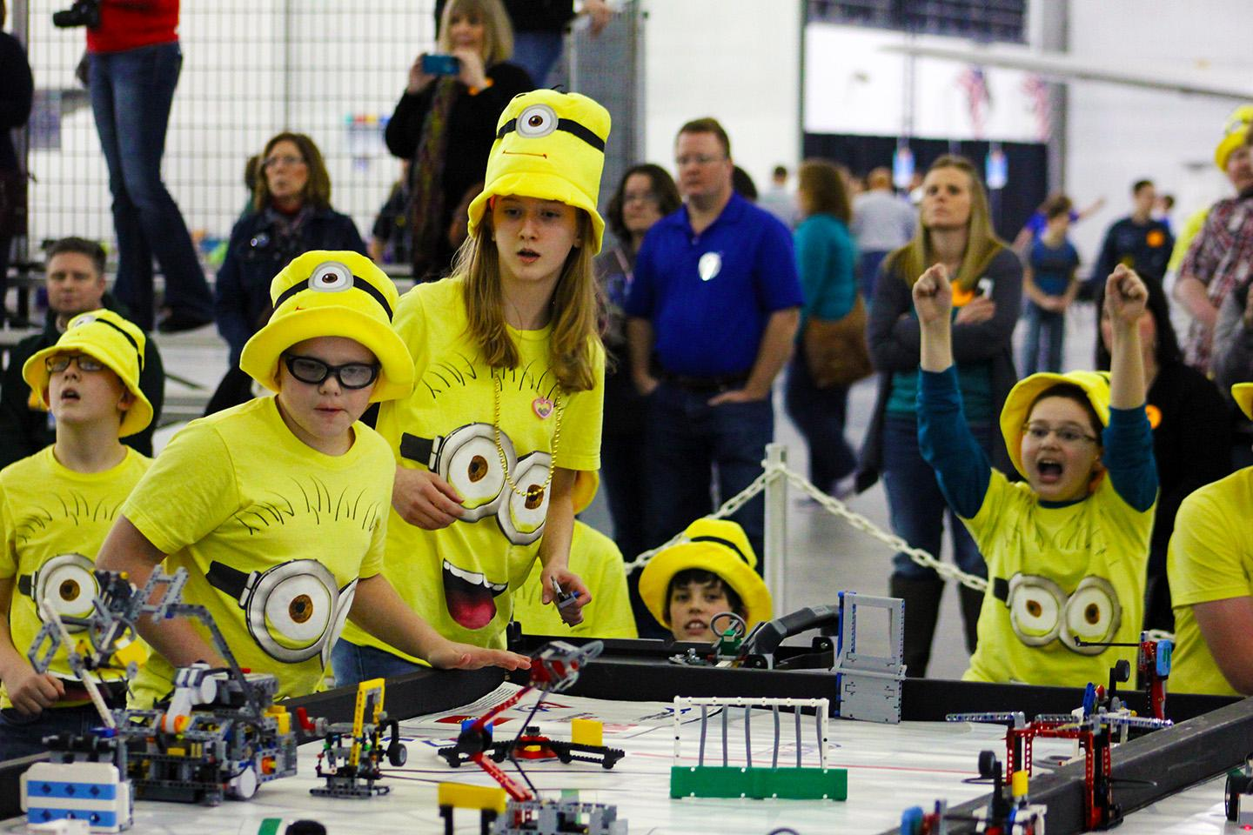
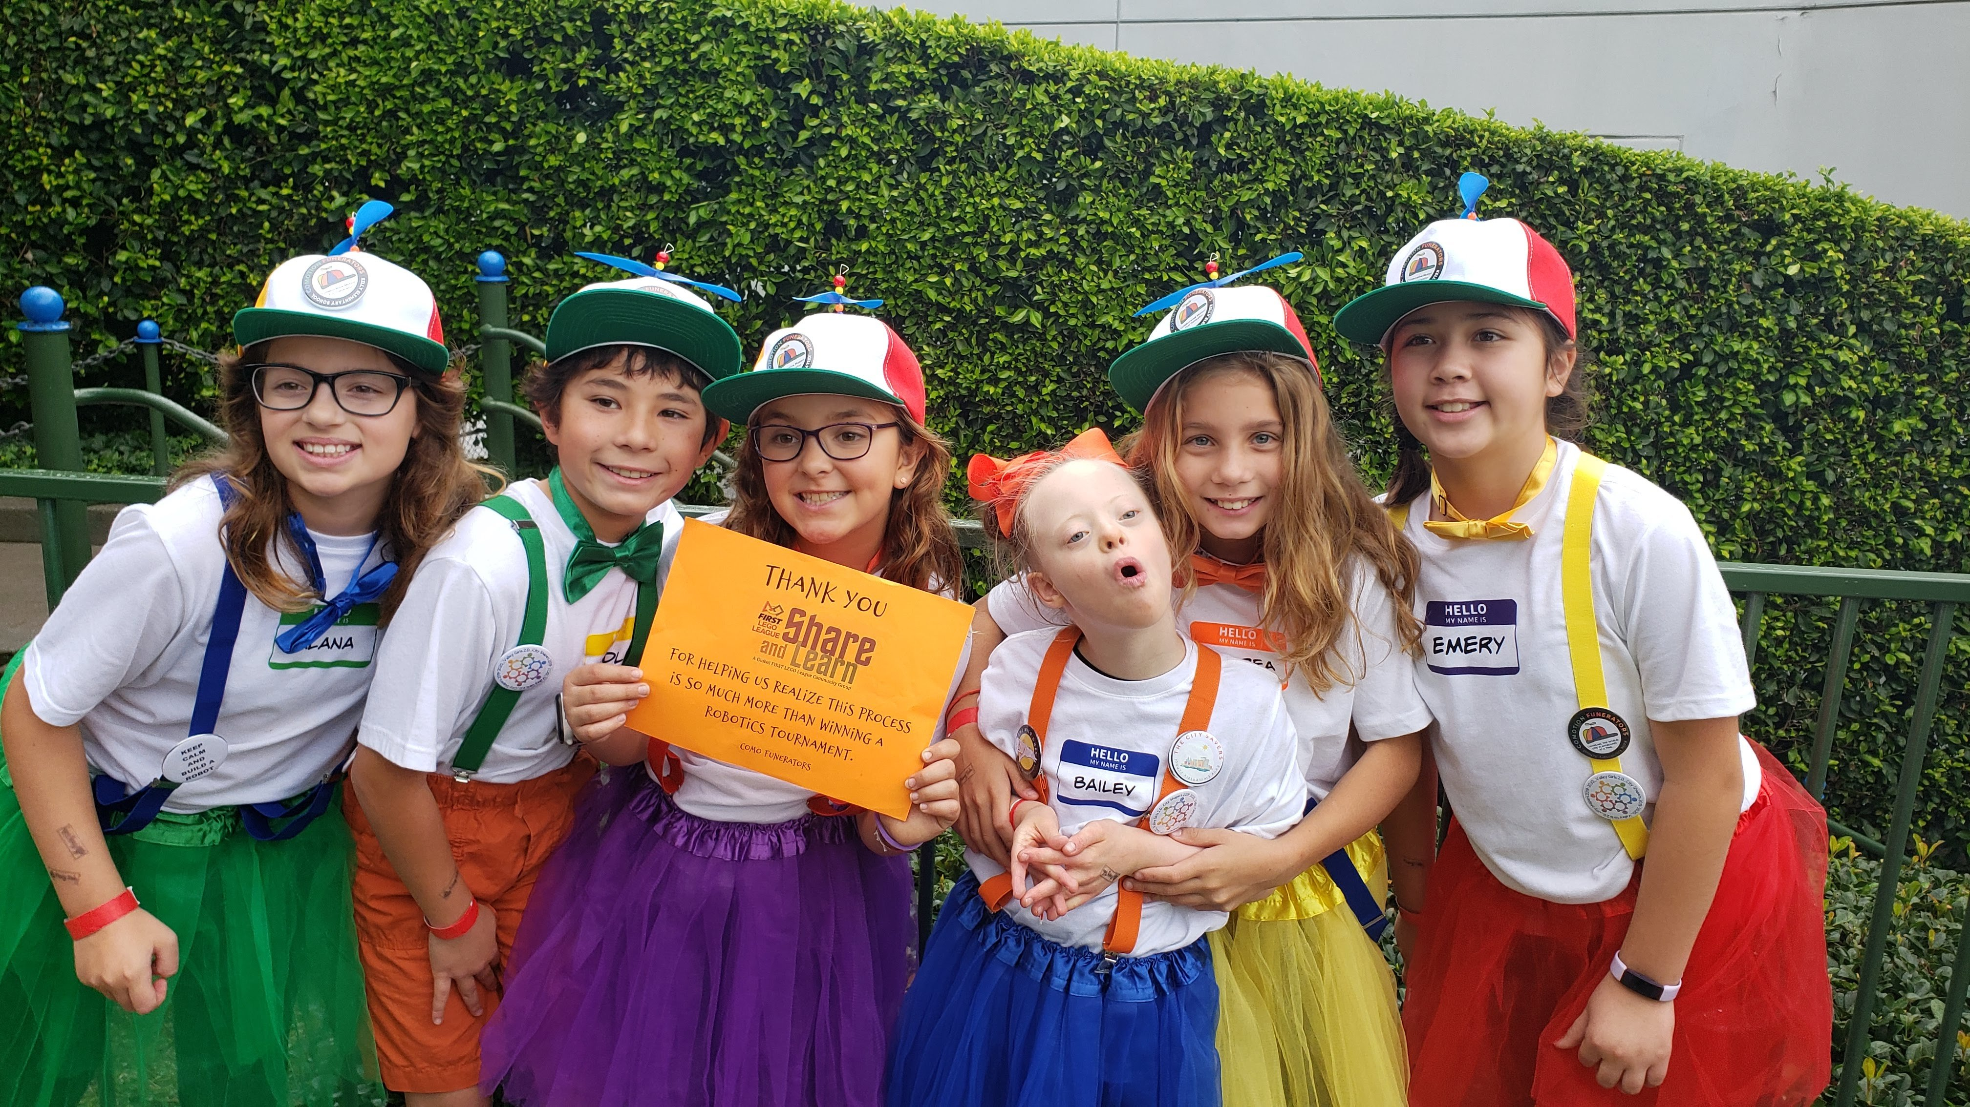
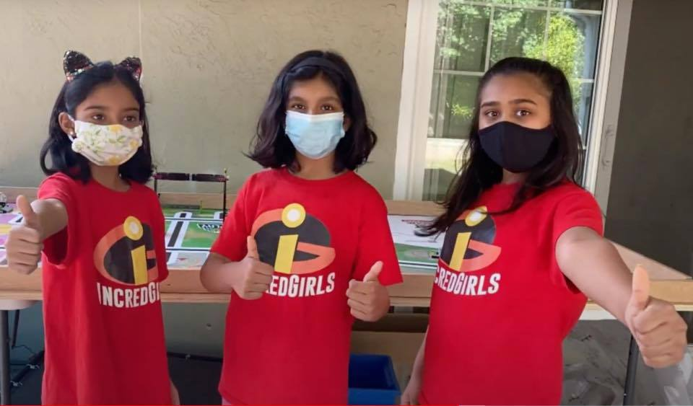
PICK A NAME THEN COMPLETE THE LOOK
Coming up with a logo and a costume or t-shirt can help your team complete the look and create your own identity.

Slide 7
CREDITS
More lessons for FIRST LEGO League are available at www.flltutorials.com
Creative Commons Attribution-NonCommercial-ShareAlike 4.0 International License

