Slide 1
Taking your innovation project to the next level for the GIA
FRc D-Bug #3316 – tEAm D++ Alumni

Slide 2
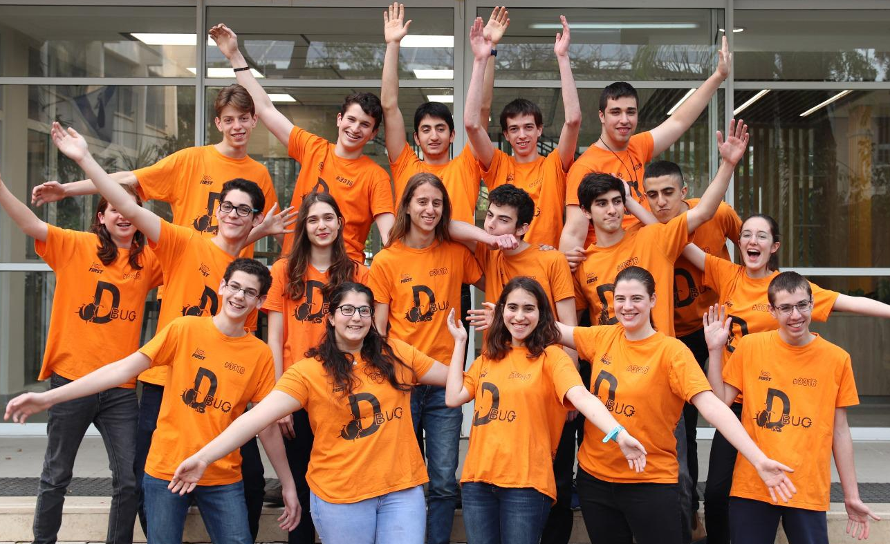
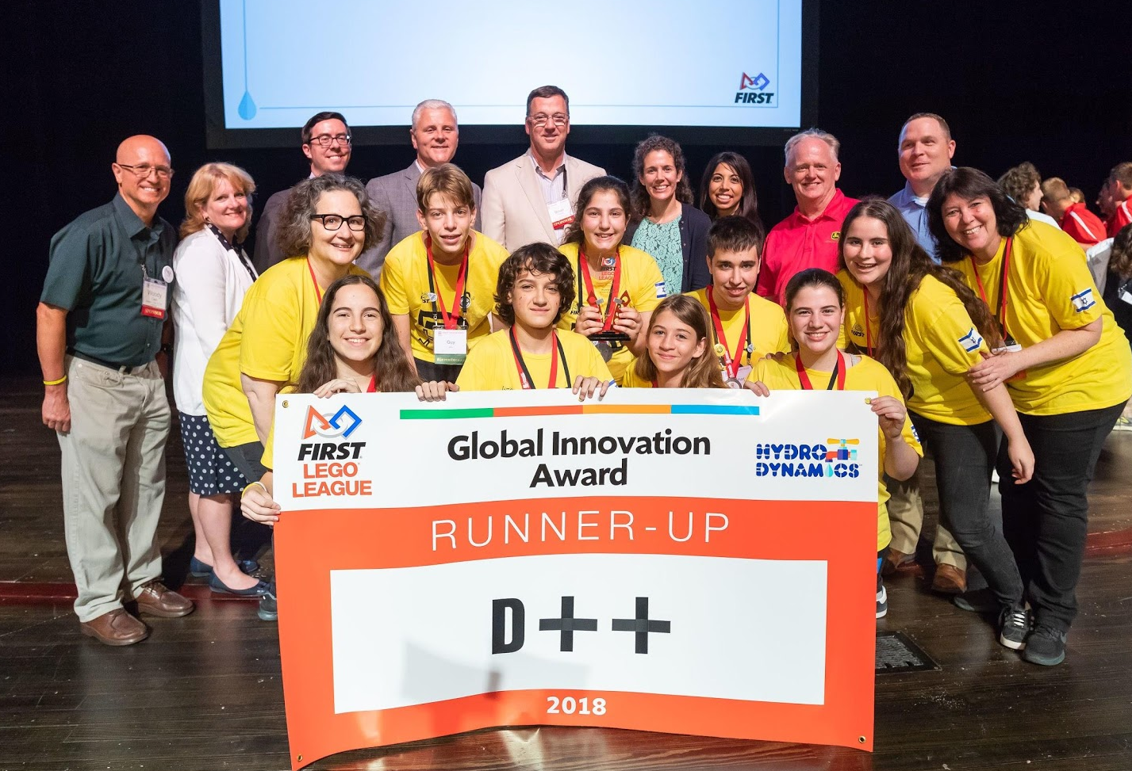
About the authors
We are part of D-Bug #3316, an Israeli FRC team from Tel Aviv.
We are alumni of team D++, the GIA runners up from the 2018 Hydrodynamics season (Plasticker)
2018-2020 FLL Israel Regional Champions Award

Slide 3

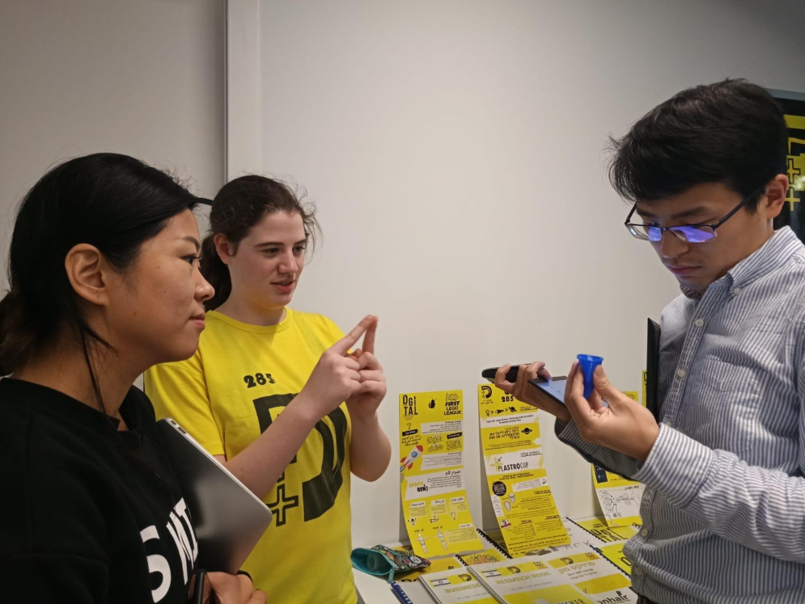
pitch
A pitch is a sum up of an idea, product or company
We recommend building a pitch to sum up your innovative solution for someone passing by, a judge, or an investor
Present your pitch with confidence and excitement!
Keep it brief, a pitch should be up to 1-5 minutes depending on who you are presenting it to
What should your pitch include?
Who you are
What problem are you solving?
What is your solution?
Who are your customers?
Why is your product better than others on the market?
What experts did you talk to?
Your solution’s strengths and market opportunities so they understand why they should vote for you or invest in you
If talking to potential investors or judges

Slide 4

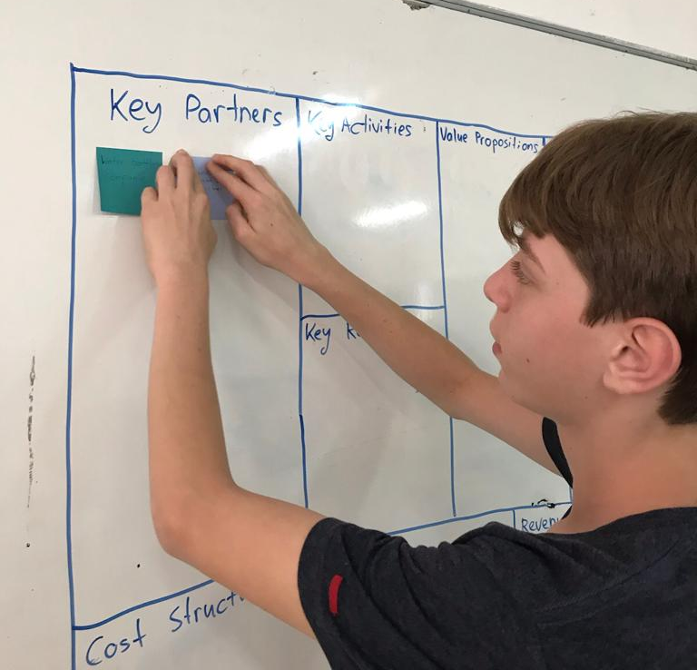
Innovation development process
Showing and documenting your innovation development process can take your project to the next level.
There are four documents that can add to this process:
Engineering Change Notice
SWOT analysis
Business Model Canvas
Value Proposition Canvas
How can you build the Business Model Canvas & Value Proposition Canvas ?
Watch videos explaining each canvas (linked above)
Sit together as a team and draw the canvas on a board
Talk about each block in the canvas, write down the relevant points on a post it note and add to the board
** we recommend these canvases for higher levels of competition, since the Global Innovation Award our teams have been building one for the state championship level

Slide 5
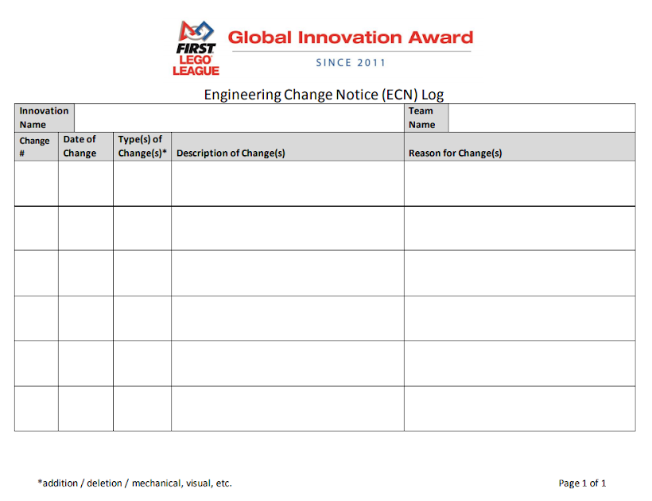
Engineering change notice
An Engineering Change Notice (ECN) is a document authorizing and recording design changes throughout the prototyping and life-cycle phases of a product
This is beneficial for your team and the judges – it tracks the changes you made and the reasons it also shows your product’s development over time
You can make an ECN not only for your innovation project but also for your robot!

Slide 6
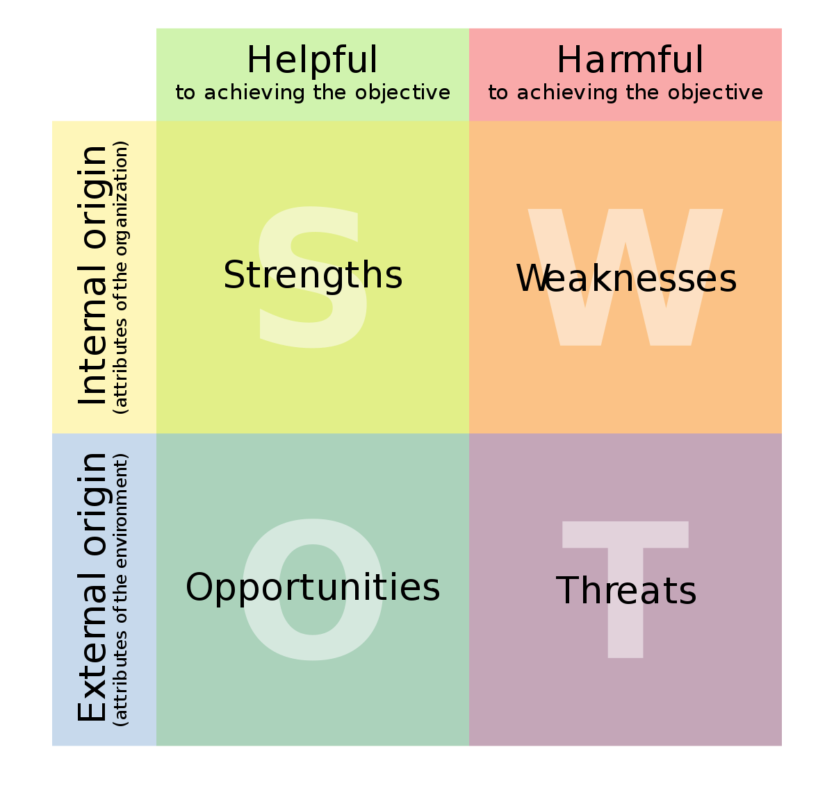
SWOT analysis
A SWOT analysis is an incredibly simple, yet powerful tool to help you develop your product.
Strengths and weaknesses are internal —things that you have control over and can change.
Opportunities and threats are external. You can take advantage of opportunities and protect yourselves against threats, but you can’t change them.
https://commons.wikimedia.org/wiki/File:SWOT_en.svg

Slide 7
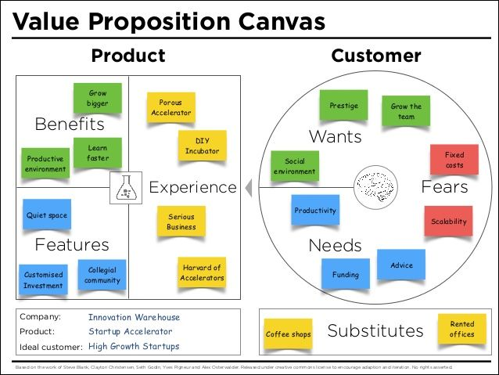
Value proposition canvas
Your value proposition is your unique identifier. Your value proposition clearly presents why someone would want to buy your product instead of a competitors.
The Value Proposition Canvas is a tool which can help ensure that a product or service is positioned around what the customer values and needs

Slide 8
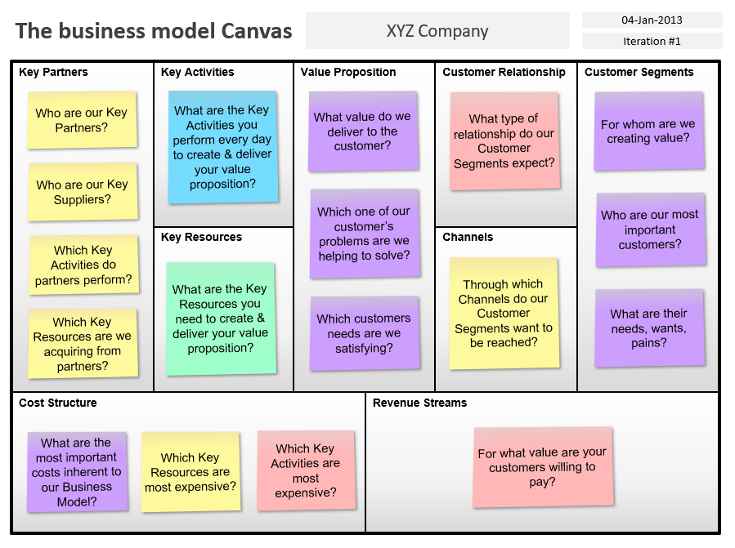
Business model canvas
The business model canvas is a shared language for describing, visualizing, assessing and changing business models.
Why build one? The Business Model Canvas breaks your business model down into easily-understood segments you can present to judges and investors.
https://slidehunter.com/powerpoint-templates/business-model-canvas-template-for-powerpoint/

Slide 9
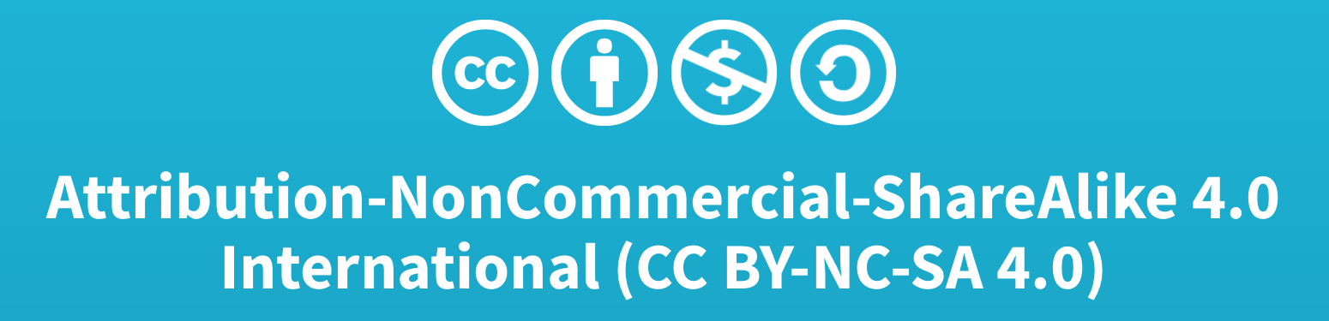
Credits
This lesson was written by FRC D-Bug #3316
You can contact us at outreach3316@gmail.com
More lessons available at www.ev3lessons.com and www.flltutorials.com

