Slide 1
Taking your innovation Project to the next level
ShARON TIGER TECHS, NOT THE DROIDS YOU ARE LOOKING FOR, LEGO LEgion

Slide 2
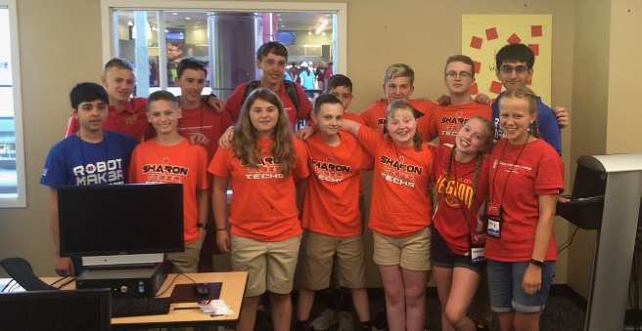
About The AUTHORs
Sharon Tiger Techs (2019), LEGO Legion (2018), Not the Droids You Are Looking For (2016) - All three authors are Global Innovation Award Top 20 Teams
Tips shared in this document helped the teams take their projects to the level of the Global Innovation Award (which existed until 2022)

Slide 3
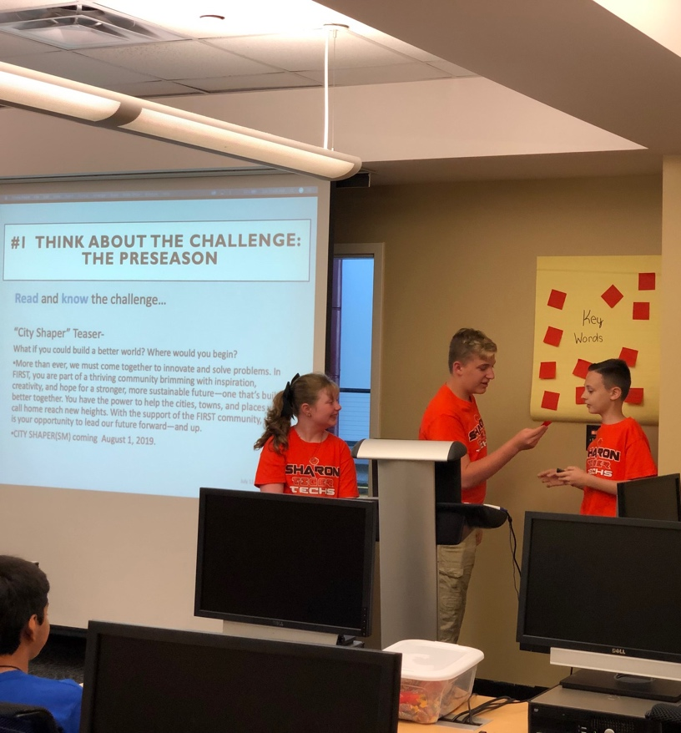
GET A Head Start in the OFF SEASON
Key words can be taken from teaser text or teaser video that can lead to great preseason trips or talks with experts for the season.
Think about…who could you
talk to? Where could you visit?
This will lead to great resources and contacts for the team after the season is launched.
In addition, think about presenting to these experts for project feedback later in the season.

Slide 4
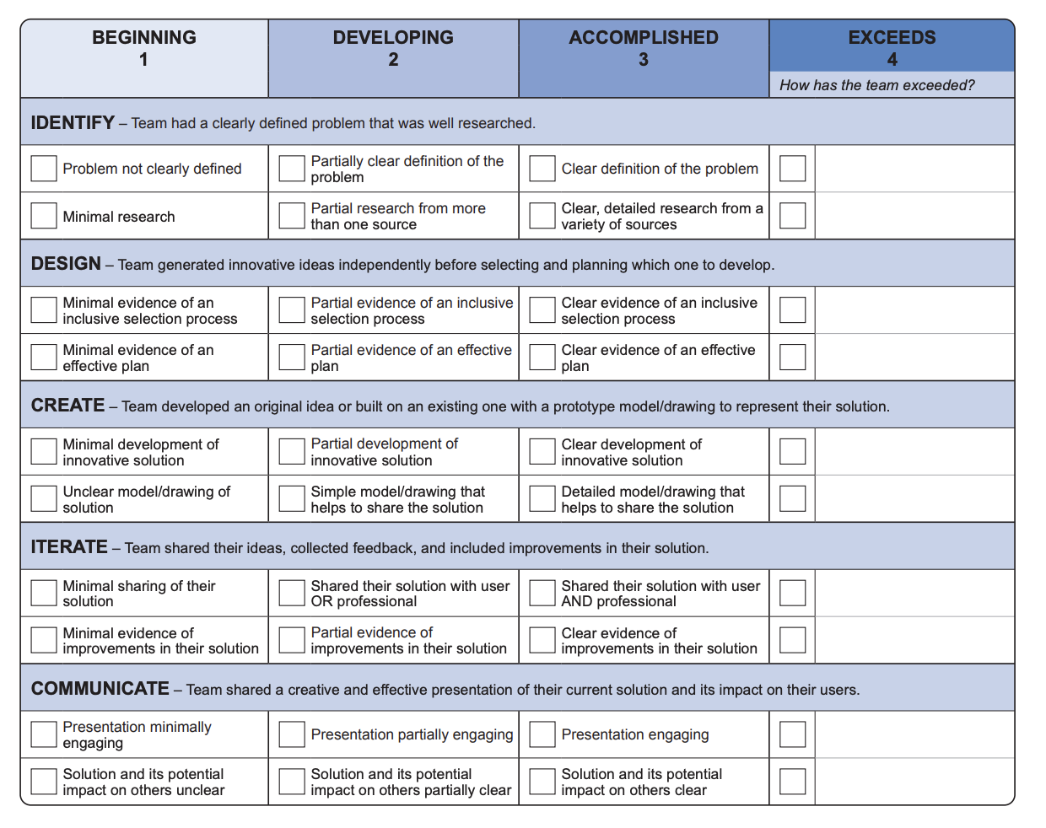
Communicate your content in your 5 mins
It is very important to communicate all the key information in your 5 minute presentation so that judges can easily mark the rubric.
5 minutes includes set-up time, so keep the setup short and easy always so you have more time for your presentation

Slide 5
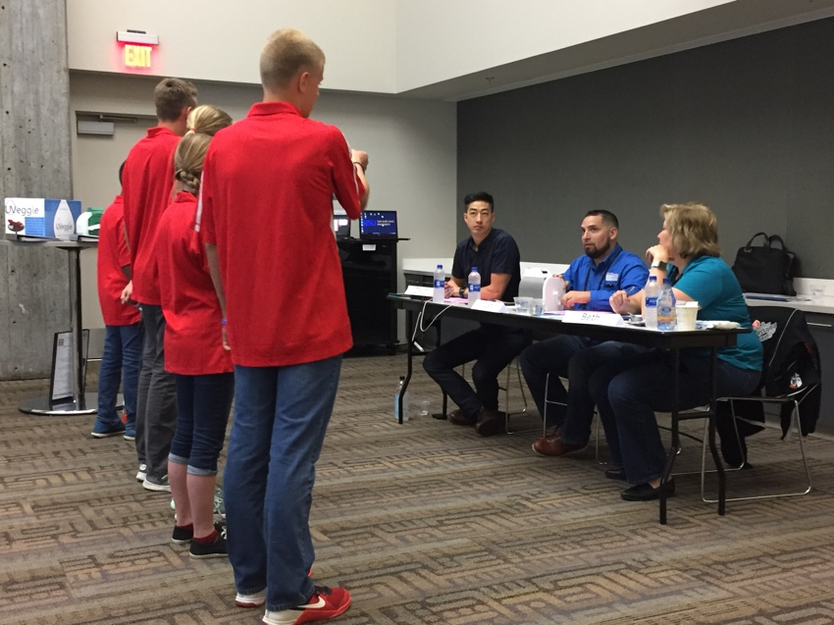
BUT Always have more to tell in Q&A
A good project will have more information than what you presented in the 5 minutes.
Keep a binder with your additional data.
During Q&A, you will have a chance to share this additional information.
At the end of Q&A, provide a handout for the judges with details that highlight your project.

Slide 6
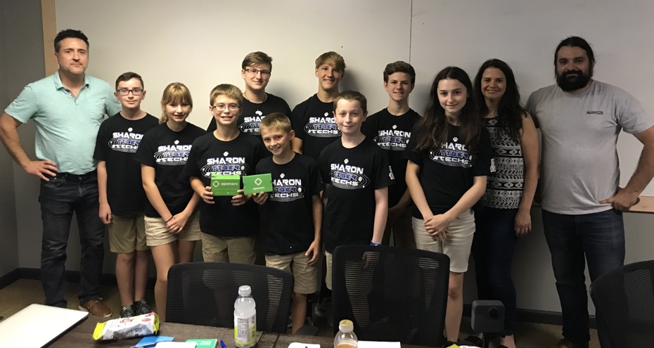
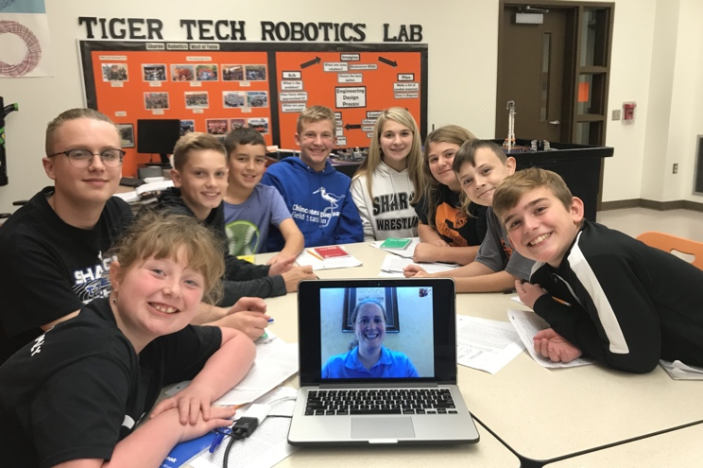
MAKE EXPERTS count – not just parents
Internet research itself only goes so far- use it to find experts! Don’t be afraid to ask for a phone or video call. You’ll be surprised how willing some experts are to help a group of students.
Ask around in your own network of contacts. Sometimes a friend of a friend is just who you need.
Think outside the box. Even if your invention is intended to be used by an astronaut, the best feedback may still come from doctors, scientists, college professors, or manufacturers.

Slide 7
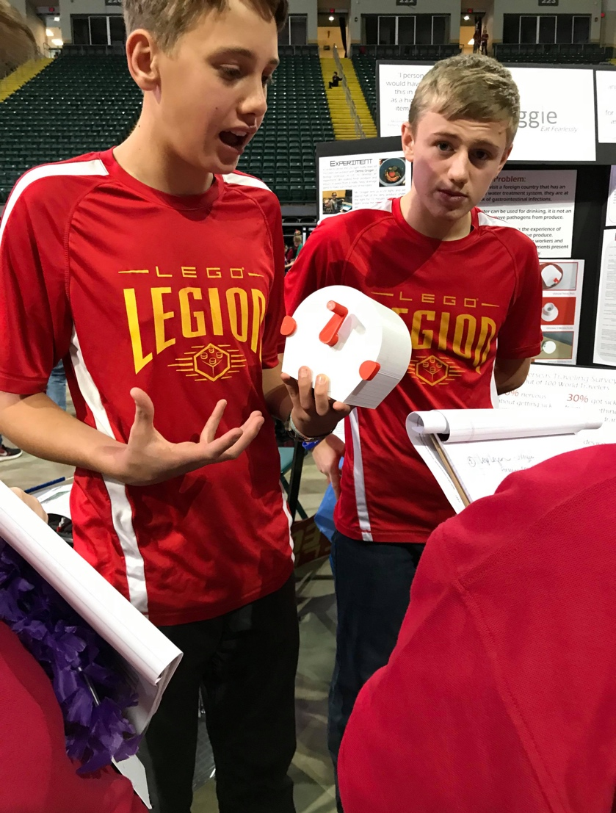
SHARE WITH THOSE WHO CARE
Some of LEGO Legion’s best feedback came from kitchen utensil maker OXO. Even though the design had heavy technological aspects, the product design part was right up OXO’s alley.
The stronger your invention’s connection with an expert’s niche, the more helpful, and willing to help, they can be.
Use their ideas as well as your own. They know the market or the technology, but you know your specific project better than anyone else.

Slide 8
Make it Innovative
Solution should be innovative. This means that is needs to meet one or more of the following:
Improve existing options;
Develop a new application of existing ideas;
Solve the problem in a completely new way.
The original solution/application must demonstrate added value.
For your solution, it does not have to be a full working prototype; however, a partial prototype or detailed drawings will help convey your project to the judges.
During the presentation, convey that your product is innovative by comparing it and demonstrating that it is better than products that are already on the market.

Slide 9
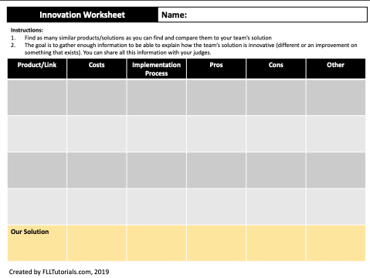
Comparison sheet
Here is a sample comparison sheet that the Droids used to convey how our solution is different.
You can download a copy here: http://flltutorials.com/Worksheets.html

Slide 10
DISCUSSION
Watch the following videos of project presentations from teams who have attended International-level tournaments.
LEGO Legion – INTO ORBIT - https://youtu.be/Xl2fL5iaD6A
LEGO Legion World Festival – Hydro Dynamics - https://youtu.be/JUowcfW5oRg
Is LOST – World Class - https://www.youtube.com/watch?v=VJ3cs9W83Ug
Caught in a Brainstorm - World Class - https://youtu.be/9bskcvE9JkU
What can we learn from each presentation?
What did they do well?
How many students were involved?
Were you able to fill in a rubric?
Were they creative?
What made this presentation different?

Slide 11
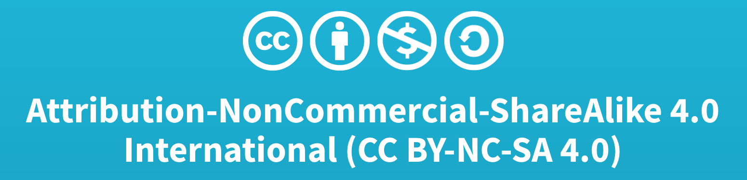
Credits
This lesson was written by Tiger Techs, LEGO Legion and Not the Droids You Are Looking For.
More lessons available at www.ev3lessons.com and www.flltutorials.com

