Slide 1
Sharing Your Project
Team 3659 NeXt Gen & Seshan Brothers

Slide 2
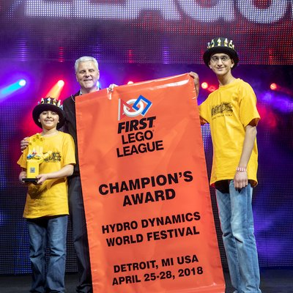
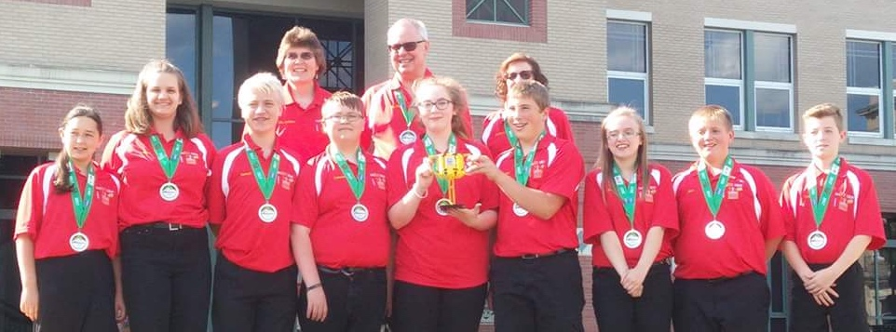
About the authors
NeXT Gen are a middle school team from Garrett County, Maryland with 13 years in FIRST LEGO League (including competing in International Tournaments).
They have won first place in 2013 Global Innovation Award. They also won Top 20 GIA Semi-Finalist in 2017 for innovative solution, BeeHaven.
In addition, they won first Place Innovative Solution at Mountain State Invitational in 2017.
Seshan Brothers were on Team Not the Droids You Are Looking For
They were Global Innovation Award Semi-Finalists for their Trash-Trek Project. EV3Lessons.com was their award-winning World Class project. They have also won First Place Innovative Solution at the International Open in Toronto.
They are the Champion’s Team from World Festival 2018.

Slide 3
Why Share?
In FIRST LEGO League, sharing your project is a very important component.
Sharing your project involves the presentation given to judges (which is covered in the lesson on Presentations), but also sharing with members of the public (experts and users)
Not only is it good practice for your team to share your project, but it is a key part of FIRST LEGO League and included on the Innovation Project rubric
The overall goal is to get feedback and improve your solution

Slide 4
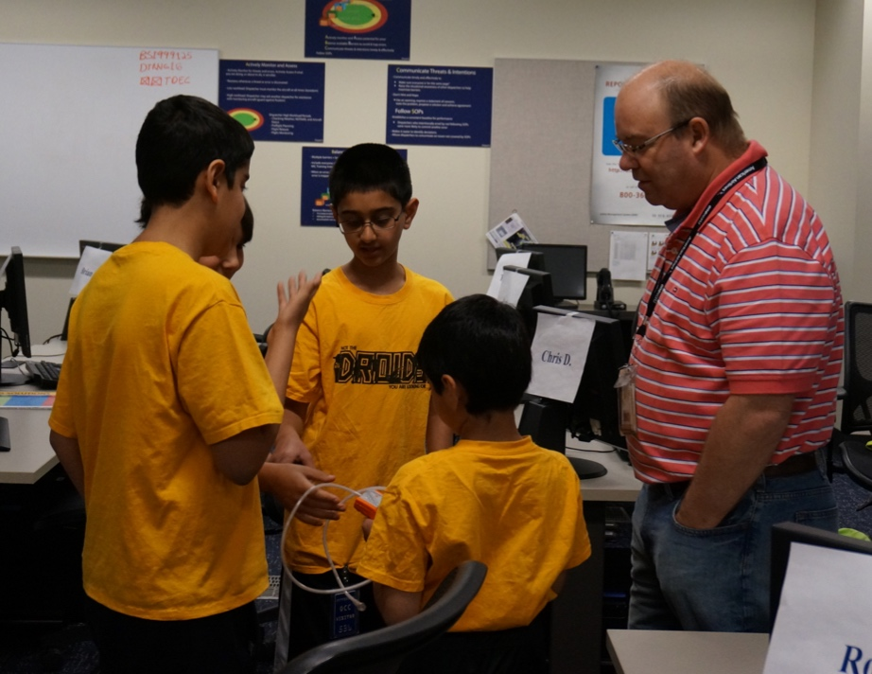
Who Should You Share With?
Starting with friends and family is a good idea
Sharing with school teachers and classmates is also great
But also make sure to share with people who would actually use your innovative solution and experts in the field who can give you feedback

Slide 5
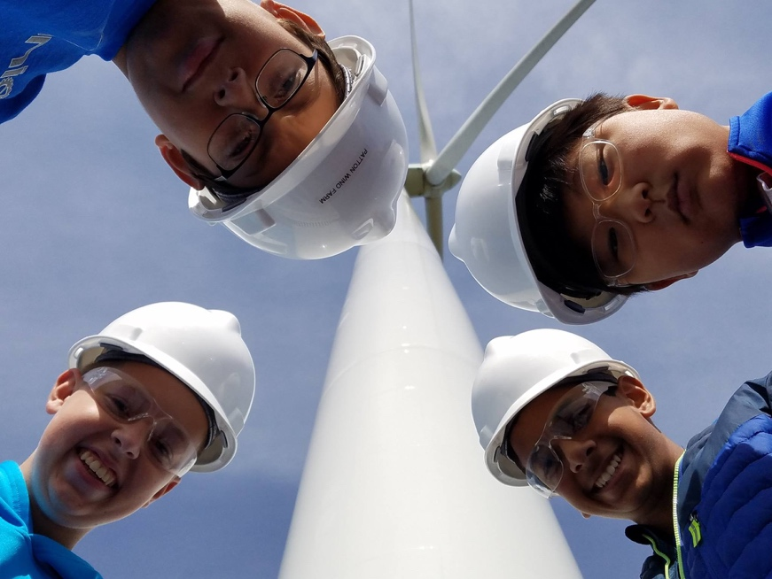
Examples
Project: Bats killed by turbines
Shared with: Turbine operators
Project: Ash clouds causing engine damage
Shared with: Airline operators
Project: Senior Citizens needing reminders
Shared with: Your own grandparents as well those in nursing homes

Slide 6
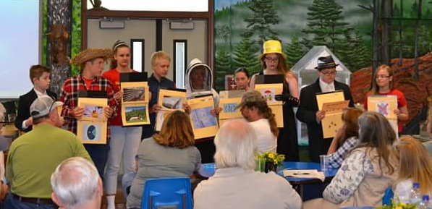
How to Share Your Project
When the team is sharing their project
Introduce the team enthusiastically
Explain FIRST LEGO League
Explain the theme of this season
Define the problem
Explain existing solutions
Explain the solution
Explain why the solution is innovative
If the team tested the solution and made prototypes, explain the data that was received and talk about the prototype(s).
Tip: If your presentation for the judges is ready, use this opportunity to present it. This gives the team practice and allows the team to see what can be improved.

Slide 7
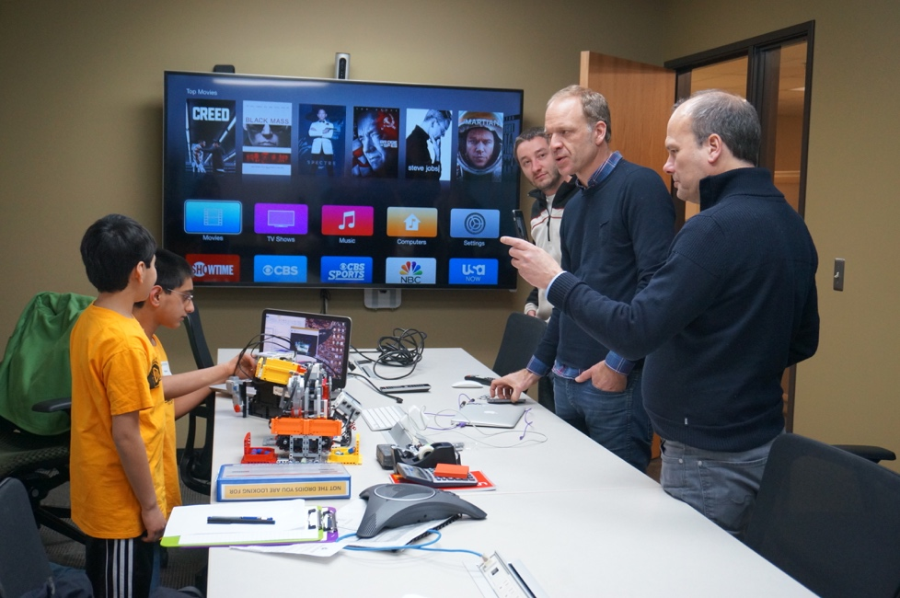
What Next?
People you shared with might give you some useful feedback
Incorporate the ideas into your innovative solution
More than likely, the questions they asked you are also ones the judges may ask you.
So, listen well and use their feedback to also improve your presentation

Slide 8

Credits
This lesson was written by Sanjay and Arvind from Not the Droids You Are Looking For and Team 3659 NeXT GEN (Facebook: Garrett County FIRST LEGO League Team 3659).
More lessons available on www.ev3lessons.com and www.flltutorials.com

