Slide 1
CORE VALUES JUDGING
SESHAN BROTHERS

Slide 2
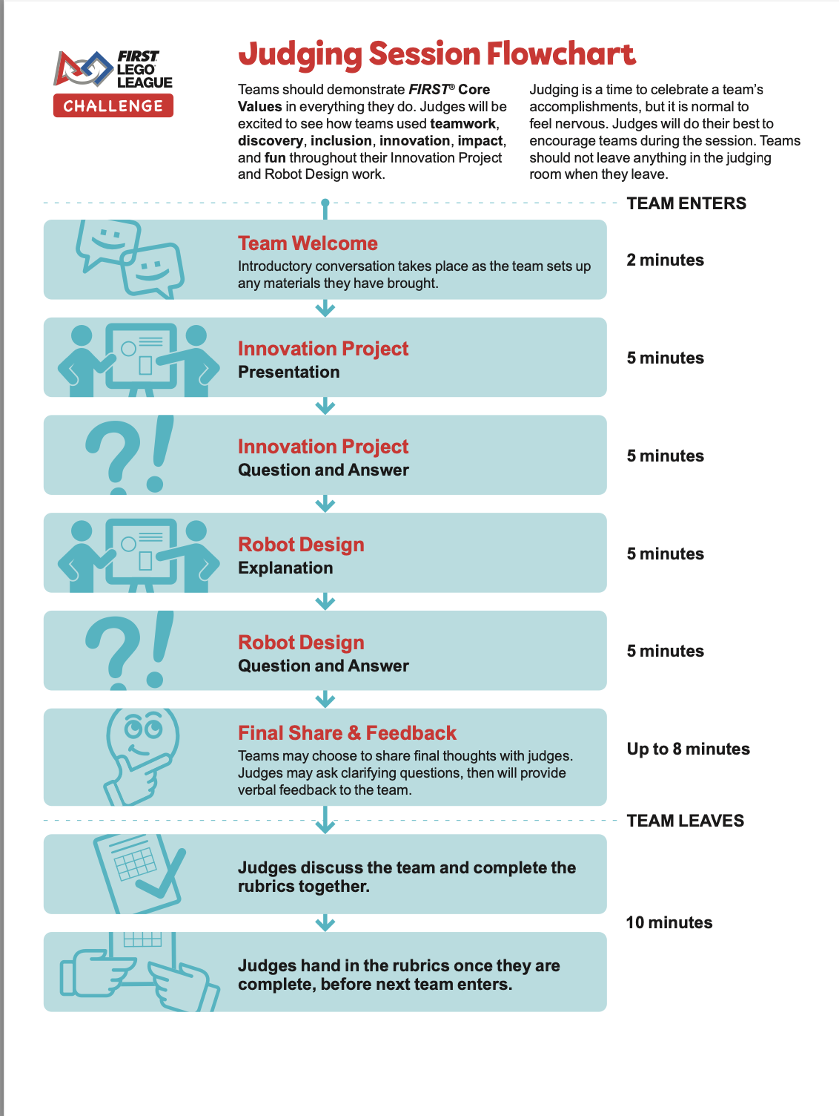
JUDGING FLOWCHART
New for 2024-25 Season
There is no specific time allotted for discussing Core Values
There is no presentation required for Core Values

Slide 3
CORE VALUEs JUDGING OBJECTIVES
Core Values are supposed to be applied to your daily work as a team
Judges will be listening to your during Robot Design and Innovation Project judging to see how you actually used teamwork, discovery, inclusion, innovation, impact and fun

Slide 4
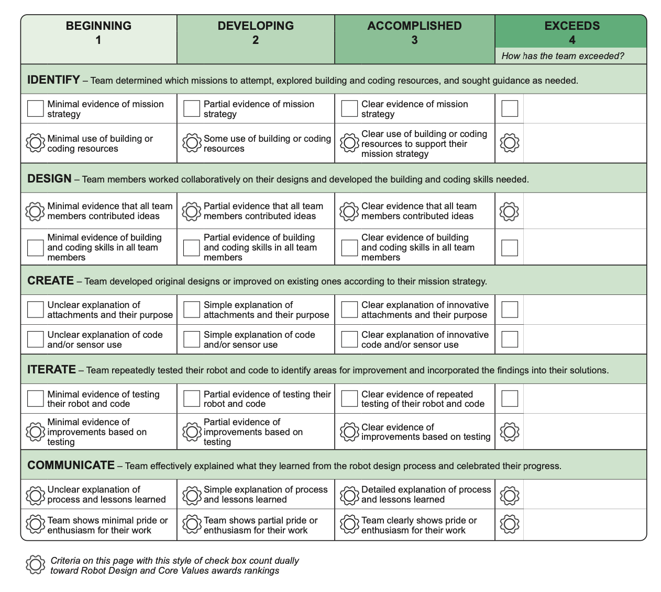
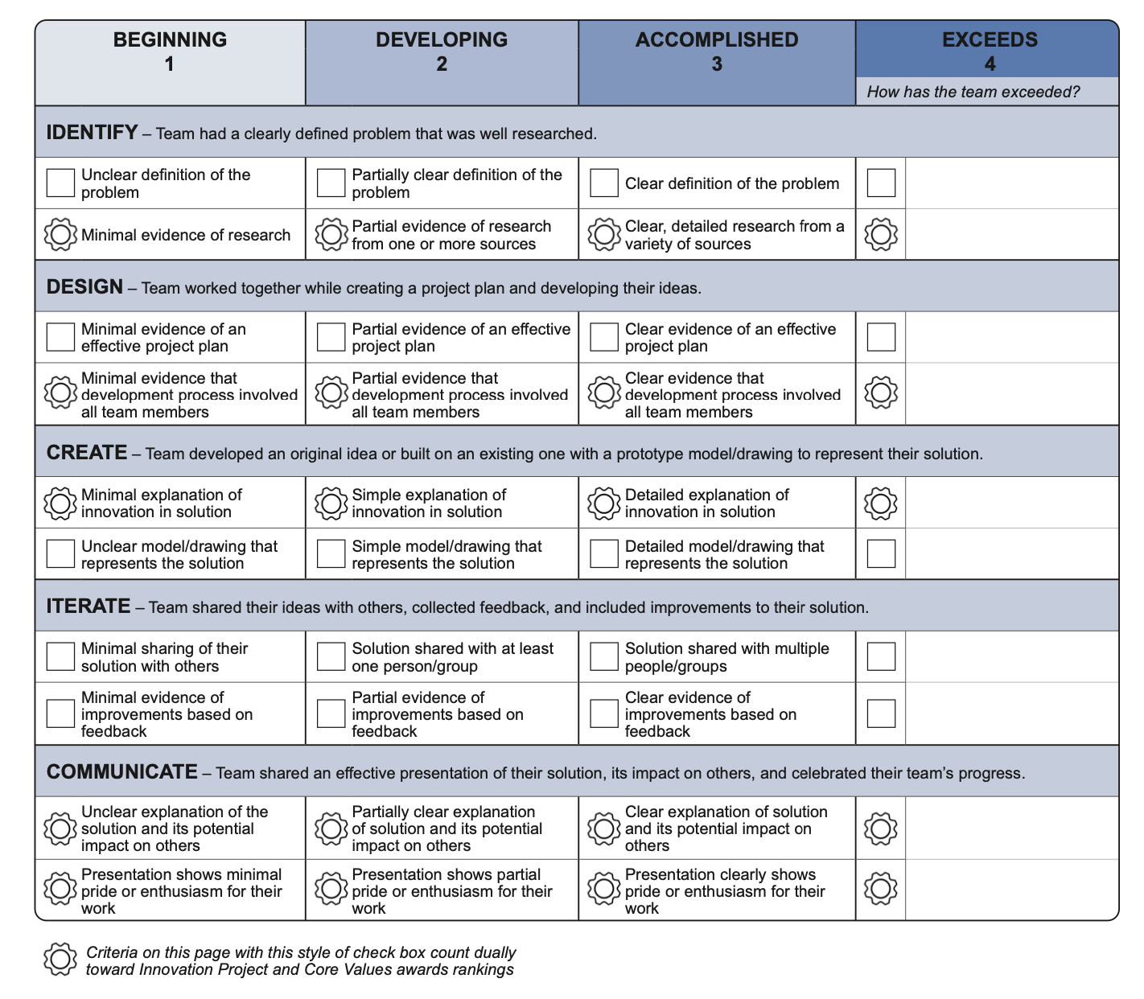
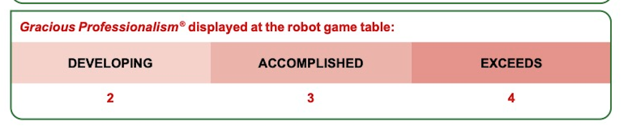
HOW DO YOU GET A CORE VALUES SCORE?
Core Values Score is calculated by adding together 5 criteria from the Innovation Project Rubric and 5 from the Robot Design Rubric (marked with a flower icon)
In addition, a Gracious Professionalism (judged at the Robot Game table) score is added.

Slide 5
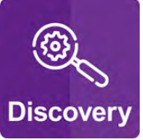



MAPPING THE RUBRIC TO CORE VALUES PT. 1
Build and Coding Resources
All team members contributed ideas
Improvements based on testing
Process and lessons learned
Pride and Enthusiasm
Clearly state all sources you used (books, websites, mentors, another team, etc.) and what you learned from each of them. What did you discover? How did this influence the rest of your Robot Design?
Clearly state all sources you used (books, websites, mentors, another team, etc.) and what you learned from each of them. What did you discover? How did this influence the rest of your Robot Design?
Clearly state all sources you used (books, websites, mentors, another team, etc.) and what you learned from each of them. What did you discover? How did this influence the rest of your Robot Design?
Clearly state all sources you used (books, websites, mentors, another team, etc.) and what you learned from each of them. What did you discover? How did this influence the rest of your Robot Design?
Clearly state all sources you used (books, websites, mentors, another team, etc.) and what you learned from each of them. What did you discover? How did this influence the rest of your Robot Design?

Slide 6


MAPPING THE RUBRIC TO CORE VALUES PT. 2
Research from a variety of sources
Development process that involved everyone
Innovation in the Solution
Solution and its impact
Pride and Enthusiasm
Clearly state all the different types of sources you used (survey, interview, field trip, articles, website, etc.) and what you learnt from each of them. How did they influence the rest of your Innovation Project?
Share clearly with the judges how team members had different ideas on what problem to research and even the solution. Share with them your Project Plan that gives everyone a role.
Be clear about what the solution is and whom or what it will impact. Share any data to demonstrate and prove this.
Be clear about what the solution is and whom or what it will impact. Share any data to demonstrate/prove this.
Be energetic and enthusiastic throughout your presentations and Q&A. Get creative.

Slide 7

CREDITS
More lessons for FIRST LEGO League are available at www.flltutorials.com
Creative Commons Attribution-NonCommercial-ShareAlike 4.0 International License

