Slide 1
CORE VALUES POSTER
BY PENNSYLVANIA’s FINEST ROBOTICS

Slide 2
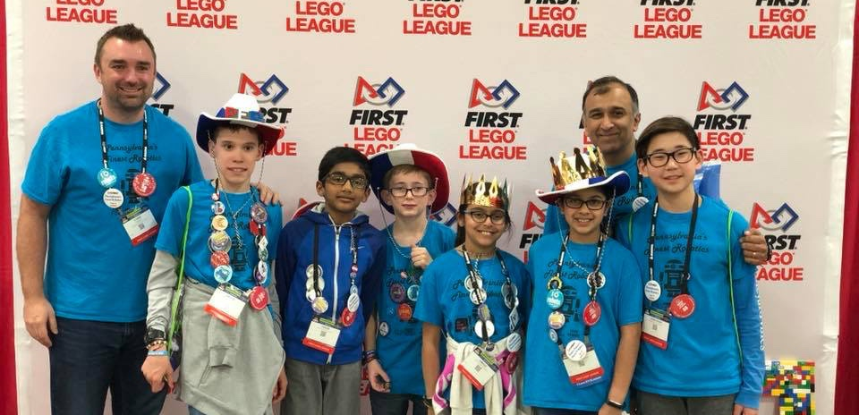
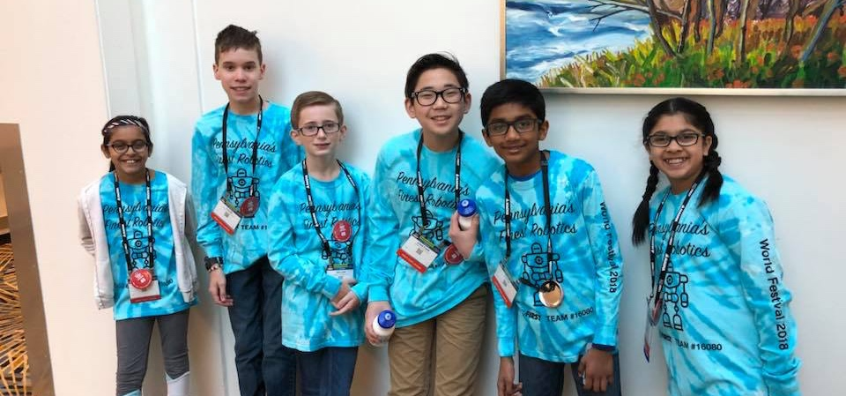
MEET THE AUTHORS
6 members, 5th grade – 8th grade
1st place Champion’s at 2016 Central PA
1st place Champion’s at 2017 Southeast PA
1st place Champion’s at 2018 East PA
3rd place trophy in Teamwork at World Festival 2017
Our favorite core values are ”We are a Team” and ”We have fun”!

Slide 3
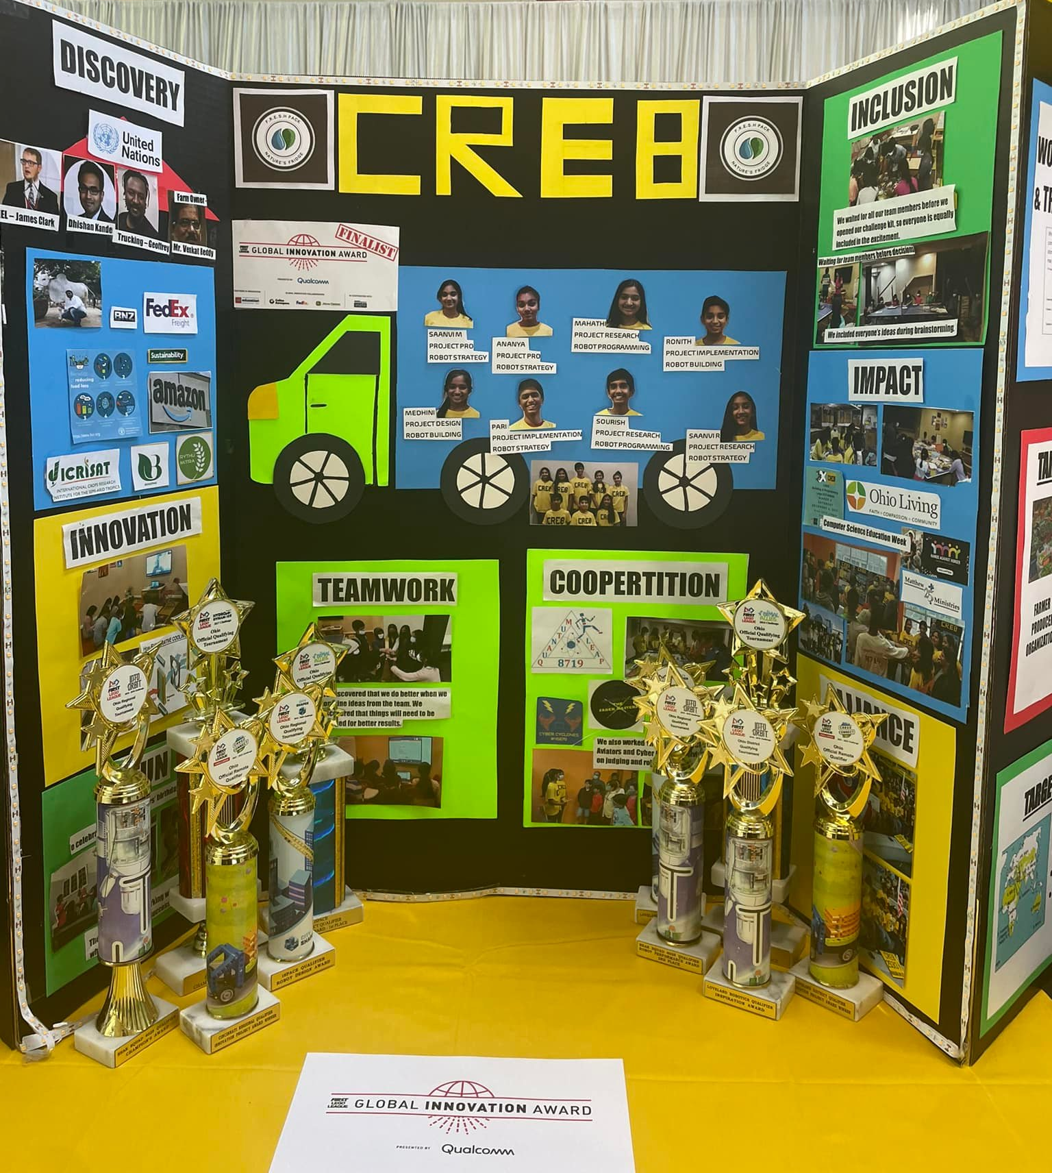
WHY ARE CORE VALUES POSTERS USED?
Some teams make posters to take into judging or to leave at their pit
They are never required, but might be a fun way to capture your journey
Note: The list of FIRST Core Values has changed over time. Some examples in this lesson are based on a past list.

Slide 4
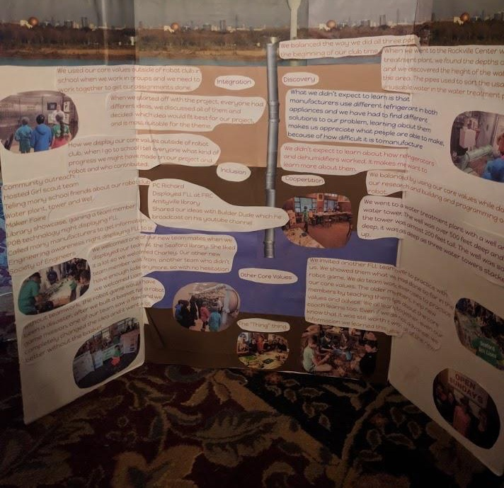
POSTER DESIGN CONNECTED TO TEAM PROJECT
The Seaford Sea Lions designed their poster to look like the layers of soil and aquafer under Long Island, NY
They connected their Core Values poster to the season’s theme/their project

Slide 5
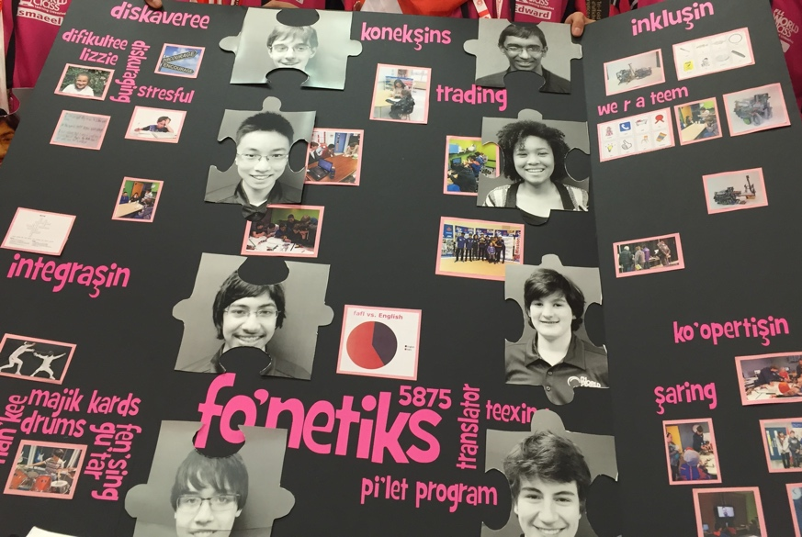
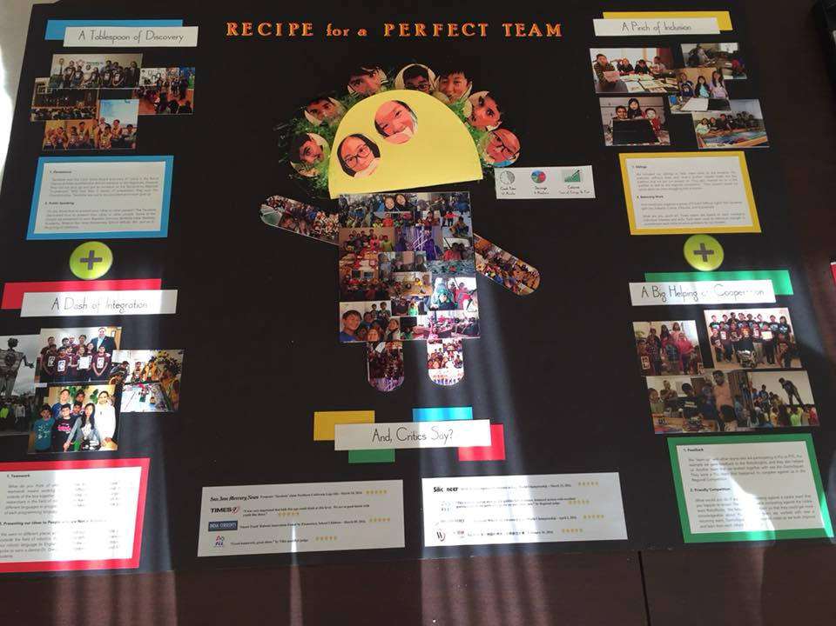
POSTER DESIGN CONNECTED TO TEAM NAME
Tacobots
fonetiks

Slide 6
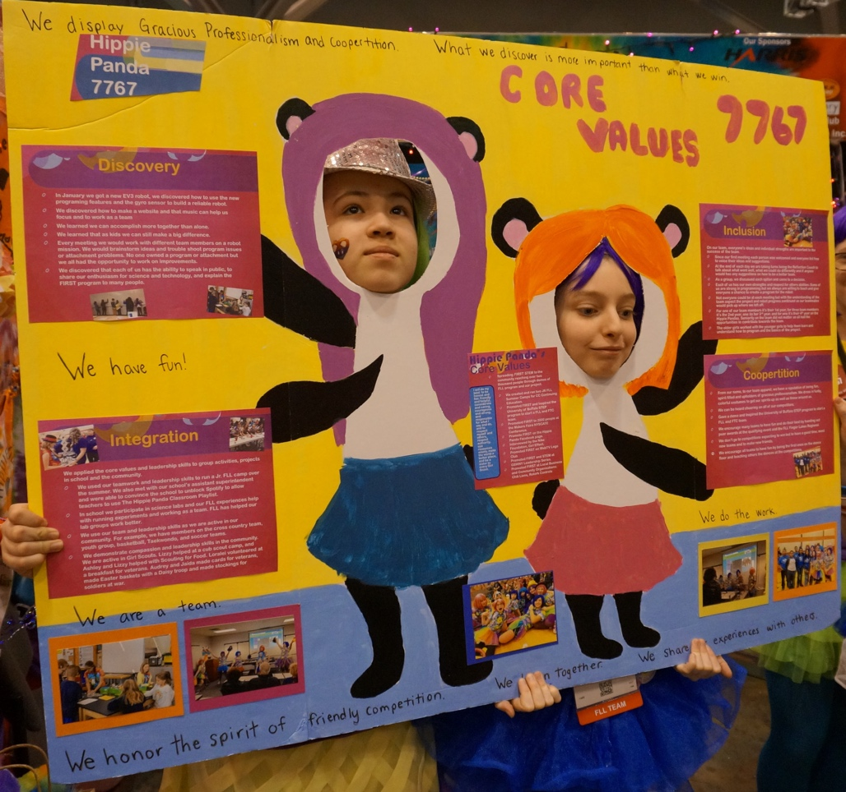
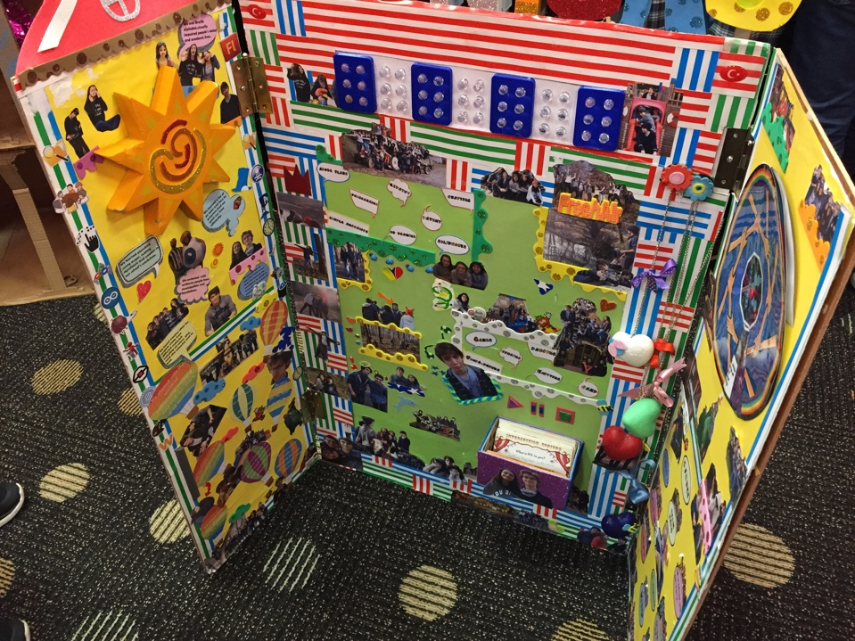
COLORFUL posters
Have fun with your posters!

Slide 7
CREDITS
This lesson was written by PA’s Finest Robotics Team
More lessons for FIRST LEGO League are available at www.flltutorials.com
Creative Commons Attribution-NonCommercial-ShareAlike 4.0 International License

