Slide 1
Identifying a Problem
Seshan brothers

Slide 2
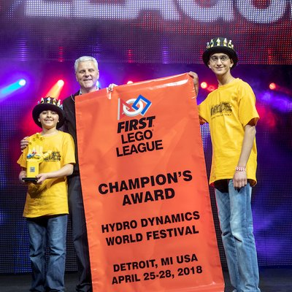
About The AUTHOR
Seshan Brothers were on team Not the Droids You Are Looking For
Our research project for Trash Trek was a Global Innovation Award semi-finalist project (Top 20 out of 30,000 teams).
Our research project in Nature’s Fury won Innovative Solution at the FIRST LEGO League International Open in Toronto.
Our research project for World Class was EV3Lessons.com! ;-)
We are the Champion’s award winners from World Festival 2018

Slide 3
Getting STARTED IN APRIL
Usually, FIRST LEGO League releases the theme and reveals the Challenge Mat and Models during the World Festival in April.
FIRST and LEGO Education also release several teasers and images on their social media channels
While you will not know the details of the challenge until August, you can start thinking about the high-level topic well in advance

Slide 4
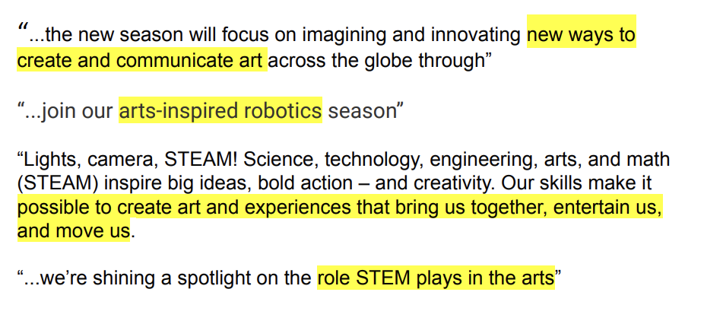
SAMPLE RELEASED TEXT FROM MASTERPIECE
Source: Pre-Season Guide provided on FLLTutorials → Worksheets

Slide 5
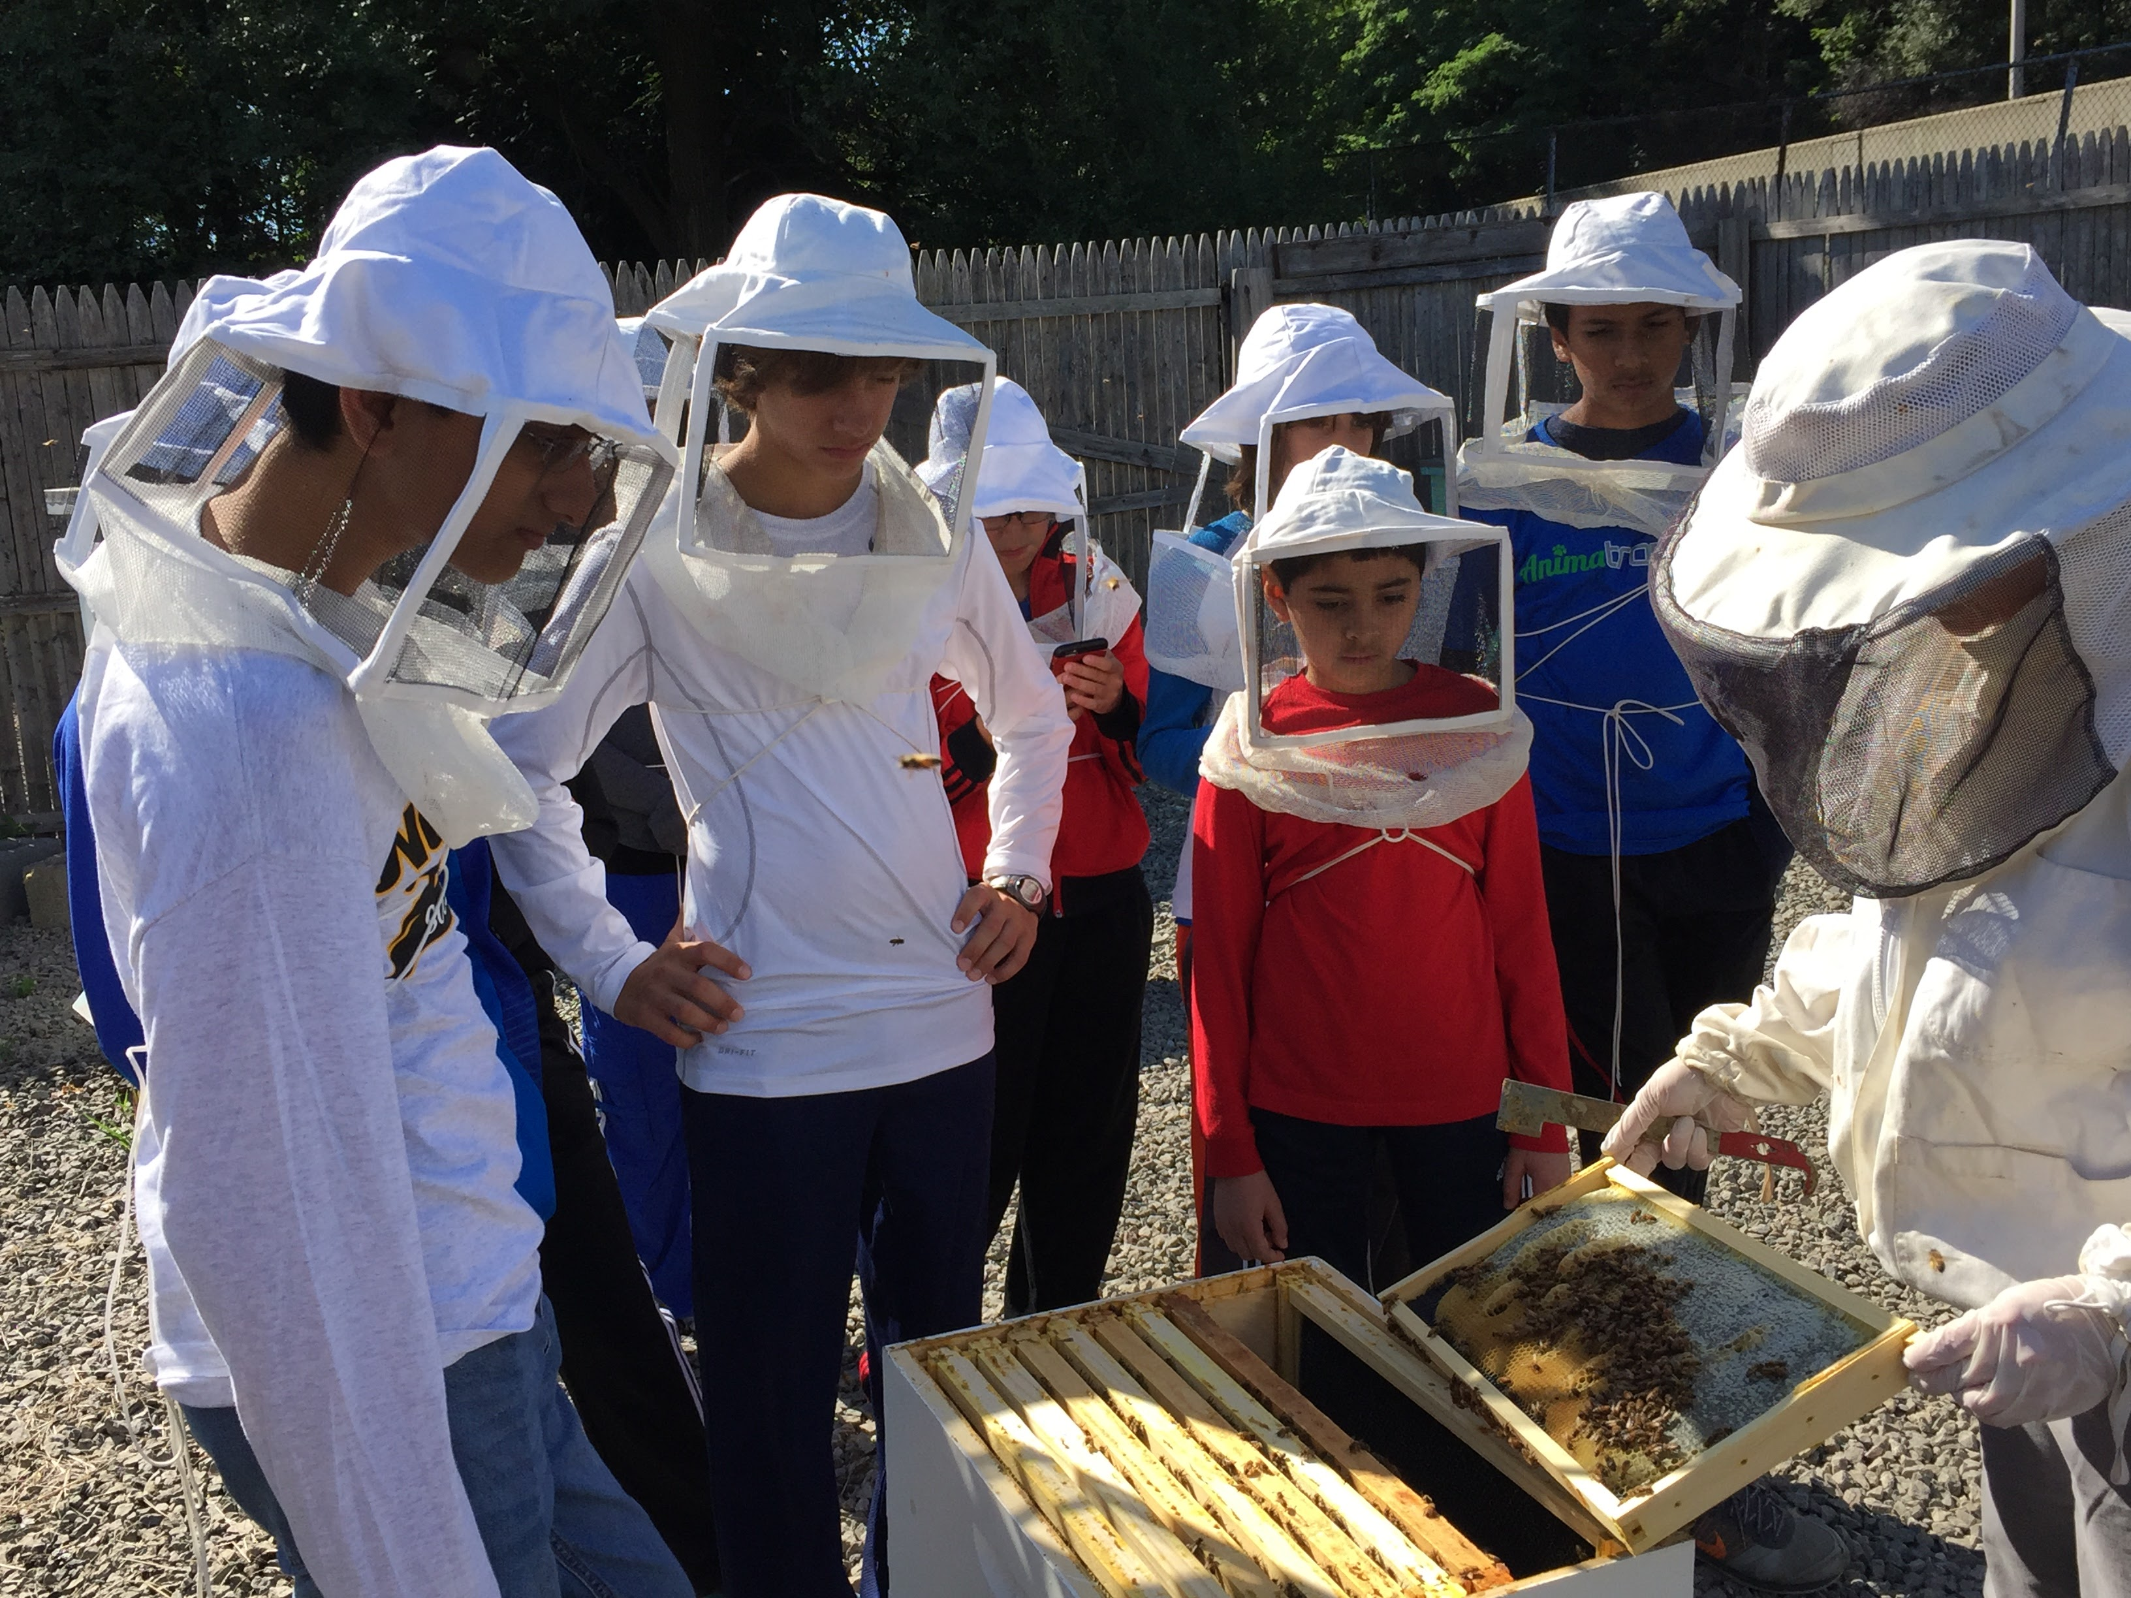
USING THE RELEASED TEXT AND IMAGES
Between April and August, try to go on some early field trips to inspire project topics
In Animal Allies, many teams visited Zoos and Aquariums over the summer
Where could you go for the MASTERPIECE season?
Do some preliminary online research related to the topic
Your goal is not to finish your project, but get some general ideas for possible topics related to the theme.

Slide 6

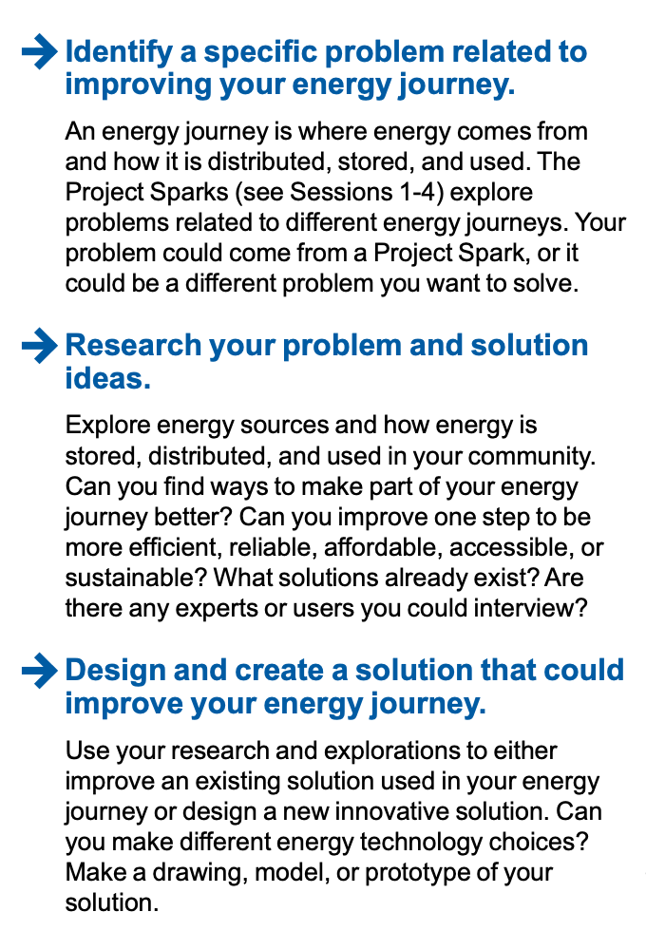
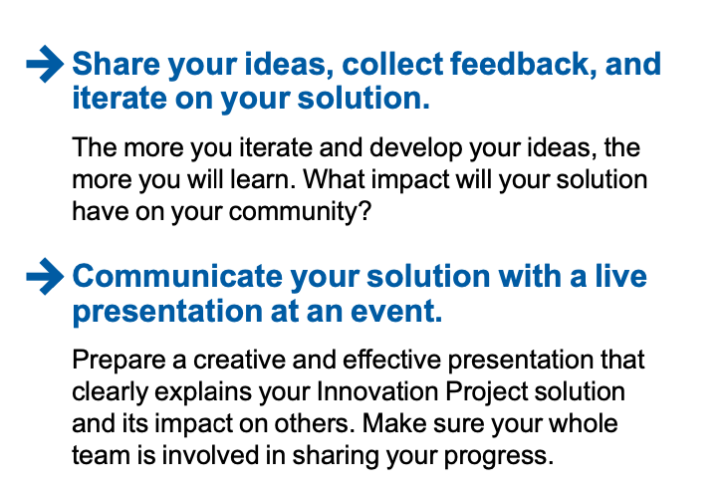
CHALLENGE RELEASED IN AUGUST
SAMPLE FROM SUPERPOWERED

Slide 7
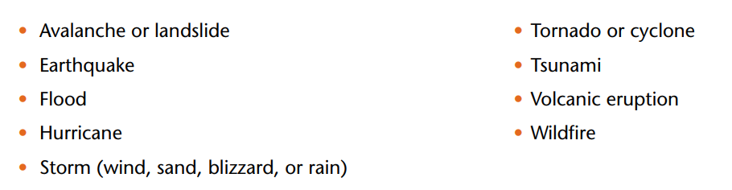
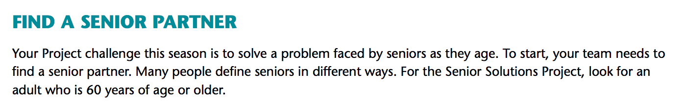
Read the Challenge Documents Carefully
Sometimes, you are allowed to pick only from a certain sub-set of topics (e.g. Nature’s Fury listed which natural disasters were allowed)
Sometimes, it calls for something specific (e.g. Senior Solutions required a Senior Partner for every team)

Slide 8
PICK A PROBLEM That is meaningful
Always think of a problem first, not the solution
The problem can be as small or big as you want
Most students relate better to local problems that impact their daily lives in some way
Do not worry that there is already a solution to the problem. As part of the process, you will look at existing solutions and see if you can make improvements.

Slide 9
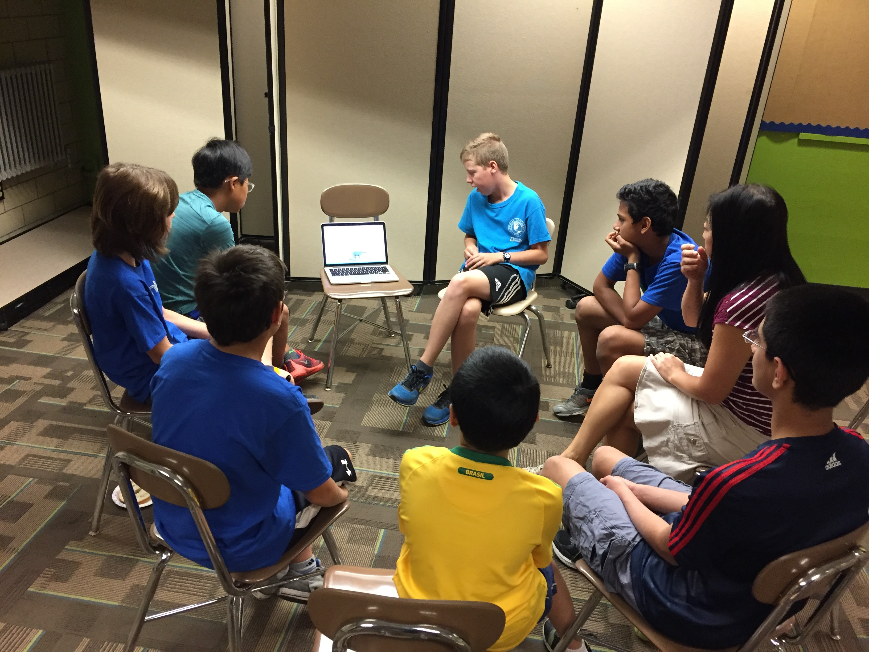
Pick a Topic Everyone Agrees Upon
Everyone works on the project
Pick a topic that all team members can agree on/are interested in
One idea is to have all team members do a little bit of research on their favorite topic and then present this topic to each other.
Then the team decides which topic they are most interested in to pick for their team’s project.
Next, the team identifies a specific problem within this topic

Slide 10
“Identifying a Problem” Process
Select an Animal
Identify the Human Interaction
Problem Selected
Dolphins
Bats are killed by wind turbines humans make
How to reduce bat deaths caused by wind turbines
K-9
Bats
Bats are killed by White Nose Syndrome which humans can spread
Bats
Sample based on team that participated in FIRST LEGO League Animal Allies

Slide 11
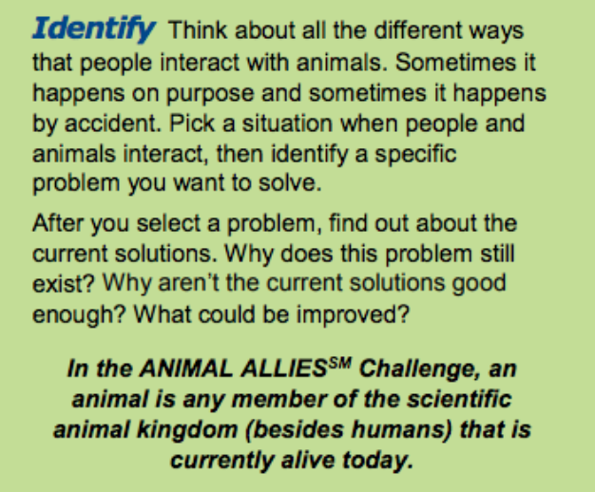
Sample Topics FROM Animal Allies SEASON
Chimney Swifts losing their homes
Training therapy dogs
K-9 dogs helping the police
Monitoring bee hives to keep them healthy
Bears getting into trash cans
Finding lost dogs
Preventing Lyme disease from deer ticks
Helping baby turtles find their way to the ocean
Cow tagging
Animals drinking from polluted city water
Keeping horses hydrated
Sample topics from teams that participated in FIRST LEGO League Animal Allies

Slide 12
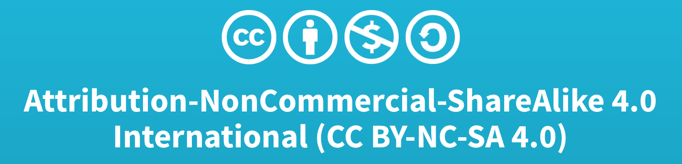
Credits
This lesson was written by Sanjay and Arvind Seshan
More lessons available at www.ev3lessons.com and www.flltutorials.com

