Slide 1
Research Project TIMELINE
Seshan Brothers

Slide 2
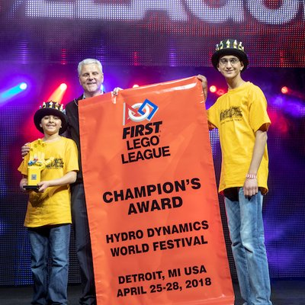
About The AUTHOR
Seshan Brothers were on team Not the Droids You Are Looking For
Our research project for Trash Trek was a Global Innovation Award semi-finalist project (Top 20 out of 30,000 teams).
Our research project in Nature’s Fury won Innovative Solution at the FIRST LEGO League International Open in Toronto.
Our research project for World Class was EV3Lessons.com! ;-)
We are the Champion’s award winners from World Festival 2018. We were selected for an Encore Presentation at World Festival for our project presentation.

Slide 3
TIMElINE: WORKING BACKWARDS
We like to begin at the end!
On a calendar, mark down when your first contest is (in this document, we picked October 15), then work your way backwards keep all the items you must complete in mind.
Adjust the dates depending upon how much time you will have.
What you must complete by your first qualifier:
Pick a topic
Research that topic
Come up with an innovative solution
Share that solution
Improve/Iterate the solution
Write a presentation for judges
Create props and poster boards
Practice your presentation

Slide 4
August 1st: Challenge Release
The Challenge document is released on early in August.
Read it very carefully to see if there are any rules specific to the season that would limit what topic your team can research
For example, in Nature’s Fury, you had to pick from a specific list of natural disasters.
In SUBMERGED, the problem has to be related to exploring oceans.

Slide 5
August
August 8: Narrow down topics
Everyone should come to the team meeting with some background research on a topic that will fit the Challenge. What would they like to research.
Each team member makes a presentation. Team should listen to each other and then narrow down some topics. These topics (or subtopics) can be redistributed for further research.
August 15: Pick a problem
Everyone should have done some research on the narrowed-down topics and present possible problems, possible solutions, and possible fieldtrip ideas
Using whatever method the team prefers to select ideas, the team should pick their research project topic for the season.
Team should come up with a list of possible research sources and begin contacting any experts.
August 22: Go on fieldtrips, do research
Team should work on their background research to find out more about their chosen topic and problem.
August 29: Go on fieldtrips, talk to experts, read books, etc.
Continue your research, develop your innovative solution idea

Slide 6
September
September 5: Finish your innovative solution
Finish and test your innovative solution
Create any presentation materials to share your project with others (slides, posters, prototype)
September 12: Refine Solution and share it with others
Share your project with others, especially those who can benefit from your solution
Get feedback and incorporate the feedback into your final solution
September 19: Share your project solution
Share your project with others, especially those who can benefit from your solution
Get feedback and incorporate it into your final solution
September 27: Finalize solution and write drafts
Finalize solution
Have the presentation drafted and have everyone read through their lines. Check to make sure that you will be under the time limit. Tweak lines if necessary.
If you are creating a research poster board, spilt up the tasks
If any props are needed, make them.

Slide 7
October
October 1: Scripts, Props and Posters
This week, make sure that scripts are complete. Finish up the poster board (if you use one) and any props you might need.
Practice the skit multiple times (keep a printed copy handy) and finalize your presentation
October 8: Full dress rehearsal
Everyone should have their lines memorized, props and poster board ready. Practice coming in and setting up and presenting in 5 minutes
October 14: Final rehearsal
Teams often meet one last time the day before a competition to practice and pack up.
October 15: Qualifier
Remember to take all your props, poster boards, etc.
If your team created handouts for the judges, remember to take them too (not required)

Slide 8
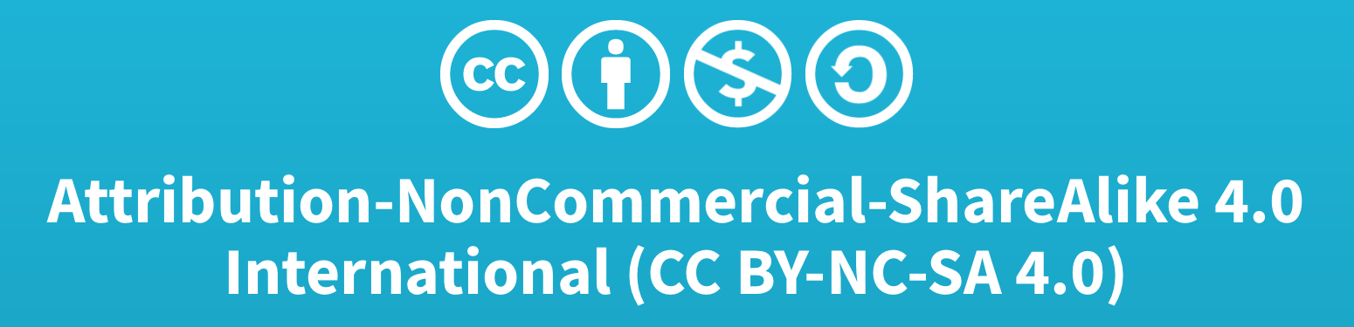
Credits
This lesson was written by Sanjay and Arvind Seshan
More lessons available at www.ev3lessons.com and www.flltutorials.com

