Slide 1
Lesson 7: aligning in LAUNCH AREA
Seshan brothers

Slide 2
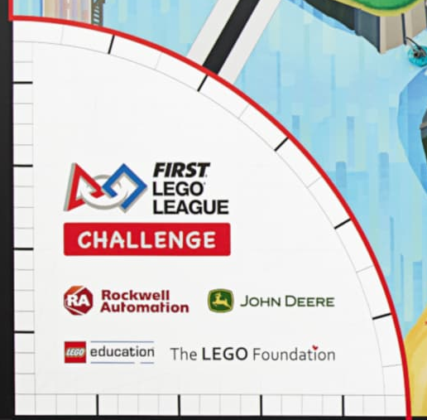
USING MARKINGS IN THE LAUNCH AREA
Aligning before you launch helps your robot get a good start
Notice that the Launch Area has markings like a grid. Use these marks to start you robot in the same spot each time
You can also use the text or logos in Launch Area to align your robot (eg. Start at the top of the red box surrounding the word Challenge)
Sample mat from past season

Slide 3
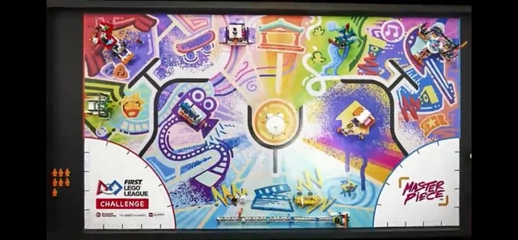
OTHER GOOD PRACTICES FOR ALIGNMENT
When you begin your run, consider backing into the wall to straighten out before you head out of the Launch Area

Slide 4
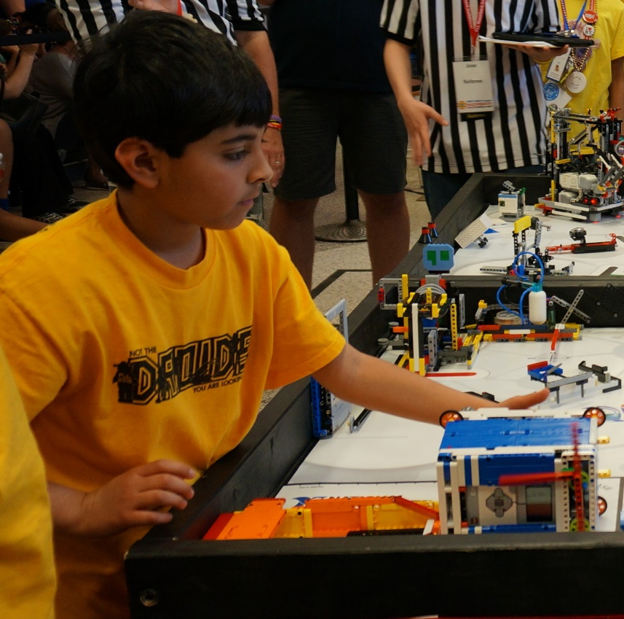
USING JIGS
Jigs are LEGO guides/rulers that the team places in the Launch Area
The robot is pushed against the jig for alignment
Jigs can be made from any LEGO elements (including Duplo)
Read the rules carefully to check if a jig can extend outside the Launch Area and if you are allowed to hold it in place or not (rules can vary every year)

Slide 5
Credits
This tutorial was created by Sanjay Seshan and Arvind Seshan
More lessons at www.ev3lessons.com and www.flltutorials.com
This work is licensed under a Creative Commons Attribution-NonCommercial-ShareAlike 4.0 International License.

