Slide 1
Lesson 4: Aligning on Lines On The Mat
Seshan brothers

Slide 2
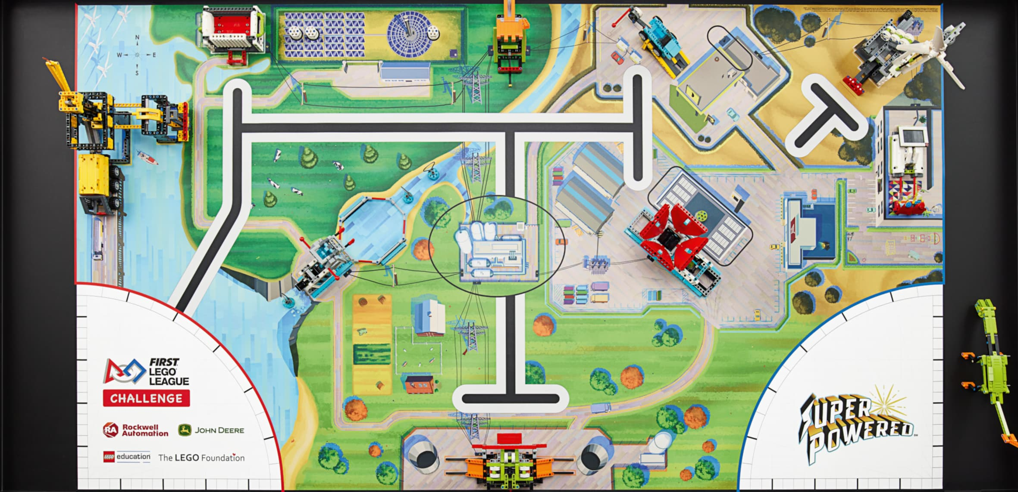
Why is Aligning on a line useful?
To complete a mission reliably, your robot has to be close to the same position and angle every time.
You have learnt how to find the line. This makes sure that your robot has travelled the right distance.
How do you make sure it is at the correct angle?
You can align on walls, missions and lines to straighten the robot up. In this lesson, we look at straightening up on lines.
This is also referred to as aligning on a line or squaring up on a line.
Straightening up is very important for a FIRST LEGO League robot because they don’t always travel straight.
A slight error in your angle will result in a significant position error after a long move.
Angle errors add up → if each turn is off by a few degrees, your robot may be many degrees off after a few turns.
Align on a Line

Slide 3
How does it work?
If you have two color sensors on the robot, you can use them to straighten out.
First move both motors until one sensor finds the line.
Stop the motor on that side (B).
Then, move the just the other motor (C) until the second color sensor finds the line.
The details of programming this are in the Advanced → Squaring on lines lessons on EV3Lessons.com and PrimeLessons.org
Figure 1
B
Figure 2
C

Slide 4
Reliable Line Squaring
Line squaring suffers from the same problem as line finding → if you try to find a white region over a large section of the mat, the sensor may report white in some spot before the line.
The solution is the same → move close to the line before having the robot start searching for the line
Looking for White?
Moving for Inches
Looking for White?

Slide 5
Common Problems and Solutions
You might find that your robot is not quite straight at the end of an align
The amount of error typically depends on how far from straight your robot was before you began to align
Since the align process makes you ”straighter” you can repeat the align to reduce the error
Each repetition will make you closer to straight
You will need to experiment to determine how many times you need to align

Slide 6
Credits
This tutorial was created by Sanjay Seshan and Arvind Seshan
More lessons at www.ev3lessons.com, www.primelessons.org and www.flltutorials.com
This work is licensed under a Creative Commons Attribution-NonCommercial-ShareAlike 4.0 International License.

