Slide 1
Engineering notebook
SESHAN BROTHERS

Slide 2
What is an engineering notebook?
Documentation is an important aspect of FIRST LEGO League and something you can share during judging
The Engineering Notebook is a way to record your team’s journey through your season of FIRST LEGO League.
Record the process of designing and building the robot
Record your research, fieldtrips and interviews, and testing your solution
Record your outreach events, what you do during team meetings, and your even your future ideas
In short, you can record EVERYTHING!
FLL Tutorials has provided some pages from actual Engineering Journals in FIRST LEGO League and also provided some blank templates for your team to use (see Worksheets section of Resources)

Slide 3
What can be included?
Photographs and drawings
LDD CAD drawings of your robot
Plans for the season and tasks to complete
Discussions & decisions during team meetings
Robot and attachment designs ideas and tests
Code printouts and pseudocode
Problems you faced
Improvements you made
Ideas you have

Slide 4
SOME QUESTIONS THAT ARE USEFUL
What is the goal for today’s meeting?
What decisions were made today?
Why did you make that choice?
What did you try today?
What worked, what did not work?
When something didn’t work, how did you solve the problem?
What modifications are you planning on making next time? What are your next steps?

Slide 5
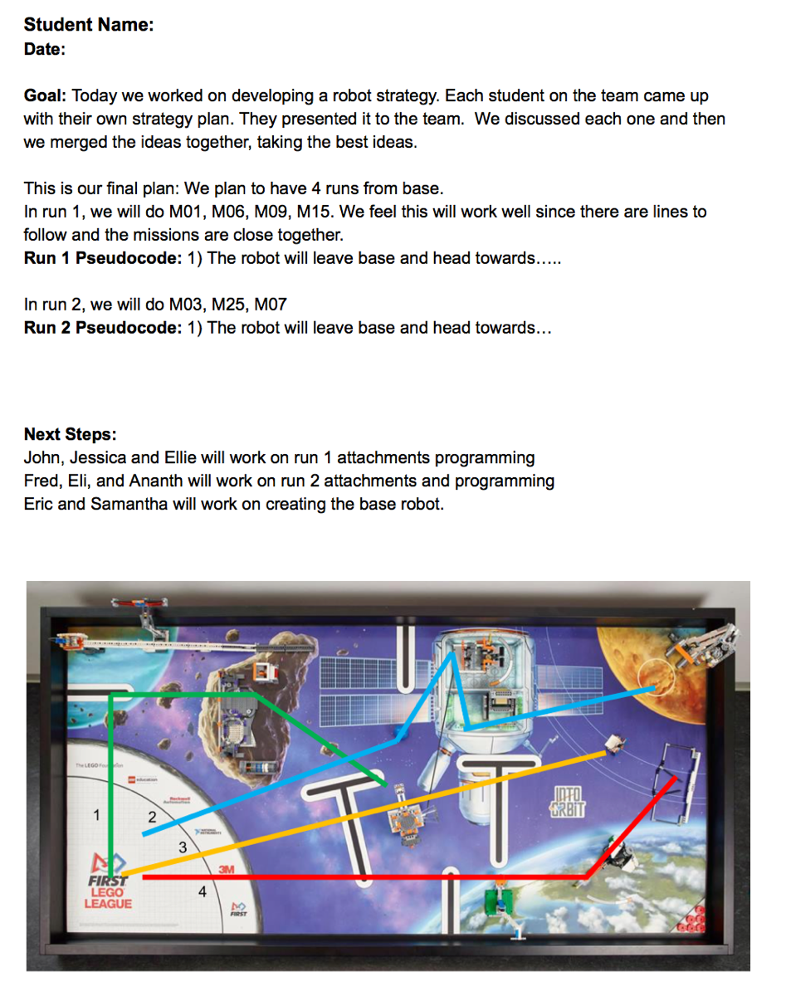
ENGINEERING JOURNAL SAMPLE 1
Record how the team came up with their Robot Game Strategy
Record what missions you will complete in each run and pseudocode
Record who is going to work on what

Slide 6
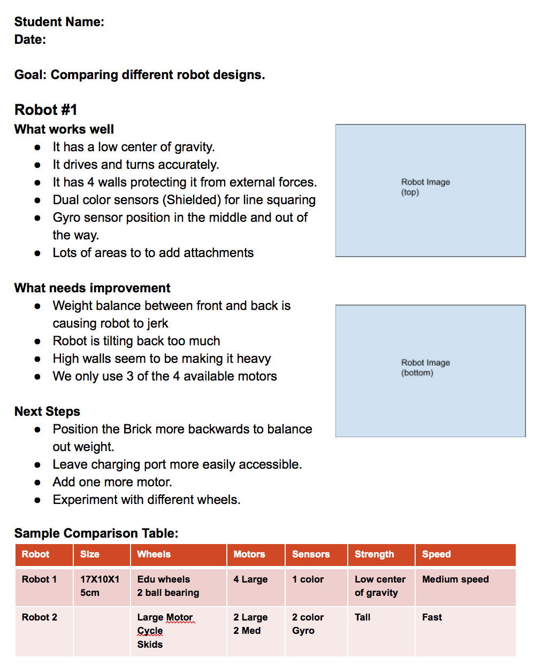
ENGINEERING JOURNAL SAMPLE 2
Record tests on different base robots

Slide 7
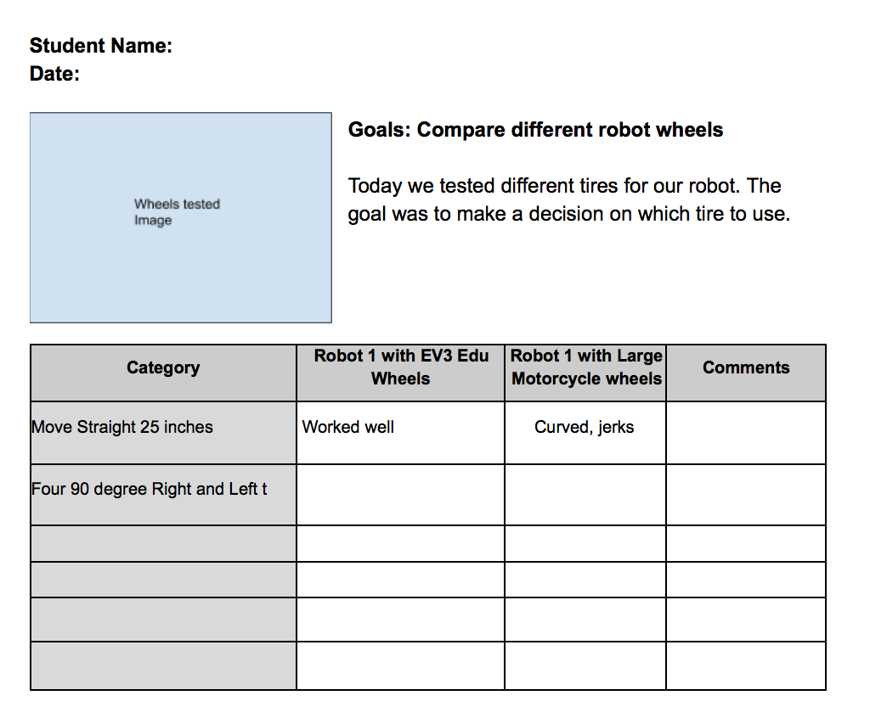
ENGINEERING JOURNAL SAMPLE 3
Record other tests such as comparing different wheels

Slide 8
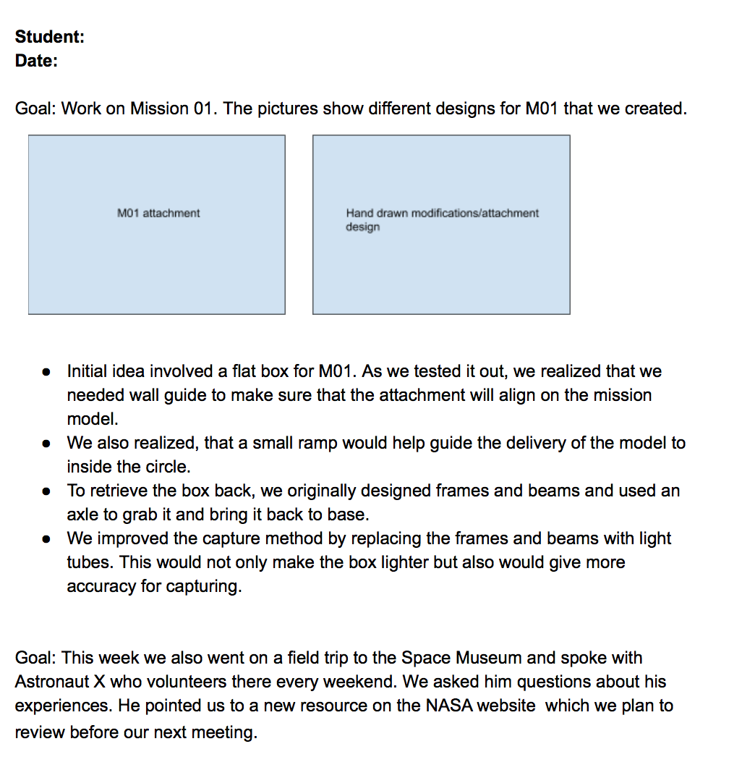
ENGINEERING JOURNAL SAMPLE 4
Document different attachment ideas
Document interviews/fieldtrips

Slide 9
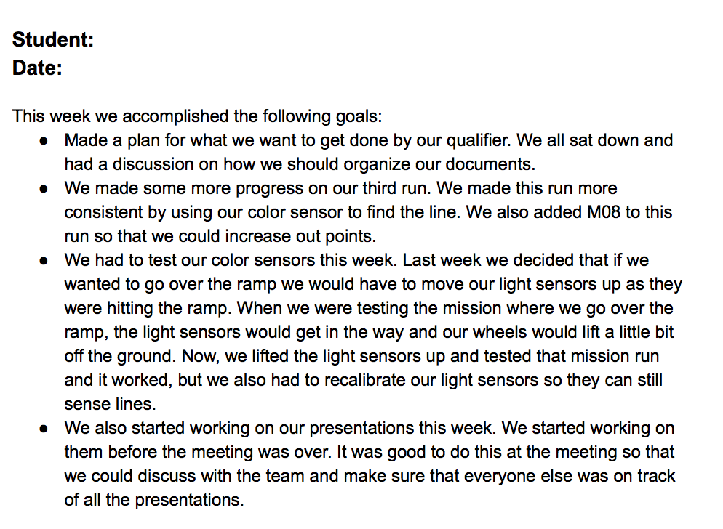
ENGINEERING JOURNAL SAMPLE 5
Document goals you have set
Document problems encountered
Document what your worked on during a meeting

Slide 10
CREDITS
This lesson was written by Sanjay and Arvind Seshan
More lessons for FIRST LEGO League are available at www.flltutorials.com
Creative Commons Attribution-NonCommercial-ShareAlike 4.0 International License

