Slide 1
Lego DEGITAL DESIGN software
Seshan brothers

Slide 2
NOTE: LDD is NO LONGER SUPPORTED
LEGO DIGITAL DESIGNER website was shut down in January 2022.
It is replaced by Bricklink Studio (https://www.bricklink.com/v2/build/studio.page)
If you already have it installed on your computer, you can use the tips in this lesson and open .lxf files on the FLLTutorials site
https://jaysbrickblog.com/news/lego-digital-designer-ldd-will-be-shut-down-end-january-replaced-by-bricklink-studio/

Slide 3
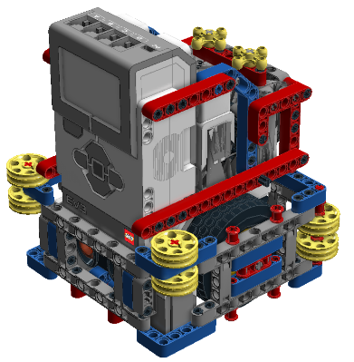
Why use LEGO CAD SOFTWARE?
An easy way to share your designs with team members
Can help you document your designs for your Robot Game judging
Can help you create a duplicate of your robot or make repairs if your robot is damaged
Can be used to upload you design into some virtual robotics environments that are available from third-party providers

Slide 4
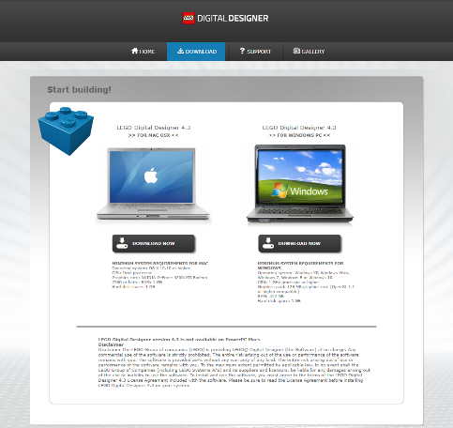
LEGO digital designer
There are many tools available for creating LEGO designs
LEGO Digital Designer (LDD) is frequently used by teams and is free to download
Link: http://ldd.lego.com/en-us/download
You can download and view .lxf files shared on FLLTutorials.com and EV3Lessons.com and open them using this software

Slide 5

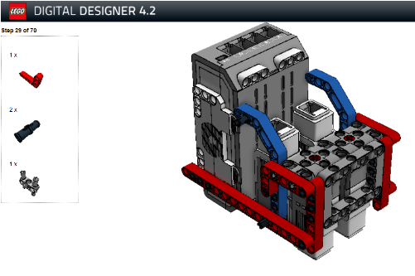

Generating HTML Building guide from .lxf files
Select Building Guide Mode Icon on the far right
Select the HTML Icon Guide on the far left
Follow the rest of the onscreen instructions
Note: Building Instructions created by LEGO Digital Designer often don’t make sense and cannot be customized

Slide 6
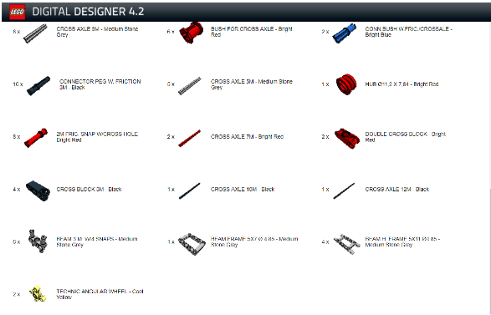
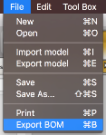
Generating a Parts List
The last page of the build instructions (HTML Building Guide mode) has a parts list
Alternatively, you can select Export BOM (Bill of Materials) from the menu

Slide 7
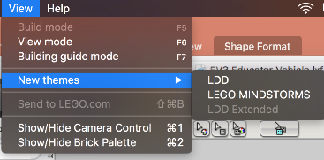
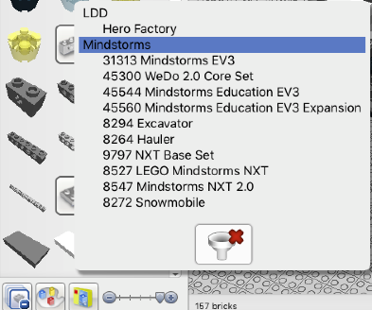
USING LDD to create mindstorms DESIGNS
TIP #1: Filtering will help you find MINDSTORMS-related parts quickly
Step 1: File —> View —> New Themes Select MINDSTORMS
Step 2: Bottom Left corner: Select “Filter Bricks by Boxes” and then select which MINDSTORMS kit you want to use.

Slide 8
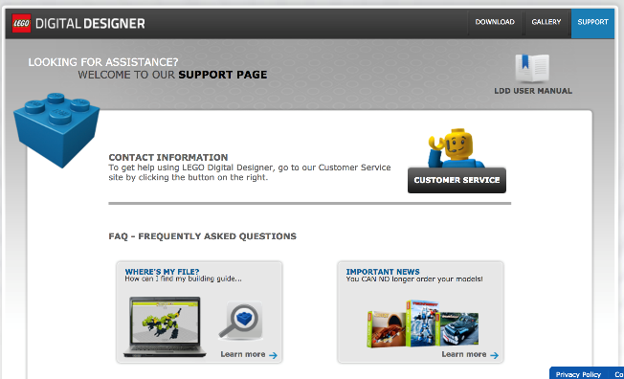
USING LDD to create mindstorms DESIGNS
TIP #2: Read the Support Manual which can be downloaded at http://ldd.lego.com/en-us/support

Slide 9
LOTS MORE TIPS & TRICKS
Virtual Robotics Toolkit Introduction to LDD Videos:
https://youtu.be/F0bunR-iBHU?list=PLH3wHnw9b170XP7HkZ6wc-FNl_7kxZOyo
https://youtu.be/-IaTwfQXmY0?list=PLH3wHnw9b170XP7HkZ6wc-FNl_7kxZOyo
Isaac Lloyd Tips & Tricks Videos:
https://youtu.be/X4c7Q0W4cDI
https://youtu.be/p-UBj76eEGA

Slide 10
Limitations with LDD
Build instructions generated by the software often seem out-of-order and do not make sense
Build instructions cannot be customized
Sometimes builds you may have created in the real world are not permitted in the LDD environment as they are technically stressing the LEGO elements
Pneumatic hoses, rubber bands, and some other elements often cannot be connected and placed correctly

Slide 11
Other LEGO Cad software
LDCad: http://www.melkert.net/LDCad
MLCAD: http://mlcad.lm-software.com/
LeoCAD: http://www.leocad.org/trac
All these above use the LDRAW building system

Slide 12
Credits
This tutorial was created by Sanjay Seshan and Arvind Seshan
More lessons at www.ev3lessons.com and www.flltutorials.com
This work is licensed under a Creative Commons Attribution-NonCommercial-ShareAlike 4.0 International License.

